Slide 1
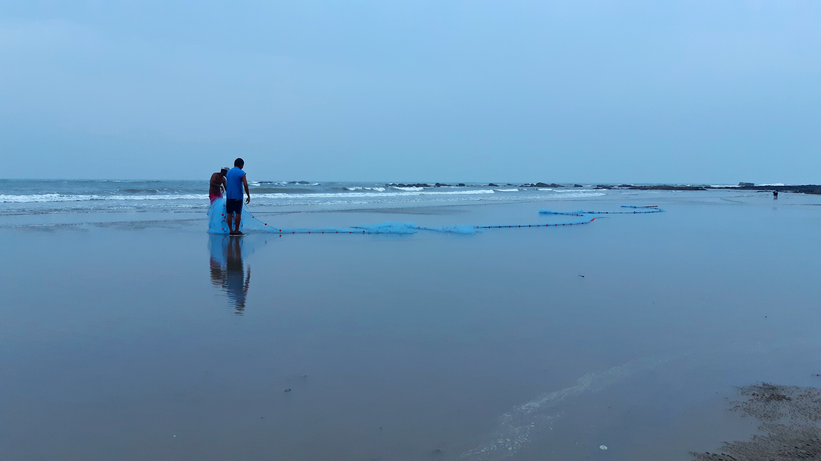



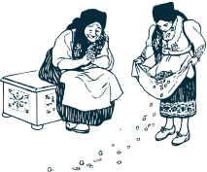


GOA STATE-LEVEL WORKSHOP ON SSF GUIDELINES
9th FEBRUARY, 2023
VASCO
Goenchea Raponkarancho Ekvott

Slide 2
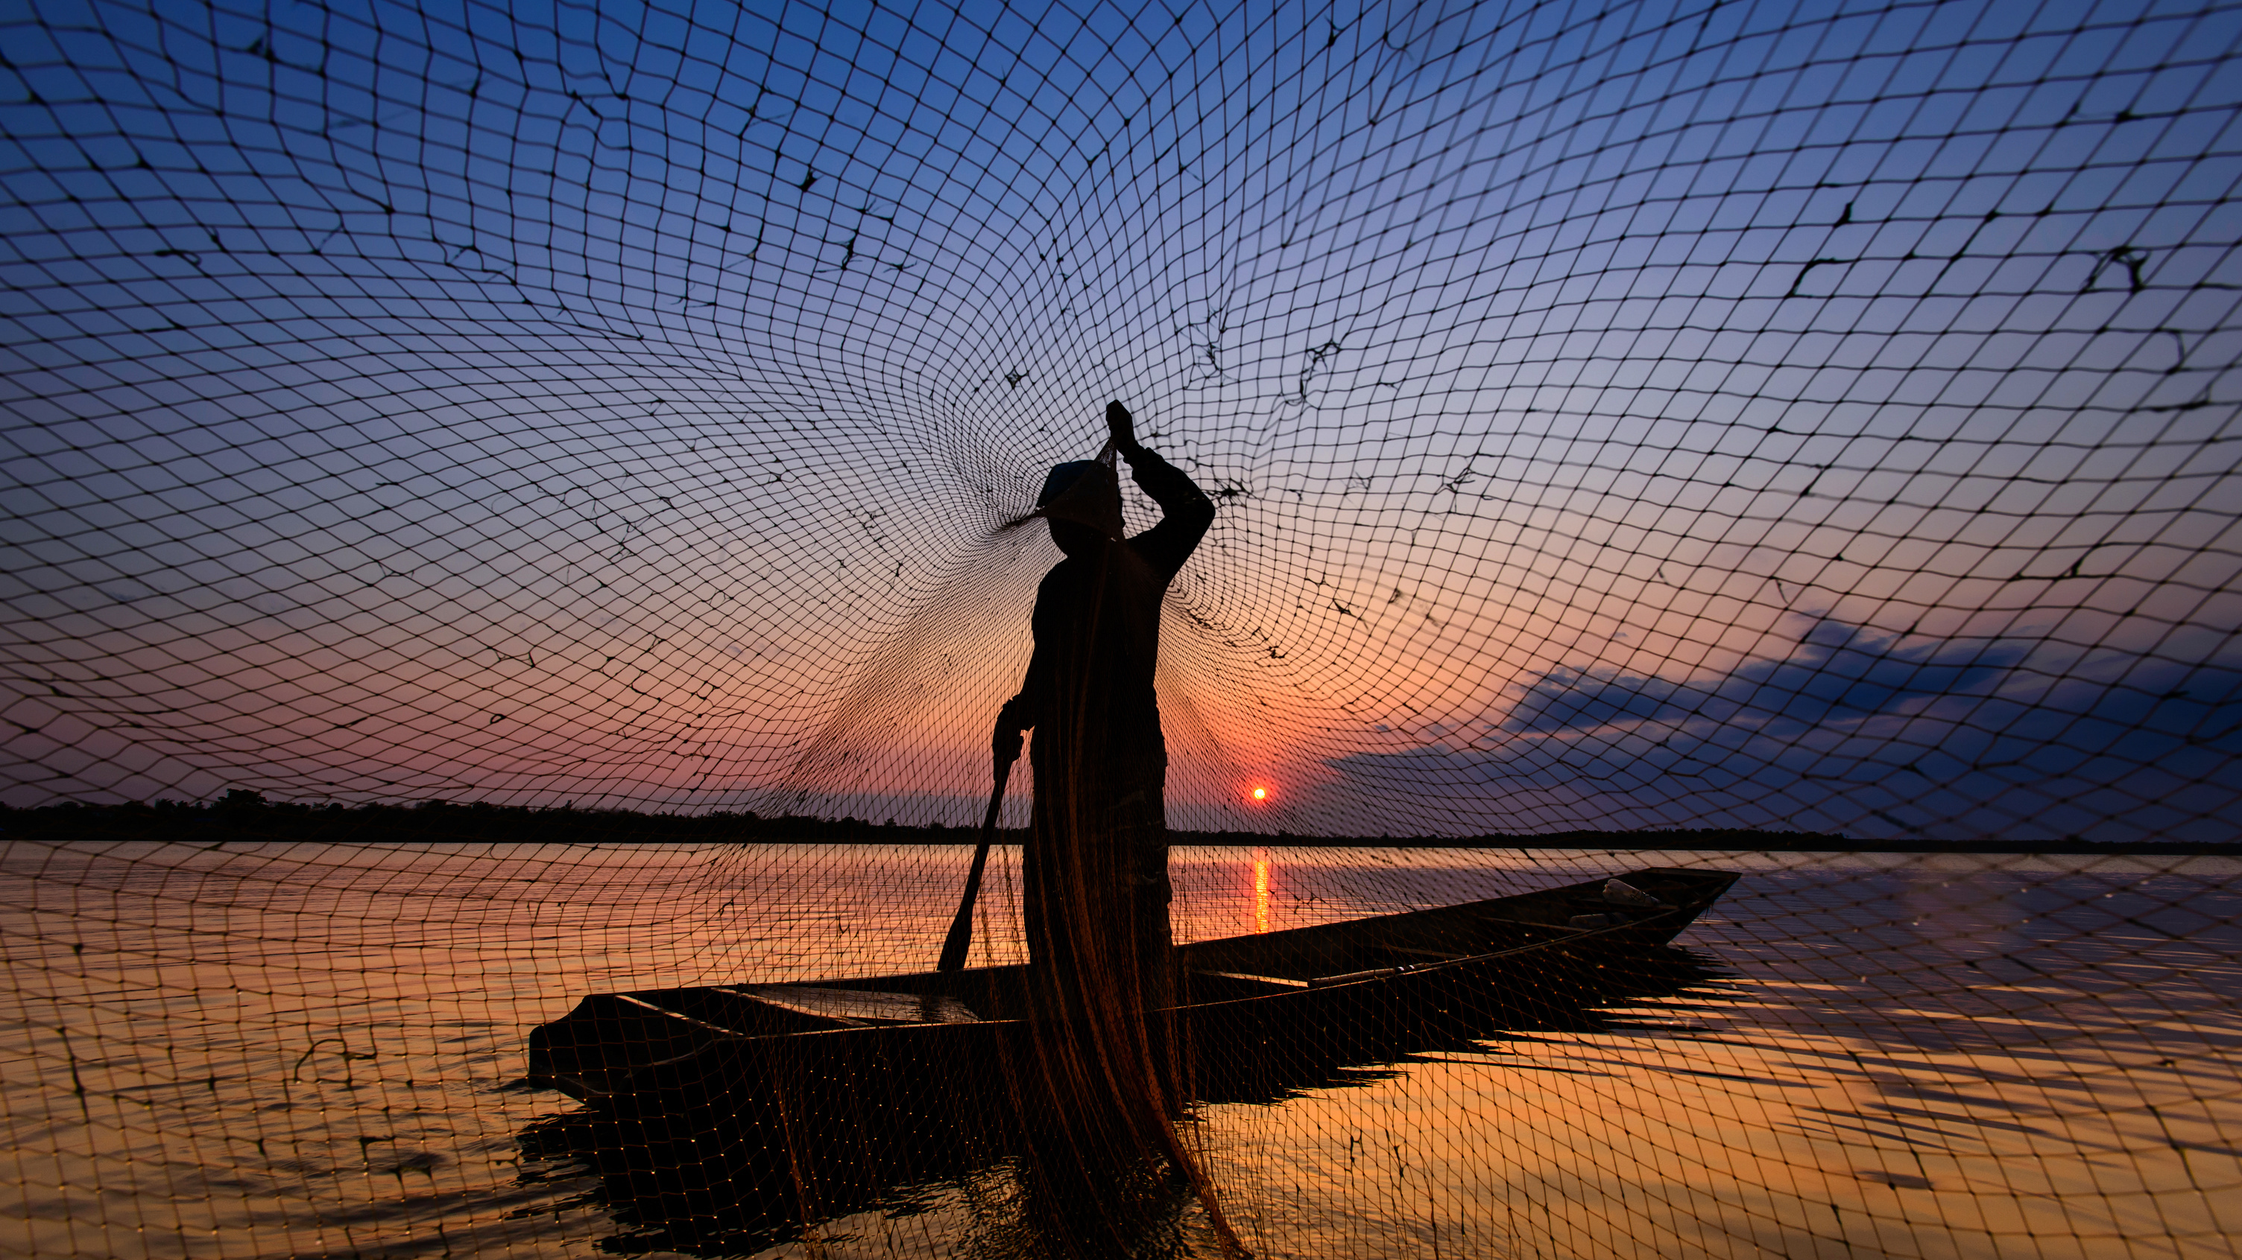
WHAT/WHO/WHERE ARE SSFs?

Slide 3

WHAT ARE SSFs?
  SMALL-SCALE FISHERS
  ENGAGED IN SMALL-SCALE FISHERIES WITH OR WITHOUT BOATS WITHIN 12 NM OF THE MARITIME BOUNDARY
  RESPONSIBLE FOR FOOD-SECURITY
  EMPLOYS A LARGE PERCENTAGE OF LOCAL POPULATION IN DIFFERENT ACTIVITIES

Slide 4
WHO ARE SSFs?
  INDIGENOUS COMMUNITIES/LOCAL COASTAL/AQUATIC POPULATIONS
  ENGAGED IN ARTISANAL METHODS OR SMALL-SCALE CATCH
  FISH BASED ON TYPE OF CATCH, SEASONS AND CRAFT

Slide 5
WHERE ARE SSFs?
  COASTAL / ISLAND/ INLAND RIVER BANKS
  LIVE IN COMMUNITIES (VADDOS/KOLIWADAS/ETC.)
  ACROSS THE WORLD.

Slide 6
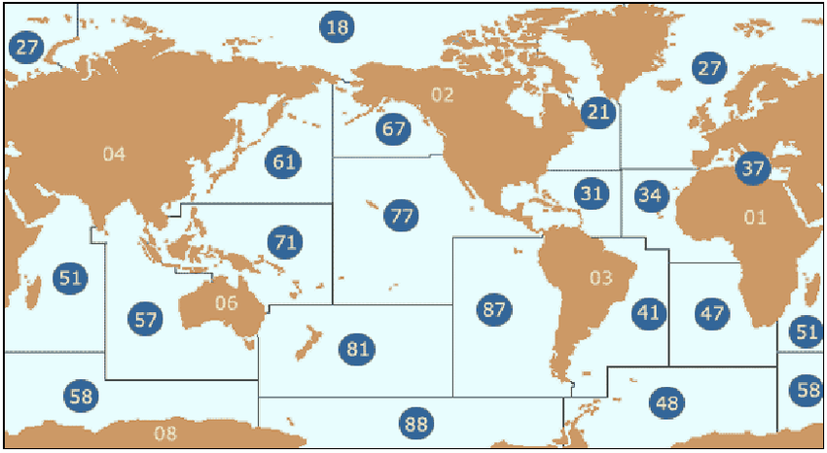

Slide 7
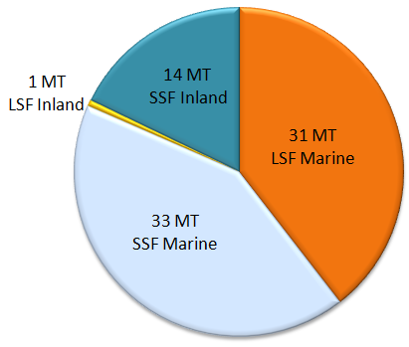

Slide 8

WHY ARE DISCUSSING THE TOPIC?
  Global per-capital of consumption of fish is 20.5 kilograms (FAO, 2019)
  20.5 KG x 7.7 billion people
  20.5 x 7,700,000,000 = 157,850,000,000 or 157850000 kilo-tonnes
(about 92% of the world is non-vegetarian)
(Ipsos Mori, 2018)

Slide 10
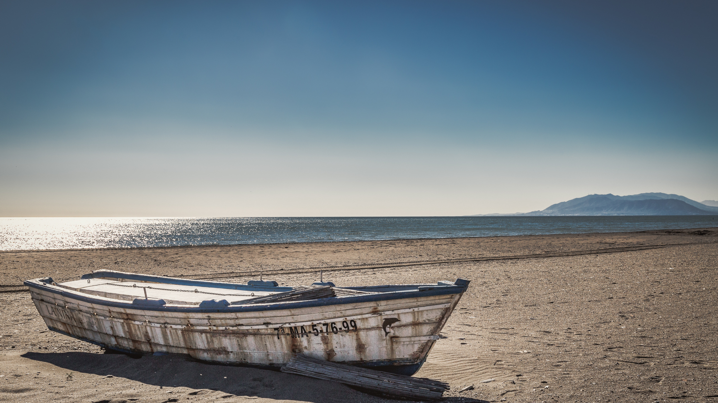


Slide 11
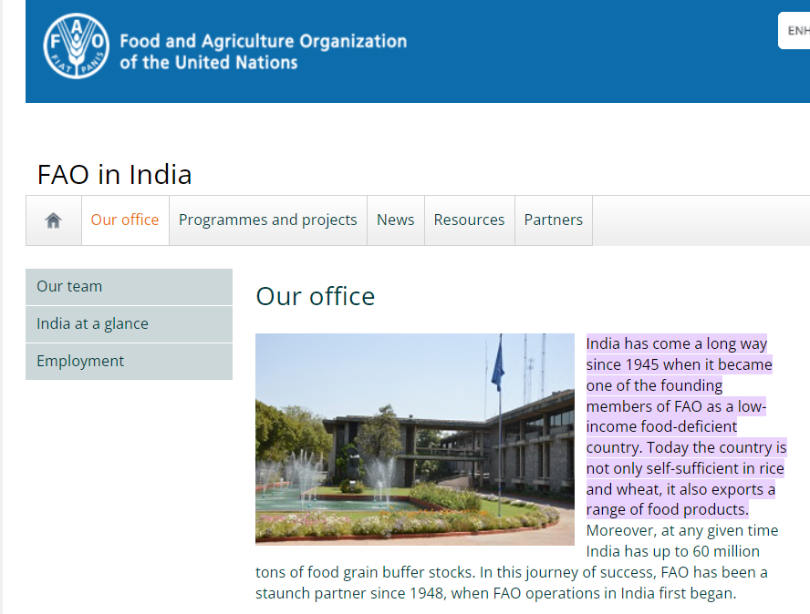
FAO AND INDIA:

Slide 12
PART I
PART II
PART III

Slide 13

PART I
2.3 These Guidelines are addressed to FAO Members and non-Members, at all levels
of the country, as well as to subregional, regional, international and intergovernmental
organizations (IGOs) and small-scale fisheries actors (fishers, fish workers, their communities, traditional and customary authorities, and
related professional organizations and
CSOs).
2.4 These Guidelines recognize the great diversity of small-scale fisheries and that there
is no single, agreed definition of the subsector.

Slide 14
PART II
5.a RESPONSIBLE TENURE RIGHTS:
5.6: SSFs deserve lease rights
5.9: Land aqcuisition from SSFs: Cannot involve displacement

Slide 15




PART II
6: SOCIAL DEVELOPMENT, EMPLOYMENT AND DECENT WORK
HOUSING
SOCIAL SECURITY AND INSURANCE SCHEMES
EDUCATION OF FISHER CHILDREN
OCCUPATIONAL HAZARDS: ACCIDENT, DEATH AND DISABILITY

Slide 16


PART II
9 & 12: DISASTER RISKS AND CLIMATE CHANGE AND CAPACITY BUILDING
DISASTER PREPAREDNESS AND RISK REDUCTION
TRAINING AND CAPACITY BUILDING TO ALLOW SMALL-SCALE FISHERS TO BENEFIT FROM MARKET OPPORTUNITIES

Slide 17
WHY ARE WE SPEAKING ABOUT THIS?

Slide 18
All-India Fisheries Budget: Rs. 1624.18 crore during 2022-23
Goa State Fisheries Budget: ???

Slide 19
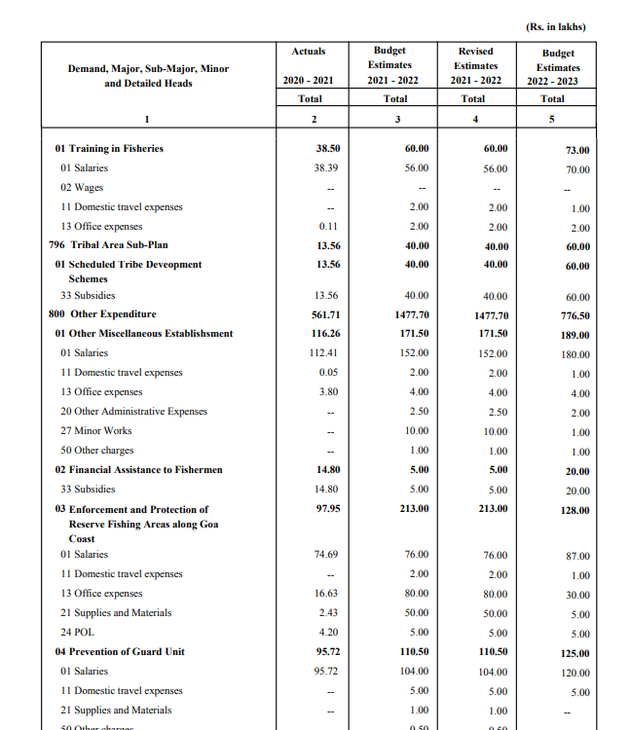
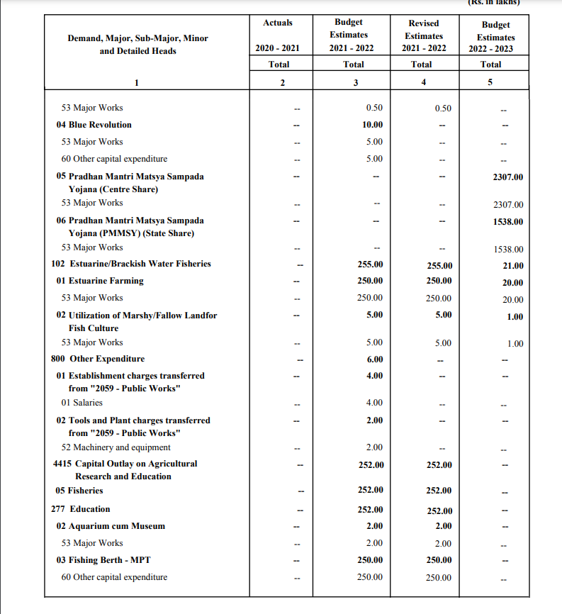

Slide 20
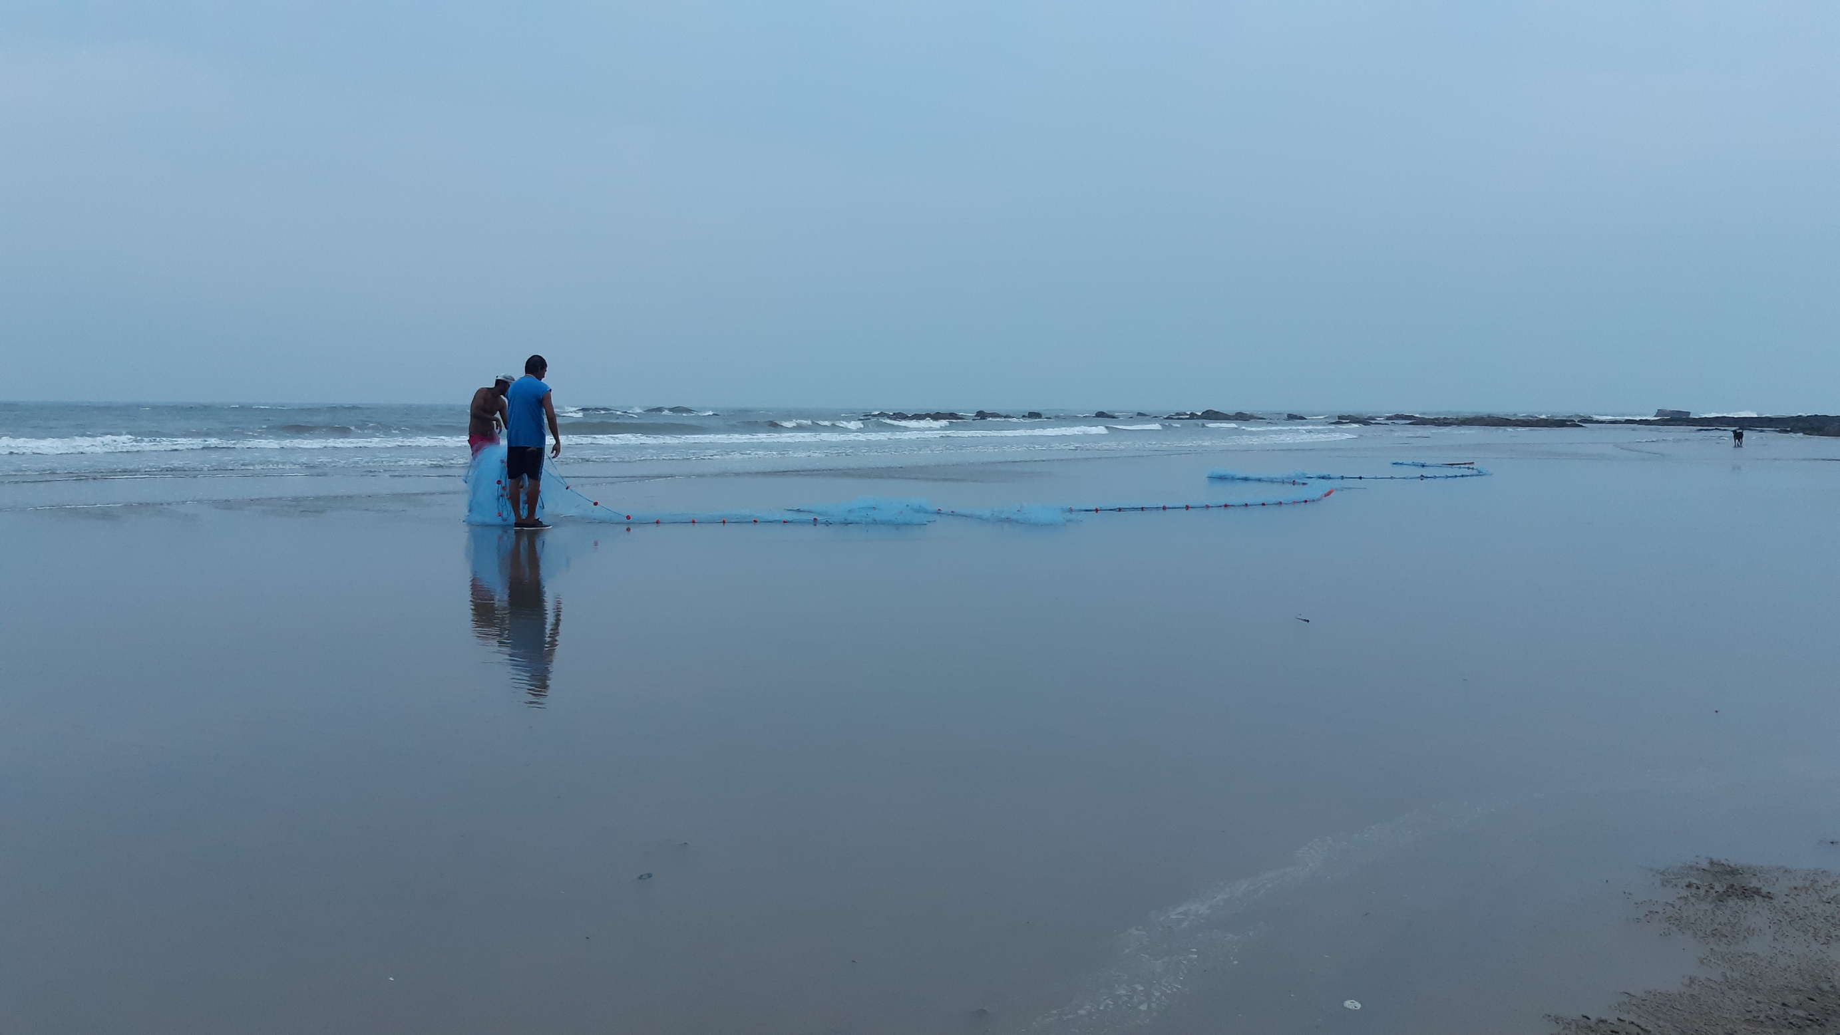
CRZ 1991 -----> CRZ 2011 -----> CRZ 2019
FISHERIES RIGHTS?

Slide 21
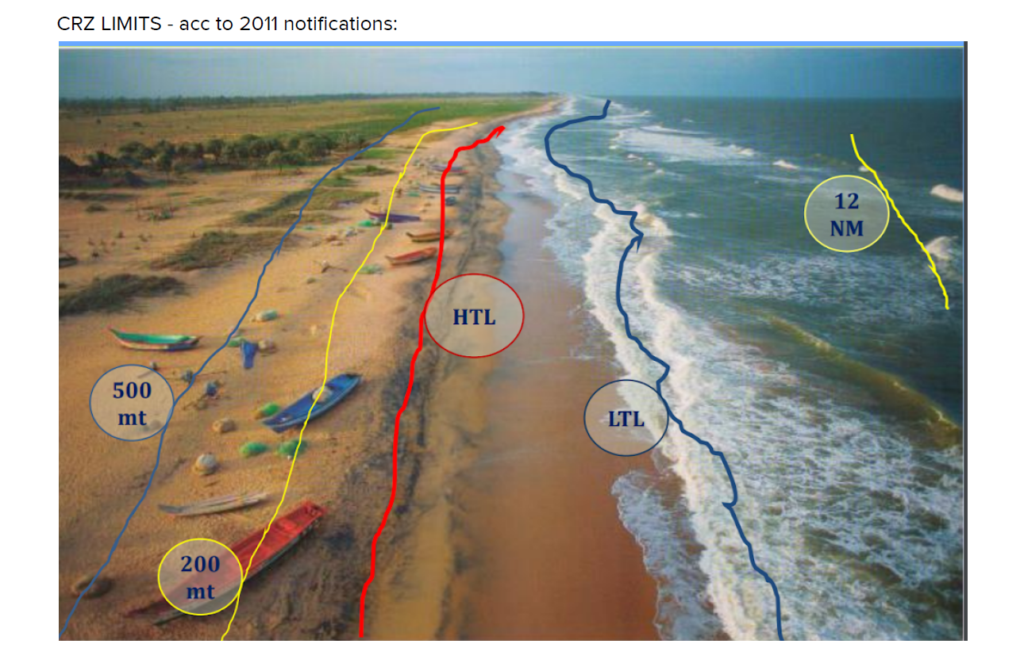

Slide 22
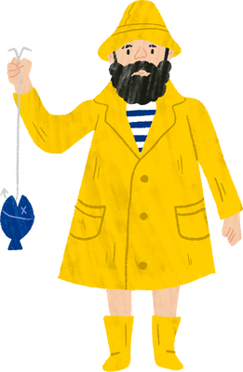







Slide 23


Slide 24
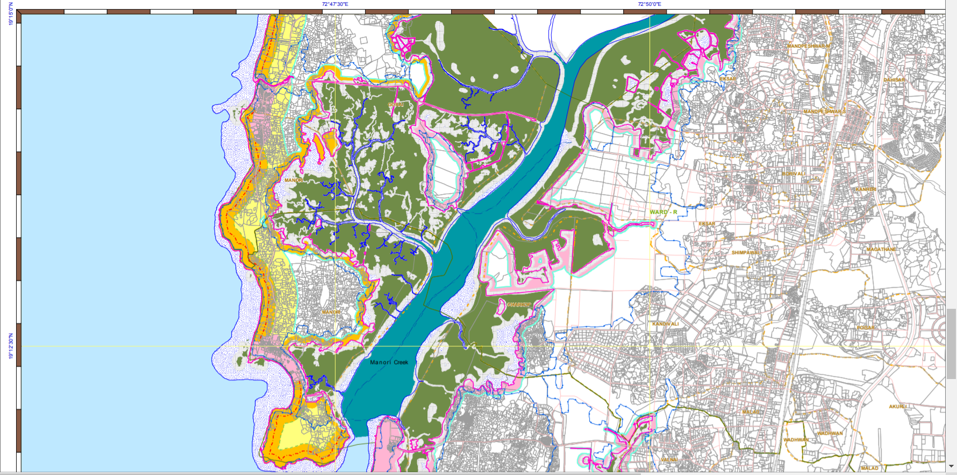
DRAFT MAP

Slide 25
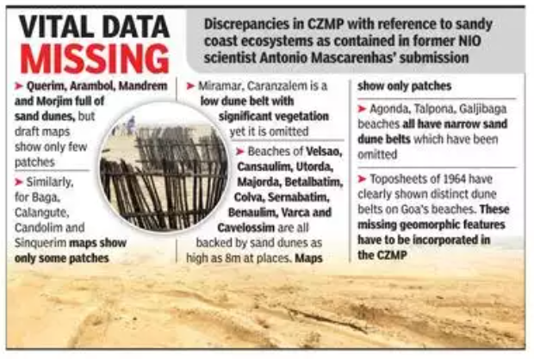

Slide 26
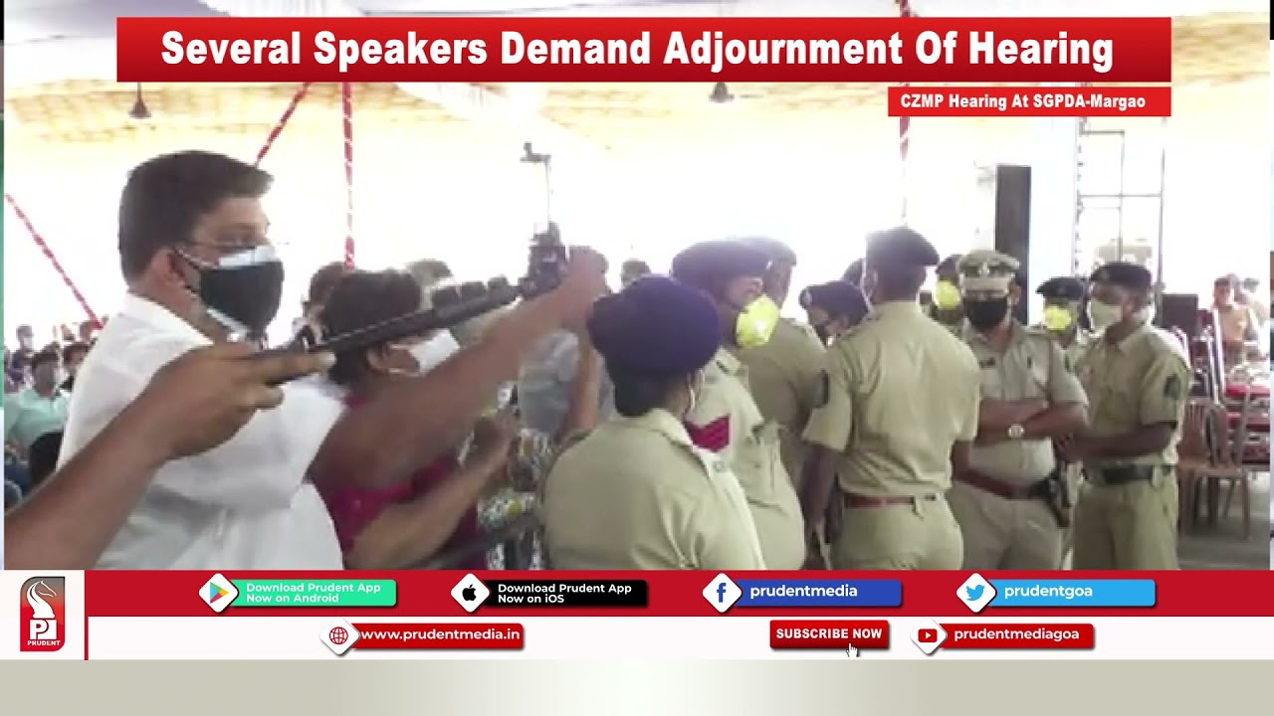
PUBLIC HEARING

Slide 27

What can we do?
  DEMAND BUDGET ALLOCATION FOR SSFs
  ASK WHY NO ACTIVITIES UNDER THE SSF GUIDELINES HAVE BEEN CONDUCTED BY THE STATE DEPARTMENT?
  LOBBY AT DIFFERENT LEVELS WITH DIFFERENT STATE UNIONS

Slide 28
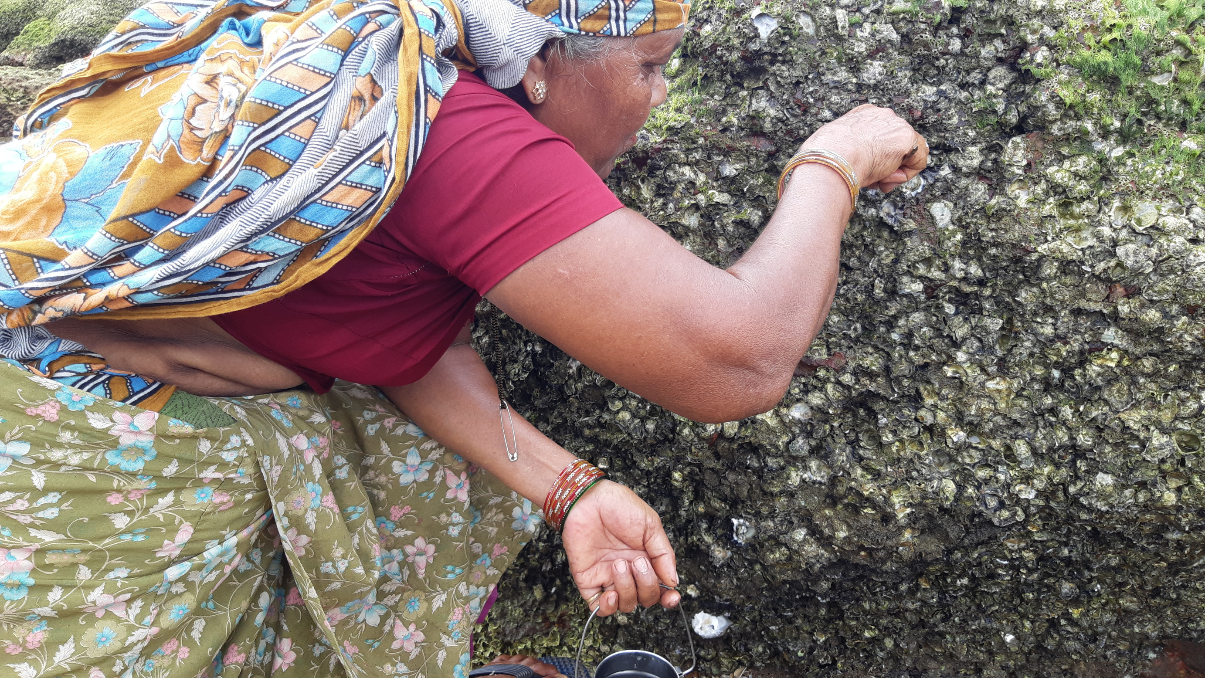
Thank you!

