Slide 1

Linking fishworkers’ lives and livelihoods to national and international environmental processes
Manas Roshan and Nivedita Shridhar, ICSF Trust
National Workshop: SSF Guidelines and Women in Fisheries, India
Chennai, Tamil Nadu
8 April, 2022

Slide 2
Biodiversity
Biodiversity is the sum total of all species of living organisms (terrestrial, marine and aquatic) on our planet.
Ecosystem is a system of interacting organisms and their physical environment

Slide 3
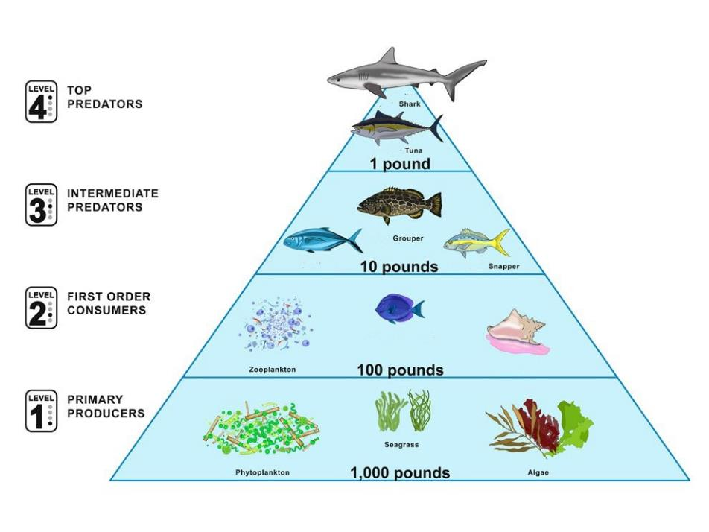

Slide 4
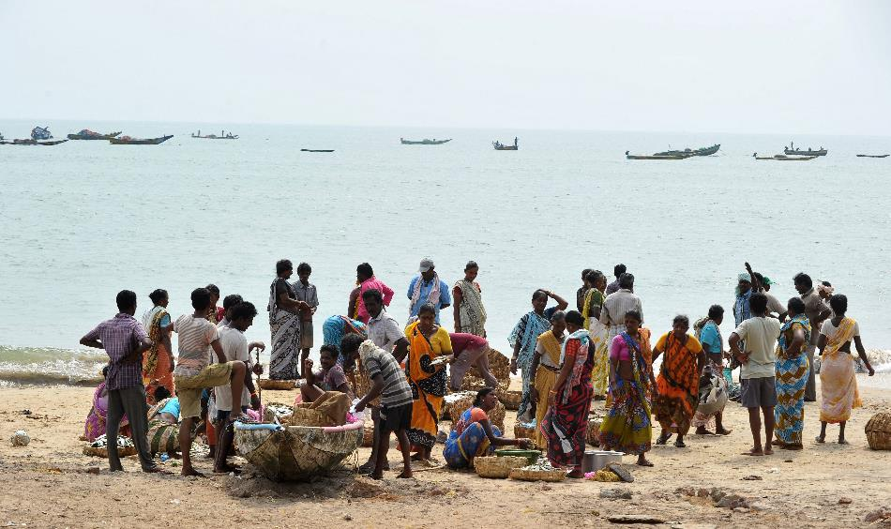
Biodiversity and fisheries
Globally, fish stocks fished at unsustainable levels increased from 10 % in 1974 to 34.2 % today
Fisheries have an impact on the ecosystem. They need to be managed in an ecosystem context.
Sustainable small-scale fishing has less impact on ecosystem because they target many species with low quantities of selective gear

Slide 5
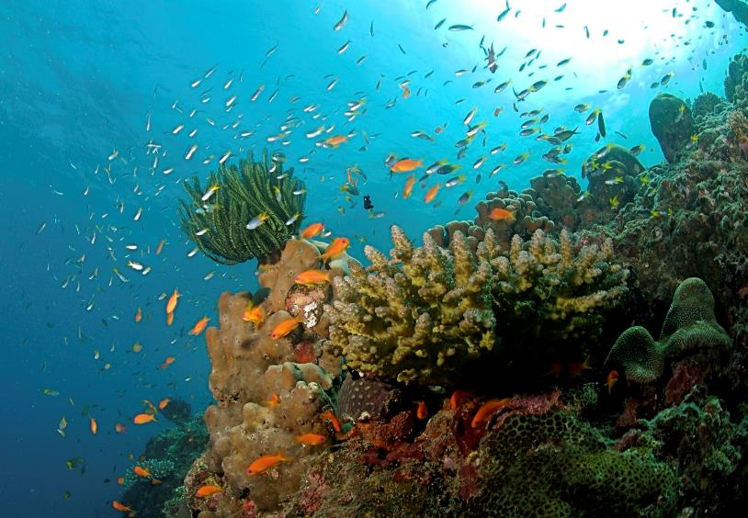
Convention on Biological Diversity (CBD)
International treaty (196 countries) to conserve and sustainably use biological diversity
India is a signatory. The Biological Diversity Act, 2002 and other wildlife and environment laws contribute to conservation goals
Marine and coastal biodiversity in CBD: sustainable fisheries, protected areas, coral reefs, marine pollution and plastics, marine spatial planning

Slide 6
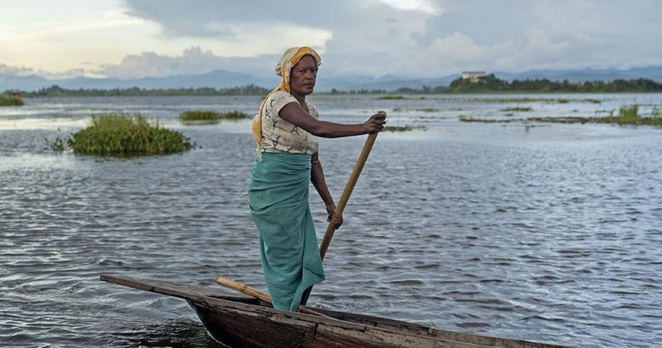
Biodiversity in fisheries policies
National Fisheries Policy, 2020 (also in NPMF, 2017):
Mainstream biodiversity in fisheries
Species- and area-specific mgmt
Conservation of vulnerable areas
Protection of iconic, endangered and threatened species
Spatial and temporal measures
Review of protected areas to ensure that rights of the traditional fishers are secured

Slide 7
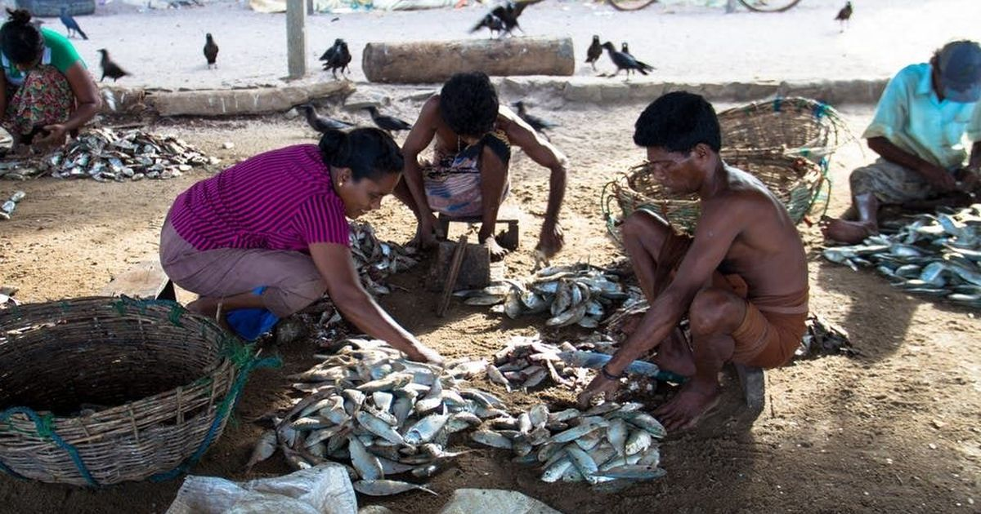
Fisheries resources are not in-exhaustive and subject to over- exploitation … over-exploitation would lead to loss of biodiversity and reduced availability of resources for our future generations
- National Marine Fisheries Policy, 2017

Slide 8
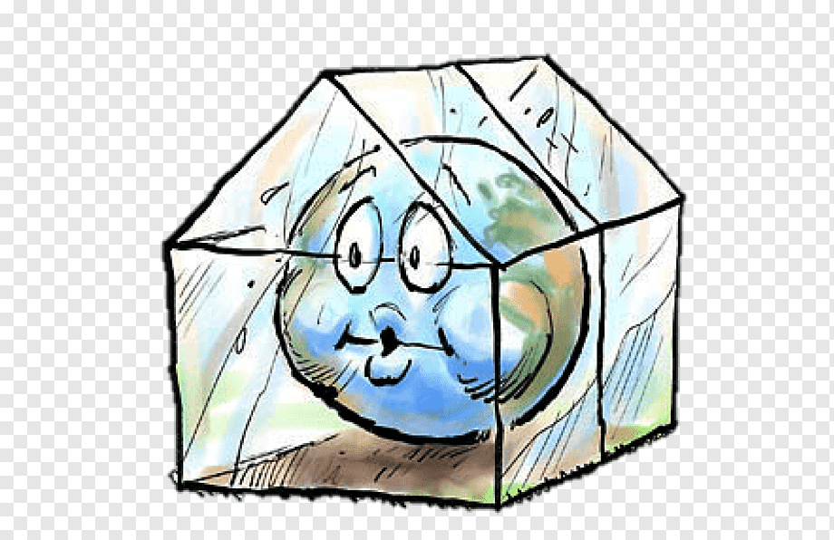
What is Climate Change
Climate change refers to long-term shifts in temperatures and weather patterns.
These shifts may be natural, such as through variations in the solar cycle.
But since the 1800s, human activities have been the main driver of climate change, primarily due to burning fossil fuels like coal, oil and gas.

Slide 9
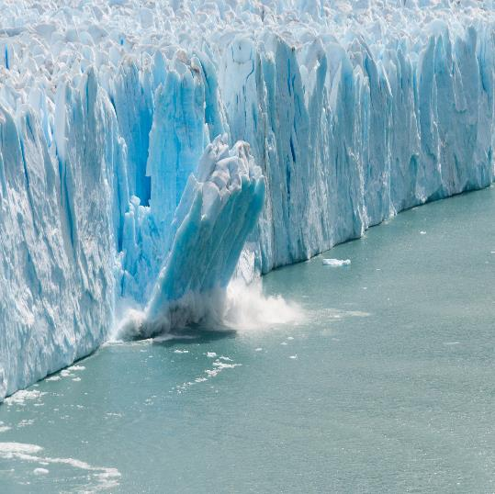
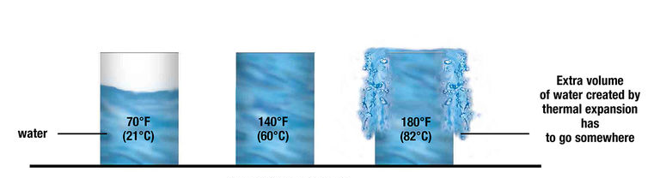
Sea Level Rise- Is it just the glaciers melting?
Thermal Expansion of Water
Glaciers melting
Do you know?
Thermal expansion happens when water gets warmer, which causes the volume of the water to increase. About half of the measured global sea level rise on Earth is from warming waters and thermal expansion.

Slide 10
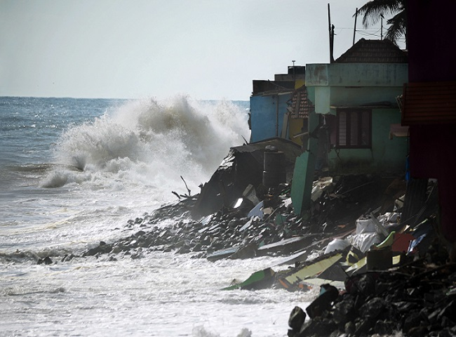
Scene from our everyday life!
Coastal Erosion
Sea Water Intrusion
Potable water shortage
Damage to lives and property

Slide 11
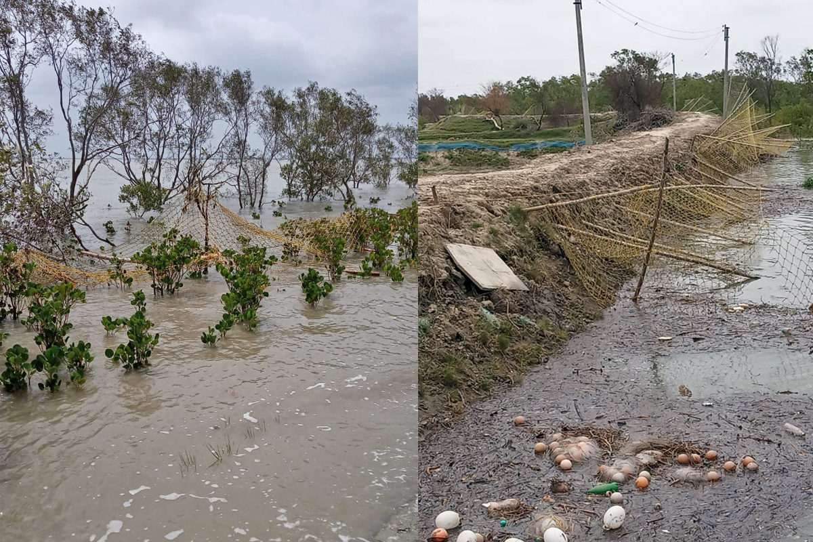
Cyclone/Floods
Habitat Destruction- Animal Human Conflict
Loss in lives and livelihood

Slide 12
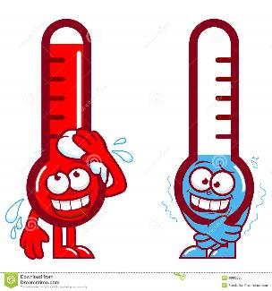
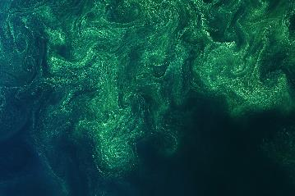
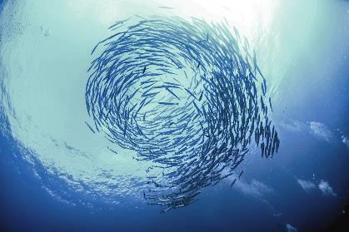
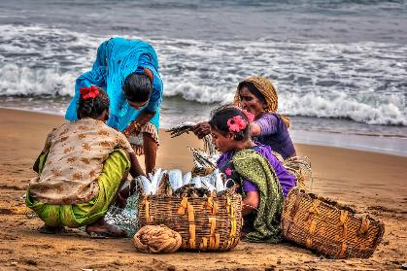
How does change in temperature determine your catch?
Temperature
Upwelling
Nutrients- Phytoplankton blooms
Spawning of Fish

Slide 13
Impacts of Climate Change- What are at stake?
Impacts
Health
Food Security
Housing
Safety
Livelihood

Slide 14
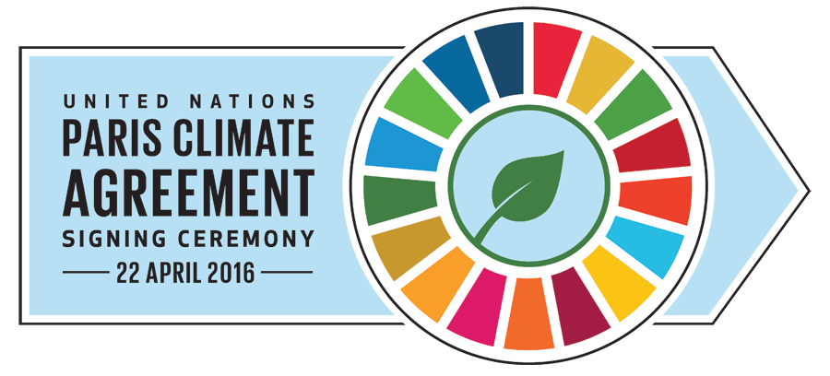
The importance of 1.5°C
Holding the increase in the global average temperature to well below 2°C above pre-industrial (1850-1900) levels and pursuing efforts to limit the temperature increase to 1.5°C above pre-industrial levels
COP 21
December 2015

Slide 15
Nationally Determined Contributions (NDCs)
The Paris Agreement requests each country to outline and communicate their post-2020 climate actions, known as their NDCs.
Introducing new, more efficient and cleaner technologies in thermal power generation.
Promoting renewable energy generation and increasing the share of alternative fuels in overall fuel mix- Cutting down subsidy of diesel, coal, kerosene and LPG
Protect coastal livelihood - ‘Mangroves for the Future (MFF)’ coordinated by International Union for Conservation of Nature (IUCN) in India.
National Initiative on Climate Resilient Agriculture (NICRA)- Main modules include Natural Resource Management, improving crop production, livestock and fisheries

Slide 16
National Fisheries Policy
While disaster risk reduction is a national priority and within the domain of the National Disaster Management Authority, community based disaster management and cluster approaches in fisheries and aquaculture sectors will also be initiated in a collaborative cross-sector mode.
Government will also consider landscape to seascape approach for the sound management of Inland coastal ecosystems, considering their importance in sustaining the marine fisheries resources

Slide 17

Social Equity
Stronger communities
Gender Equality
Access to Services
Poverty Alleviation
Economic Opportunity
Fair wages
Improved working conditions
Scope of Entreprenuership
Environmental Action
Sustainable Fisheries
Clean Air and Water
Resilient Infrastructure
Mitigation Measures
Inclusive
Climate Action
Top Down
Approach
Bottom Up
Approach

Slide 18

What can the fishing community do?
Using alternative fishing nets – Decomposable
Practicing fishing methods that do not disturb the sea bed
Energy efficient- fuel conserving- engines
Alternate energy- Solar power
Improving safety at Sea

