Slide 1
Women in Fisheries: Schemes & Budget in India
Ananthan P.S., M. Geetha & Deboshmita Dey
ICAR-Central Institute of Fisheries Education, Mumbai
ICSF National Workshop on SSF & Women in Fisheries
8-10 April 2022 * Chennai
The data & results presented here may be considered provisional as its preliminary results from on an ongoing study

Slide 2
What is Gender Budgeting?
Gender Budgeting is a tool for gender mainstreaming using the Budget as an entry point
to apply a gender lens to the entire policy process

Slide 3
What is a Gender Budget?
concerned with gender sensitive formulation of legislation, policies, plans, programmes and schemes;
allocation and collection of resources;
implementation and execution;
monitoring, review, audit and impact assessment of programmes and schemes; and
follow-up corrective action to address gender disparities.

Slide 4
Gender Budgeting in India?
Maharashtra Employment Guarantee Scheme (MEGS) – 1977
Right to Work on Demand to all adults willing to do unskilled manual work provided they were above 18 years of age
MGNREGA (Mahatma Gandhi National Rural Employment Guarantee Act) - 2005
guarantee at the level of the household and not at the level of the individual.
Now, at least one-third of the beneficiaries under NREGA should be women

Slide 5
Why Gender Budgeting?
Achievement of Gender Equity / Equality
Monitoring the achievement of policy Goals
Valuing Unpaid Work

Slide 6
Scope of Gender Budgeting
can be applied to entire National or State or Local Budget
can be applied to a selected Department or just one programme
Can be applied to an existing or a new programme.
can be applied on the expenditure or the revenue side.
It can be applied to new or existing Legislation.

Slide 7
Gender Budgeting in India
Gender Budget Cell (GBC) since 2005-06 set up in all Departments like the Department of Fisheries to influence/ effect changes in Ministry's policies / programmes, promote gender equality and development of women.
GBC is headed by Joint Secretary (PC) with six members

Slide 8
Gender Budgeting in India
Gender Budget Statement (Statement 20) since 2005-06
Part A includes Schemes with 100% allocation for women
Part B includes Schemes/Programmes with 30-99% allocation for women
Outcome Budget since 2007-08
progress card on how Ministries have used the outlays or funds announced
Results Framework Document (RFD) during 2012-17

Slide 9
Gender Budgeting in India
No separate fund earmarked for women component; about 5-6% fund is spent on women oriented schemes in DOF/DAHDF
But, advises States/Implementing Agencies to utilize around 30% of allocated funds towards women beneficiaries under the Centrally Sponsored Scheme Matsya Sampada Yojana

Slide 10
Pradhan Mantri Matsya Sampada Yojana (PMMSY) (2019-20 to 2023-24)
FM’s Budget 2019-20: Department of Fisheries to establish a robust fisheries management framework through PMMSY
an additional 70 lakh tons fish production, Rs. I lakh crores fisheries exports, generation of 55 lakh employment over next 5 years
PMMSY is an umbrella scheme with 2 separate Components:
(A) Central Sector Scheme (CS) (Rs. 1,720 crores) &
(B) Centrally Sponsored Scheme (CSS) (Rs.7,687 crores)
PMMSY’s estimated investment of Rs.20,050 crores for 5 years
Central share: Rs.9,407 crores + State share Rs.4,880 crores + Beneficiaries contribution: Rs.5,763 crores

Slide 11
Funding Pattern under PMMSY Scheme
For any proposal under Centrally Sponsored Scheme (CSS), the total admissible Government subsidy (Central + State) will be limited to 40% of the project cost for general category & 60% of the project cost for women, Scheduled Castes (SCs), & Scheduled Tribes (STs)

Slide 12
PMMSY: A. ENHANCEMENT OF PRODUCTION & PRODUCTIVITY
Development of Inland Fisheries And Aquaculture
Development of Marine Fisheries including Mariculture & Seaweed cultivation
Establishment of Seaweed culture rafts including inputs (Rs900/raft as subsidy: 60%)
Establishment of Seaweed culture with Monoline/tubenets (Rs.5000/unit)
Bivalve cultivation (mussels, clams, pearl etc. (Rs.12,000 / unit)
Development of ornamental and recreational fisheries
Technology Infusion and adaptation

Slide 13
PMMSY: B. POST HARVEST & COLD CHAIN INFRASTRUCTURE
Construction of Cold Storages/Ice Plants:
Motor cycle with Ice Box (Rs.45,000/bike;
Cycle with Ice Boxes (Rs.6000);
Three wheeler with Ice Box including e-rickshaws 1.8 lakh);
Live fish vending Centres (Rs.12 lakhs);
Refrigerated & Insulated vehicles (Rs.12-15 lakhs/vehicle);
Cold storage of 10 tonne capacity (Rs.24 lakh)
Fish Feed Mills
Markets and Marketing infrastructure
Development of Deep Sea Fishing
Aquatic Health Management

Slide 14
PMMSY: C. FISHERIES MANAGEMENT & REGULATORY FRAMEWORK
Monitoring, Control and Surveillance
Strengthening of safety and security of fishermen
Fisheries Extension and support services
- Sagar Mitras
Insurance of fishing vessels and fishermen
Livelihood and nutritional support for fishers for conservation of fisheries resources

Slide 15
Central Sector Scheme (CS): Rs.1,720 crores for 5 years (2020-21 to 2024-25)
a. Genetic improvement programmes and Nucleus Breeding Centers (NBCs)
b. Innovations and innovative projects/activities, technology demonstration including startups, incubators and pilot projects
c. Training, awareness, exposure and capacity building
d. Aquatic quarantine facilities
e. Modernization of fishing harbours of central government and its entities
f. Support to NFDB, Fisheries Institutions and regulatory Authorities of Department of Fisheries, Government of India and need based assistance to State Fisheries Development Boards
g. Supports for survey and training vessels for Fisheries institutes including dredger TSD Sindhuraj owned by the Government
h. Disease monitoring and surveillance network
i. Fish data collection, fishers‟ survey and strengthening of fisheries database
j. Support to security agencies to ensure safety and security of marine fishermen at sea
k. Fish farmers producer Organizations/Companies (FFPOs/Cs)
l. Certification, accreditation, traceability and labeling
m. Administrative expenses for implementation of PMMSY (to meet expenses of both CSS and components

Slide 16
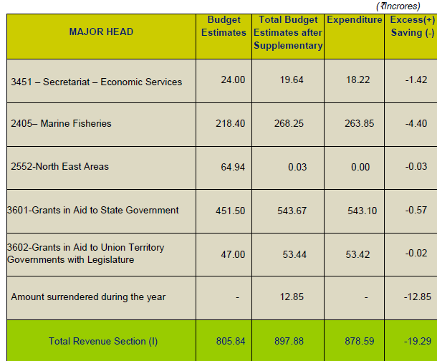
GoI’s Department of Fisheries: Expenditure 2020-21 Rs.879 crores

Slide 17
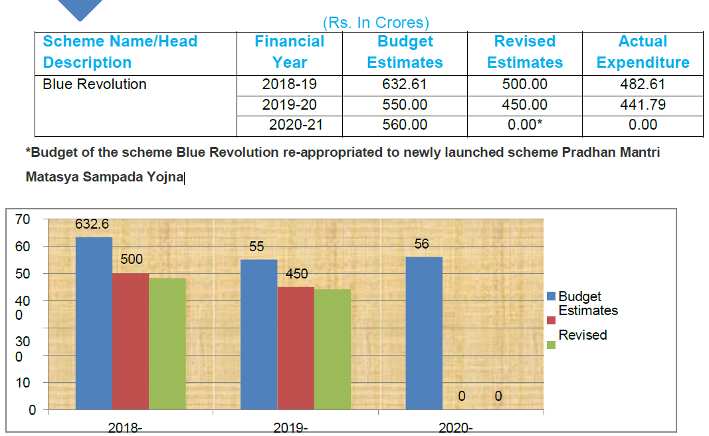
BR/PMMSY Schemes Expenditure (2018-21)
Expenditure in 2020-21:
Rs. 543 crores

Slide 18
Tamil Nadu’s Fisheries Budget (2017-2020)
Financial year | Budget Estimate | Revised Estimate | Expenditure
2016-17 | 740 | 680 | 536
2017-18 | 767 | 814 | 734
2018-19 | 1016 | 863 | 772
2019-20 | 928 | 678 | 738
Rs. in Crores
An average of Rs.748 crores was spent on fisheries by DoF during 2017-2019, which was 0.32% of state’s total expenditure (Rs.234,86,433 crores)
Expenditure increased by 7% between 2016-2020
Rupees in lakhs

Slide 19
Tamil Nadu’s Fisheries Budget (2017-2020)
Revenue Expenditure
Salaries and allowances, pension
Development schemes expenditure
Subsidies & welfare benefits
Interest payments and charges etc.
Capital Expenditure
Fish landing facilities
Harbors
Hatchery
Machinery and equipment, etc.
Primarily restricted to the expenditure which don’t lead to Capital Formation
Primarily restricted to the expenditure which lead to Capital Formation
(Source: Finance Department of Tamil Nadu)

Slide 20
Tamil Nadu’s Fisheries Budget (2017-2020)
(Rupees in Lakhs)
Expenditure | 2016-17 | 2017-18 | 2018-19 | 2019-20
Revenue | 381 (70%) | 563 (76%) | 526 (68%) | 487 (64%)
Capital | 164 (30%) | 182 (24%) | 247 (32%) | 269 (36%)
Total | 545 | 744 | 773 | 755
Nearly Rs.489 crores of revenue expenditure - 69% of the total
It increased by 10% in the year of 2017-18, then declined 5%
Reasons for increase during 2017-18
Increased expenditure on relief assistance to marine fishermen (24%) and fisherwomen (26%) during lean months &
Increased expenditure on livelihood support to the coastal fishermen during ban period by 18%
Rupees in lakhs

Slide 21
Tamil Nadu’s Fisheries Budget (2017-2020)
Revenue Expenditure
(Rupees in Crores)
Sub-Head | 2016-17 | 2017-18 | 2018-19 | 2019-20
Administrative expenses | 47 (12%) | 4,949 (9%) | 54 (10%) | 61 (13%)
Extension and Training expenses | 93 (2%) | 48 (1%) | 20 (3%) | 14 (3%)
Welfare Benefits | 251 (66 %) | 422 (75 %) | 386 (73%) | 360 (73%)
Education, Research & Development | 74 (20%) | 86 (15%) | 66 (14%) | 52 (11%)

Slide 22
Tamil Nadu’s Fisheries Budget (2017-2020)
Welfare Expenses
Expenditure on Grants in aid (63%) dominated the welfare expenses when compared to subsidies (34%) and compensation (2%)
Nearly Rs.264 crores spent on relief and livelihood support to the fishermen during Non-fishing, fishing ban and lean fishing season: 75% of the total welfare expenditure of Rs.354 crores
Marine Fisher population of the state were mainly benefitted
Rupees in lakhs

Slide 23
Tamil Nadu’s Fisheries Budget (2017-2020)
(Rupees in Crores)
SI. No | Schemes | 2016-17 | 2017-18 | 2018-19 | 2019-20
1 | Livelihood support to the coastal fishermen during ban period | 33 | 83 | 83 | 84
2 | Grants to commercial kerosene to fishermen | 27 | 22 | 26 | 26
3 | Special allowance to fishermen during Non-fishing period | 83 | 83 | 83 | 86
4 | Relief scheme for Tamil Nadu marine fishermen during lean months | 38 | 63 | 63 | 62
5 | Relief scheme for Tamil Nadu marine fisherwomen during lean months | 36 | 60 | 60 | 60

Slide 24
Tamil Nadu: State Vs Central share

Slide 25
Tamil Nadu Fisheries Budget: Unit Value Analysis
Expenditure / Coastal Kilometer length | 45 lakhs
Expenditure / / Coastal District | 35 crores
Expenditure / Fishing village | 79 lakhs
Expenditure / ha of Inland water body | 1,240
Expenditure / Active Marine Fisher (both men & women) | 6,546
Expenditure / Active Marine Fisher Family | 26,184
Expenditure / Active Marine Fisher Women | 2,745
Expenditure / Active Marine Fishermen | 2,291

Slide 26
Tamil Nadu Fisheries Budget: Unit Value Analysis
Fisheries Resource Area per DoF Staff (Technical) | 1978 ha
No. of. Fish farmer per DoF Staff (Inland) | 160
No. of. Fishermen per DoF staff (Inland) | 553
Fishermen per DoF staff (Marine) | 3166

Slide 27
West Bengal: Budget Estimate & Expenditure (2017-2020)
Rs. In Crores)
Financial year | Budget Estimate | Revised Estimate | Expenditure
FY 2017-18 | 401 | 363 | 332
FY 2018-19 | 414 | 353 | 259
FY 2019-20 | 452 | 379 | 274
On an average, Rs. 422 crores was allocated for Fisheries Expenditure which was around 0.21 % of the total budget.
Actual expenditure is less than budget allocated.
Actual expenditure decreased by 17.3% during last 3 years

Slide 28
W.B. :Expenditure under Different Schemes

Slide 29
Expenditure on Welfare Schemes
Financial Year | Expenditure on Welfare Scemes (Rs in Crore) | % Total Expenditure
FY 2017-18 | 89 | 26.90%
FY 2018-19 | 97 | 37.64%
FY 2019-20 | 1,23 | 44.83%
Expenditure on Welfare Schemes has increased over the period of three financial years due to implementation of new Welfare schemes and more expenses incurred on the same.
Expenditure on Welfare Schemes increased by 12.5% from FY 2017 and FY 2020.
On an average, Rs. 103 crore was spent on Welfare Schemes which was 36.5% of the total expenditure.

Slide 30
Fisheries Development in West Bengal: State Vs. Central Share (2017-2020)
MAJOR ASPECT | FY 2017-18 | FY 2018-19 | FY 2019-20
State Development Schemes | 187 | 147 | 141
State Development Schemes (Central Assistance) | 32.3 | 8.4 | 17.3
Central Sector Scheme | 1
Contribution of Centre is meagre (13%)

Slide 31
Sl. No. | Name of District | Total nos. of Block | Nos. of FEO Posted at Block | Vacancy in %
1 | Cooch Behar | 12 | 8 | 33
2 | Alipurduar | 6 | 4 | 33
3 | Jalpaiguri | 7 | 4 | 43
4 | Darjeeling GTA | 5 | 4 | 20
5 | Siliguri MKP | 4 | 2 | 50
6 | Kalimpong | 3 | 2 | 33
7 | Uttar Dinajpur | 9 | 6 | 33
8 | Dakshin Dinajpur | 8 | 6 | 25
9 | Malda | 15 | 9 | 40
10 | Murshidabad | 26 | 11 | 58
11 | Birbhum | 19 | 9 | 53
12 | Nadia | 18 | 13 | 28
13 | Purba Bardhaman | 23 | 10 | 57
14 | Paschim Bardhaman | 8 | 4 | 50
15 | Hooghly | 18 | 13 | 28
16 | Howrah | 14 | 10 | 29
17 | N 24 Pgs | 22 | 17 | 23
18 | S 24 Pgs | 29 | 18 | 38
19 | Purba Medinipur | 25 | 15 | 40
20 | Paschim Medinipur | 21 | 13 | 38
21 | Jhargram | 8 | 1 | 88
22 | Bankura | 22 | 15 | 32
23 | Purulia | 20 | 8 | 60
Total |  | 342 | 202 | 41

Slide 32
West Bengal: Unit Expenditure
Expenditure per Coastal Kilometer | Rs. 83538
Expenditure per Coastal District | Rs. 6599483
Expenditure per Marine Fishing Village | Rs. 70207.27
Expenditure per Ha of Inland Water body | Rs. 3638.76
Expenditure per Marine Fishermen | Rs. 32.78
Number of Active Inland Fishermen | Rs. 207.25

Slide 33
ধন্যবাদ
धन्यवाद
THANK YOU
നന്ദി
நன்றி

