Slide 1


Tenure
The cornerstone of small-scale fishing
Maarten Bavinck
Bangkok, May 5th 2022

Slide 2

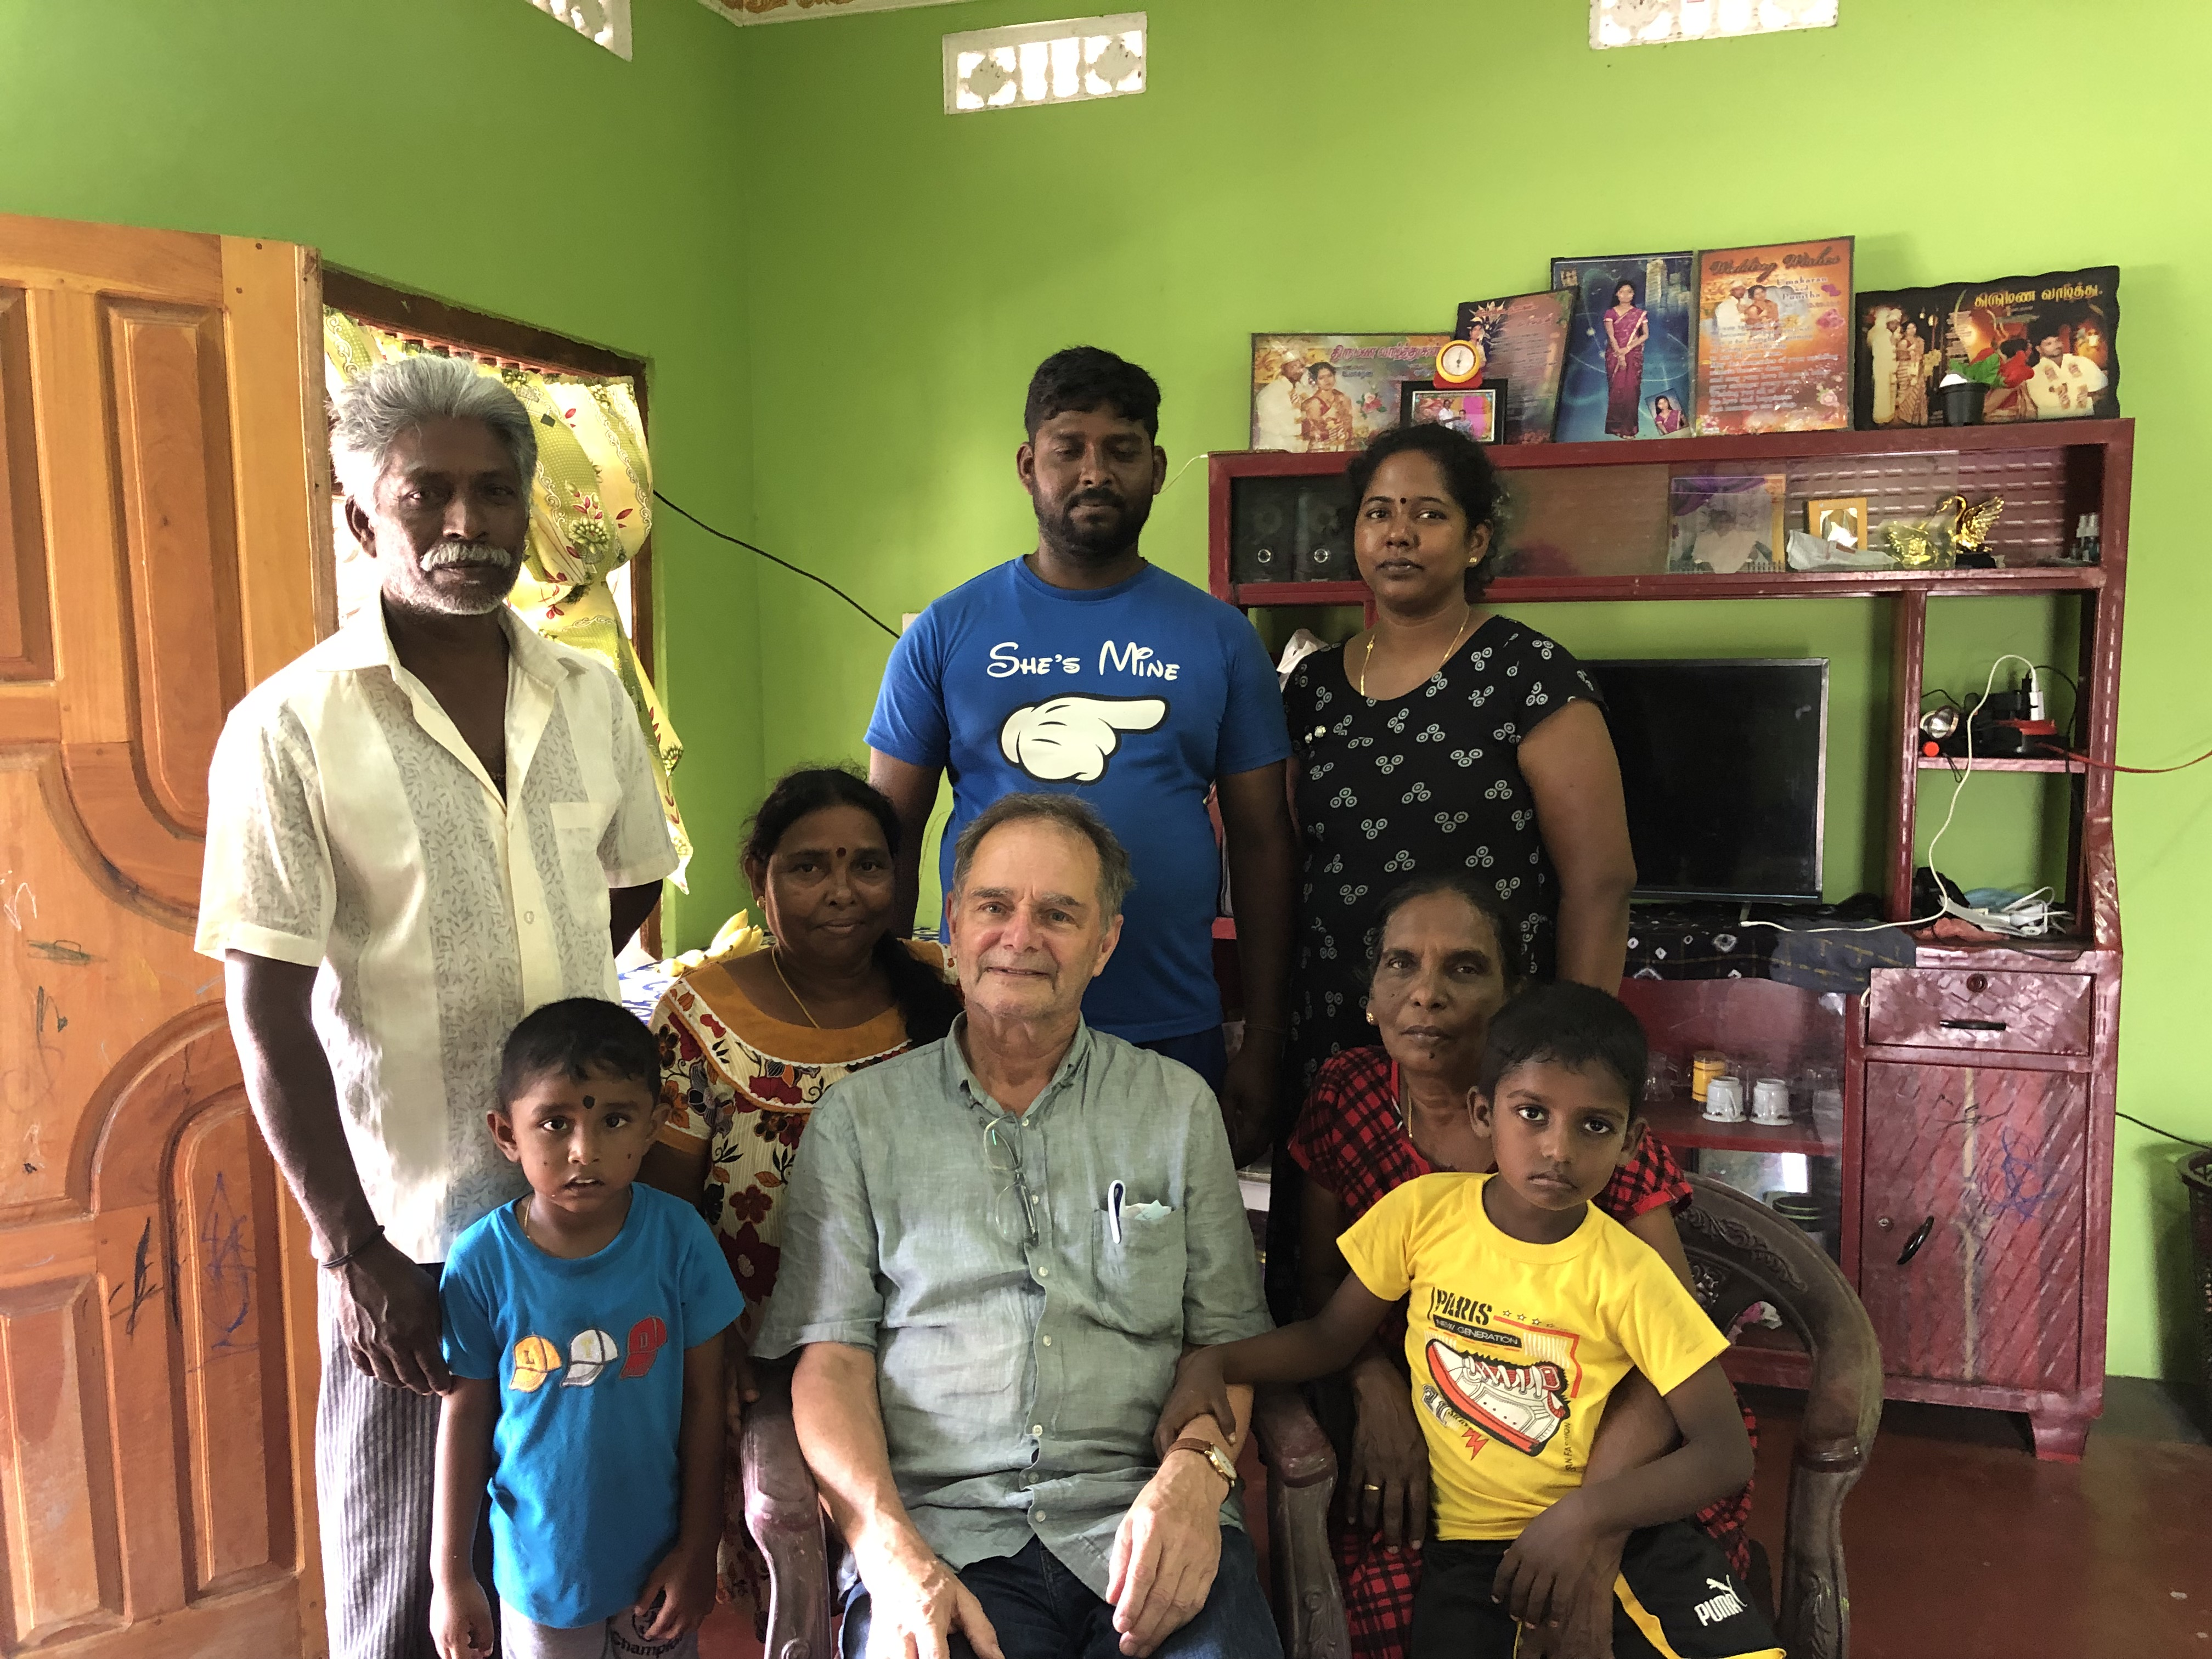
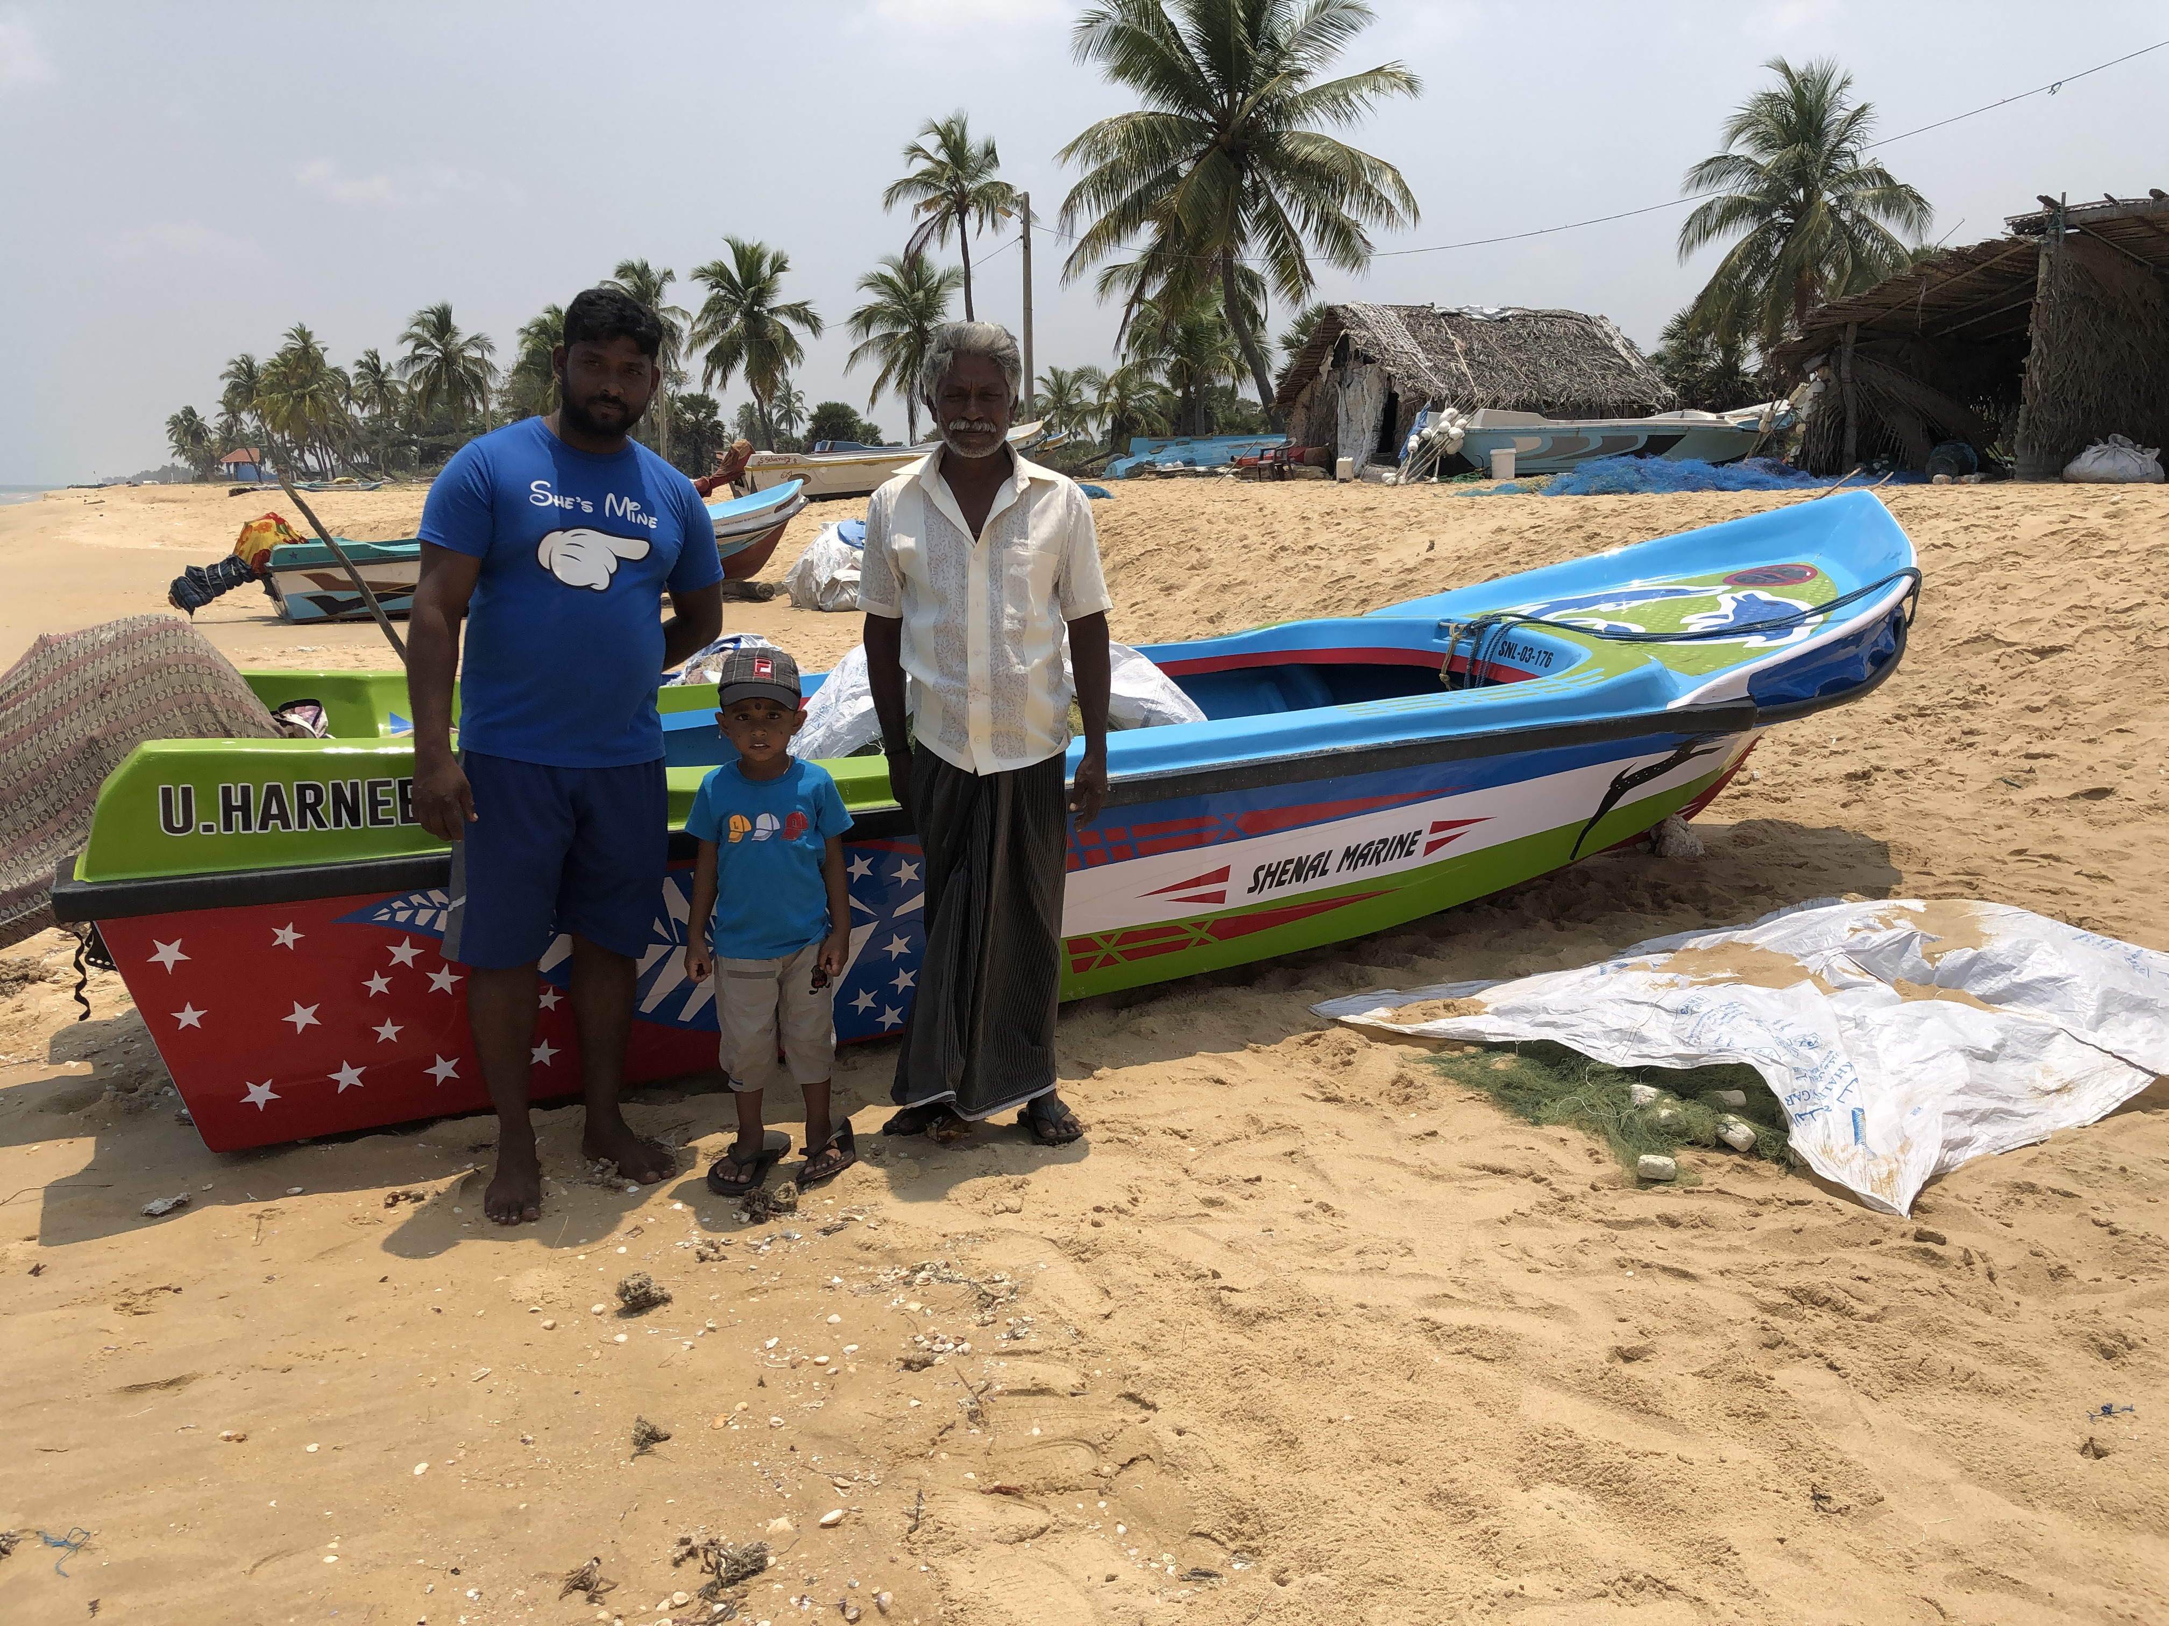
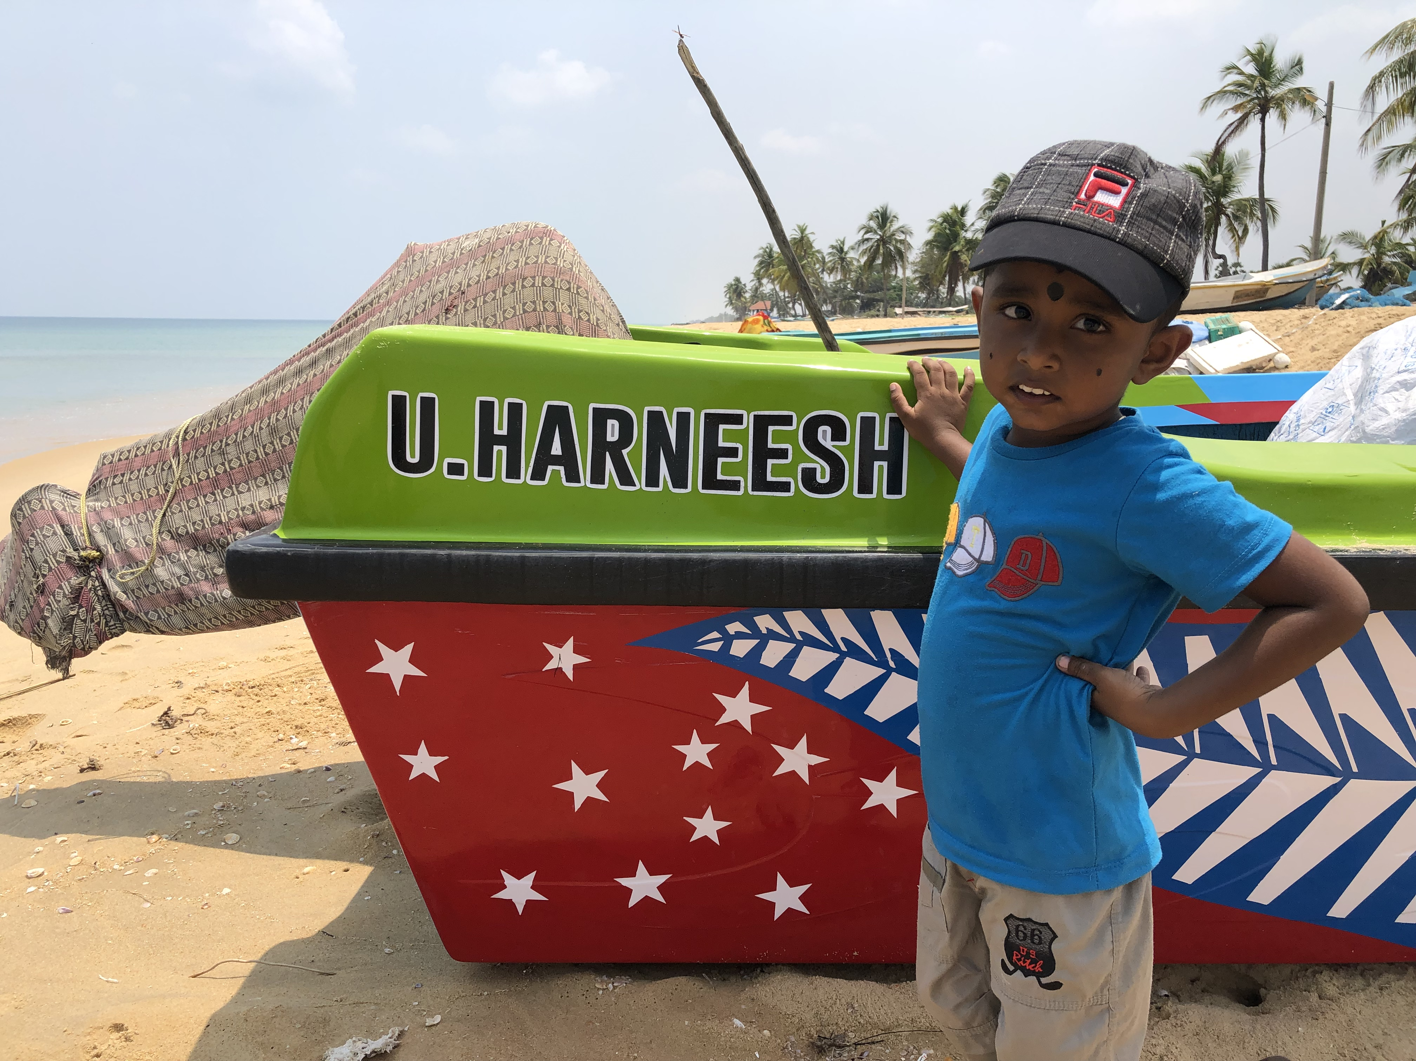
1. Small-scale fishers in Sri Lanka
Kanagaratnam and Kunchu
(March 2022)
“Is he going to be a fisher?”

Slide 3
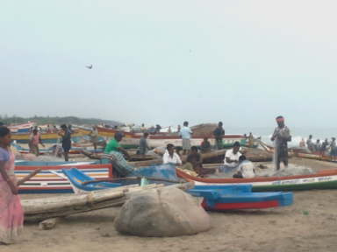
Members of communities
Communities are generally the basis of fisheries tenure.
Will they survive?
Will the children be able to become confident fishworkers?

Slide 4
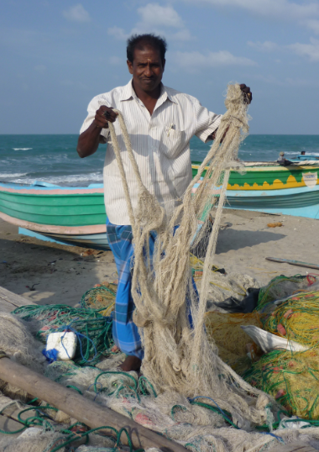
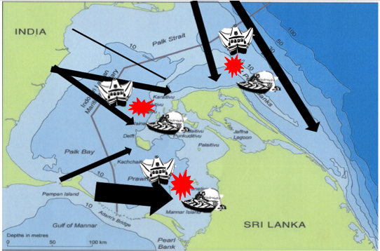
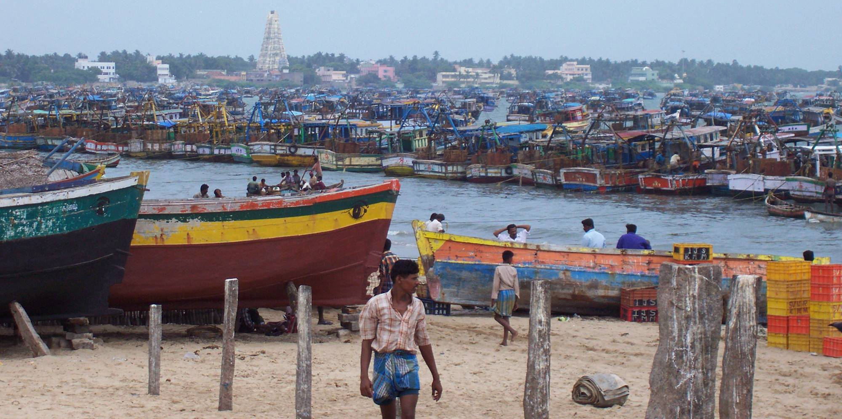
North Sri Lankan fisher problems:

Slide 5
Could it be that ‘problems of tenure’ are the main reason our fisher friends want to leave fisheries?

Slide 6
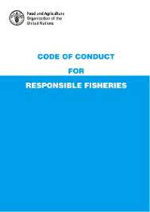


International attention to tenure
1995
2012
2014

Slide 7
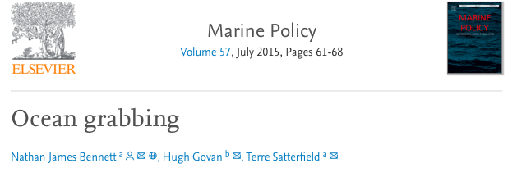

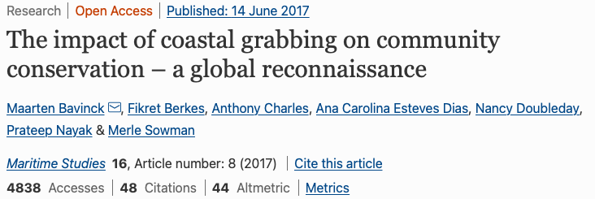
Why are international bodies concerned?
“Many tenure problems arise because of weak governance…” (Tenure Guidelines 2012:5)

Slide 8


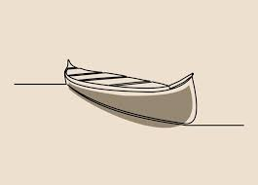
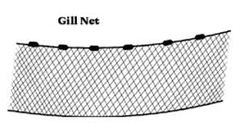
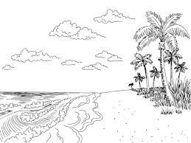



2. What are the necessities for fishing?
TENURE

Slide 9
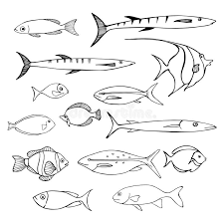

What is ‘tenure’?
“Tenure systems determine who can use which resources, for how long, and under what conditions” (Tenure Guidelines 2012:5)
Clear relationship
[property/access]
+ the spaces necessary to go fishing

Slide 10

Tenure is:
‘property’ (but also different) – ‘can’t put a fence at sea’
‘control’
‘rights’ and ‘responsibility’
and a form of ‘law’
It is the cornerstone of livelihoods, food security and human rights
”We belong here” (and ‘here’ belongs to us).

Slide 11
3. What is the current tenure situation:
Historical rights
Customary law by fishers
Governmental law
International law
Other law (companies, NGOs)
No law at all = theft
Rule of thumb: while the influence of customary law is reducing, the influence of governmental law and other law is increasing.
Mixedness!
Confusion!
Loss of control!

Slide 12
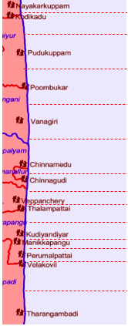
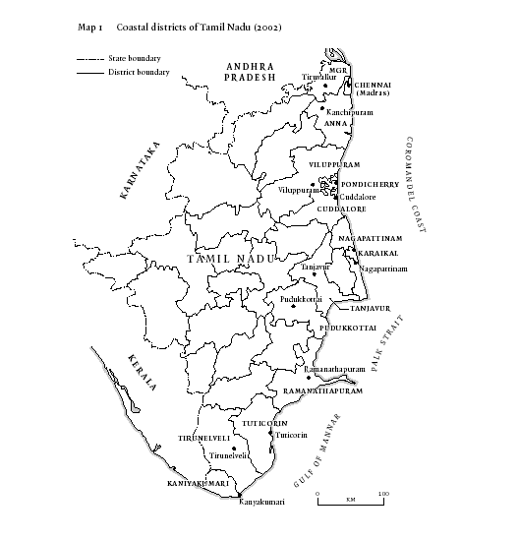
Contemporary tenure in South Asia
A coastline (beach and waters) divided according to customary tenure
But customary tenure is not recognized by governments
That have introduced new systems of rights (but frequently not implementing them properly).
Role of international law
SE India

Slide 13
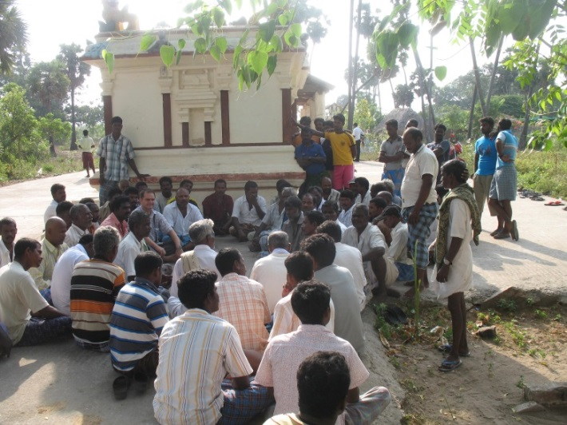
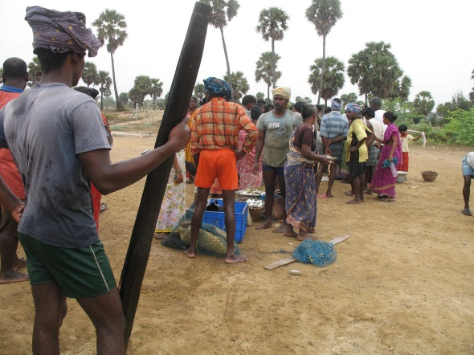
Customary marine tenure in South Asia
Ur Panchayat (village council) claim tenure over coastal land & water
All adult fishers are represented in the village council:
  Take part in decision-making (panchayat meetings)
  Pay taxes
  Take care of religious obligations
  Implement fishing rules at sea
  Catch offenders
  Defend village territory
  Regulate migration
  Regulate marketing

Slide 14
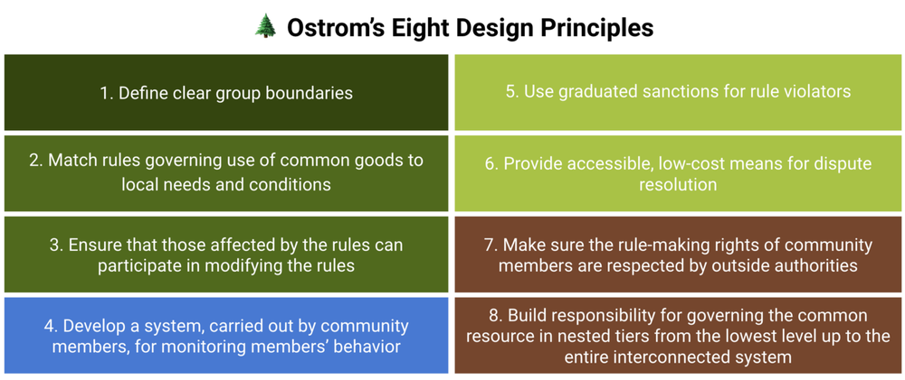
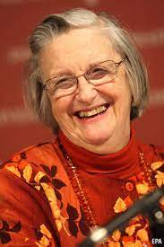
Conditions for successful tenure
Elinor Ostrom
1933-2012
‘Nestedness’ is crucial!

Slide 15
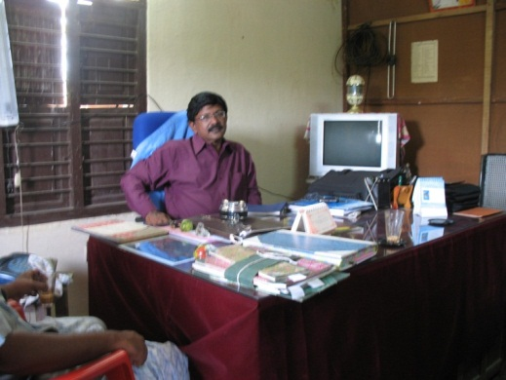
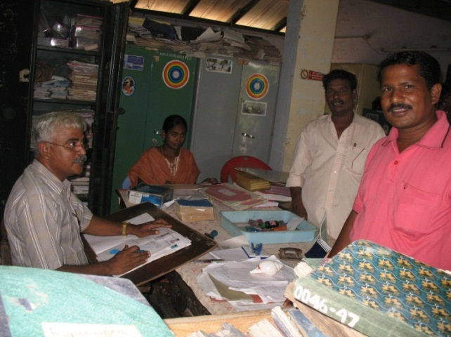
Features of governmental tenure
”We are the ones to regulate fisheries.”
ID-cards and registration of craft
Preferential fishing zones
Prohibited gears
Rights to living space along shores
But governments are based far away
And other interests are emerging

Slide 16
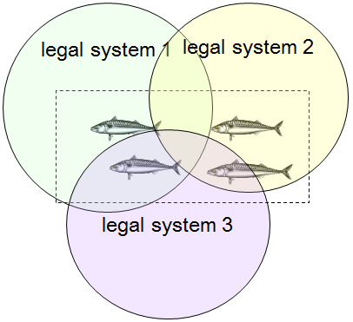
Fragmentation of tenure:
Vertical fragmentation
Horizontal fragmentation
International law
________________
National law
________________
Local law
Fragmentation causes loss of control

Slide 17
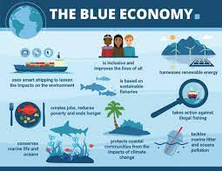
4. Threats to existing tenure rights
Aquaculture
Tourism
Mineral exploitation
Harbours
Industrial fisheries
Effects of pollution
Effects of climate change
Disinterested government

Slide 18

5. ‘Fixing’ problems of tenure
Make clear the contribution of fisheries to food security and employment
Seek local control
Visibilize customary tenure
Find allies
Seek coherence
Fight for a just and sustainable tenure system

Slide 19
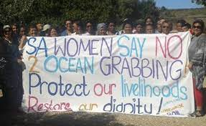
6. Fighting for just tenure rights
Documenting and mapping
Obtaining recognition
Maintainance of tenure rights
Revising tenure rights
Dealing with disputes
Taking the initiative
Forming alliances

Slide 20
7. So what will happen to Harneesh?
Will he find pride in fishing?
Will he and his future family find a home in a fishing community?
Will he and his community continue to be able to make a living from fishing?
Will they be able to fight those who are undermining small-scale fishing?

Slide 21
Thank you for your attention

Slide 22
Extra slides

Slide 23
Code of Conduct 1995:
“States should appropriately protect the rights of fishers and fishworkers […] to a secure and just livelihood, as well as preferential access […] to traditional fishing grounds and resources in the waters under their national jurisdiction.” (Art. 6.18)

Slide 24
Tenure Guidelines 2012:
Many tenure problems arise because of weak governance…
People can be condemned to a life of hunger and poverty if they lose their tenure rights to their homes, land, fisheries and forests and their livelihoods because of corrupt tenure practices or if implementing agencies fail to protect their tenure rights.
Responsible governance of tenure promotes sustainable social and economic development that can help eradicate poverty and food insecurity, and encourages responsible investment. (2012:5)

Slide 25
SSF Guidelines 2014
Small-scale fishing communities need to have secure tenure rights to the resources that form the basis of their social and cultural wellbeing, livelihoods and sustainable development. (Art. 5.1)
Special attention [should be] paid to women with respect to tenure rights. (Art. 5.3)
States […]and all other parties should recognize, respect and protect all forms of legitimate tenure rights, taking into account, where appropriate, customary rights to aquatic resources and land and small-scale fishing areas enjoyed by small-scale fishing communities. (Art.5.4)

