Slide 1

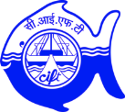
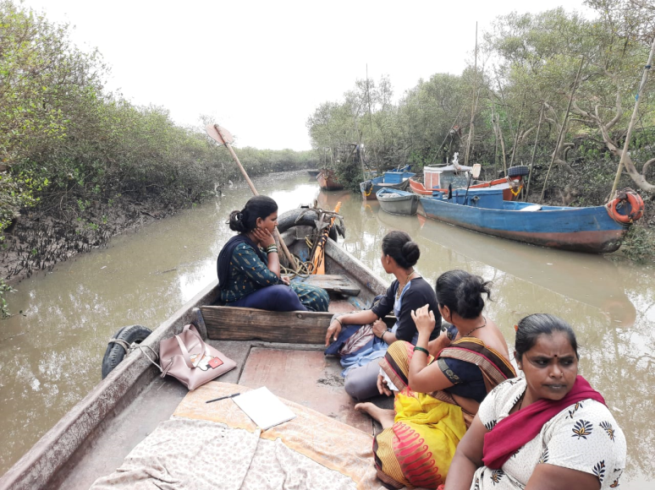
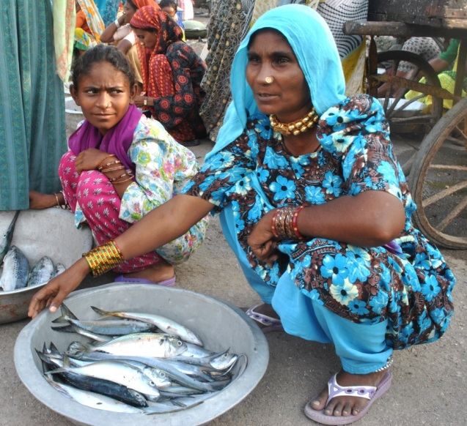
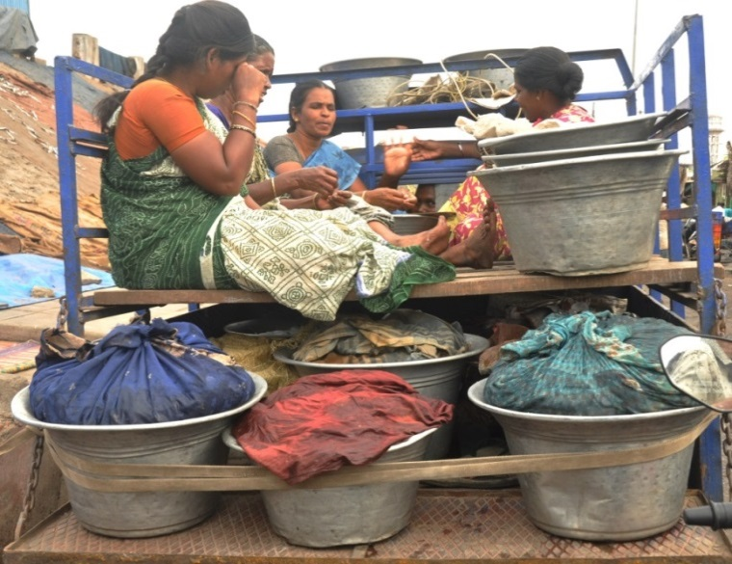
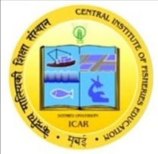
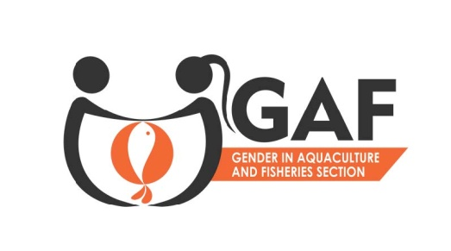
Women fish harvesters in India: Issues and Challenges
Nikita Gopal, , Principal Scientist, ICAR-CIFT
National Workshop: SSF Guidelines and Women in Fisheries, India, Chennai; 8-10 April 2022

Slide 2
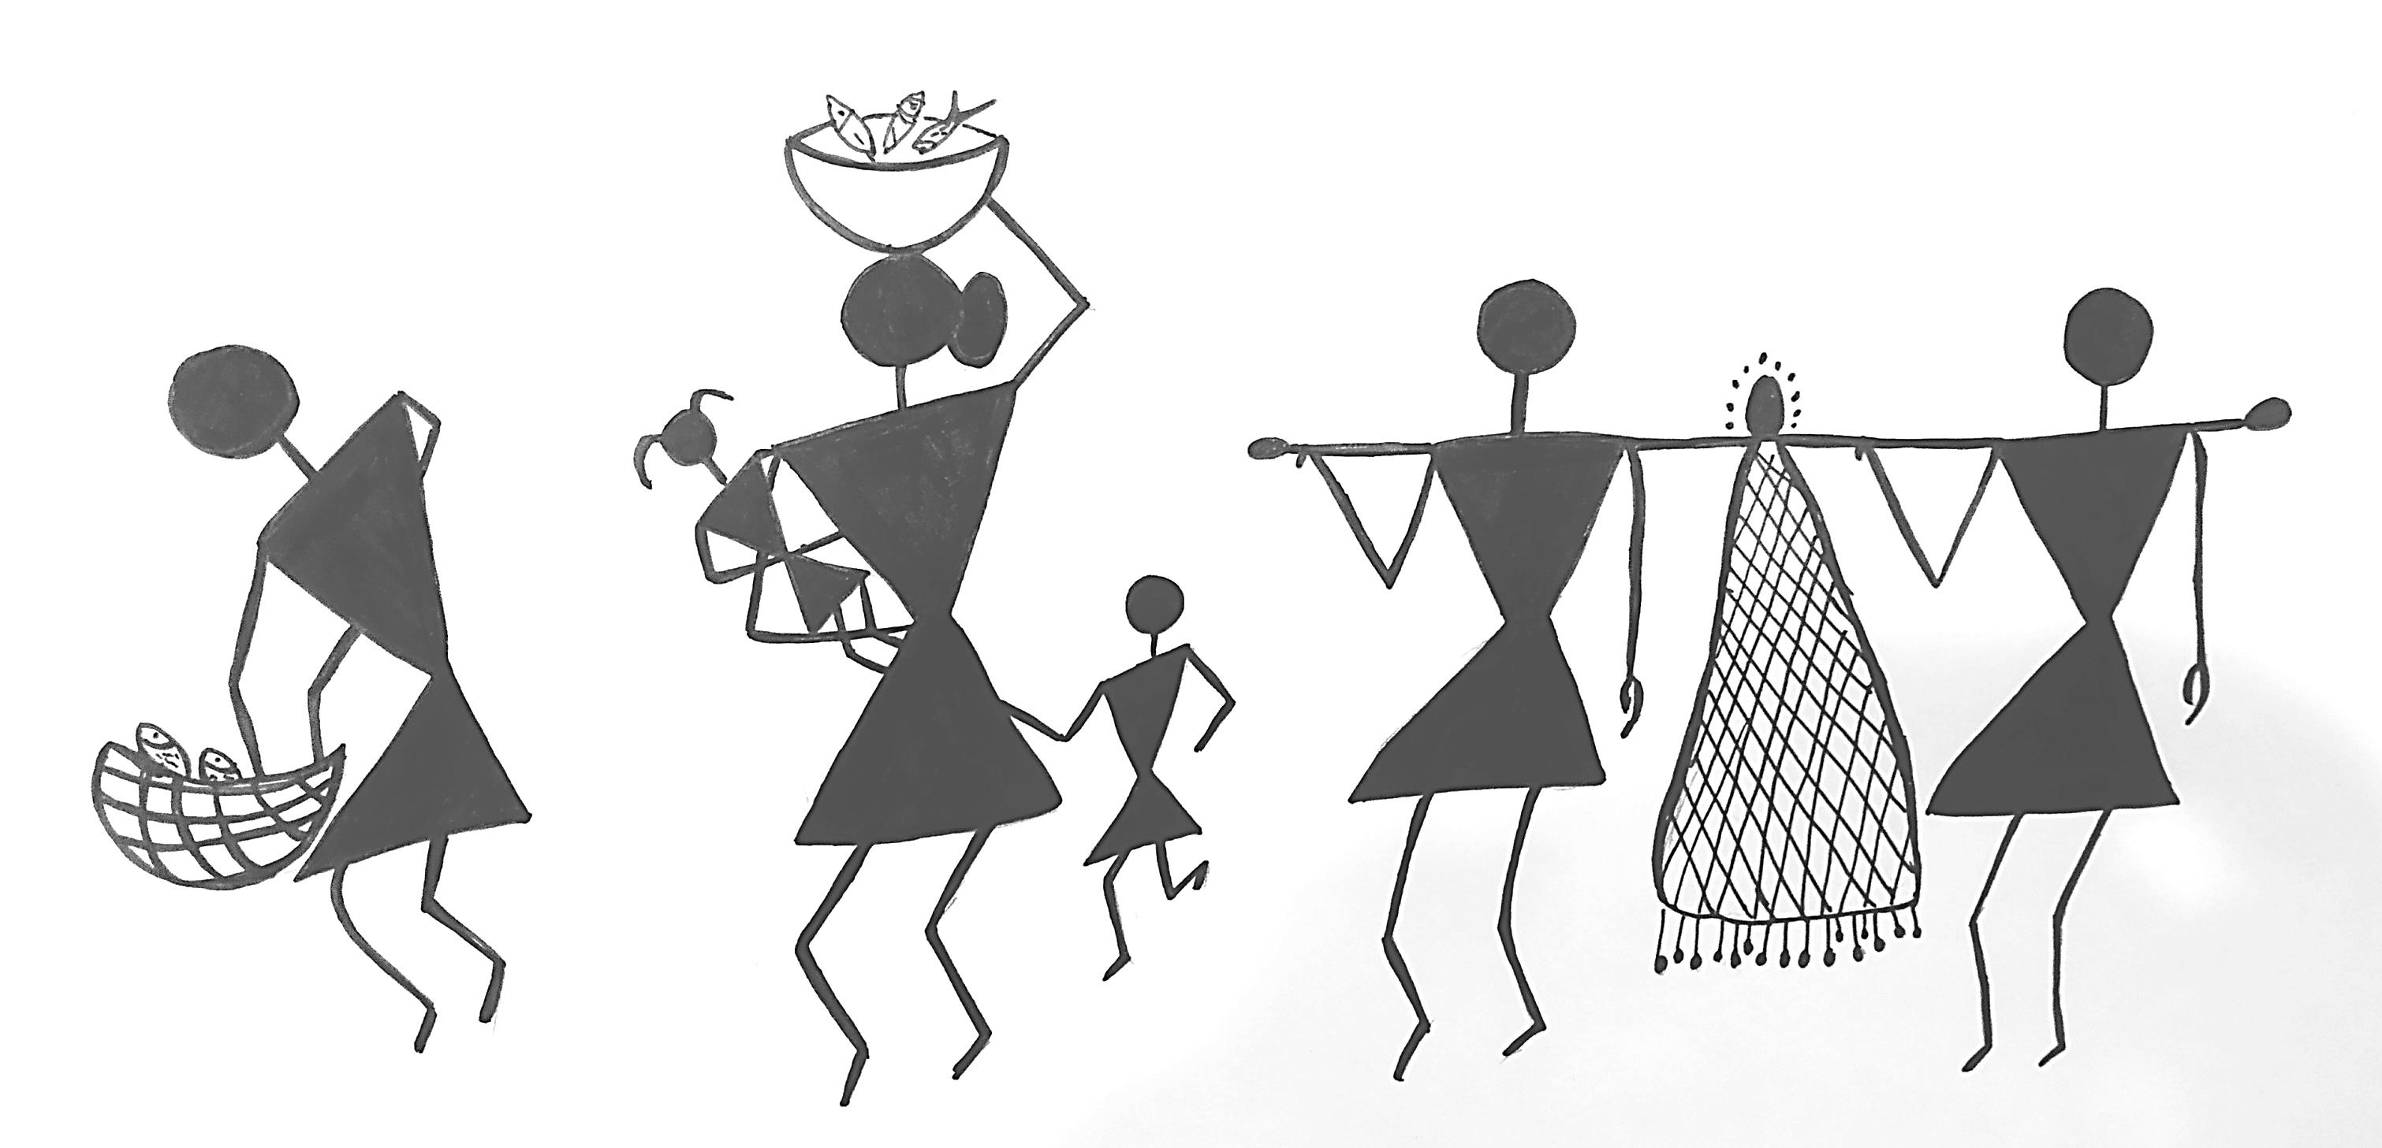
Introduction
Women - 50% of the workforce in fisheries and aquaculture
The Illuminating Hidden Harvest - globally about one in 4 workers in small scale fisheries is women
Artwork: Sijitha Mary C X

Slide 3
How many women?
Women - about 49% of adult population in marine fishing villages
Adult population, 81.16% of men and 32.55 % women employed in the sector
Not reported - active fishing
58% - fish seed collectors (most of them part-time)
74% of all allied workers
Source: Marine Fisheries Census 2016, ICAR-CMFRI & DoF, MFAHD, GoI

Slide 4
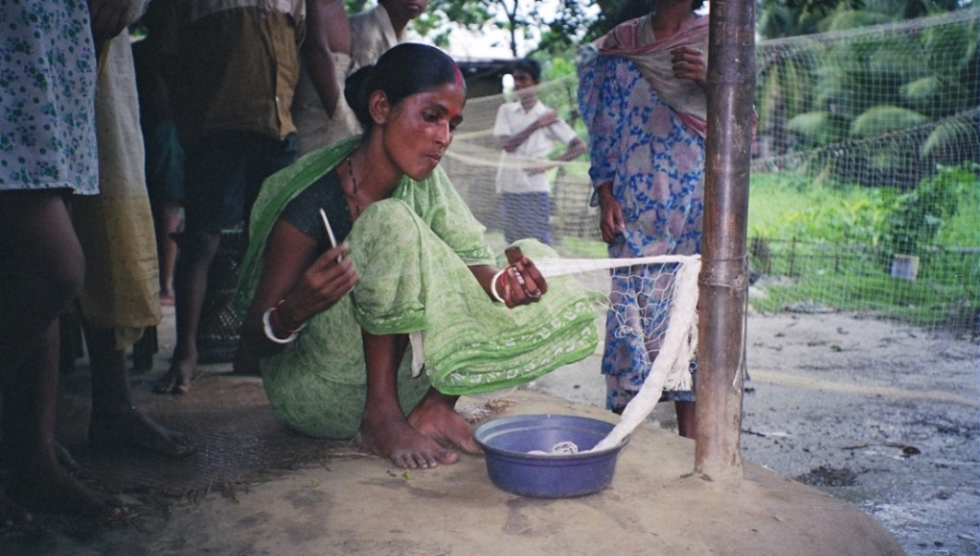
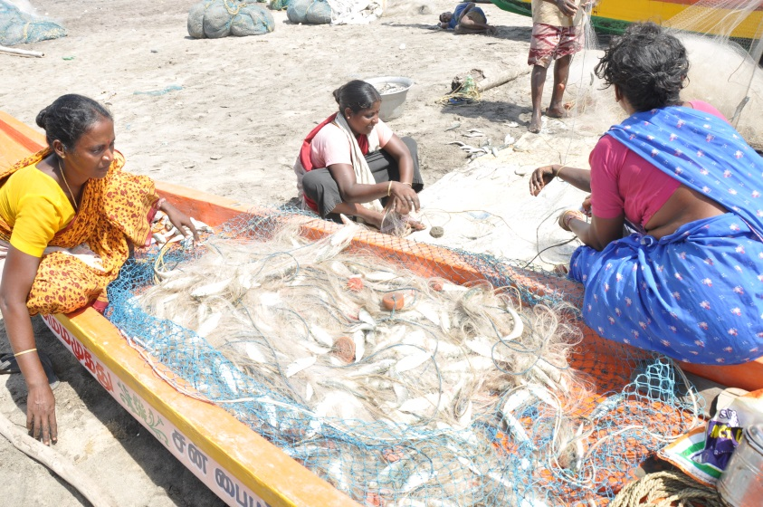
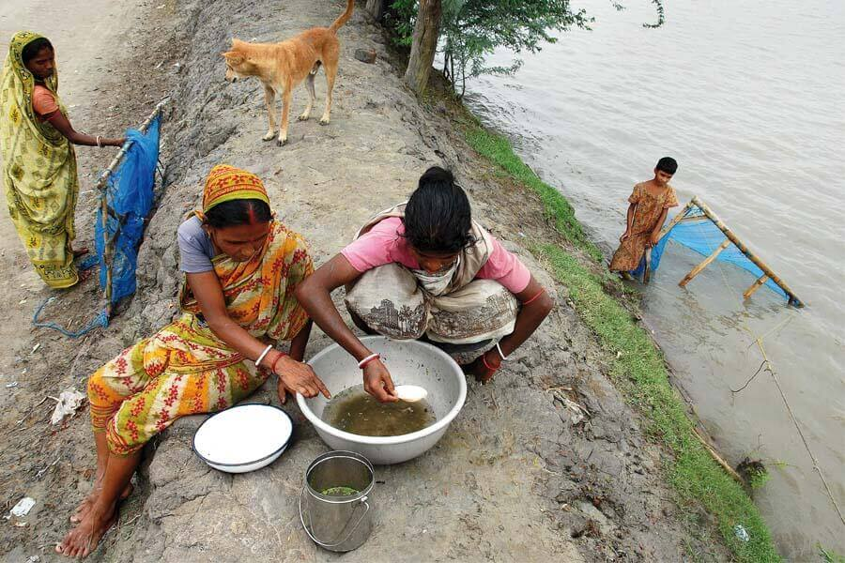
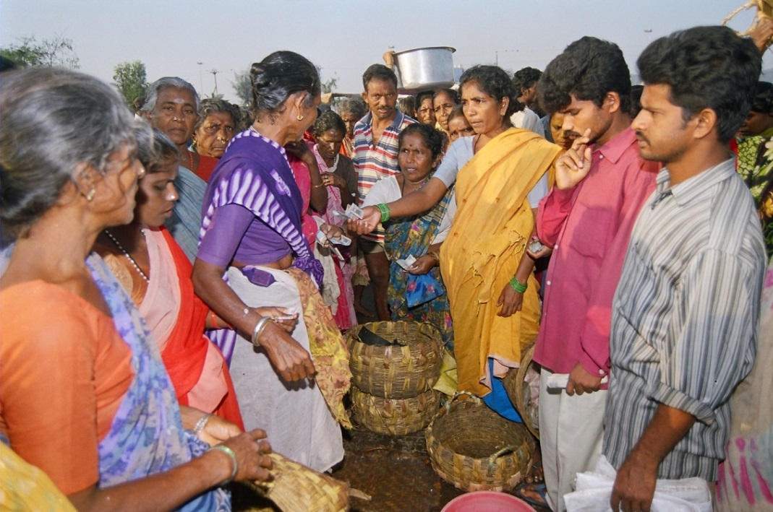
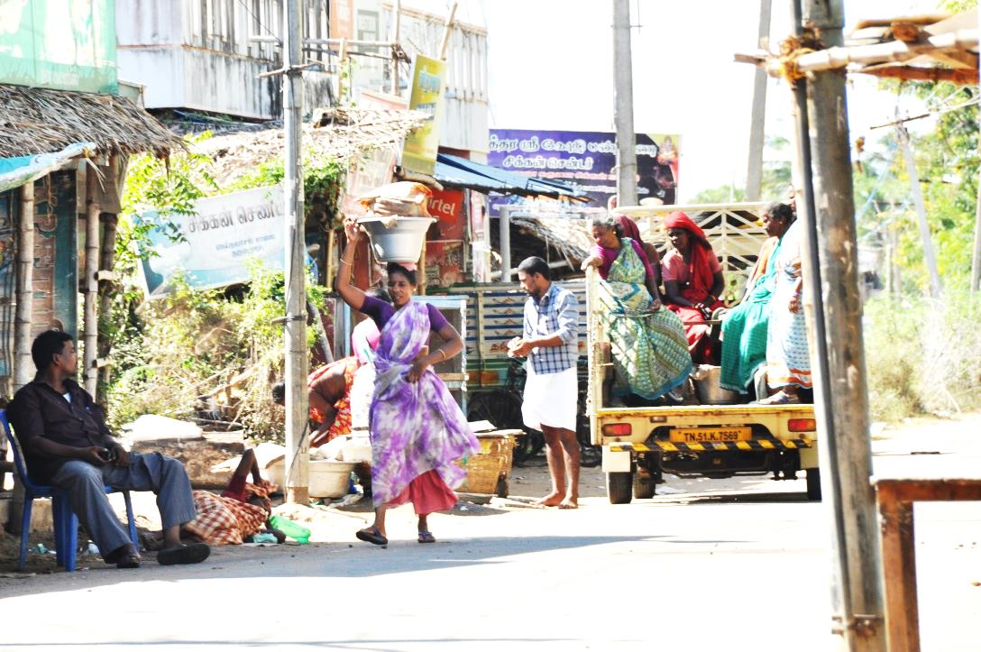
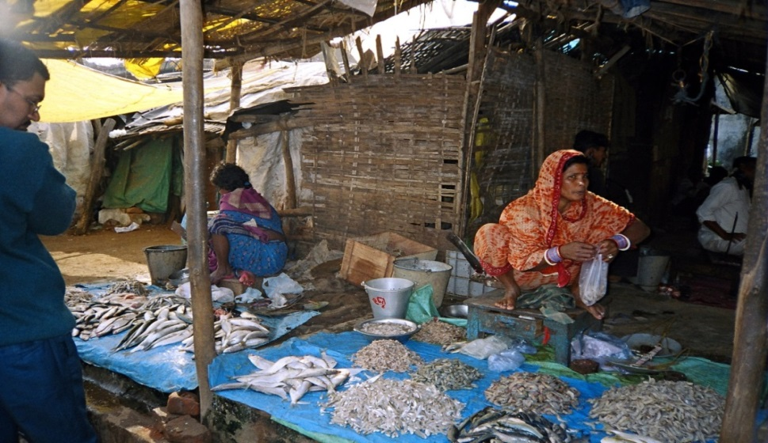
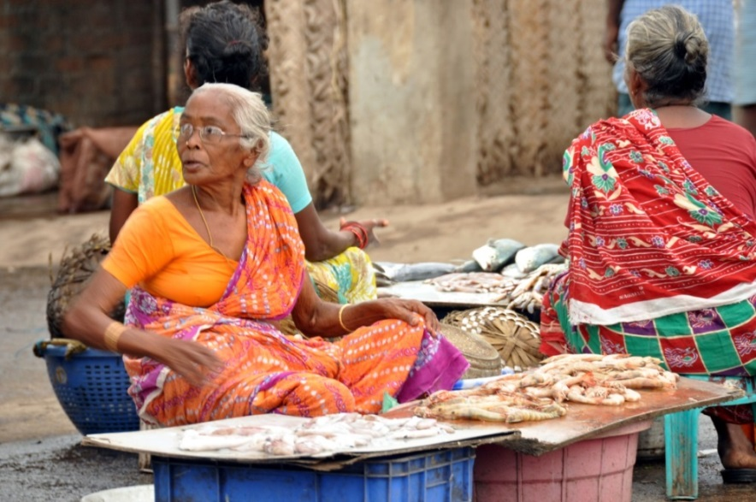
Where?
Picture courtesy: https://geographyandyou.com/wild-shrimp-seed-collection/
Diverse work profile

Slide 5
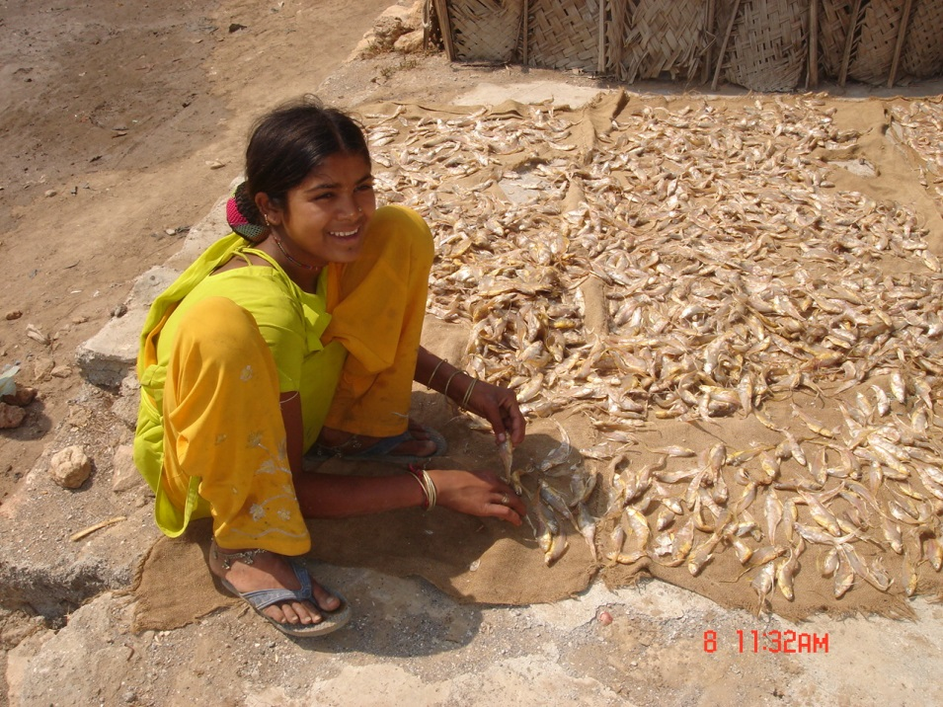
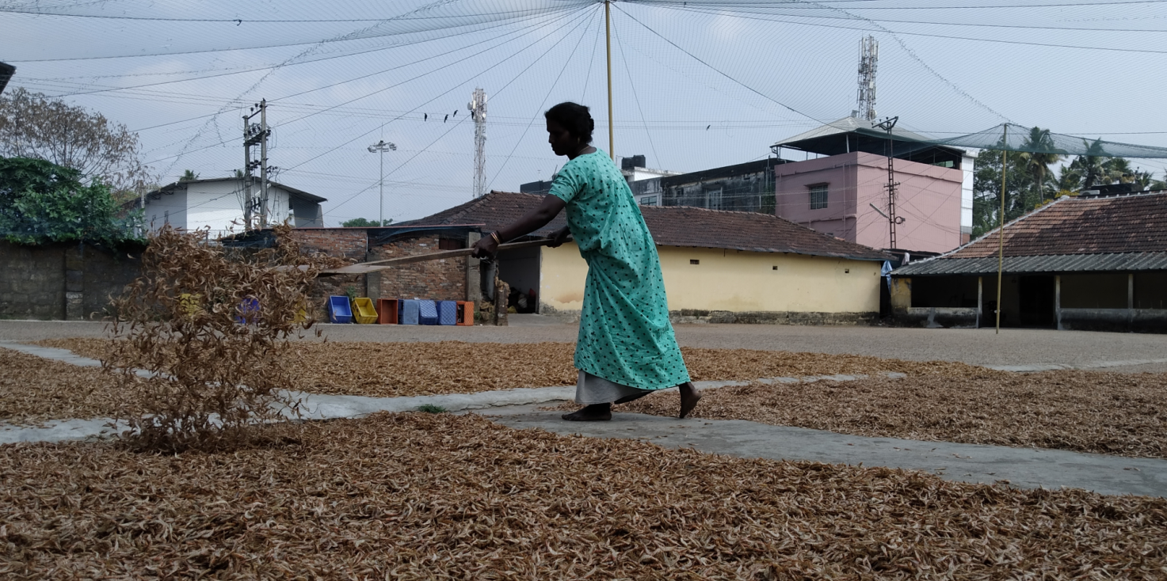
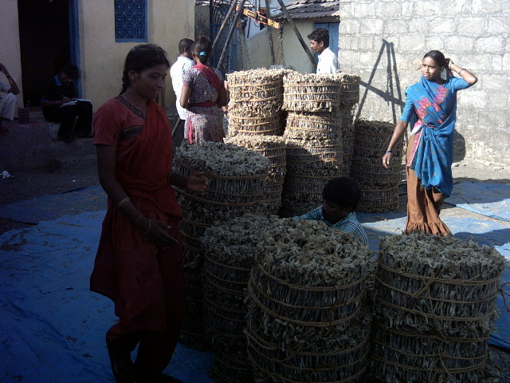
Where?

Slide 6
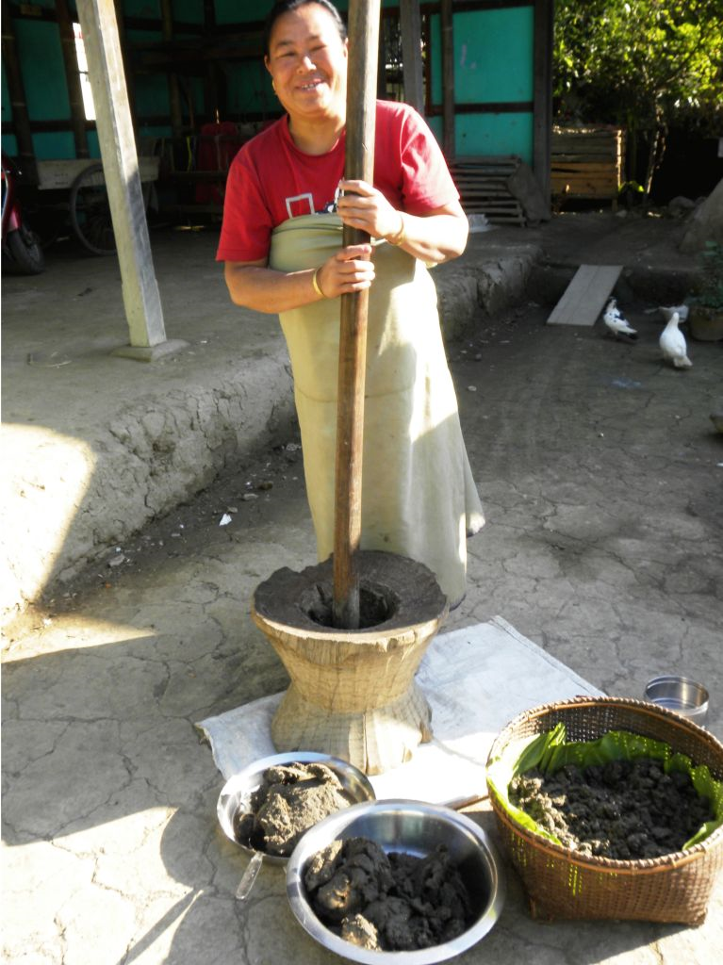
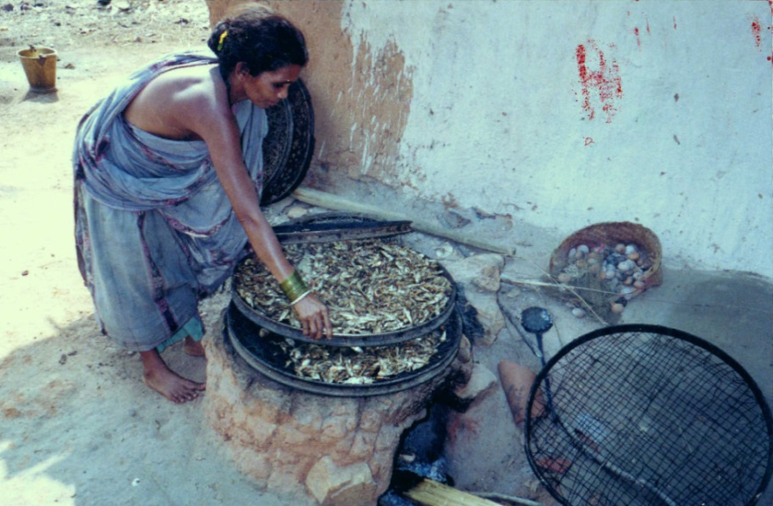
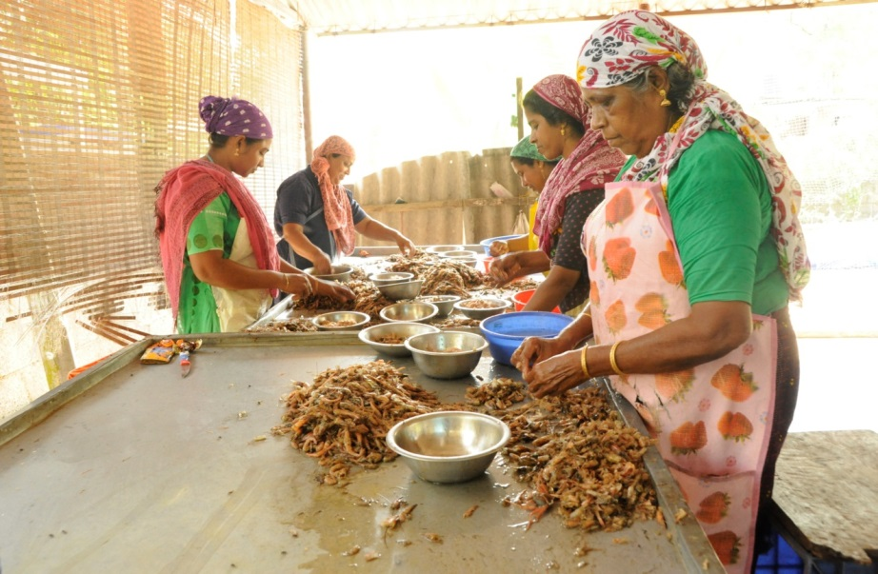
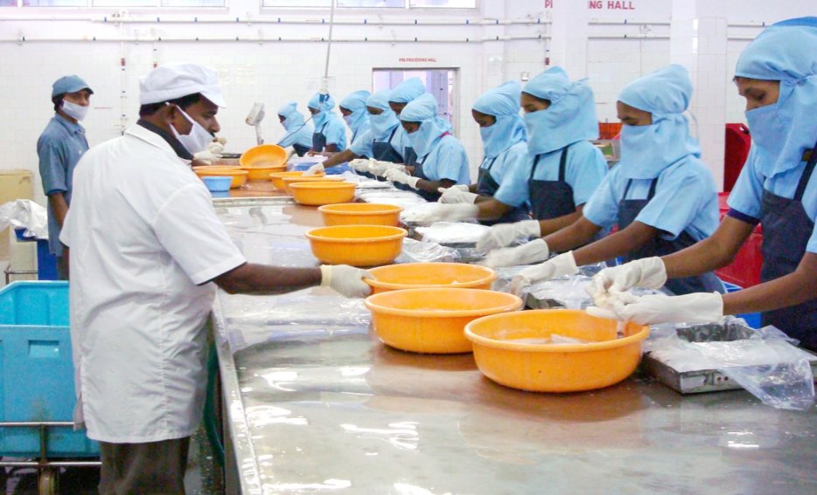
Where?
Pictures courtesy (Fermentation and fish paste making): Dr. Shaikhom Inaotombi, Gender in Aquaculture and Fisheries: The Long Journey to Equality Asian Fisheries Science Special Issue 29S (2016): 181-191, Asian Fisheries Society ISSN 0116-6514

Slide 7
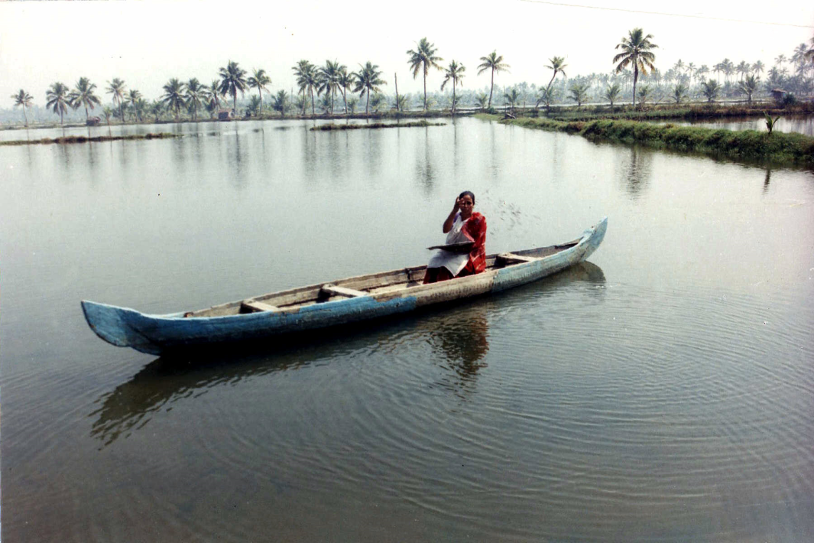
Do women fish?
There is no official data of women in fish harvest

Slide 8
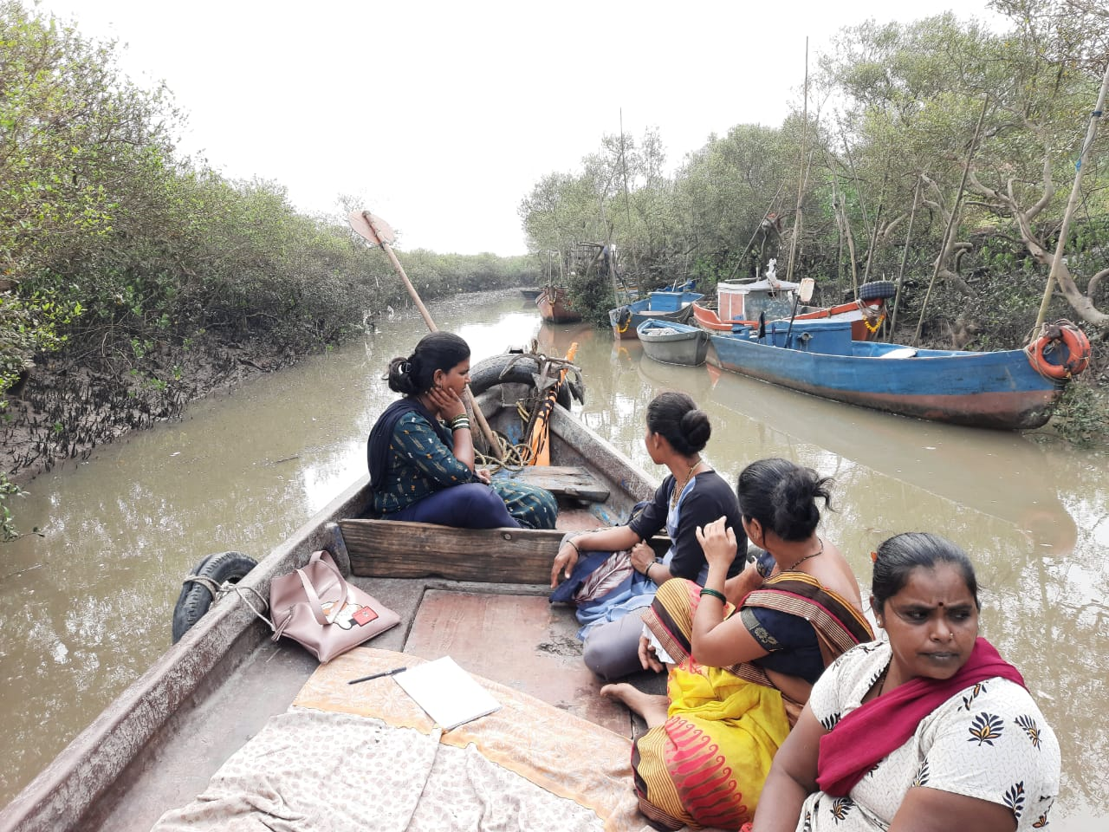
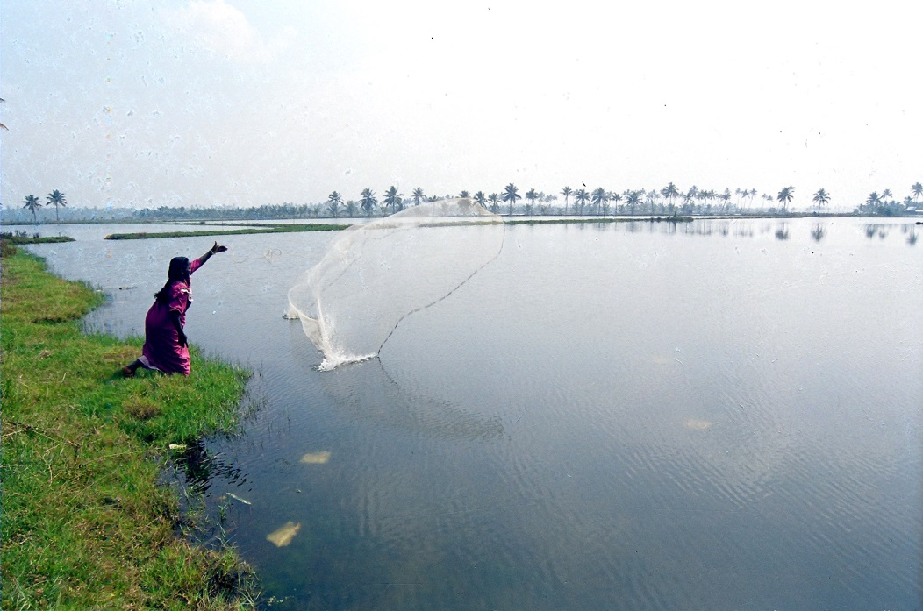
Women in small scale fish harvesting
Evidence from small scale fisheries
Women fish in various water bodies
Reservoirs
Lakes/ rivers
Kole lands
Estuaries & Backwaters
Beels & ponds
Types of fishing
Gleaning
Coracle fishing
Gill net fishing
Fishing using traditional gear

Slide 9
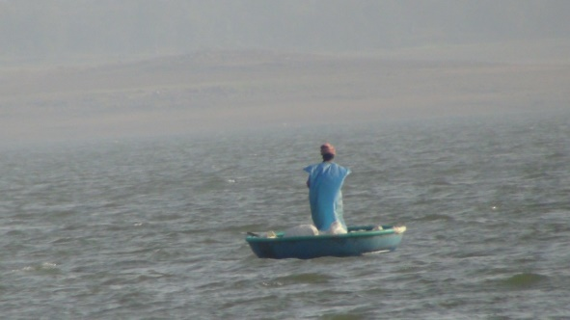
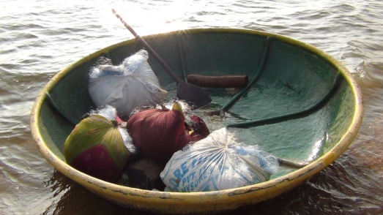
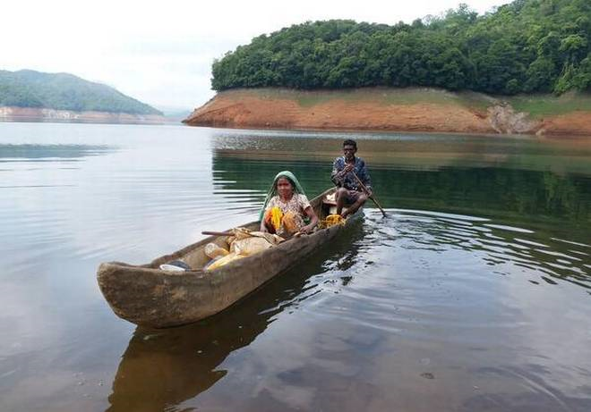
Women in small scale fish harvesting
Women in small scale fish harvesting
Reservoirs
Krishna Raja Sagar reservoir, Karnataka, India (Velumani et. al., 2018)
Tribal fishers in Idukki reservoir
Source: https://www.thehindu.com/news/national/kerala/where-tribespeople-fish-for-a-living/article27153494.ece

Slide 10
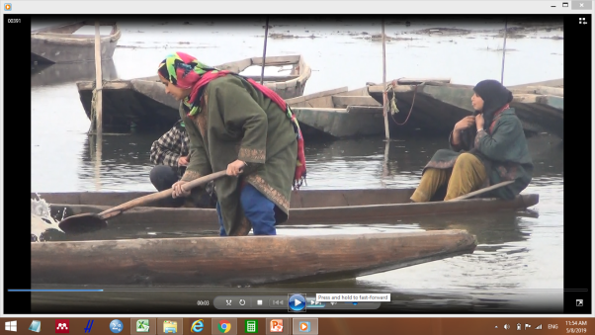
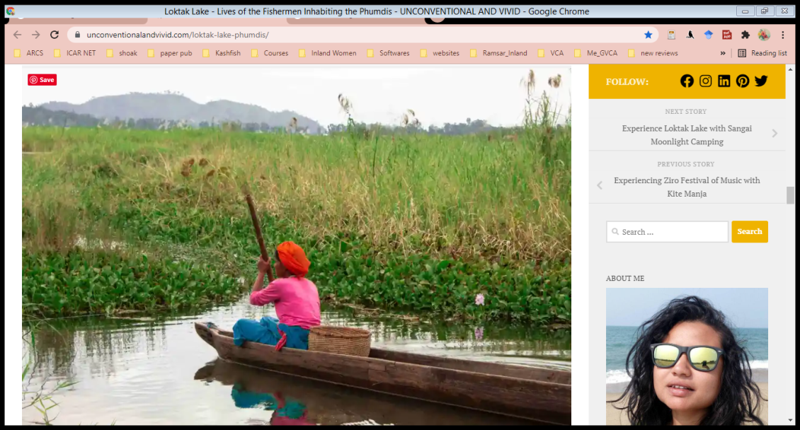
Women in small scale fish harvesting
Women in small scale fish harvesting
Lakes/ rivers
Wular Lake (Jammu & Kashmir) (Regu and Ananthan, 2021)
Loktak Lake ( Manipur) (Gurumayum et al., 2006)

Slide 11
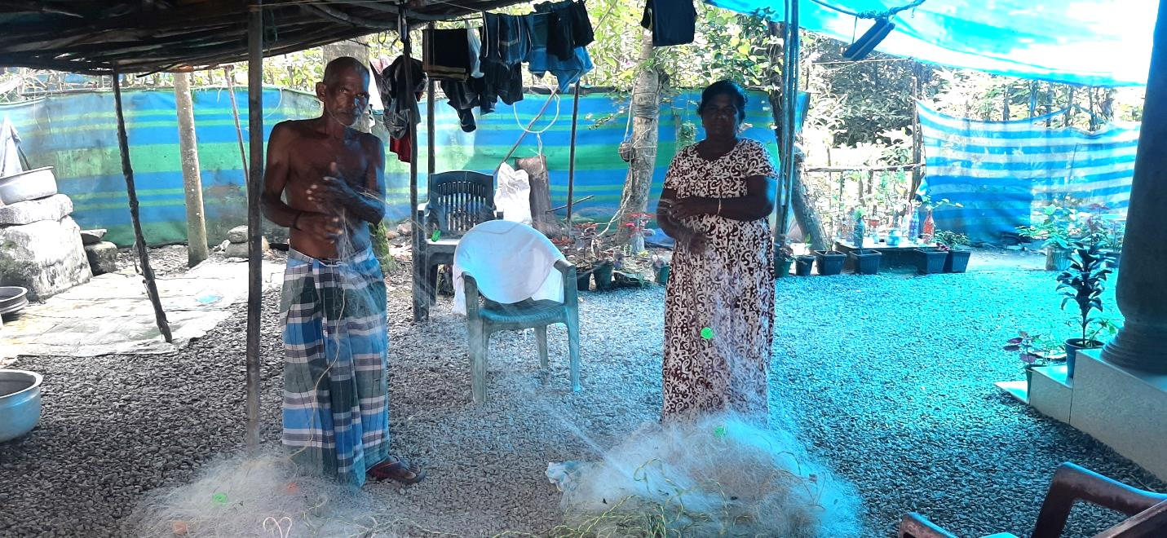
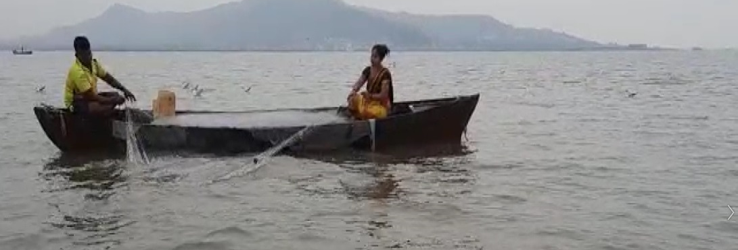
Women in small scale fish harvesting
Women in small scale fish harvesting
Estuaries & Backwaters
Activity | Man | Woman
Fishing | ✓ | ✓
Sorting of catch | ✓ | ✓
Marketing | ✓
Net mending | ✓ | ✓
(Gopal, et.al, 2021)
Gill net fishing in Vembanad backwaters, Kerala
Activity | Man | Woman
Fishing | ✓ | ✓
Sorting of catch | ✓ | ✓
Marketing |  | ✓
Net mending | ✓ | ✓
(Priyanka and Ananthan, 2021)
Gill net fishing, Raigad, Maharashtra

Slide 12
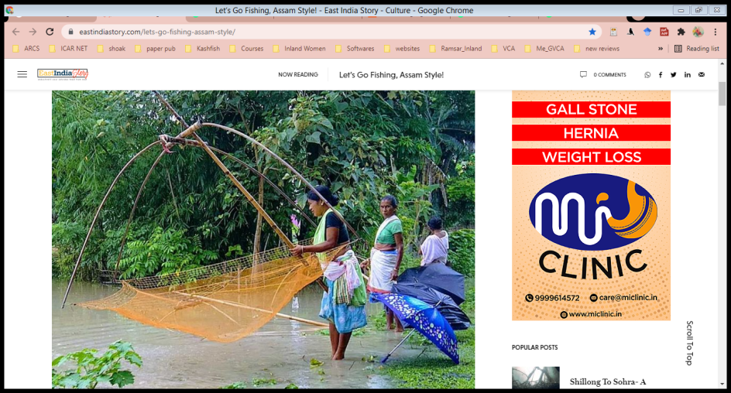
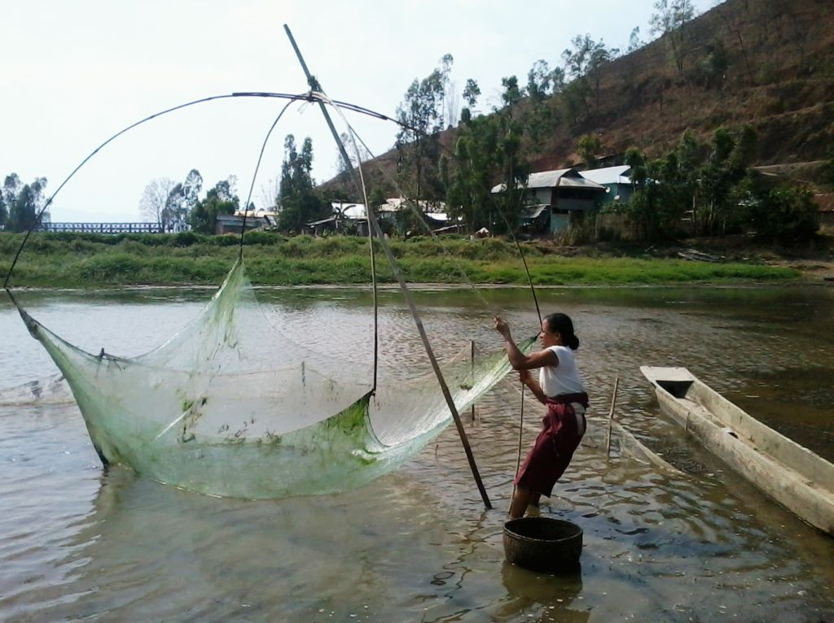
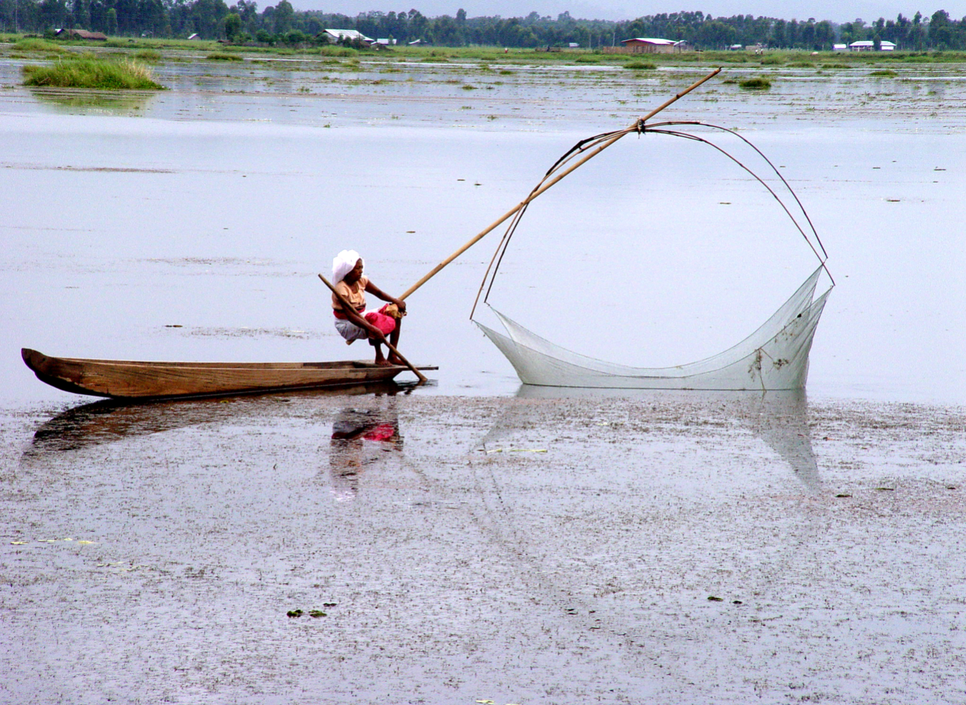
Women in small scale fish harvesting
Women in small scale fish harvesting
Beels & ponds
(Regu and Ananthan, 2021; Gopal, et.al, 2012)

Slide 13
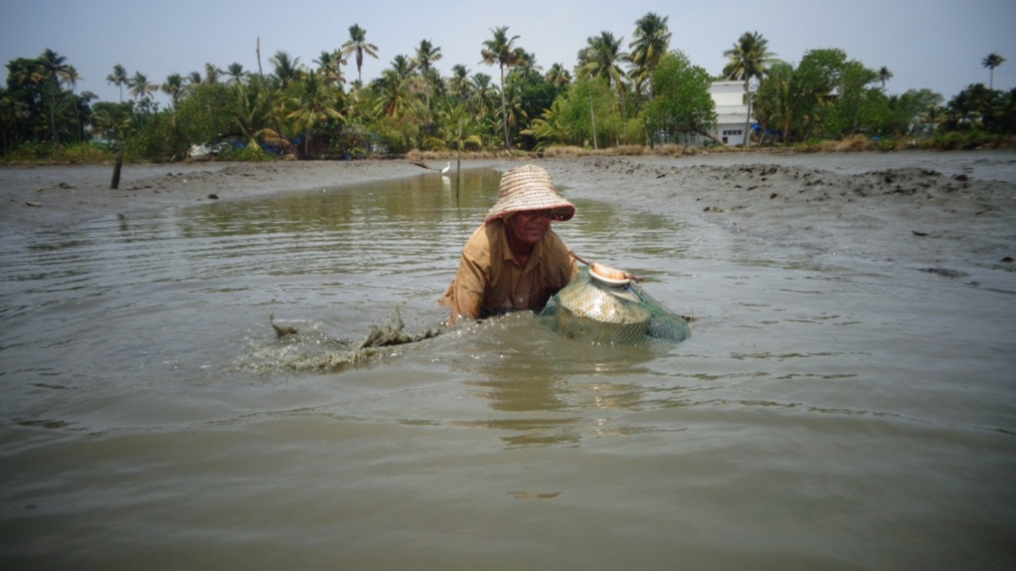
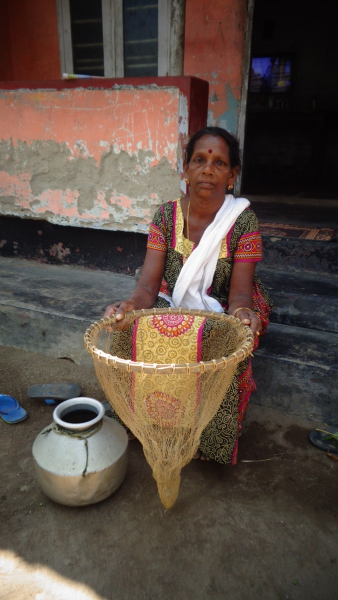
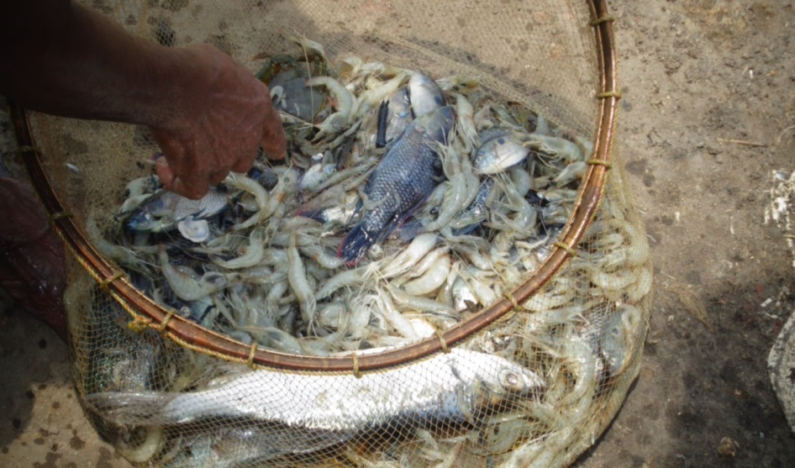
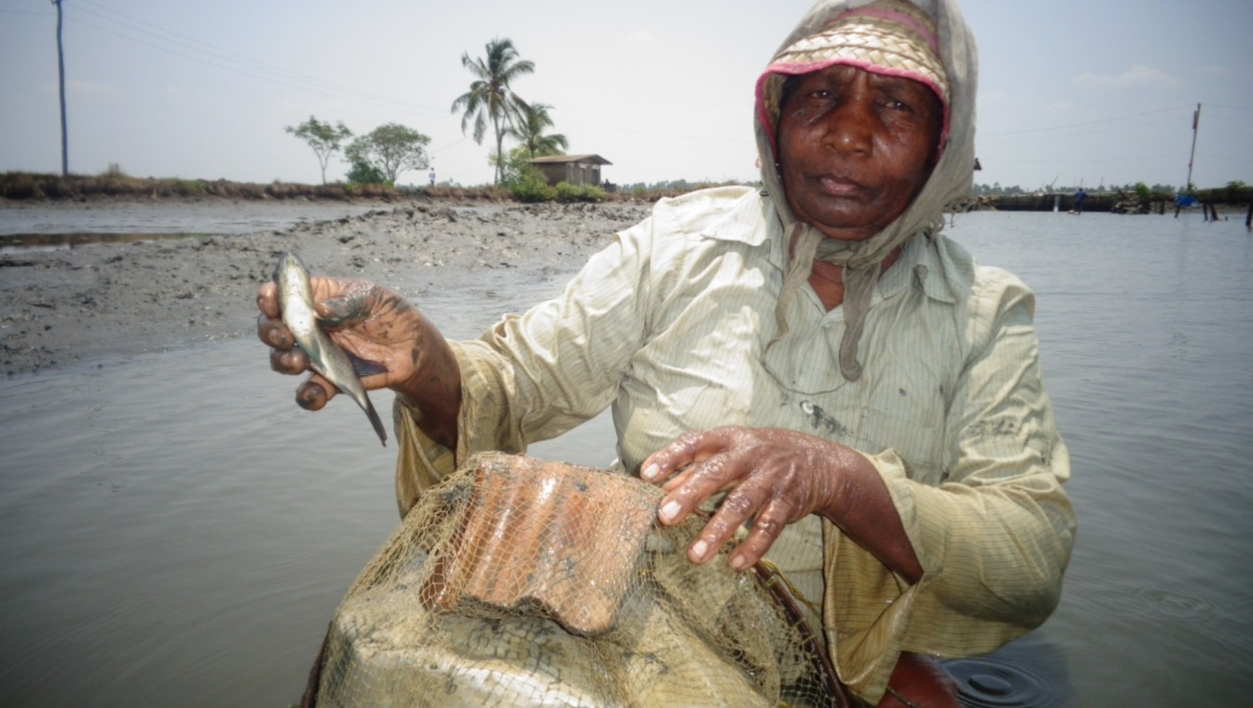
Women in small scale fish harvesting
Women in small scale fish harvesting
Paadams/kettus(alternate rice-fish)/ prawn filtration-farming areas/ paddy fields

Slide 14
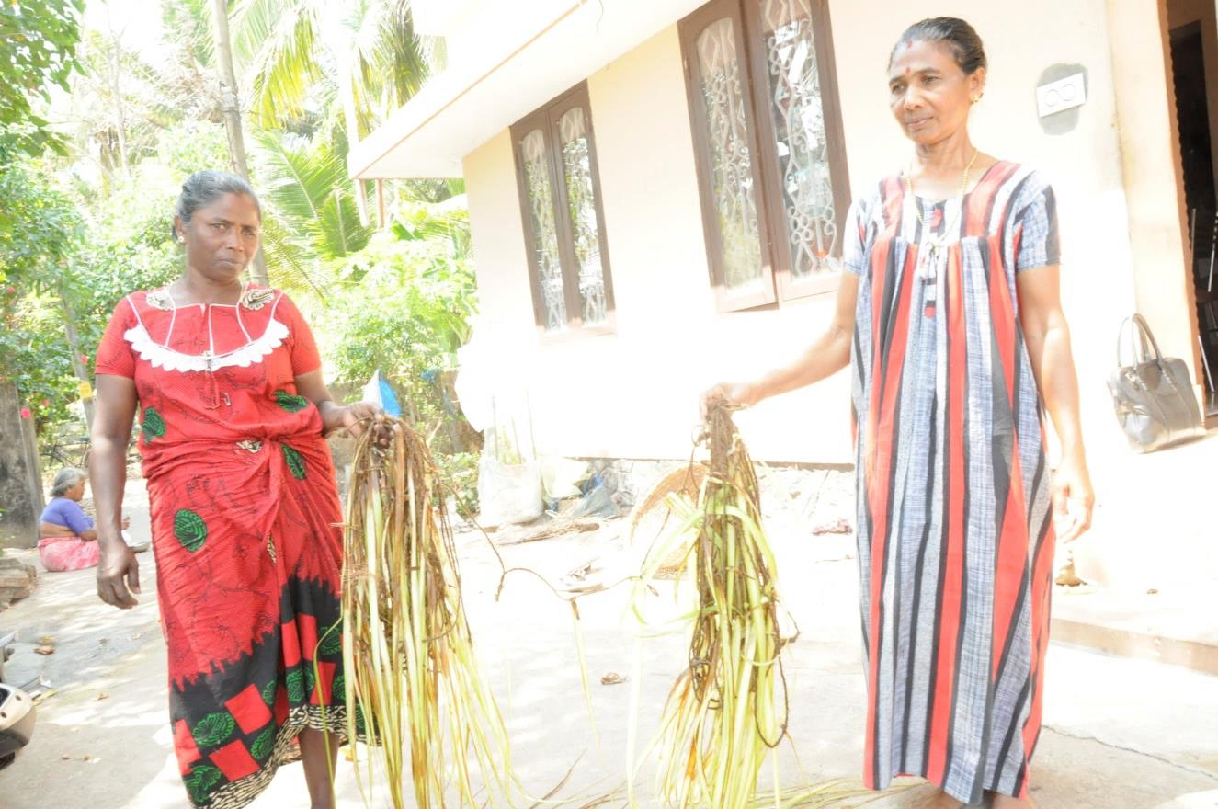
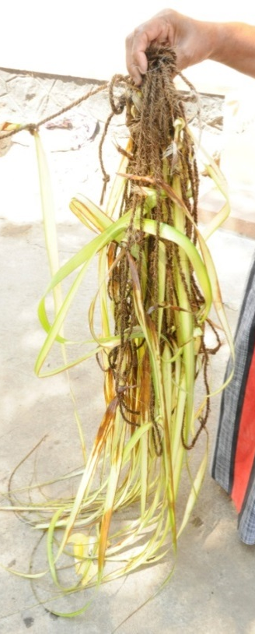
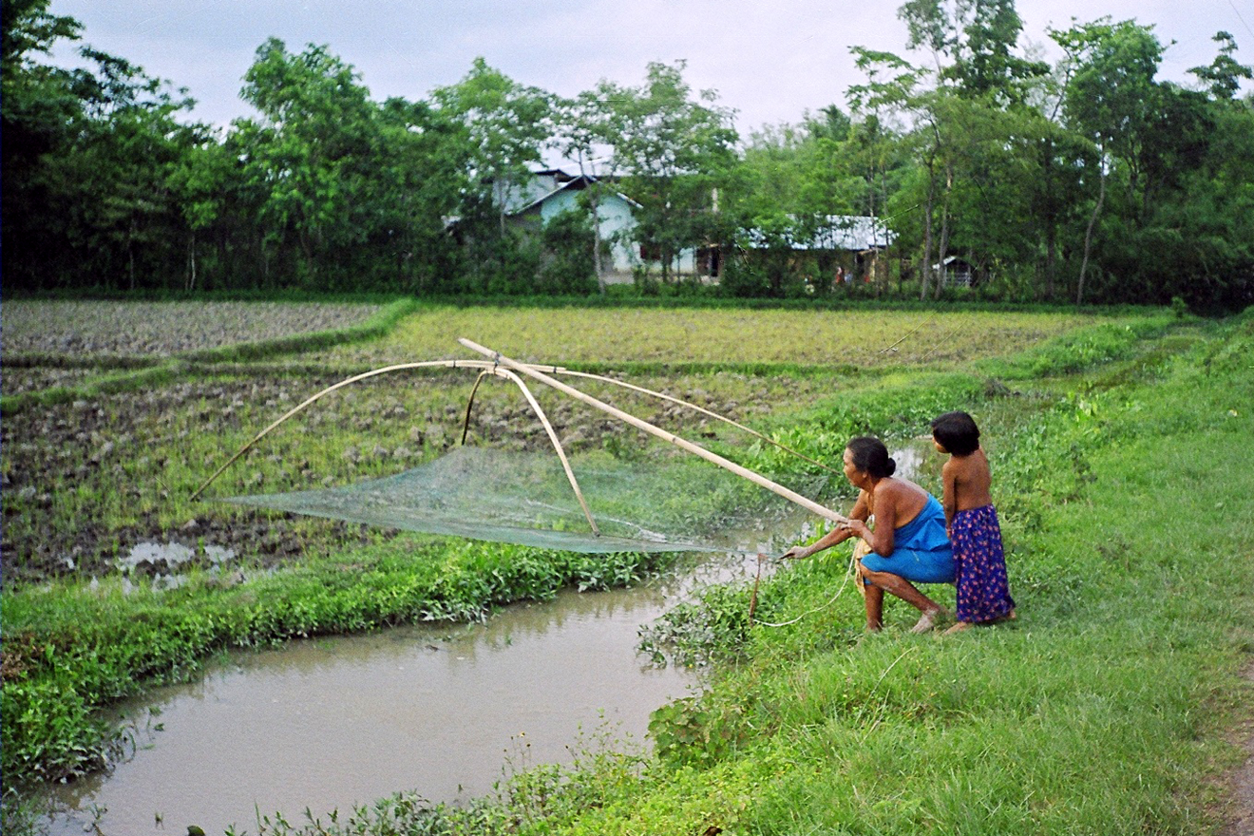
Women in small scale fish harvesting
Women in small scale fish harvesting
Paadams/ Kettus (alternate rice-fish)/ prawn filtration-farming areas/ paddy fields

Slide 15
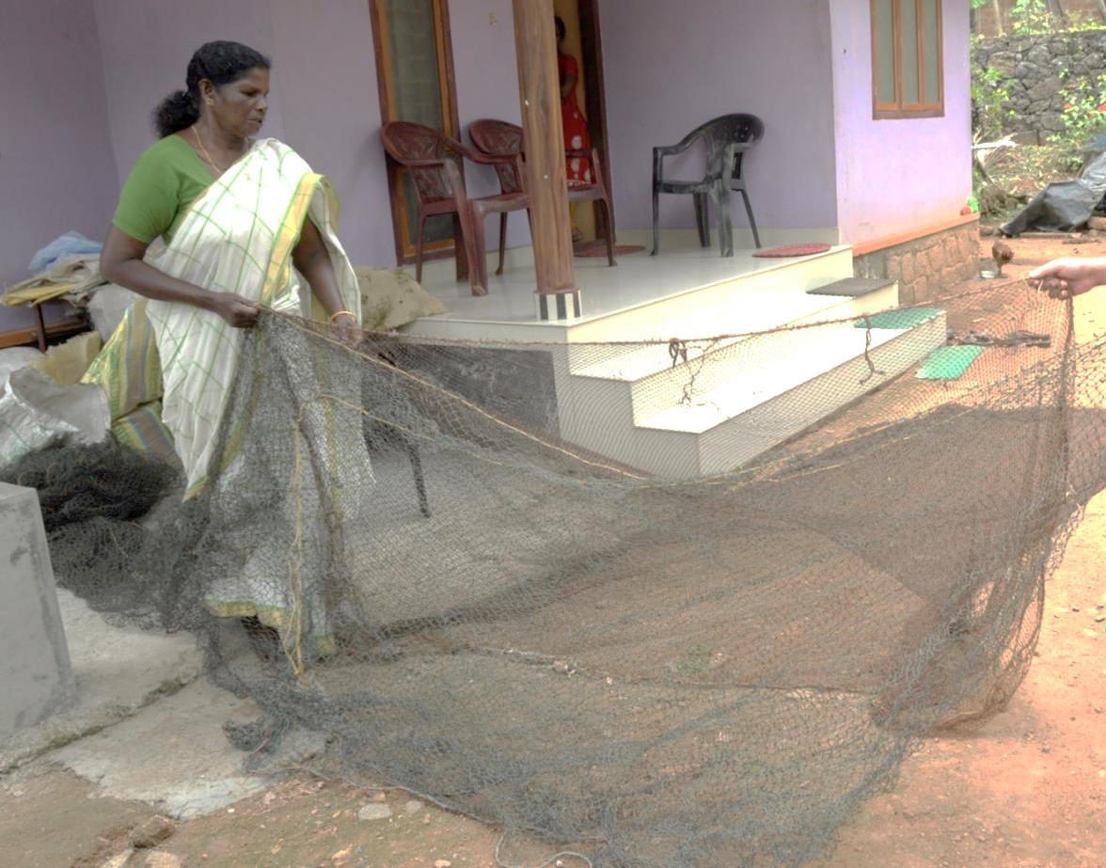
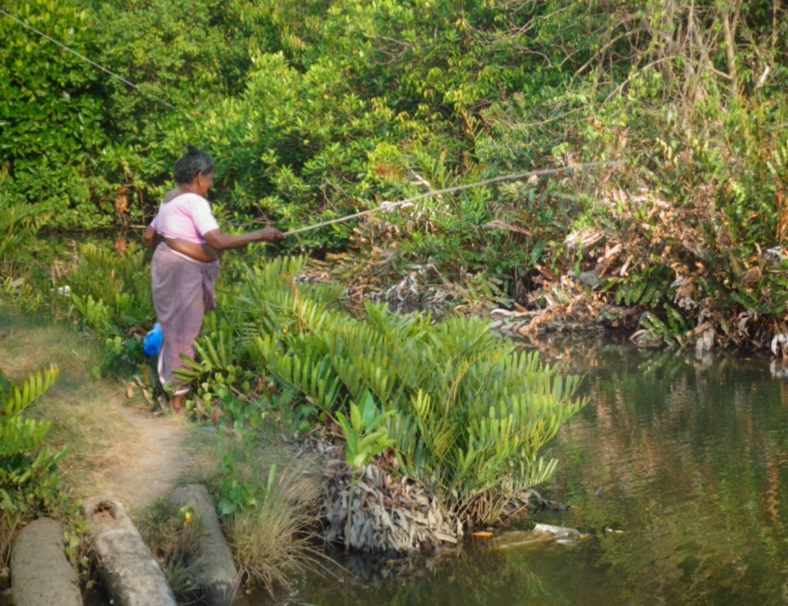
Women in small scale fish harvesting
Women in small scale fish harvesting
Paadams/ Kettus (alternate rice-fish)/ prawn filtration-farming areas/ paddy fields

Slide 16
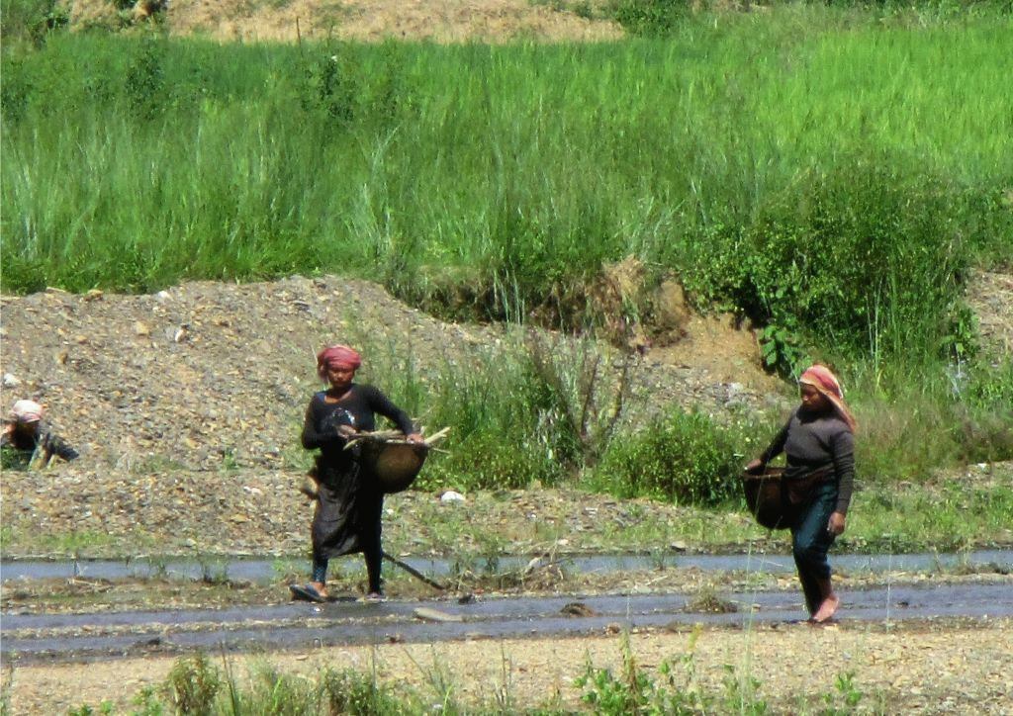
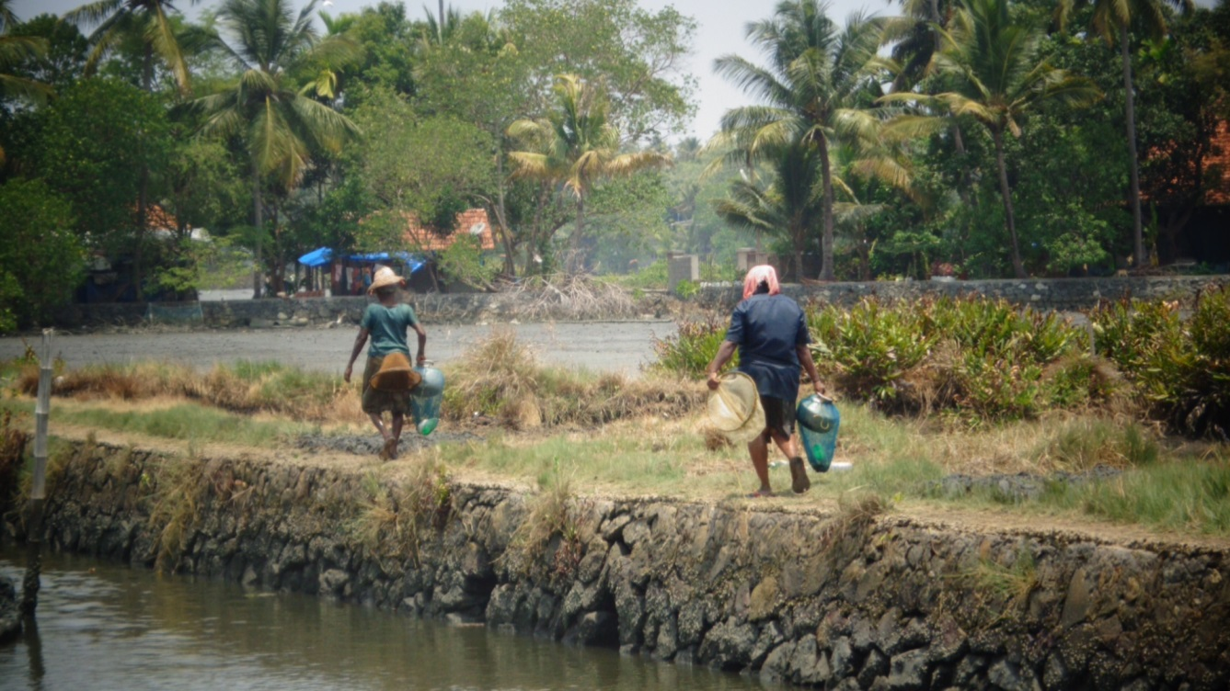
Women in small scale fish harvesting
Women in small scale fish harvesting
Community fishing
Picture courtesy (Long Khonba Community fishing): Dr. Shaikhom Inaotombi
Gender in Aquaculture and Fisheries: The Long Journey to Equality Asian Fisheries Science Special Issue 29S (2016): 181-191 Asian Fisheries Society ISSN 0116-6514

Slide 17
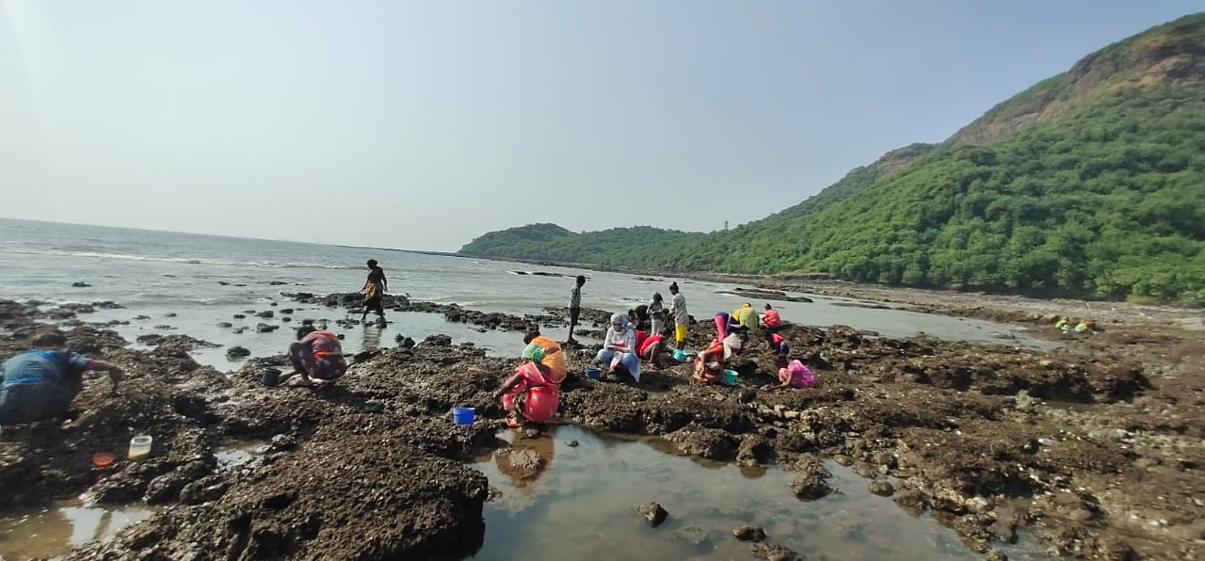
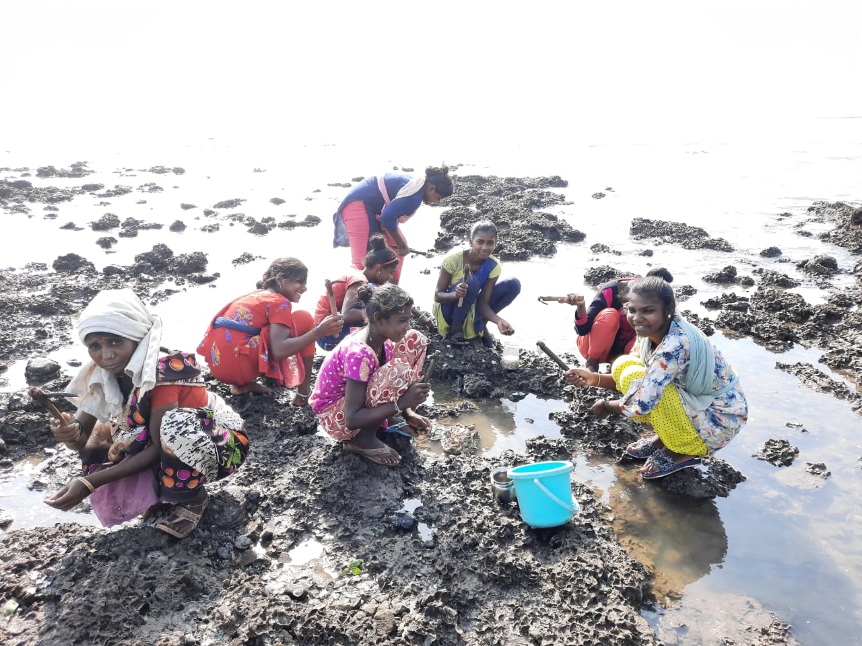
Women in small scale fish harvesting
Women in small scale fish harvesting
Coastal creeks
(Priyanka and Ananthan, 2021)

Slide 18
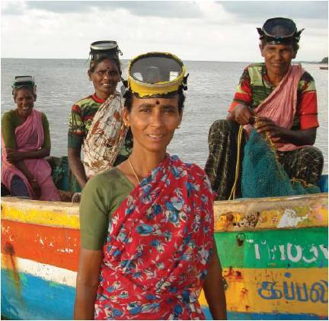
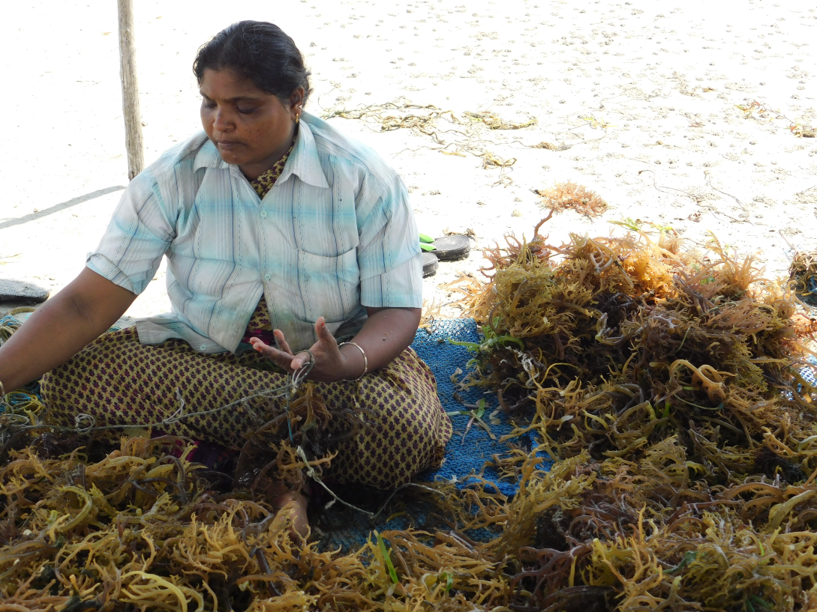
Women in small scale fish harvesting
Women in small scale fish harvesting
Marine – seaweed harvesters and farmers
Picture Courtesy: https://www.genderaquafish.org/discover-gaf/gaf-networks-and-resources/women-divers/
Picture Courtesy: Dr. Swathileakshmi P S, ICAR-CMFRI

Slide 19
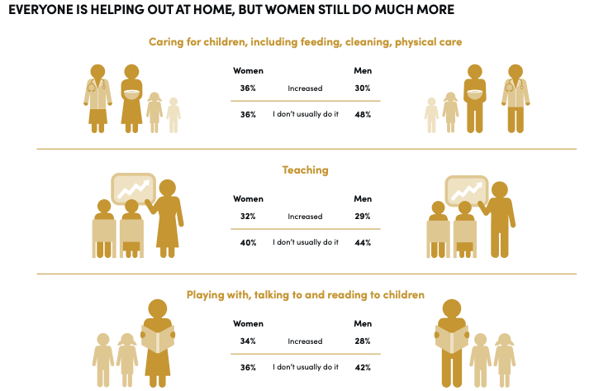
….persistent issues have been exacerbated during the pandemic
Impacts of COVID-19
Source: COVID-19: How women are bearing the burden of unpaid work | World Economic Forum (weforum.org)

Slide 20




Impacts of COVID-19

Slide 21


Impacts of COVID-19
Women being trained in using the kiosk at ICAR-CIFT under the SAF collaborative program

Slide 22

Conclusions
Women are engaged in various activities in small-scale fish value chains
Their work makes significant contributions to household income and nutritional security
Women are a major workforce in fish harvesting all across the country
Impacts of different stressors different on men and women

Slide 23
Recommendations
Gender should be central to policy development in the sector
Recognition of all women workers as fish workers
Comprehensive census to generate on-the-ground factual information on women and their contributions
Gender inclusive and sensitive policy and programs, especially for mitigating disasters and other risks
Needs of women fishers to be taken into account when fisheries related infrastructure is being developed (markets, landing centres etc.)
Ensuring equal access to all resources

Slide 24


Women in small scale fish harvesting
Rekha, the only licensed fisherwoman in India
Source: Home / India News / Meet India’s first and only licensed fisherwoman, KC Rekha; INDIA NEWS

Slide 25

Thank you!
This presentation was first made at the webinar on Women Work in Fisheries Too! in November 2021 which was organized by GAFS of the AFS in collaboration with USAID, CTI, SOFTI and ICAR-CIFT

