Slide 1
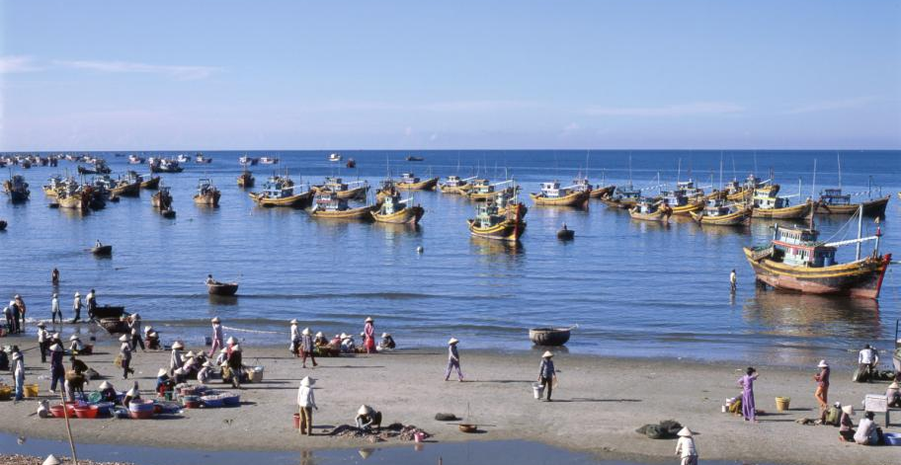
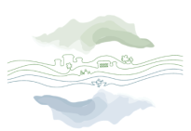
Small-scale Fisheries Governance Training Course for Asia – November 2021
Creating an enabling environment for SSF Guideline implementation
©️Evgeny Nelmin
Social Development, Employment and Decent Work
Sebastian Mathew, ICSF
CBC Building, Kirstenbosch
Rhodes Drive, Newlands
Cape Town, South Africa
Tel: +27 21 799 8491
Website: www.ioisa.org.za
Notes:
For final: group image and copyright

Slide 2
SSF Guidelines
Complement the 1995 Code of Conduct for Responsible Fisheries (EAF)
To create conditions for small-scale fishers to move towards sustainable fisheries and to create an enabling environment for sustainable development
Reconcile an ecosystem-based approach with the complexity of livelihoods in the SSF subsector (balancing ecological well-being, social well-being)
Social development of small-scale fishing communities is assumed to help realize the human rights and empowerment of small-scale fishing communities, and enjoyment of human rights is seen as a prerequisite for social development

Slide 3
What is social development?
A concept that originated in the 1920s (Leonard T. Hobhouse, British sociologist who tried to reconcile liberalism with collectivism for social progress)
Social development signifies the overall well-being of the people, the community, and the society (Oxford Encyclopaedia of Social Sciences)
Social development brings attention to the poor and disadvantaged, including the vulnerable and marginalized
Social development advances human rights, social and economic equality and inclusion
Social development can be community-led, state-led or enterprise-led, or it can be a combination of these, and coordinated by the state under an “institutional approach”

Slide 4
Principles of social development
Affordability
Extending preferential treatment (of women, Indigenous Peoples, the vulnerable and marginalized groups, children, older persons, subsistence, occasional, part-time, full-time and formal or informal fishers and fishworkers)
Providing equitable benefits
Fair treatment of all

Slide 5
Decent Work
Decent: satisfying a fair standard (OED)
Protecting and promoting decent work and fair returns to their labour in small-scale fisheries (productive employment, protecting rights at work, providing social protection and social security to women, Indigenous Peoples, vulnerable and marginalized groups, informal workers, and migrants)
Decent work in both formal and informal fisheries sectors along the value chain to ensure sustainable small-scale fisheries

Slide 6
Social Security and Social Protection
Social security is a human right (Article 22, UDHR) and includes nine branches: child and family benefits, maternity protection, unemployment support, employment injury benefits, sickness benefits, health protection (medical care),old age benefits and invalidity/disability benefits (ILO World Social Protection Report 2020-22)
Social protection covers a broad range of services in addition to “social security” and include: protection provided between family members, between members of a local community, and measures addressed to the poorest, most vulnerable or marginalized members of society (ibid.)

Slide 7
Occupational Health, Forced Labour
Adopting legislation to deal with occupational safety and health (OSH) issues and unfair working conditions of small-scale fishers and fishworkers
Integrating OSH into fisheries management
Eradicating forced labour in fisheries, including small-scale fisheries (forced labour refers to a situation where work or service is exacted from people under the menace of any penalty, and for which they have not offered themselves voluntarily (ILO Forced Labour Convention, 1930--the most widely ratified ILO Convention)

Slide 8
Protection of migrant workers
Need to facilitate fair and adequate integration of migrants into small-scale fisheries and recognize coordinated migration of fishers and fishworkers into small-scale fisheries in consultation with small-scale fisheries organizations

Slide 9
Investing in Social Development
Investing, creating and providing access to:
Food, clothing, housing, sanitation, health services, drinking water and energy
Education, literacy and digital inclusion
Saving, credit and insurance
Ensuring access to justice (environmental, social, and economic)
Improving sea safety and disaster management
protecting access to customary fishing grounds
Providing decent work opportunities

Slide 10
Achieving social development
Adhering to national, regional and international human rights standards
Encouraging conservation and sustainable use of fishery resources
Adopting inclusive, non-discriminatory and sound economic policies
Promoting alternative income generating opportunities
Providing an environment free from crime, including from organized crime, violence, piracy, theft, sexual abuse, corruption and abuse of authority
Respecting coordinated migration of fishers across national boundaries

Slide 11
Demonstrating social well-being due to social development
Duty to create the enabling conditions of social development goes beyond the mandate of fisheries authorities or the capacities of fishing community collectives
Need for effective governance (robust institutions, sound mechanisms and meaningful processes) at various levels, applying a human rights-based approach

Slide 12
Social Development and Indonesia
Social welfare and social justice are enshrined in the 1945 Constitution of Indonesia
Right to social welfare under the 1999 legislation concerning human rights (39 of 1999)
Law (UU) No. 27/2007 coastal areas as a national asset to be managed for the greatest benefit of the people, with a focus on: protecting, conserving, rehabilitating, using, and enriching coastal resources; strengthening the role of communities in their management; and enhancing their contribution to social and economic development
Ministerial Decree 572, 573: Western Indian Ocean of Sumatera; Southern Indian Ocean of Java
Increasing the benefit of sustainable fisheries for social welfare.
Increasing fishers’ income up to Provincial Minimum Wage
Ministerial Regulation (89): Social Assistance Grants for Empowerment of Coastal Communities

Slide 13
Social Development and the Constitution of the Philippines
1987 Constitution (rights-based approach): Promotion of social justice, provision of adequate social services at affordable cost, full employment, social security; protection of the rights of workers; rights of indigenous communities; strong emphasis on human rights (“Bill of Rights”)
Water rights, including for fisheries
Reduce social, economic, and political inequalities
Creation of a Commission on Human Rights

Slide 14
Article XIII, Social Justice and Human Rights, R.P. Constitution
“The State shall protect the rights of subsistence fishermen, especially of local communities, to the preferential use of local marine and fishing resources, both inland and offshore. It shall provide support to such fishermen through appropriate technology and research, adequate financial, production, and marketing assistance, and other services. The State shall also protect, develop, and conserve such resources. The protection shall extend to offshore fishing grounds of subsistence fishermen against foreign intrusion. Fishworkers shall receive a just share from their labor in the utilization of marine and fishing resources.”

Slide 15
Social Development and Cambodia
Rights-based Constitution
Respect of human rights (UN Charter, UDHR), including women’s and children’s rights, are recognized
Right to social security; and social benefits to women are recognized

Slide 16
Social Development and Timor-Leste 2002 Constitution
Rights-based Constitution
Right to education, health, housing, “ecologically-balanced” environment, social assistance and the right to social security protection, among others, are recognized
Promote social development

Slide 17
Questions for Trainees
How is the rights-based approach of your national Constitution protecting the human rights of fishers, fishworkers and fishing communities and promoting their social development?
Do you think the social development of fishing communities (marine and inland) is on a par with the social development of other sections of society?
What are the elements of social development that are provided by fisheries administrations at the national, regional and local levels? Are there collaborative initiatives, for example, by fisheries authorities to gain support from other relevant line agencies?
What is the role of civil society organizations in enhancing social development of fishing communities?

Slide 18
Thank you!

