Slide 1
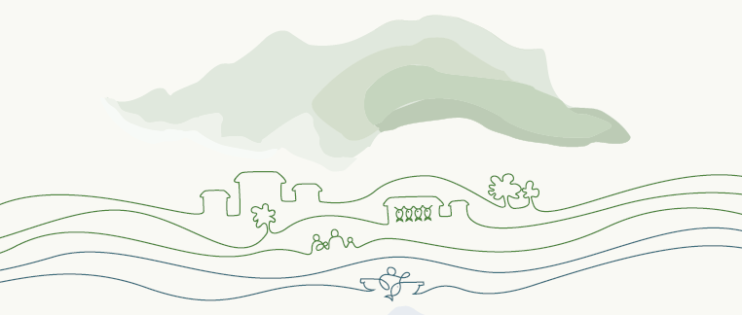
Philippine Policies and their Alignment with VGSSF
LUZON FISHERS’ CONSULTATION/WORKSHOP ON
VOLUNTARY GUIDELINES FOR SECURING SUSTAINABLE SMALL-SCALE FISHERIES (VGSSF)
Fersal Hotel, 130 Kalayaan Avenue, Diliman, Quezon City
March 27-28, 2019

Slide 2
What is the VGSSF?
First international instrument dedicated entirely to the immensely important – but until now often neglected – small-scale fisheries sector
A complement to the 1995 FAO Code of Conduct for Responsible Fisheries (the Code)
Complements other international instruments such as Right to Food Guidelines, Voluntary Guidelines on Responsible Governance of Tenure of Land, Fisheries and Forest

Slide 3
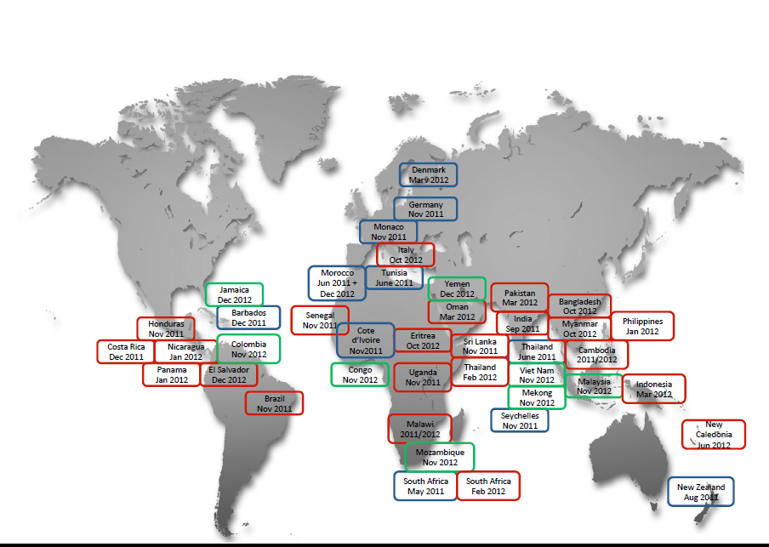
Countries Covered by the Consultation

Slide 4
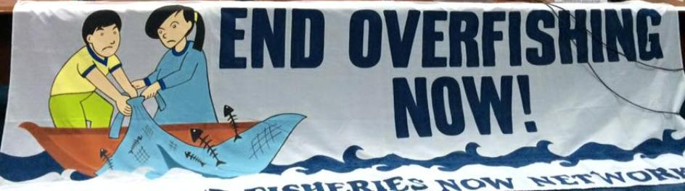
Purpose of the VGSSF
Small-scale fisheries (SSF) = ensuring food security and eradicating poverty
SSF is facing intense pressure from other sectors such as tourism, aquaculture, agriculture, energy, mining, industry
VGSSF = guidance to address the needs of the sector for sustainable small scale fisheries

Slide 5
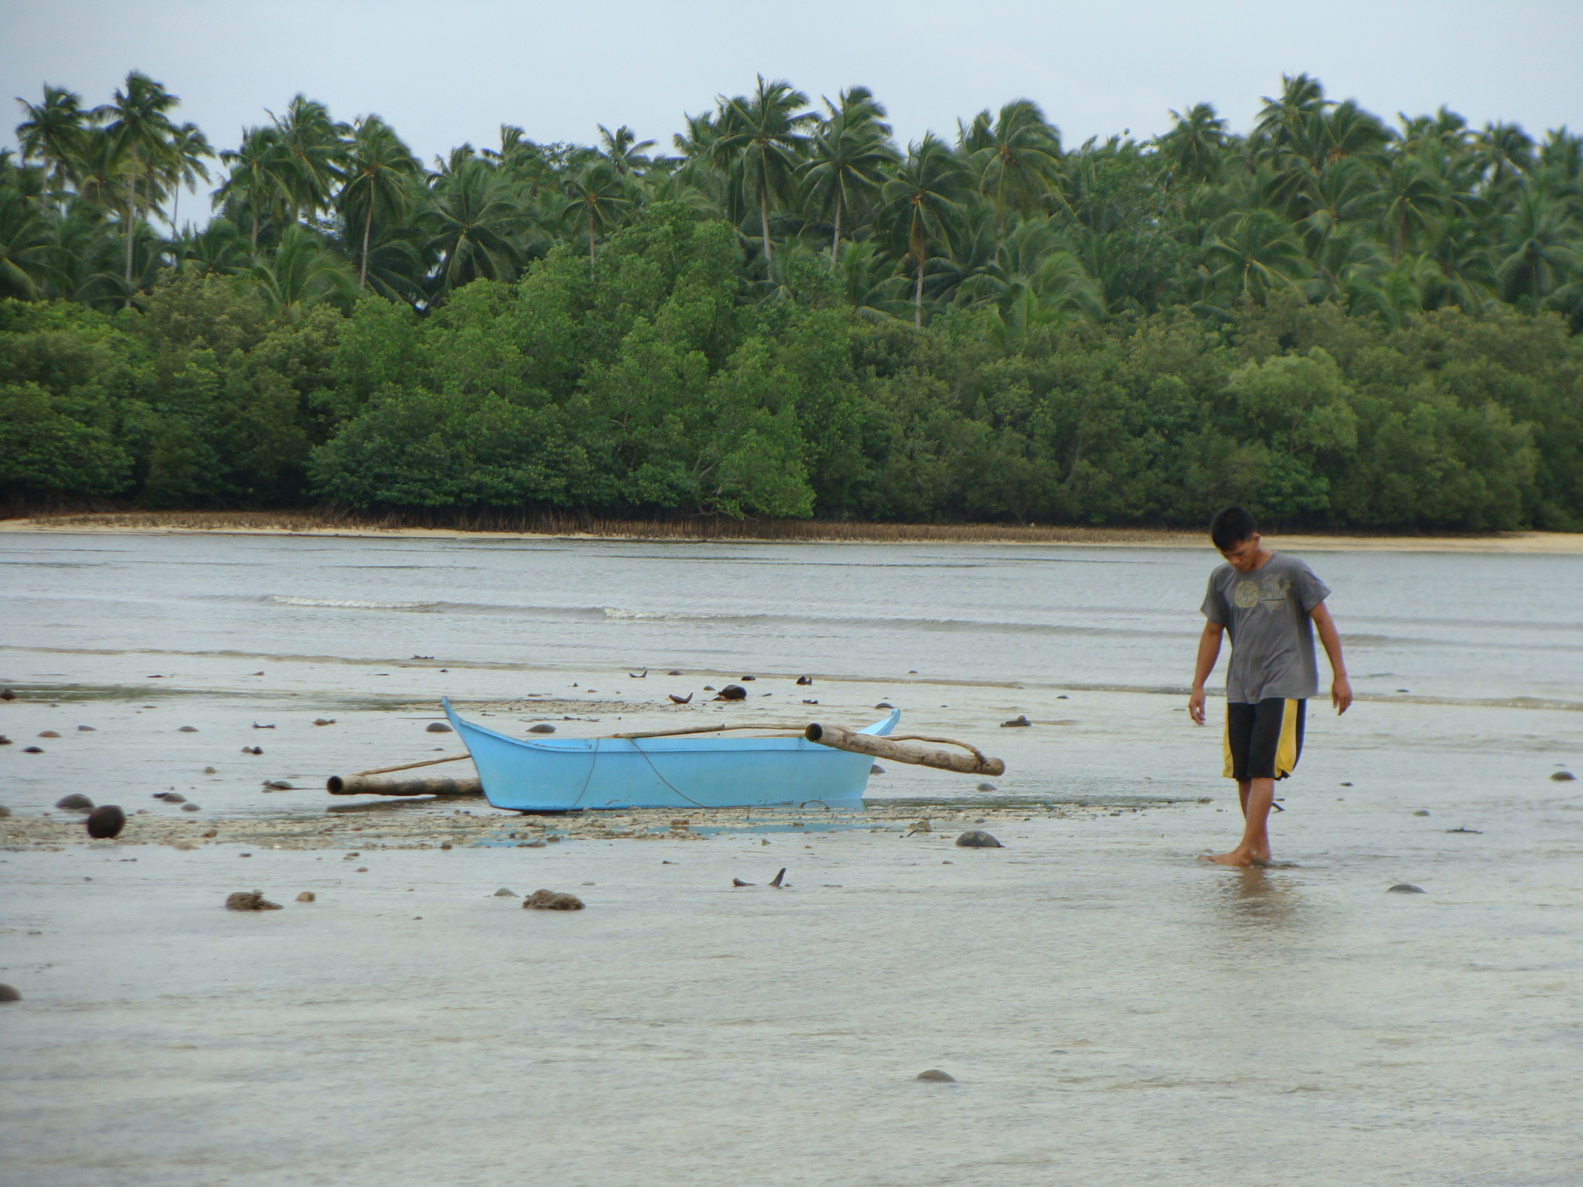
Relevance to the Philippines
Small-scale fishers are considered among the poorest of the poor and receive the least support from the government
Fishing grounds are overfished
Implementing the VGSSF in the Philippines will help address issues and concerns of the municipal fishers:
  Secure tenure rights to resources
  Measures for long-term conservation and sustainable use of fishery resources
  Preferential treatment of vulnerable groups
  Adequate standard of living
  Support for all activities along the value chain
  Support to address disaster risk and climate change

Slide 6
Responsible Fisheries and Sustainable Development
Voluntary Guidelines for Securing Sustainable Small Scale Fisheries (VGSSF)
Guiding Principles
Relationship with Other International Instruments
1 Introduction
2 Responsible Fisheries and Sustainable Development
Governance of Tenure in Small Scale Fisheries and Resource Management
Social Development, Employment and Decent Work
Value Chains, Post-Harvest and Trade
Gender Equality
Disaster Risks and Climate Change
3 Ensuring an Enabling Environment and Supporting Implementation
Policy Coherence, Institutional Coordination and Collaboration
Information, Research and Communication
Capacity Development

Slide 7
PART 1: Introduction
Unang bahagi: Panimula
Addresses guiding principles and relationship with other international instruments
Focuses on State obligations under international human rights instruments
4 Topics:
Objectives
Nature and Scope
Guiding principles
Relationship with other international instruments
Notes:
Mention in brief what are the objectives and nature and scope

Slide 8

PART 2: Responsible Fisheries and Sustainable Development
Ikalawang bahagi: Responsableng Pangingisda at Likas-kayang Pag-unlad
5 Topics:
Governance of tenure in small-scale fisheries and resource management
Social development, employment and decent work
Value chains, post-harvest and trade
Gender equality
Disaster Risks and climate change

Slide 9
PART 3: Ensuring an Enabling Environment and Supporting Implementation
Ikatlong bahagi: Pagtitiyak at Pagsuporta sa Pagpapatupad
4 Topics:
Policy coherence, institutional coordination and collaboration
Information, research and communication
Capacity development
Implementation support and monitoring

Slide 10
PART 3 – Ensuring an Enabling Environment and Supporting Implementation
Policy coherence, institutional coordination and collaboration – States should adopt measures to ensure harmonized policies; should encourage networks and platforms for exchange of experiences and information among stakeholders
Information, research and communication –States should establish system of fisheries data collection relevant for decision-making; promote flow and exchange of information; promote transparency and accountability
Capacity development – to allow SSF to benefit from market opportunities, build resilience and adaptive capacity in relation to disaster risk management and climate change adaptation

Slide 11
PART 3 – Ensuring an Enabling Environment and Supporting Implementation
Implementation support and monitoring – These guidelines should be implemented in accordance with national priorities and circumstances. States should create awareness on the Guidelines through simplified versions with specific materials on gender

Slide 12
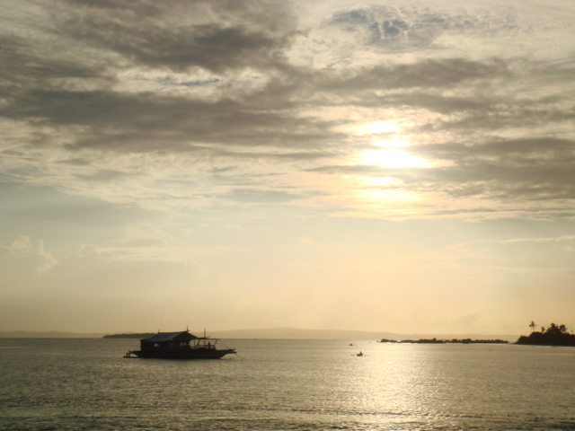
Philippine Policies and their Alignment with VGSSF

Slide 13
Before the VGSSF......
Issues in Philippine fisheries as early as the 1990s include declining fish catch due to destruction of coastal and marine resources
Local governments were called upon to address these concerns
There was a call to have a new Fisheries Code and this was approved in 1998

Slide 14
During the Philippine consultation for the development of the guidelines, the following were among the issues raised:
  SSF in the country “poorest of the poor”
  Backward technologies
  Has no security of tenure
  Resource use conflict

Slide 15
Study Objectives and Scope
Compare and analyze VGSSF and major policies and laws
  Identify areas of complementation or gaps
  Challenges related to natural disasters and climate change

Slide 16
Philippine Laws and Policies
Labor Code (1974), DAO 156-16 (2016)
  DO 156-16 requires fishing vessel owners to ensure compliance to existing laws, provide benefits and food to fishworkers, livelihood and income opportunities during closed season
Forestry Code (1975)
  Mangrove forests that protect coastal communities from the destructive force of the sea should be protected

Slide 17
Water Code (1976)
  Easement Zone – 3 meters in urban areas, 20 meters in agricultural areas, 40 meters in forest areas
Local Government Code (1991)
  DA-BFAR among the national agencies devolved
  Municipal waters – 15 kilometers from the shoreline

Slide 18
Republic Act 7586: The National Integrated Protected Areas System Act of 1992
  secure for the Filipino people the perpetual existence of all native plants and animals through the establishment of a comprehensive system of integrated protected areas
EO 263 – Community-Based Forest Management (1995)
  Access to forestland under long-term tenurial instruments
EO 273 – Philippine Plan for Gender-responsive Development 1995-2025
  Mainstreaming gender equity in public programs and policies

Slide 19
Agriculture and Fisheries Modernization Act (AFMA) (1997)
  Modernization
  Strategic Agriculture and Fisheries Development Zones (SAFDZ)
Indigenous People’s Rights Act (IPRA) (1997)
  Right to self governance and self-determination
  IPs rights to ancestral domains including critical natural resources

Slide 20
10. Fisheries Code (1998), amendments (RA10654)
BFAR AO 197-1
  Food security is the primary concern in the management of the fisheries
  Municipal waters for municipal fishers
  Fisherfolk settlement
  RA 10654 – improved the rules governing illegal, unreported, unregulated fishing
  BFAR AO 197-1: Policy on Aquasilviculture Stewardship Contract

Slide 21
Republic Act 9003: Ecological Solid Waste Management Act of 2000
  A Philippine law that can help control pollution, which is an important issue in the VGSSF
  Ensure protection of public health and the environment
  Guidelines and targets for solid waste avoidance and reduction through source reduction, among others.

Slide 22
Magna Carta of Women (2008)
  Local translation of Convention on the Elimination of all forms of Discrimination Against Women (CEDAW)
  Definition of “fisherfolk” (mangingisda) includes fishing related activities done by women, e.g. gleaning

Slide 23
Climate Change Act (2009), People’s Survival Fund (2012)
  Formation of the Climate Change Commission, National Climate Change Action Plan, Local Climate Change Action Plan
  PSF – budget for Adaptation projects
Philippine Disaster Risk Reduction and Management Act (2010)
  NDRRMC, LDRRMC
  NDRRM Framework at Plan, calamity fund = NDRRM Fund

Slide 24
Provincial/ Municipal or City/ Barangay Ordinances
Legislations approved from barangay councils are reviewed and concurred at the municipal level, and so on
Management of municipal waters through Comprehensive Municipal Fishery Ordinance
Municipal water delineation still a challenge
Fishery Management Areas –another platform for ecosystem approach to fishery management

Slide 25
Scoping of Roles
BFAR
  Principal agency for the management of the country’s fisheries and aquatic resources
  Assists LGUs on coastal resource management based on requests
  Implements ecosystem approach to fisheries management through FMAs
  FishR, BoatR, GearR, CFLCs
  Training focused on technologies, gaps on values orientation
  Assistance to LGUs on rapid assessments

Slide 26
Department of Agriculture
DA is the agency where BFAR is attached
Philippine Council for Agriculture and Fisheries (PCAF) – private-sector led consultative council
Another bureau that provides services to fisherfolk – Bureau of Agriculture and Fisheries Standards; formed by virtue of AFMA
Agricultural Credit Policy Council – attached DA agency that synchronizes credit policies and programs in support of DA priority programs
  Agriculture and Fisheries Financing Program – provides maximum amount of P300,000 as loan, priority is small fisherfolk

Slide 27
Department of Environment and Natural Resources
Primary agency responsible for conservation and management of natural resources
Forest Management Bureau is the agency responsible for forests, including mangroves
National Greening Program (NGP) flagship program , where fisherfolk can be involved through mangrove and beach forest management

Slide 28
Department of Labor and Employment
Primary agency responsible for labor and employment
To fulfil its mandate in the sector, issued DAO 156-16,

Slide 29
National Commission on Indigenous Peoples
Primary agency responsible for IPRA
Issue CADT, negotiate for funds and accept donations and grants subject for approval of the President
Programs and services:
  Policy services
  Certificate of ancestral domain title services
  Human and economic development services and
  IP rights protection services

Slide 30
Regional/Provincial/Municipal/Local
Management of community-based projects
Enforcement of fishery laws at the municipal water level
LGUs and relevant agencies should undertake land use planning as integral activity of comprehensive land use planning
Approve ordinances and resolutions for the protection of the environment and impose penalties for acts which endanger the environment

Slide 31


Issues and Recommendations
Notes:
Tenure – access to fishery including pre and post harvest
Health of ecosystem – fundamental basis for livelihood and contribute to overall well-being

Slide 32
Issues | Status
On Governance of Tenure of Small Fishers
Fisherfolk Settlement | No implementing rules and regulations (IRR) yet
Community Fish Landing Centers (CFLC) | The centers are envisioned to help secure fisherfolk access to the coastal area, but there is no clear monitoring mechanism whether the centers are indeed helpful on this matter
Municipal Water Delineation | No accepted guidelines for delineating municipal waters of municipalities with offshore islands Even municipalities without offshore islands not yet completed
Notes:
The coverage of Municipal waters as defined by the Local Government Code and the Fisheries Code is in direct conflict with the IPRA. As pointed out by the study made by Mr. De Vera and Zingapan, existing laws of the country do not vest private ownership to any body of water, which are considered a part of the Public Domain in perpetuity. Ancestral Waters of the IPs such as the one of Tagbanwa in Coron physically overlaps with the Municipal Waters of the LGU of Coron. Hence, issues and conflict in jurisdiction as well as authority to zone the ancestral waters vis-à-vis the Municipal waters and regulate activities arise.

Slide 33
Issues | Status
On Governance of Tenure of Small Fishers
Customary rights to aquatic resources and land and small scale fishing areas | Municipal waters as defined is in direct conflict with the IPRA. Existing laws of the country considered waters as part of the Public Domain in perpetuity. Hence, issues and conflict in jurisdiction as well as authority to zone the ancestral waters vis-à-vis the Municipal waters and regulate activities arise.
Notes:
The coverage of Municipal waters as defined by the Local Government Code and the Fisheries Code is in direct conflict with the IPRA. As pointed out by the study made by Mr. De Vera and Zingapan, existing laws of the country do not vest private ownership to any body of water, which are considered a part of the Public Domain in perpetuity. Ancestral Waters of the IPs such as the one of Tagbanwa in Coron physically overlaps with the Municipal Waters of the LGU of Coron. Hence, issues and conflict in jurisdiction as well as authority to zone the ancestral waters vis-à-vis the Municipal waters and regulate activities arise.

Slide 34
Issues | Status
On Sustainable Resource Management
On measures for long-term conservation and sustainable use of fishery resources | Fisheries production has remained relatively stagnant at 1-1.4 million metric tons per year. There is continuing degradation of the fishery resources due to prevalence of illegal activities. Mangrove destruction has been continuing. NGP has not provided enough help in rehabilitation because the suitability of species and planting sites are not considered. The program is too focused on number of propagules planted.

Slide 35
Issues | Status
On Social Development, Employment and Decent Work
Social and economic development of small scale fishers | Small scale fishers are still among the poorest of the poor, without adequate access to services including housing, basic sanitation, safe water, etc.
Decent work for fishworkers | There is no clear policy yet on ensuring decent work for fishworkers, with the latest draft department administrative order still not in effect

Slide 36
Issues | Status
On Disaster Risks and Climate Change
Differential impact of disasters and climate change on small scale fishers | Impacts on fishers:first to bear the brunt of extreme weather events, increase in sea surface temperatures already affect their livelihoods and rising tidal levels affect their settlement areas, but no clear policies on fisherfolk settlement are in place. The two major laws on disaster risks and climate change made no mention of securing the tenure of affected communities especially of small scale fishers

Slide 37
Issues | Status
On Policy Coherence, Institutional Coordination and Collaboration
Institutional structures for implementation of ecosystem approaches in fisheries sector | BFAR and DENR, are both devolved. Municipal waters are under the jurisdiction of LGUs. BFAR and DENR policies are not flowing smoothly at the local level. Not all LGUs have Fisheries Technician and Municipal Environment and Natural Resources Officers There is fragmentation of local governance - lack of consolidation of Comprehensive Land Use Plans (CLUPs) and Barangay Development Plans (BDPs), as well as lack of harmonization of CLUPs with Provincial Development Plans (PDPs). No clear policy on adopting Ancestral Domain Sustainable Development and Protection Plan (ADSDPP) of the IPs in the CLUPs or Municipal/City Development Plans (M/CDP)

Slide 38
Issues | Status
On Policy Coherence, Institutional Coordination and Collaboration
Spatial planning approaches for integrated coastal zone management | Mangroves, seagrass and coral reefs, the fish habitat, are under the DENR jurisdiction while the fish stock are under BFAR jurisdiction, limiting the options for holistic integrated coastal zone management. Natural resource degradation has been continuing in the inland and coastal waters leading to decline in fish catch, due to continued illegal activities not just in the waters but in agriculture and upland areas as well.

Slide 39
Recommendations
Issues | Recommendations
On Governance of Tenure of Small Fishers
Fisherfolk Settlement | Address the issue of fisherfolk settlement to secure tenure of fisherfolk. The comprehensive land use plans of the municipalities/ cities should include areas allocated for fisherfolk settlement Pass a National Land Use Act that includes specific provisions for fisherfolk settlement

Slide 40
Recommendations
Issues | Recommendations
Municipal Water Delineation | Address the gaps in municipal water delineation, including fast-tracking of delineation of waters of municipalities without offshore islands, and come up with guidelines for municipalities with offshore islands
Recognition of sectoral rights to governance including that of customary rights | Strengthen sectoral participation in legal and government processes. Their participation in policy making venues should include VGSSF provisions, thus, increasing understanding of VGGSF as well as capacity building of the sectors is crucial.

Slide 41
Recommendations
Issues | Recommendations
On Sustainable Resource Management
On measures for long-term conservation and sustainable use of fishery resources | Ensure that NGP implementation in the coastal and riverbank areas are led by fisherfolk communities in said areas Ensure small scale fishers’ roles in sustainable resource management through organizing and capacity building towards maximizing existing platforms such as Fishery Aquatic Resource management Councils (FARMCs), among others.

Slide 42
Recommendations
Issues | Recommendations
On Social Development, Employment and Decent Work
Social and economic development of small scale fishers | The Community Fish Landing Centers (CFLCs) was envision to reduce post-harvest losses as well as venues for skills trainings on disaster-resilient fisheries-based livelihoods and resource management such as monitoring fish catch and stock assessment. They are to be eventually managed by fisherfolk groups. Ensuring that operations of these centers indeed benefit the fisherfolks will help improve the social an economic situation of the small scale fishers. The NFARMC can be a platform for monitoring the CFLCs.

Slide 43
Recommendations
Issues | Recommendations
On Social Development, Employment and Decent Work
Decent work for fishworkers | Aside from ensuring the policies for fishworkers such as the DILG Department Order 156-16, programs and policies to ensure decent working condition and fair income for small scale fishers involved in the whole fisheries value chain should be in place.

Slide 44
Recommendations
Issues | Recommendations
On Disaster Risks and Climate Change
Differential impact of disasters and climate change on small scale fishers | Local level: policy advocacy to secure fisherfolk tenure in times of disasters and climate change impacts (e.g. sea level rise) National level: policy advocacy to look at sectoral impacts of disasters and climate change

Slide 45
Issues | Recommendations
On Policy Coherence, Institutional Coordination and Collaboration
Institutional structures for implementation of ecosystem approaches in fisheries sector | There should be feedback mechanisms for better-informed decisions: Between CSOs/ fisherfolk organizations and local government Internal to the government agencies, e.g. among bureaus, as national to regional Among LGUs especially those sharing the same fishing grounds Among devolved government agencies and their national level counterparts
Spatial planning approaches for integrated coastal zone management

Slide 46
  There should also be inter-agency collaboration for holistic approach to the fisheries issues, where each agency contributes efforts based on their respective mandates. There should be delineation and harmonization of roles for more holistic approach to fisheries issues.

