Slide 1
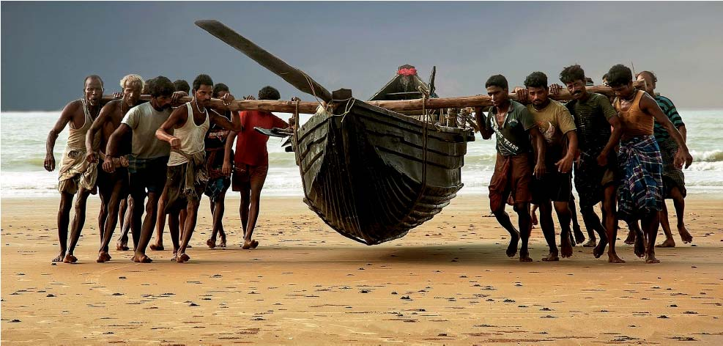
Implementing the SSF Guidelines in the Indo-Pacific Region: A CSO Perspective
Sebastian Mathew
Executive Director,
International Collective in Support of Fishworkers (ICSF)
The Seventh APFIC Regional Consultative Forum Meeting (RCFM), Cebu, 07 to 09 May 2018

Slide 2
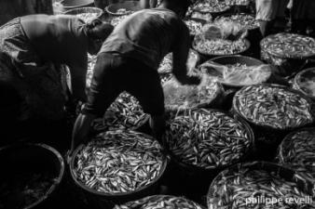
Functions and Responsibilities of APFIC
to formulate and recommend measures and to initiate and carry out programmes or projects to:
(i) increase the efficiency and sustainable productivity of fisheries and aquaculture
(ii) conserve and manage resources
(iii) protect resources from pollution
to keep under review the economic and social aspects of fishing and aquaculture industries and recommend measures aimed at improving the living and working conditions of fishermen and other workers in these industries and otherwise at improving the contribution of each fishery to social and economic goals

Slide 3
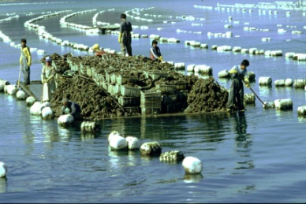
Blue Growth Initiative of FAO
emphasizes the ecosystem approach to capture fisheries and aquaculture
embraces the promotion of sustainable livelihoods for coastal fishing communities
Recognizes and supports small-scale fisheries and aquaculture development
Supports fair access to trade, markets, social protection and decent working conditions along the fish value chain

Slide 4
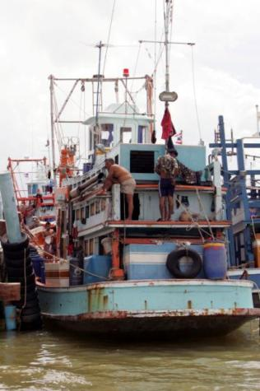
Fisheries in the Indo-Pacific Region (SOFIA 2016)
84 percent of the global population engaged in the fisheries and aquaculture sector are in Asia
75 percent of the global fishing fleet and 80 percent of engine-powered fishing vessels are in Asia (3.5 million vessels—mostly, less than 12 m LoA)
55 percent of global fish production is in Asia
More than two-thirds of fishers are in Asia
50 per cent of world exports for human consumption are from Asia
Most of the world’s undernourished people are in Southern Asia

Slide 5
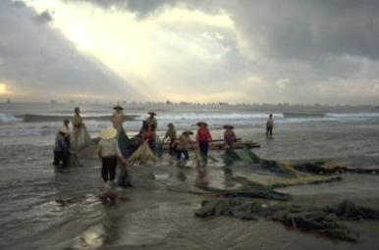
SSF Guidelines: Implementation Issues
Contextualizing the SSF Guidelines is important
Individual and collective human rights of fishers, fishworkers, and fishing communities, both men and women, are to be defended
Right to decent work of fishers and fishworkers including migrant workers are to be defended
Interaction between various social development actors in the context of fishing communities to be promoted
Collaboration with non-fisheries institutions, especially national human rights commissions to be encouraged
Action at local, provincial and state level needed with active participation of fishing communities and CSOs

Slide 6
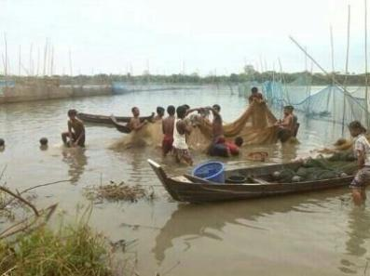
Implementation Issues (Cont.)
Developing clarity on implementation issues at various levels (local, sub-regional, national, regional)
What SSF actors could implement alone (vertical linkages) or in partnership with the State
What SSF actors could implement in partnership with CSOs from other sectors (horizontal linkages)
What others implement at the behest of SSF actors
Creating conditions for implementation (legislation, policy, strategy, coherence, etc.)

Slide 7
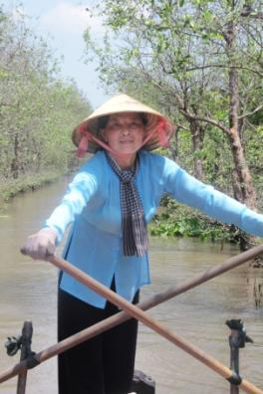
Implementation of the SSF Guidelines in Asia: State-led
National Plan of Action for the development of small-scale fisheries, Indonesia (2015 draft)
National Policy on Marine Fisheries, 2017, India, recommends implementing the SSF Guidelines
Implementation Plan under the National Policy includes developing and elaborating action points for the SSF Guidelines with timelines
Advancing regional approaches in securing sustainable small-scale fisheries (SEAFDEC) (applying human rights-based and gender equality approaches)
Regulatory framework review; participatory assessment of the community fisheries; and pilot projects (Cambodia)

Slide 8
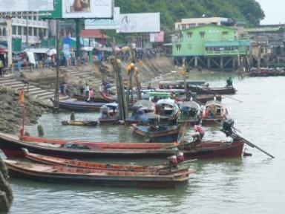
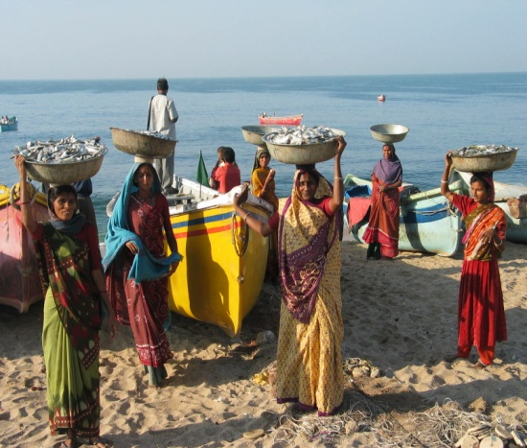
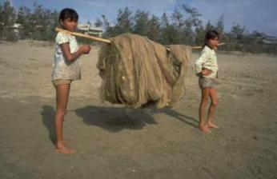
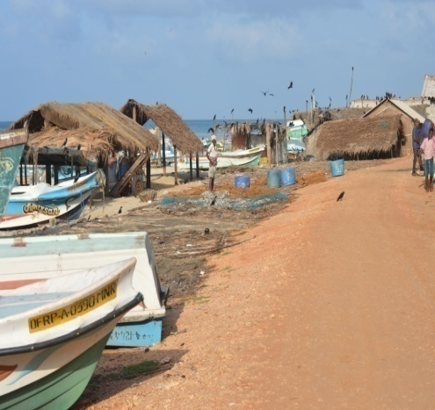
Implementing the SSF Guidelines in Asia: CSO Activities 2018-19
Applying the Guidelines to improve sea safety and disaster preparedness (India)
Raising awareness about the SSF Guidelines at the local and subnational level (India, Indonesia, Sri Lanka)
Proposing action points for implementing the SSF Guidelines (India)
Applying the Guidelines to improve fisheries co-management (Myanmar, Viet Nam)
Applying the Guidelines to protect the rights of fishers and to increase visibility of women in fisheries (Thailand)
Integrating the SSF Guidelines into national policies and legislation (The Philippines)
Developing guidelines on chapter 6 of the Guidelines (social development, employment and decent work)
Producing promotional material (infographics) on various chapters of the Guidelines

Slide 9
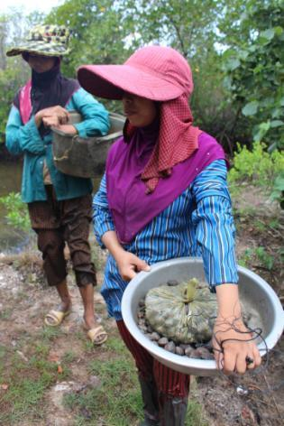
Implementation Outcomes
Small-scale fishing communities are less vulnerable and marginalized; their women are less discriminated against
Small-scale fishing communities’ contribution to food security and nutrition, poverty eradication, equitable development and sustainable resource utilization is better recognized; they have better access to resources and markets
Small-scale fishing communities are better informed and are involved in policy and decision-making processes
Small-scale fishing communities have better access to health, education and other social services
Women in small-scale fishing communities participate fully in all aspects of small-scale fisheries

Slide 10
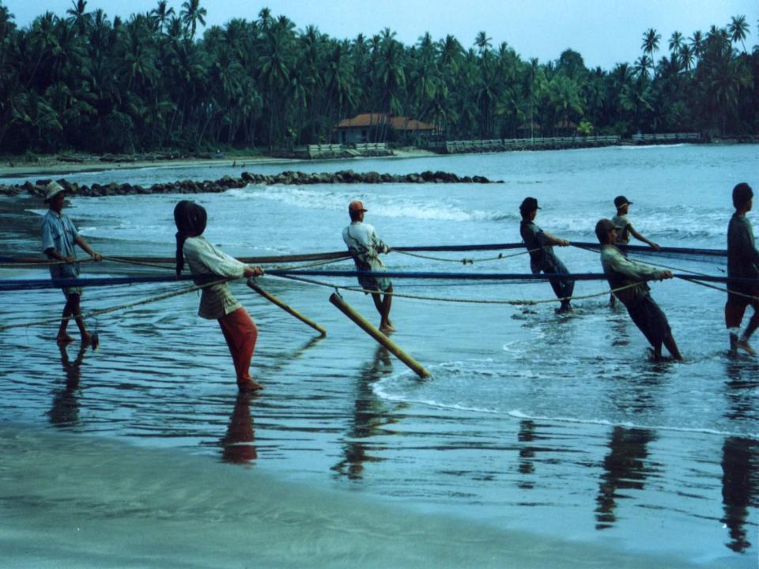
Thank You

