Slide 1
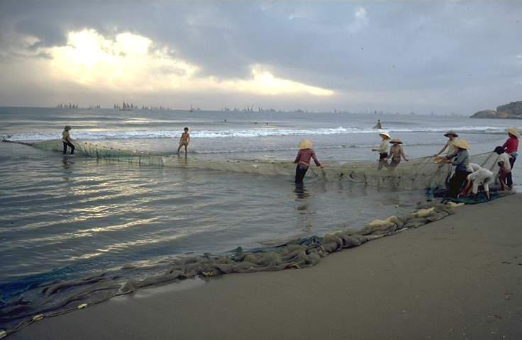
Sustainable Development of Traditional Fishery Communities
Sebastian Mathew
International Collective in Support of Fishworkers (ICSF)
XXIV World Congress of the Apostleship of the Sea Kaohsiung, Taiwan, 1st to 7th October 2017

Slide 2
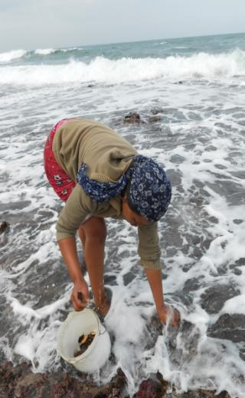
What is sustainable development?
Ability to make development sustainable to ensure that it meets the needs of the present without compromising the ability of future generations to meet their own needs
  Brundtland Commission Report (1987)
Poverty eradication is an indispensable requirement for sustainable development
  Rio Declaration on Environment and Development (1992)
Integrating economic, social and environmental aspects and their linkages are necessary to mainstream sustainable development at all levels
  Rio+20 Outcome Document (2012)

Slide 3
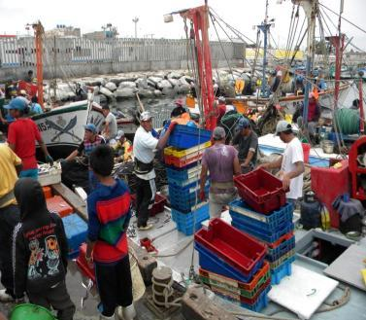
Small-scale fisheries and sustainable development
Most equitable and imposes least harm on others
Employs the largest number of fishers per unit of capital investment
Normally uses passive or selective gear and practices
Consumes less energy per fisher
Do not, in most cases, overexploit fishery resources to meet their basic needs and thus compromise the ability of their future generations to meet their essential needs from fishing

Slide 4
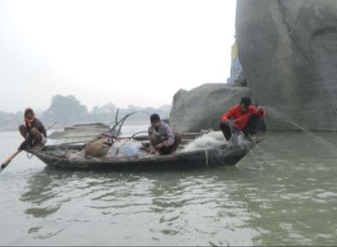
Threats facing traditional, small-scale fishing communities
Overexploitation of fishery resources
Threats to habitats and ecosystems from various sources outside the subsector affect sustainable and equitable devt.
Pollution of water bodies affects enjoyment of human rights to life and health
Customary practices for allocation and sharing of benefit are ignored
Conflicts over space and resources and conflicts with other sectors are debilitating
Impacts of natural and human induced disasters, climate change/ variability make the subsector more vulnerable
Poor visibility of the subsector in policy space leads to scant recognition of the contribution of the subsector to food security and poverty eradication

Slide 5
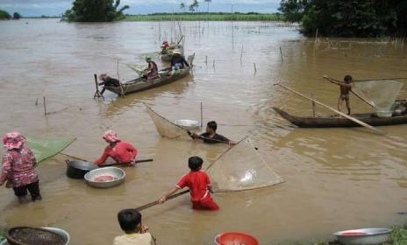
International community and small-scale fisheries
Establishment of FAO in 1945
Social issues related to fish production, employment, general wellbeing, public health, occupational hazards and diseases, education, community life, collective bargaining and labour organization, without making a distinction between small-scale and industrial fisheries

Slide 6
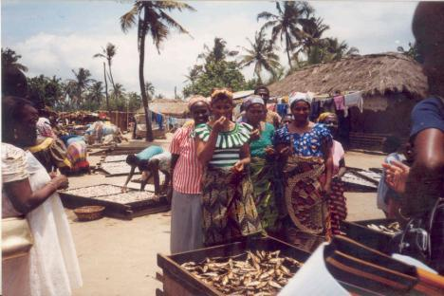
Committee on Fisheries 1965
Artisanal or small-scale fisheries discussed for the first time in 1972 using several negative attributes
  Low capital investment, low level of organization, little use of specialized skills, use of small vessels, hand-operated gear, low productivity and income, catch sold in the local market
Advocated a natural withering away of small-scale fisheries

Slide 7
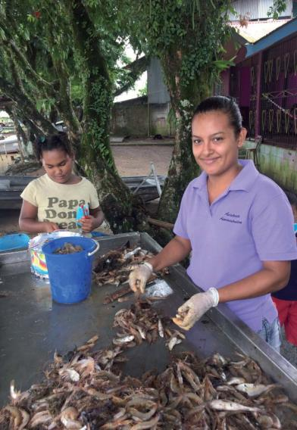
COFI 1974
Importance of SSF as a source of vital protein food supply and employment
Small-scale fishery operators and their families were recognized as people at the margin of subsistence and human dignity
Lift up SSF by its bootstraps!
  Improve state of SSF and operators by providing technological and scientific inputs, integration of SSF into overall economic and social development programmes through action projects
Improvements in SSF to be complemented by social and community developments (health services, schools, etc.)
Reserve specific fishing areas for the small-scale fishery

Slide 8
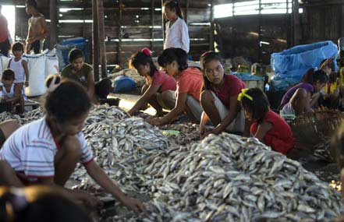
COFI 1983
Sustained small-scale fisheries development and management requires integrating not only components of the value chain but also the social and economic welfare of small-scale fishing communities
Community participation and involvement of women in the planning of development projects

Slide 9
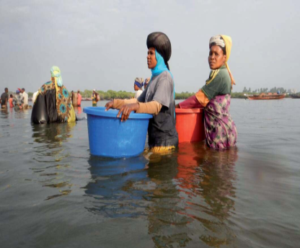
1984 World Conference on Fisheries Management and Development
Significant conference following the adoption of the 1982 UNCLOS
Themes Included: development of small-scale fisheries
Conspicuous by the absence of the representatives of small-scale fishing communities who were not invited

Slide 10
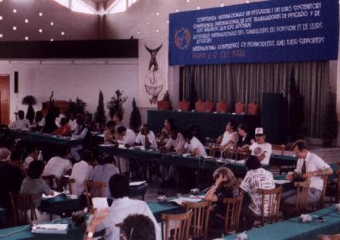
1984 International Conference of Fishworkers and their Supporters
Organized as parallel to the FAO Conference
100 fishworkers and their supporters from 34 countries participated
First instance of fishers and fishworkers coming together at an international level

Slide 11
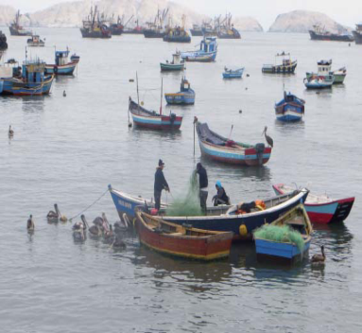
1984 Rome Conference
Fishworkers upheld their fundamental human right to freedom of association
Total disagreement with the FAO Conference over treating trawlers on a par with canoes
Sought:
  safeguards from pollution and from ind. fishing intruding into traditional fishing grounds;
  protection from iniquitous fishing technologies to regain their ‘rights over the sea’;
  Participation in decision-making processes at all levels; and
  Creation of an exclusive fishing zone for small-scale artisanal fishing vessels

Slide 12
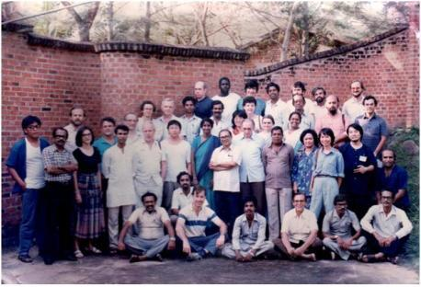
International Collective in Support of Fishworkers (ICSF)
Formed in Trivandrum, India, in 1986 in light of Rome Conference:
to defend the occupation of small-scale artisanal fisheries
To support the struggles of fishers and fishworkers
To facilitate the cause of fishworkers at a global level and to further the cause of agency of fishing communities and their organizations

Slide 13
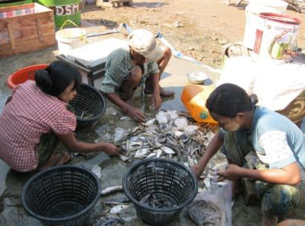
1992 Earth Summit
Agenda 21, the first UN instrument to recognize the rights of small-scale fishworkers such as their rights to utilize fishery resources and to protect their habitats on a sustainable basis

Slide 14
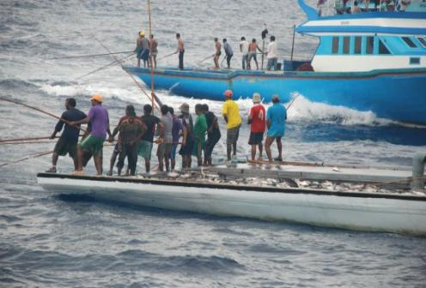
1995 UNFSA
First legally-binding instrument to recognize subsistence, small-scale artisanal fishers and fishworkers and to ensure their access to, for example, tuna and tuna-like species in developing countries

Slide 15
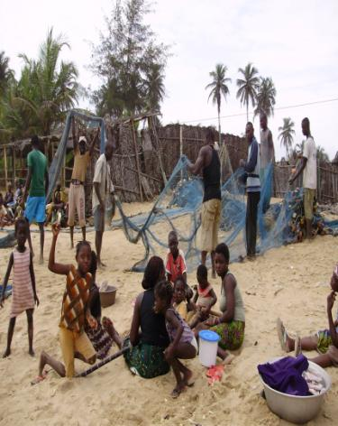
1995 CCRF
Part of international customary law
Combined protecting the rights of subsistence, small-scale fishers and fishworkers to a secure and just livelihood with preferential access not only to their traditional fishing grounds but also to their traditional fishery resources

Slide 16
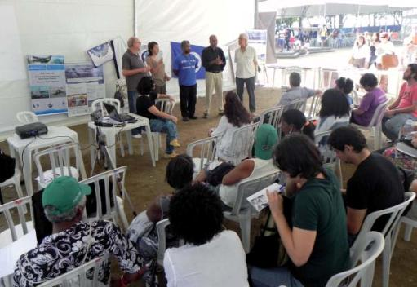
2012 Rio+20 Outcome Document and 2016 SDG 14.b
Broadened access of small-scale artisanal fishers to marine (living) resources and markets

Slide 17
Formation of World Forums
Formation of World Forum of Fish Harvesters & Fish Workers (WFF) in 1997 to protect, defend and strengthen communities that are dependent on fisheries resources for their livelihood; and the emergence of World Forum of Fisher Peoples (WFFP) in 2000

Slide 18
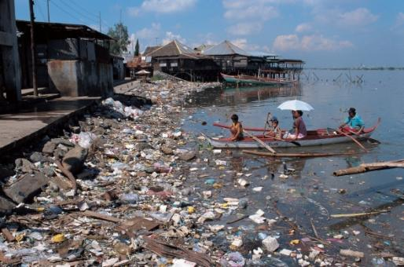
UN Conference on the Human Environment 1972
Protecting the environment is essential to the wellbeing and enjoyment of basic human rights

Slide 19
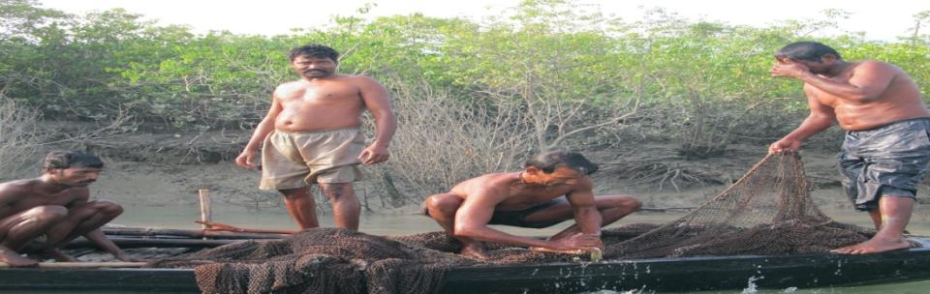
Human rights of fishers and fishworkers
1996 Rome Declaration on World Food Security (World Food Summit) recognized the connection between food security and sustainable management of natural resources, the fundamental role of food producers including fishers and the need to promote and protect all human rights and fundamental freedoms to realize food security for all

Slide 20
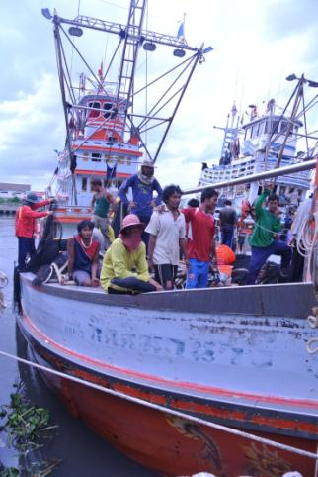
UN Programme for Reform
All entities of the UN system to mainstream human rights into their activities and programmes (1997)
2000 UN Millennium Declaration: Need to strive for the full protection and promotion of civil, political, economic, social and cultural rights; respect for and protection of the rights of migrant workers and their families; to combat all forms of violence against women

Slide 21
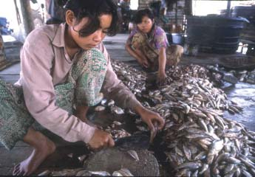
2002 World Summit on Sustainable Development
Protecting and promoting human rights, including the right to development, were recognized as essential for achieving sustainable development and to ensure that sustainable development benefited all

Slide 22
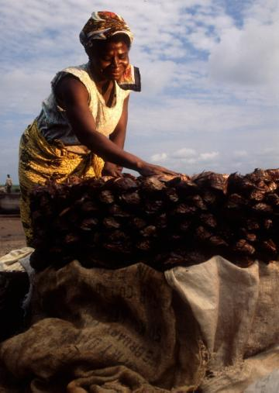
2003 UN Inter-agency Workshop on Human Rights-based Approach (HRBA)
All programmes and policies of the UN and its agencies to further the realization of human rights (as in UDHR) and other international human rights instruments; human rights standards contained in, and principles derived from, these human rights instruments were to guide all programmes; develop capacity of duty bearers to meet their obligations and rights holders to claim their rights

Slide 23
2004 Right to Food Guidelines
Recognized the importance of HRBA, democracy and good governance to food security
HRBA required not only addressing the final outcome but also proposing ways and tools by which the goal was to be achieved
States were to empower individuals and CSOs to make demands on their governments
Governments to improve governance, address needs of people, and ensure accountability and transparency of decision-making processes

Slide 24
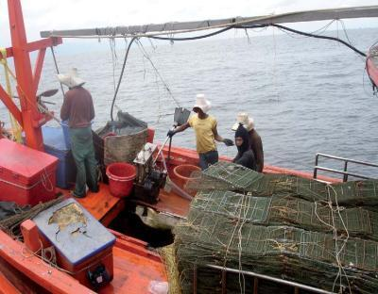
ILO Work in Fishing Convention, 2007
To reach “a greater number of the world’s fishers, particularly those working on board smaller vessels” to protect and promote decent work and living conditions on board fishing vessels
First legally-binding instrument that protects the human rights of fishers also on board small-scale fishing vessels

Slide 25
2007 COFI
For the first time, COFI discussed international human rights instruments and stressed how recognition of human rights principles could help eradicate poverty and adoption of responsible fisheries practices (poverty as the main cause of overexploitation of fisheries resources)
Decides to hold an international conference on small-scale fisheries

Slide 26
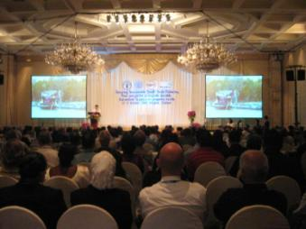
2008 Global Conference on Small-scale Fisheries
Called for an international instrument on small-scale fisheries
Protecting human rights is critical to achieve sustainable development
CSO statement—WFF, WFFP, ICSF, IPC, SDF-- focusing on securing access rights, post-harvest rights and human rights of small-scale and indigenous fishing communities and seeking a chapter in the CCRF on SSF

Slide 27
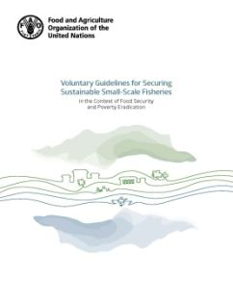
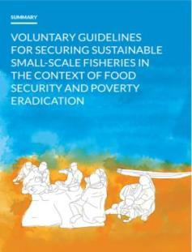
2011 COFI
Approved the development of a new international instrument on small-scale fisheries in the form of international guidelines

Slide 28
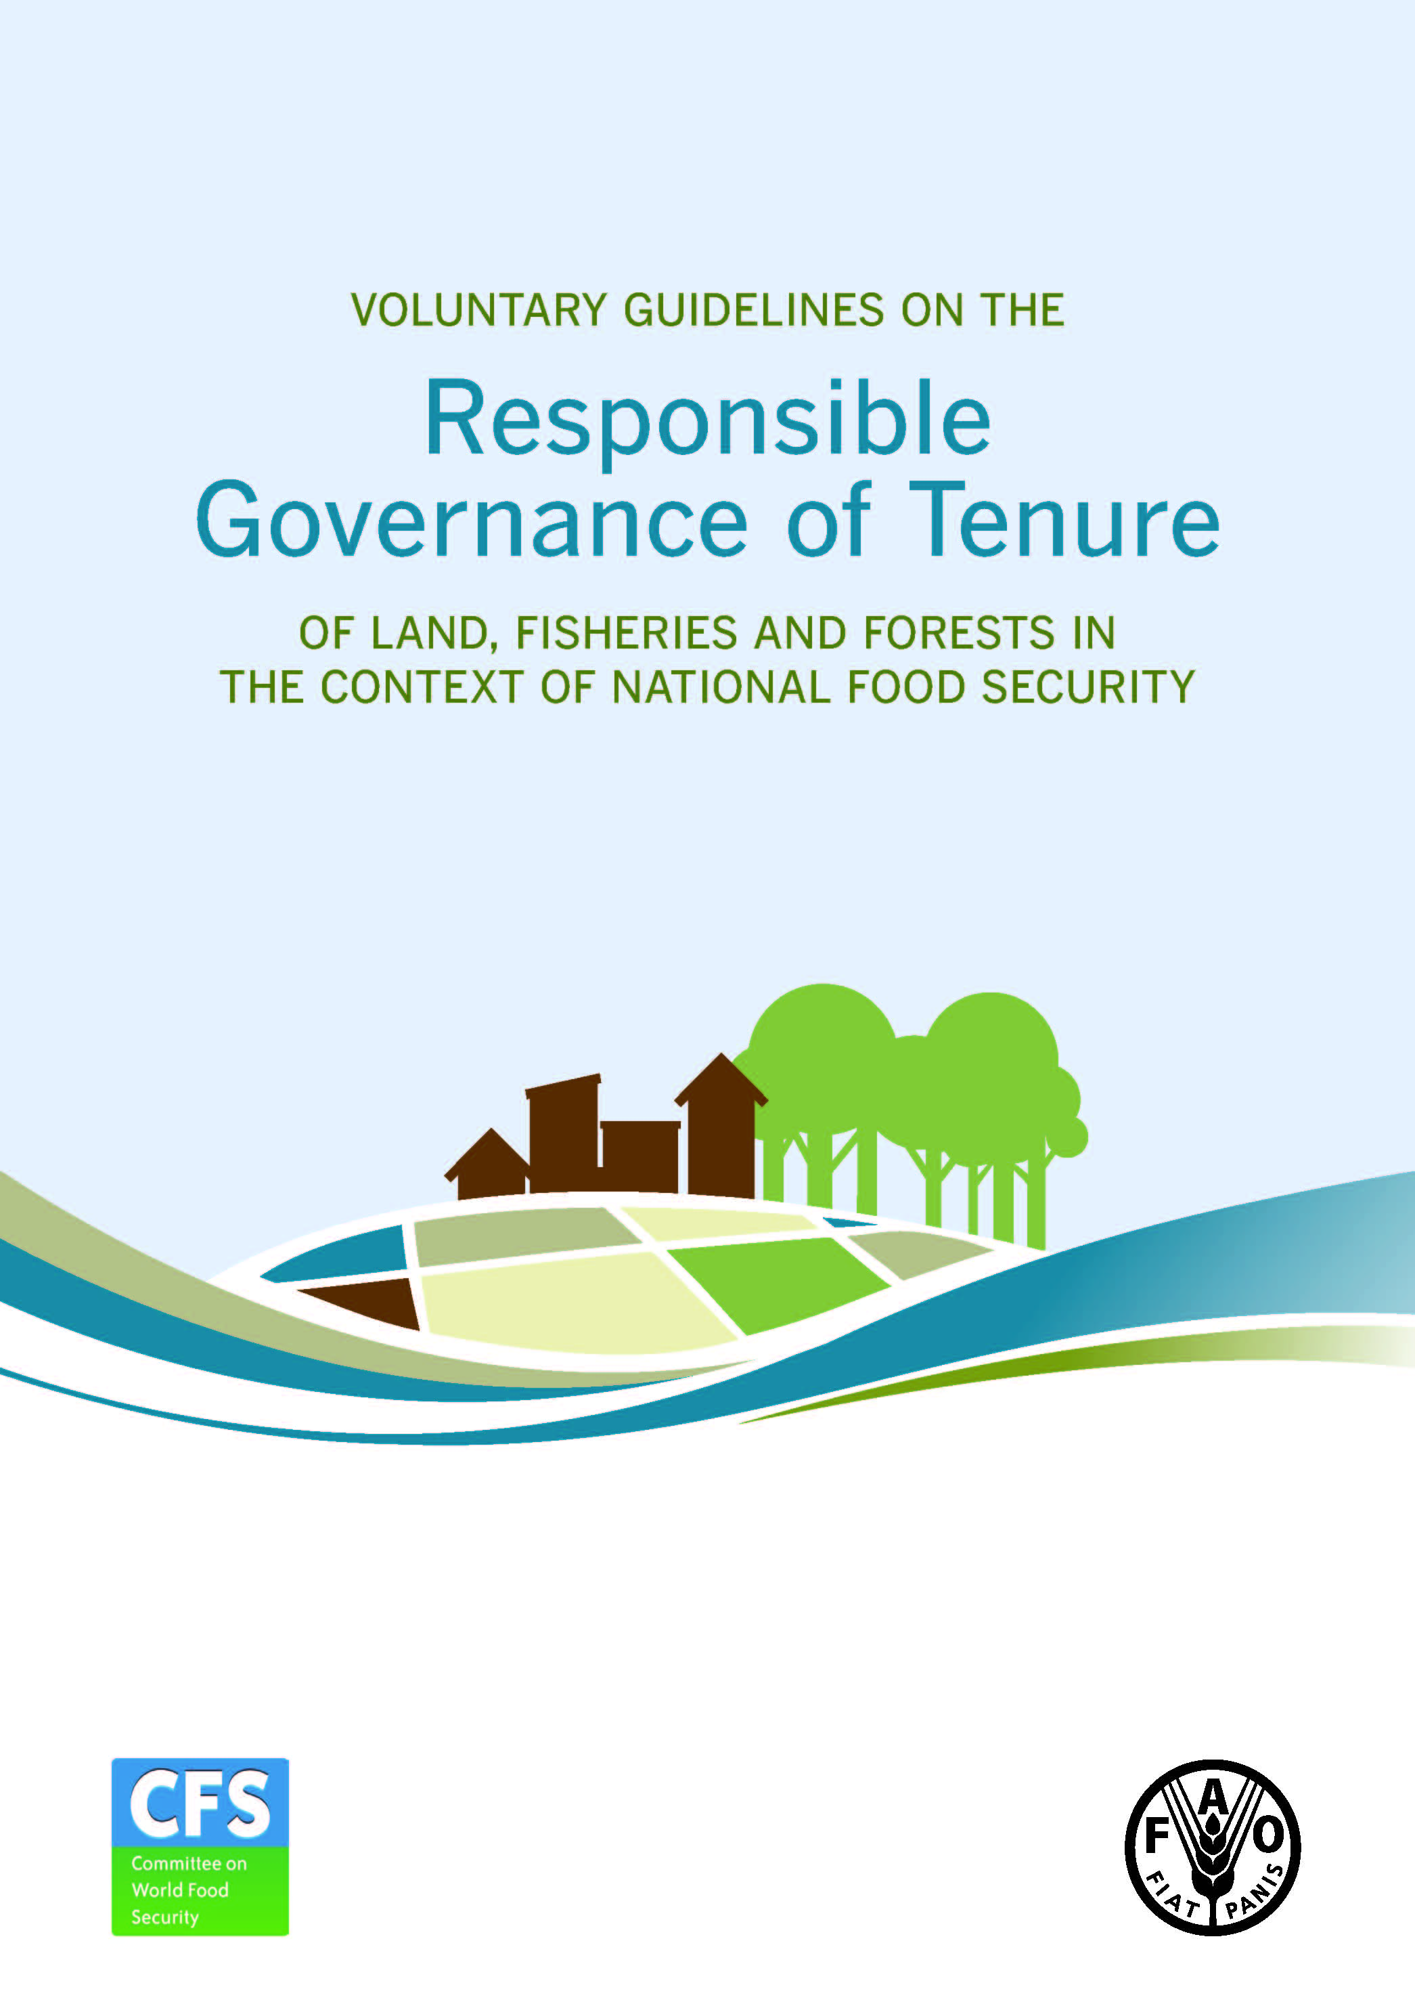
2012 Tenure Guidelines
Developed within the framework of human rights, tenure rights and governance
Endorsed by the Committee on World Food Security
Negotiations between 2009 and 2012 had the participation of WFFP, WFF and ICSF

Slide 29
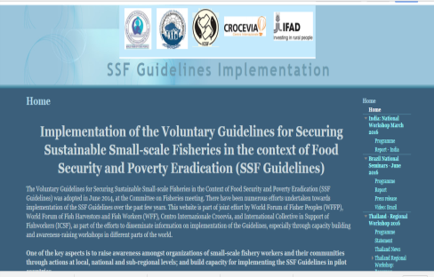
2014 SSF Guidelines
Preparatory process (2010 to 2012)
Technical consultations (2013-14)
2014 COFI endorses the SSF Guidelines
“a major achievement towards ensuring secure and sustainable small-scale fisheries”
Probably the first international instrument that explicitly recognizes the need for secure tenure rights of small-scale fishing communities to marine and inland fishery resources, to fishing grounds, and to the adjacent land
Responsibilities of duty-bearing States highlighted
Implementation process with full support of CSOs at various levels

Slide 30
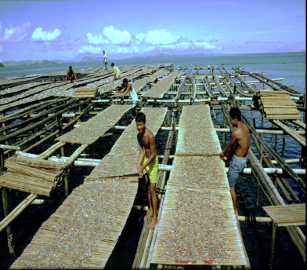
In conclusion
How does one transform lives and livelihoods of small-scale fishers and fishing communities at national and subnational levels with the aid of these instruments?
How does one generate political will to make duty-bearing State and non-State actors more responsible and accountable?
How does one create conditions for duty-bearing fishing communities to exercise their rights to sustainably manage their fishery resources?

Slide 31
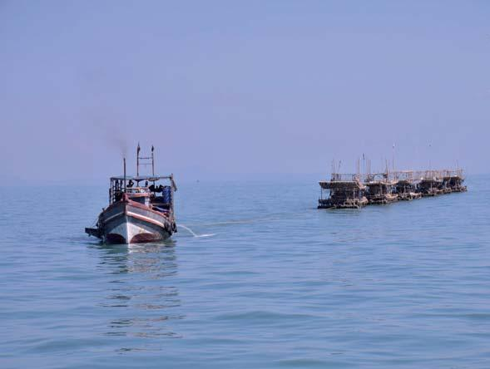
Thank you!

