Slide 1
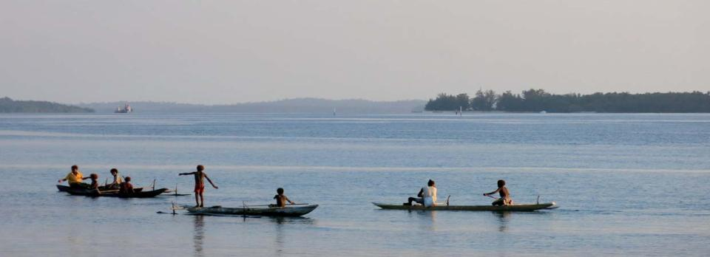
Challenges and Opportunities for Small-scale Fisheries in Fish Trade
FAO-UNCTAD session at the WTO Public Forum 2017–Trade: Behind the Headlines, Geneva , 27 September 2017
Sebastian Mathew
International Collective in Support of Fishworkers (ICSF)

Slide 2
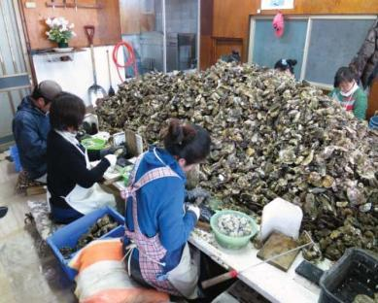
Fisheries and Oceans
Fishing provides the greatest employment opportunities much more than tourism, shipping or any other extractive industries
38 million people are engaged in capture fishing—90% in developing countries (including SIDS and LDCs)
Small-scale fishing provides employment to 34 million people (90%)
50 per cent of the workforce in capture fisheries and post-harvest sectors combined are women

Slide 3
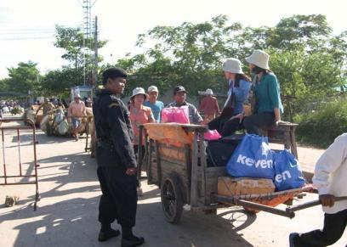
International Fish Trade
FAO estimates that about 35–36 percent of total world fish production of 172.2 million tonnes in 2016 (about 62 million tonnes in live-weight equivalent) was exported at a value of US$143 billion
Aquaculture exports are estimated to contribute 27 to 29 percent of volume (about 18 million tonnes) and 36 to 38 per cent of value (about US$54.34 million)
The contribution of wild capture fisheries production to total exports would be 44 million tonnes at a value of US$89 billion
  (FAO Sub Committee on Trade, 2017)

Slide 4
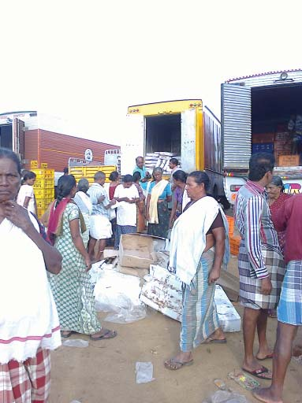
Fish trade and developing countries
The exports of developing countries were valued at US$76 billion and their fishery net-export revenues (exports minus imports) reached US$36 billion, higher than for all other agricultural commodities combined (FAO)
The share of developing countries in total export of fish and fishery products was 54 per cent in 2016; 48 percent in 2004; and 37 percent in 1976 (FAO)
The share of developing countries in global merchandise exports grew from 26 per cent in 1976 to 34 per cent in 2004 and to 43 per cent in 2015 (WTO)
The percentage share of global fishery exports to total world merchandise export trade declined from 1.09 per cent in 1994 to 0.77 per cent in 2004 and more than doubled to 1.92 per cent in 2015

Slide 5
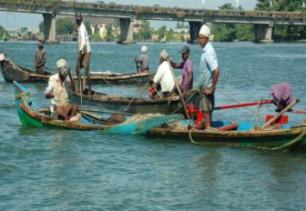
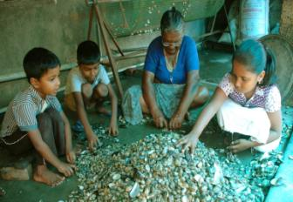
Small-scale fisheries and international trade
Generates employment, income, food security and nutrition

Slide 6
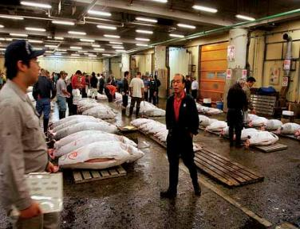
Non-tariff measures (TBT)
  Requirements of TEDs, dolphin-safe labelling (EII); eco-labelling and certification (MSC, Carbon Neutral Product Certification, Fair Trade Certification, Oceanwise, etc.); Rules of Origin (RoO);
  Voluntary certification for biological sustainability, as well as social and labour conditions
  notifications that refer to international standards and agreements (e.g. CITES)

Slide 7
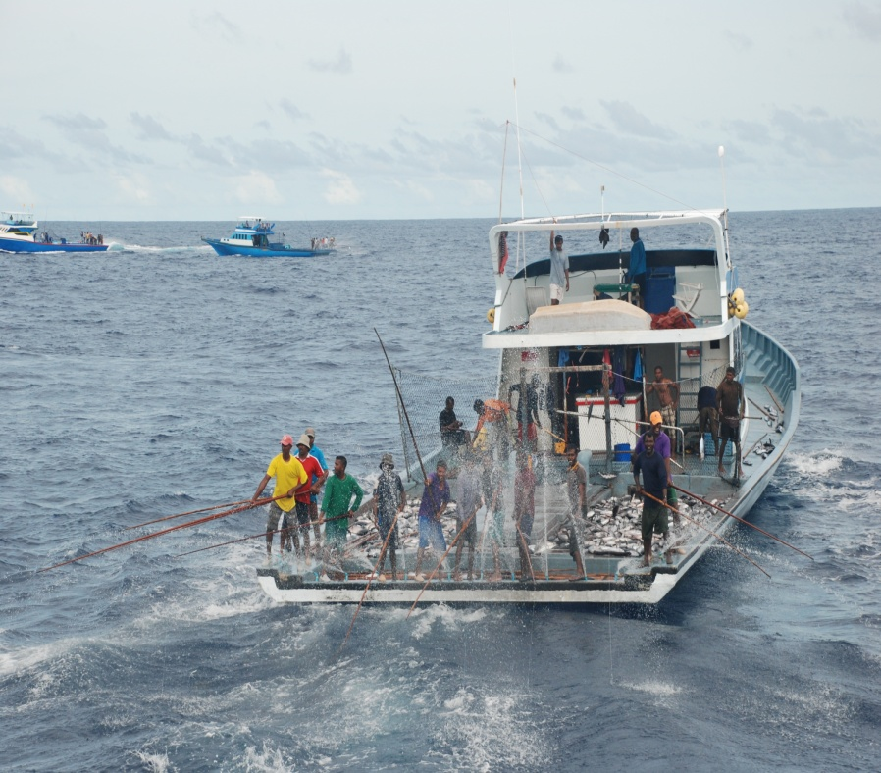
Non-tariff measures (TBT) 2
Labelling requirements for canning methods for fish products, or standards that do not allow canned products to contain juvenile species
Marketing arrangements, packaging requirements, internal taxes on fish products
Technical regulations and standards covering minimum landing size of fish, and physical criteria such as whether the fish is carrying eggs

Slide 8
Non-tariff measures (SPS)
Quarantine requirements
Standards related to: fish additives (maximum permitted levels of additives); maximum residue limits for agricultural and veterinary chemical residues; maximum level of natural and man-made contaminants; and natural toxicants such as histamine; EU standards on aflatoxins
Criteria related to fish health (certification for ornamental fish and fish products)
regulatory approaches (2004 Codex Alimentarius standards for fish and fishery products-- ISO 22000, HACCP approaches, GMP, QM such as ISO 9000); risk assessment procedures (EU, U.S.A. E.g., in relation to mahi-mahi, harvested by small-scale fishers in Peru)

Slide 9
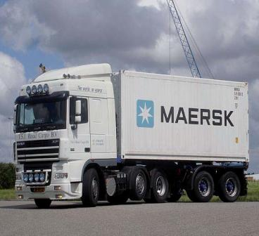
Agreement on Import Licensing Procedures
Licensing schemes covering live fish, fresh fish, chilled and frozen fish
Control of imports of certain types of fish species (such as flying fish or associated pelagics)
Import controls on fish products used for animal feed and quantitative restrictions on the import of smoked trout, cod, salmon, lobster, scallops

Slide 10
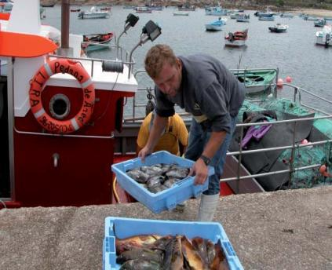
Protecting the interests and rights of small-scale fishers and fishworkers (1)
Import of frozen fish should not lead to domestic fish having to compete unsuccessfully with such fish with adverse consequences for small-scale fishers (e.g. the Philippines)
Export of fish and fishery products should not lead to adverse impact on local fish consumers, especially the poor (e.g. Chile) (See 7.7 of SSF Guidelines or 11.2.15 of CCRF)

Slide 11
Protecting the interests of small-scale fishers and fishworkers (2)
Complying with international food safety and environmental standards should not lead to greater differentiation within small-scale fisheries (e.g. Lake Victoria) and widening income inequalities in fishery-dependent communities
Regulate transgressions by distant water fishing operations, especially employing time charter vessels, into artisanal fishing zones or in conflict with traditional fishing grounds and resources

Slide 12
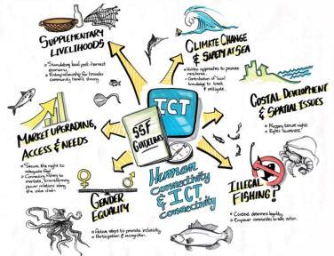
Protecting the interests of small-scale fishers and fishworkers (3)
Enable access to all relevant market and trade information for small-scale fisheries stakeholders
Provide timely and accurate market information to adjust to changing market conditions
Provide capacity development, especially to women and vulnerable and marginalized groups to adapt to, and benefit equitably from international trade in fish and fishery products (7.10 SSF Guidelines)
Build up capacity of fishworker organizations through cooperatives to deal with both access to resources and access to markets issues

Slide 13
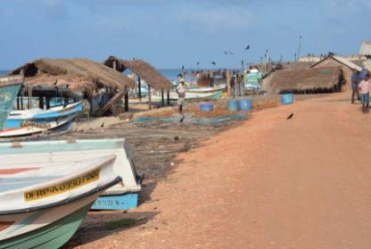
Protecting the interests of small-scale fishers and fishworkers (4)
Need for recognition at the policy level of fisheries trade contributing to the economic wellbeing of fishers and fishworkers
Need for measures to ensure that benefits from trade percolate down to fishers and fishworkers
Develop indicators under SDG target 14.b to ascertain the contribution of small-scale fisheries to international trade in fish and fishery products
Implementation of TFA should not lead to displacement of small fish vendors by large multinational retail chains

Slide 14
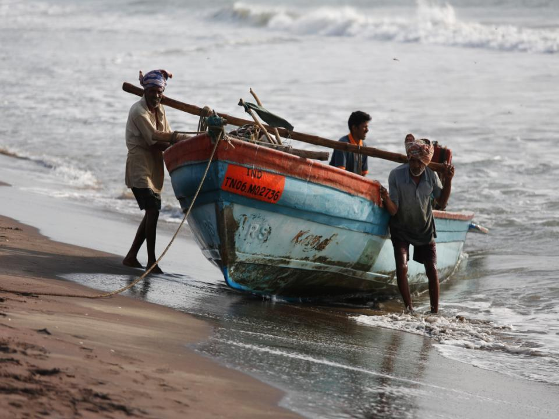
Thank you

