Slide 1


Slide 2

SSF Guidelines

Slide 3
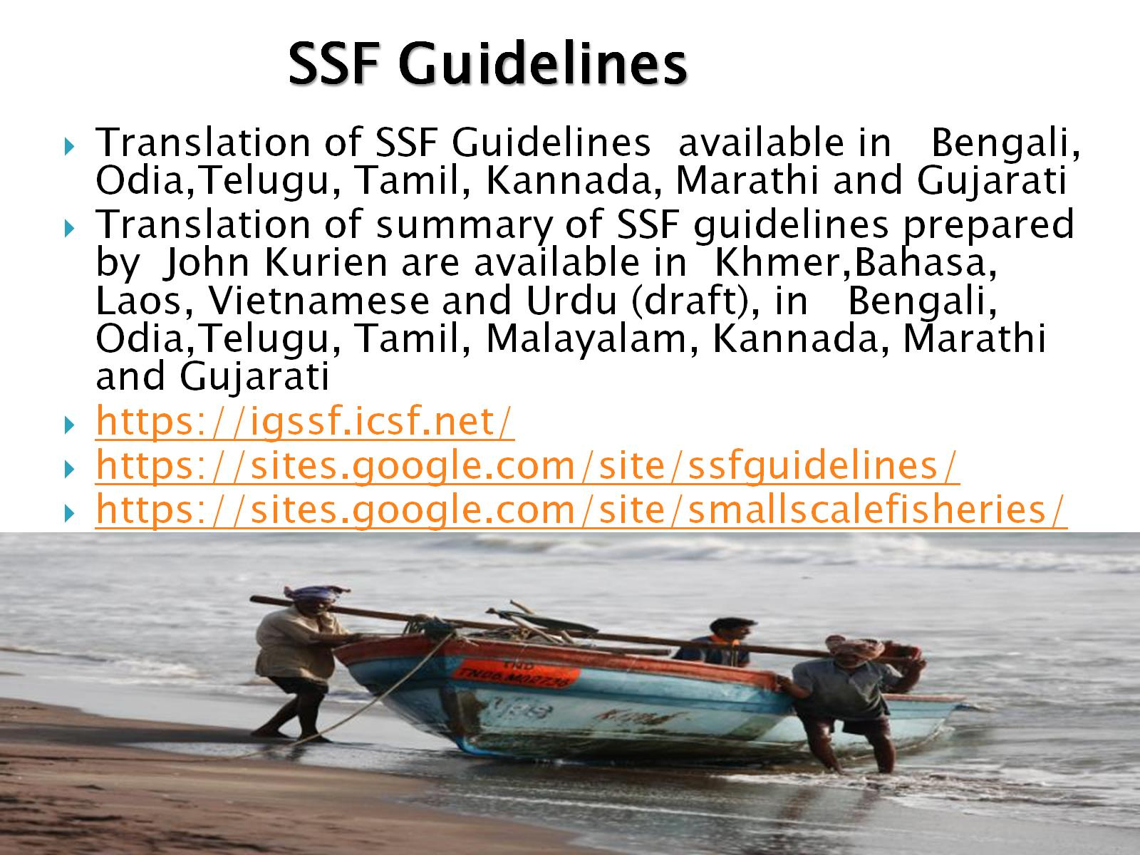

Slide 4
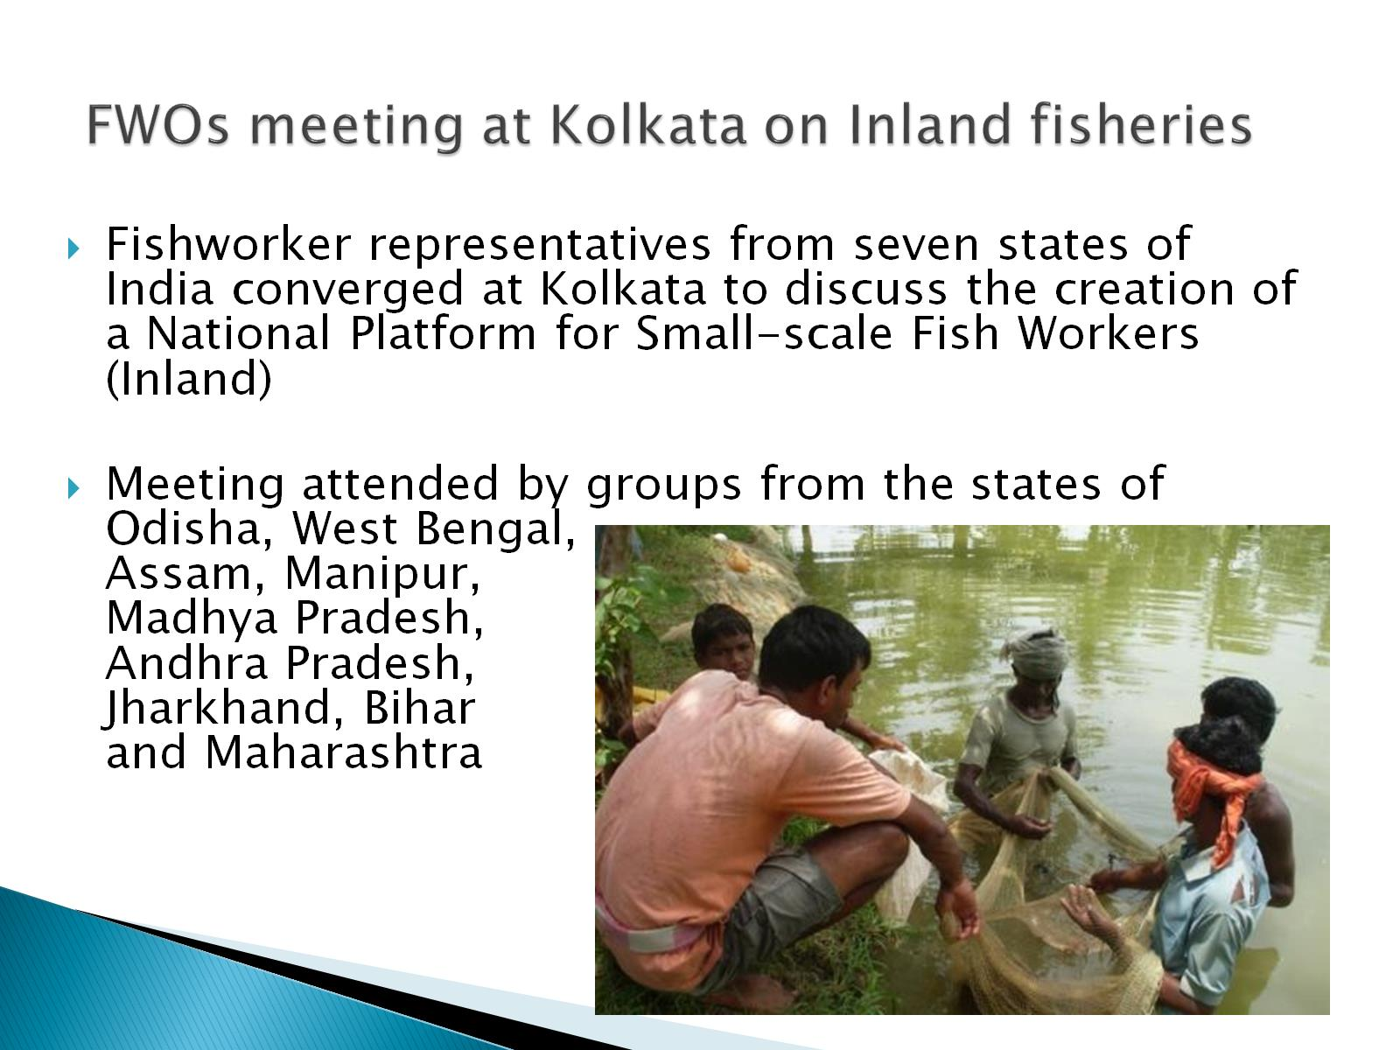
FWOs meeting at Kolkata on Inland fisheries

Slide 5
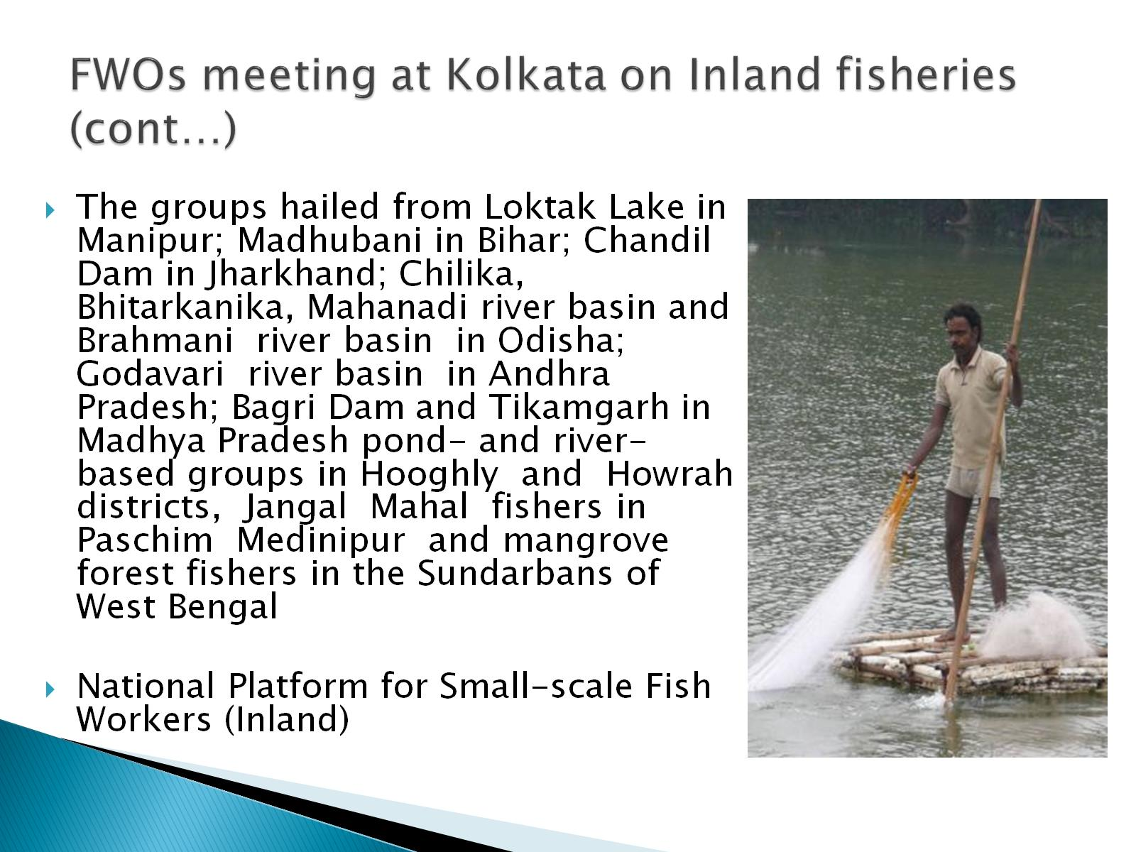
FWOs meeting at Kolkata on Inland fisheries (cont…)

Slide 6
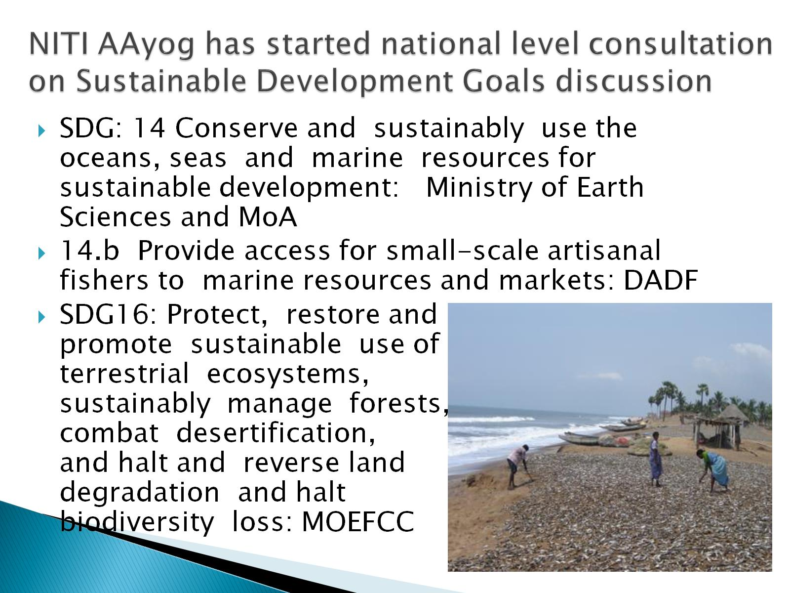
NITI AAyog has started national level consultation on Sustainable Development Goals discussion

Slide 7
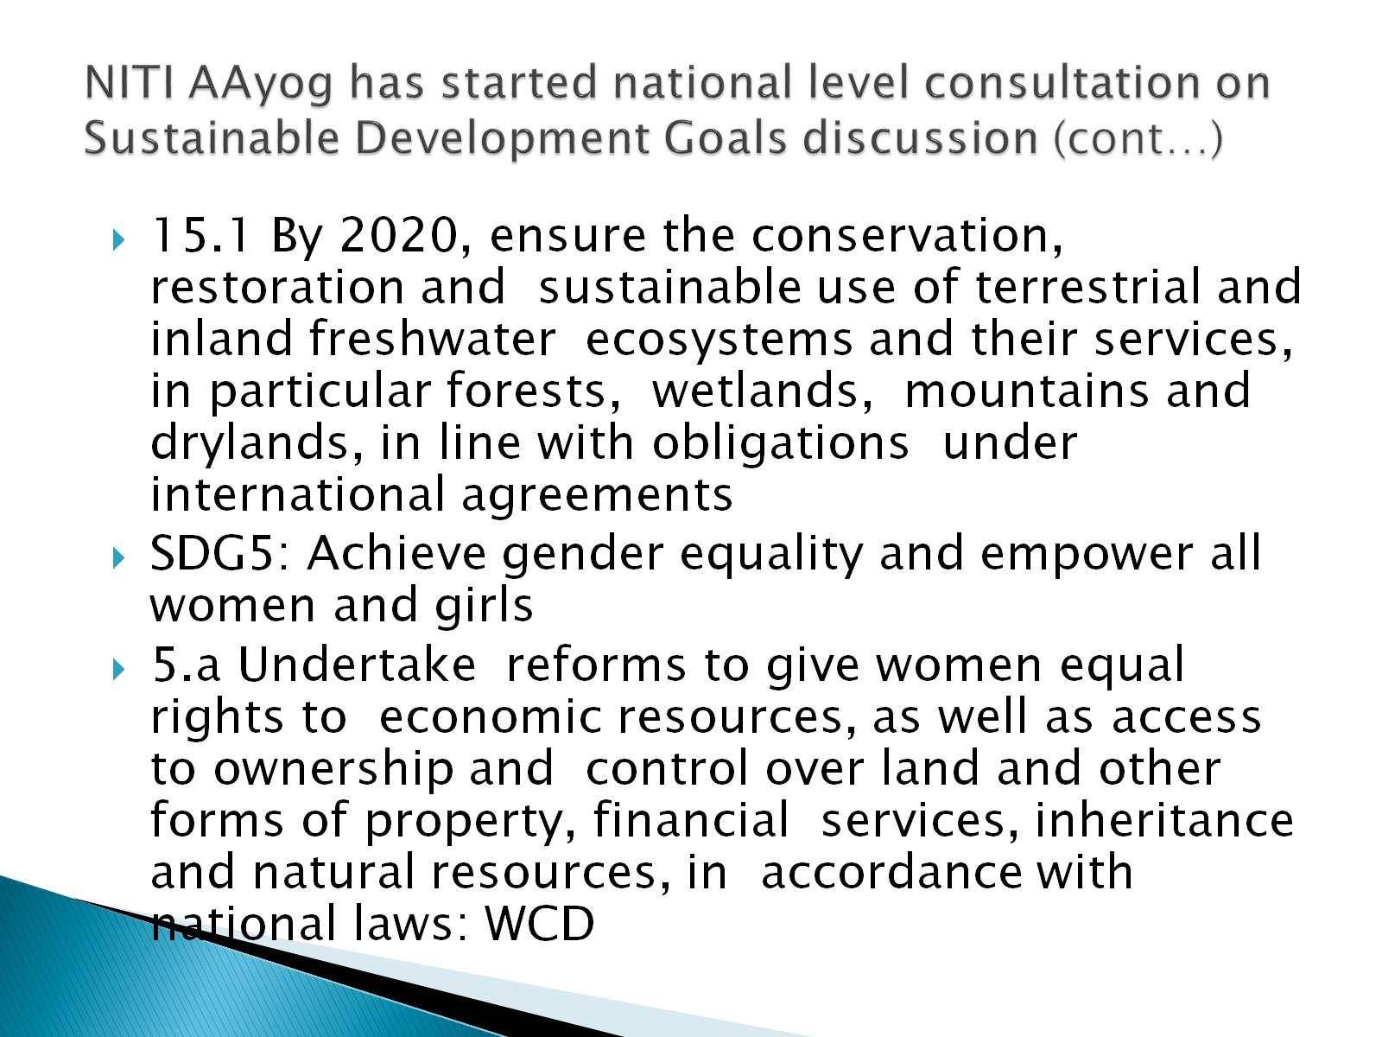
NITI AAyog has started national level consultation on Sustainable Development Goals discussion (cont…)

Slide 8
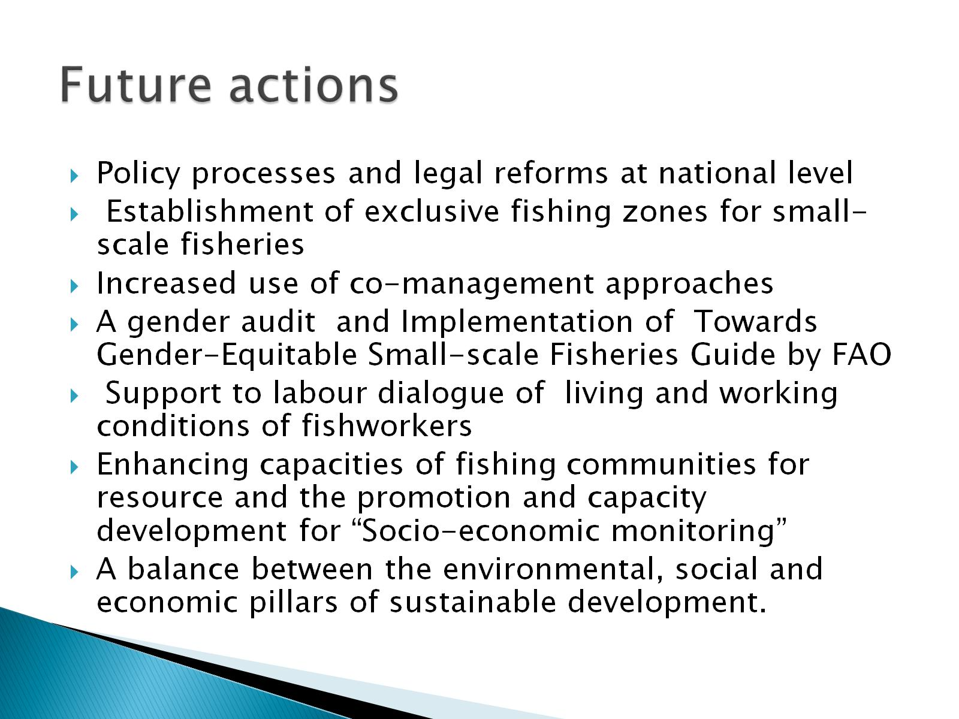
Future actions

Slide 9

Thank You

