Slide 1
National and Subnational Policies and Legislation for Protecting Marine Fisheries Resources:
Moving from Principles to Practice
Sebastian Mathew
International Collective in Support of Fishworkers (ICSF)
International Conference on Aquatic Resources and Sustainable Development, Kolkata, 18 February 2016

Slide 2
Fisheries Sector, India
“Sunshine sector” in Indian agriculture (Report of the Subcommittee on Agriculture and Allied Sectors, 2014)
0.83% of GDP at current prices
Fish production 30% marine, 70% inland
Marine fisheries: largest employer among all maritime sectors (one million active fishers and 4 million dependents, one million in allied activities and their dependents)

Slide 3
Traditional Fishing Communities
Kaibartas (West Bengal, Odisha)
Vadabalijas, Jalaris, Pattappu, Palles (Andhra Pradesh)
Pattanavan, Paravan, Mukkuvan (Tamil Nadu)
Mogera (Karnataka)
Kolis (Maharashtra and Gujarat)
Mukkuvan, Dheevaran, Pooislan (Kerala)
Schedules Tribes (Lakshadwip, Andaman and Nicobar Islands)
Backward Classes Commission Report, 1980: fishers be included in the list of Backward Castes/Backward Tribes

Slide 4
Conservation and Sustainable Use of Fisheries Resources
Food security
Livelihood security
Poverty eradication
Protection of traditional knowledge and culture

Slide 5
Indian legislation
Law provides lead to society, law has placed before society ideals and values to which people should conform
Indian Constitution (Adopted, 26 November, 1949 by the Constituent Assembly) (first Constitution in the world after the UDHR)
Directive Principles of State Policy: promote welfare of the people; minimize the inequalities of income; ensure men and women have the right to an adequate means of livelihood; promote justice; secure the right to work; education and social security; securing just and humane conditions of work; secure a living wage; ensure decent standard of life; ensure worker participation; free and compulsory education for all children; promote the educational and economic interests of the weaker sections of the people (SC/ST, in particular); raise the level of nutrition; improve public health; protect and improve the environment; foster respect for international law, etc

Slide 6
Marine Fisheries: Jurisdictional Issues
1947– territorial waters up to 3 nautical miles from the sea coast
1956-Presidental Proclamation: 3 nautical miles to 6 nautical miles from the baseline
1967-Presidental Proclamation: 6 naut. miles to 12 naut. Miles
1976-Territorial Waters, Continental Shelf, Exclusive Economic Zone and other Maritime Zones Act (12 naut. miles territorial waters, and the EEZ 200 naut. miles from the appropriate baselines)

Slide 7
Jurisdictional Issues
Baseline system notification, 2009
  Normal baseline
  Straight baseline
Benefit of internal waters and territorial waters in some coastal areas (e.g. West Bengal, Orissa, Gujarat, etc.)
Fishing up to +60 naut. miles of maritime space from the shoreline in West Bengal

Slide 8
MZA, 1976
Avers sovereign rights to explore, exploit, conserve and manage living resources in the EEZ --Article 7.4 (a)
Upholds rights recognized by international law in the EEZ --Article 7.4 (e)
Allows Indian citizens to undertake fishing in the EEZ -----(Article 7. 5)
Grants Central Govt the right to declare any area in the EEZ as a designated area for protecting the resources of that area, or for protecting the marine environment --(Article 7. 6)
Grants Central Govt the right to make rules to carry out the purposes of this Act-- Article 15

Slide 9
MZI, 1981
Maritime Zones of India (Regulation of Fishing by Foreign Vessels) Act, 1981
To regulate fish catch, species caught, discards, gear, including its abandonment, destructive fishing, etc. by foreign vessels
Little evidence of any fishing arrangements licensed or permitted under this Act

Slide 10
Marine Fisheries (Regulation and Management) Bill, 2009
For the conservation and sustainable use of fisheries resources in the maritime zones of India (YET, to be legislated)
Obligations under the 1982 UNCLOS, 1995 UNFSA remain unfulfilled

Slide 11
MFRA (1980 to 2008)
Conserving fish and regulating fishing, are part of all marine fishing regulation acts and rules for internal waters and territorial waters in all the coastal states and union territories
Protection of marine species listed under Wild Life Protection Act, 1972 (turtles, whale sharks, giant groupers, etc) recognized under West Bengal MFR Rules ,1998; Gujarat MFR Rules, 2003; Andaman and Nicobar MF Rules, 2004; Puducherry MFRA, 2008)

Slide 12
MFRA Reform
Full exploitation and overexploitation of fishery resources to be addressed
Overcapitalization of fishing fleet
Marginalization of non-mechanized fishing
Movement of fishing vessels from the territorial waters to the EEZ
Inter-state movement of fishing vessels across internal waters/territorial waters

Slide 13
Central Comprehensive Fisheries Policy, 2004
Promote food security and livelihood security in the territorial waters and the EEZ
Harmonizing national laws with international conventions of relevance
Suggests developing a new model bill for the coastal states to revamp their fisheries development and management legislation mainly with a view to reduce fishing capacity
A new national fisheries policy is now being developed

Slide 14
State Fisheries Policies
Odisha Fisheries Policy
West Bengal Fisheries Policy
Andhra Pradesh Fisheries Policy
Tamil Nadu Fisheries Policy Note
Fisheries conservation and management; community participation in fisheries management through co-management; protecting the rights of traditional fishers (T.N), customary rights of fishing communities (West Bengal), rights of small-scale fishers and participation of women (A.P.)
Promote deep sea fishing
Policy coherence (Orissa, A.P.)

Slide 15
Policy as a Statement of Practice
Can cooperative federalism help?
Cooperation between the Centre and states where the states would be dependent on the Centre for financial resources to gain access to the fishery resources of the EEZ and where the Centre would make such grants conditional upon adopting measures for effective conservation and management of fisheries in all the maritime zones of India

Slide 16
SSF Guidelines
Can the 2014 FAO Voluntary Guidelines for Securing Sustainable Small-Scale Fisheries in the Context of Food Security and Poverty Eradication (SSF Guidelines) provide a powerful toolbox to adopt relevant policies and legislation?
These Guidelines provide a framework for developing policies and legislation in a coherent manner by applying the principles of human rights and dignity, respect of cultures, non-discrimination, consultation and participation, rule of law, transparency, accountability, sustainability, holistic and integrated approaches

Slide 17

William Shakespeare
We must not make a scarecrow of the law,
Setting it up to fear the birds of prey,
And let it keep one shape, till custom make it
Their perch and not their terror!
--Act II, Scene I, Measure for Measure

Slide 18
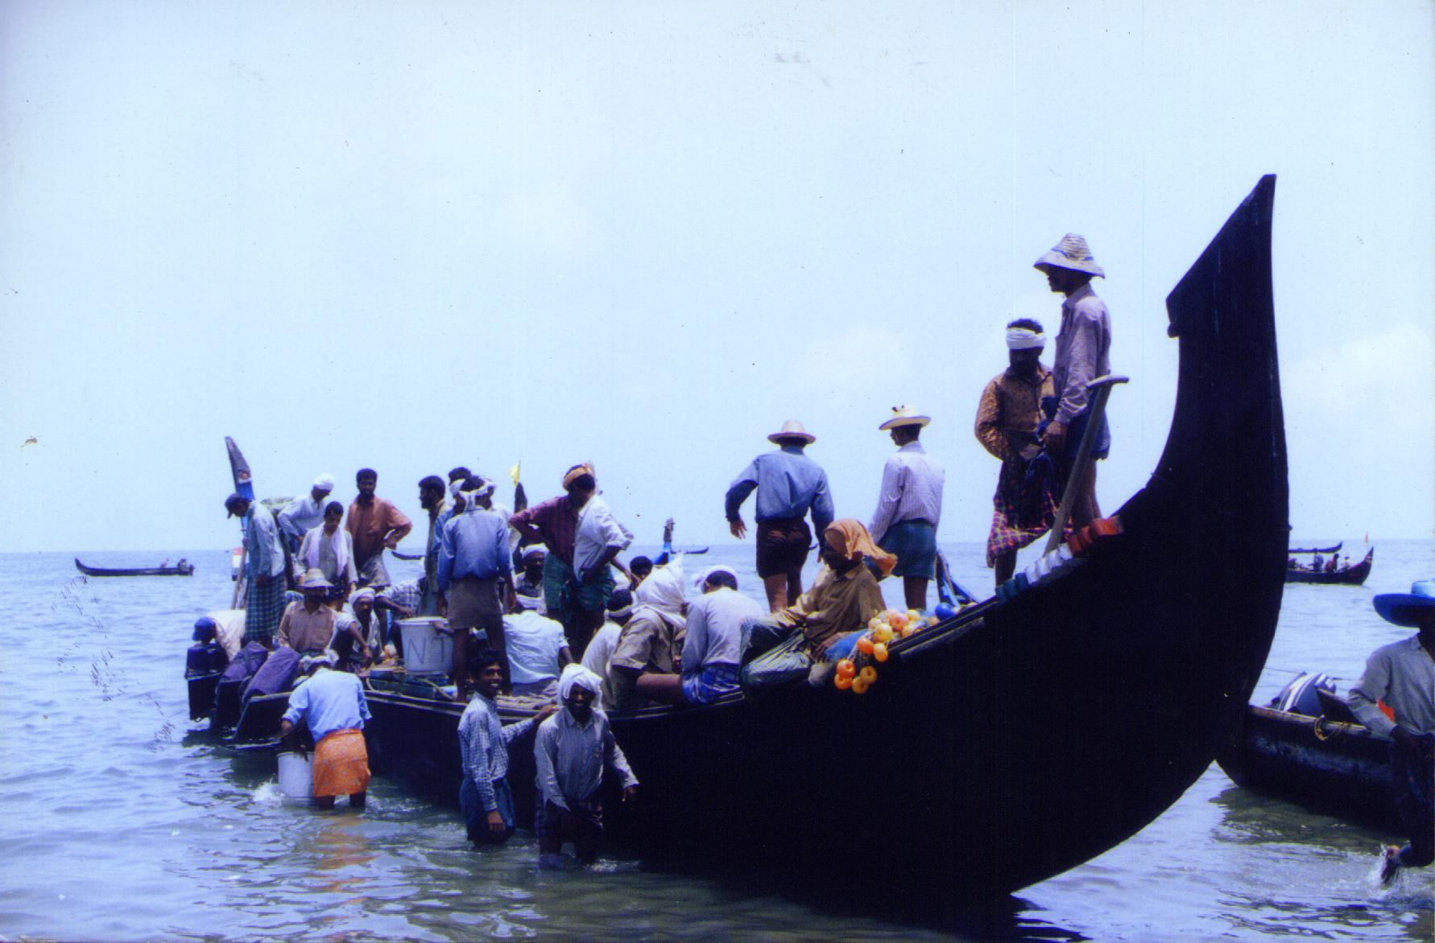
Thank you

