Slide 1

25 Years of Work: Connecting with Fishing Communities for a Sustainable Future

Slide 2
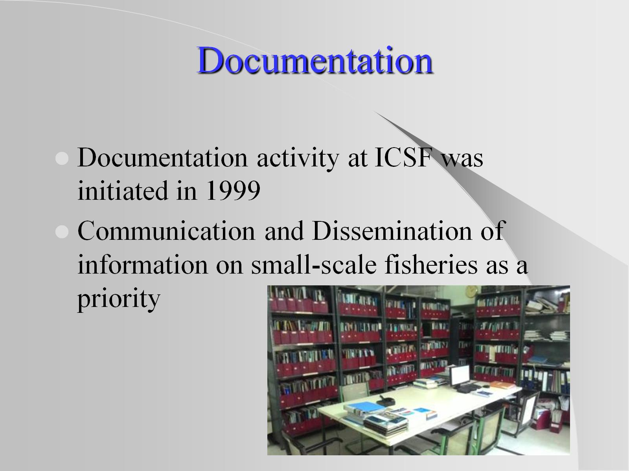
Documentation

Slide 3
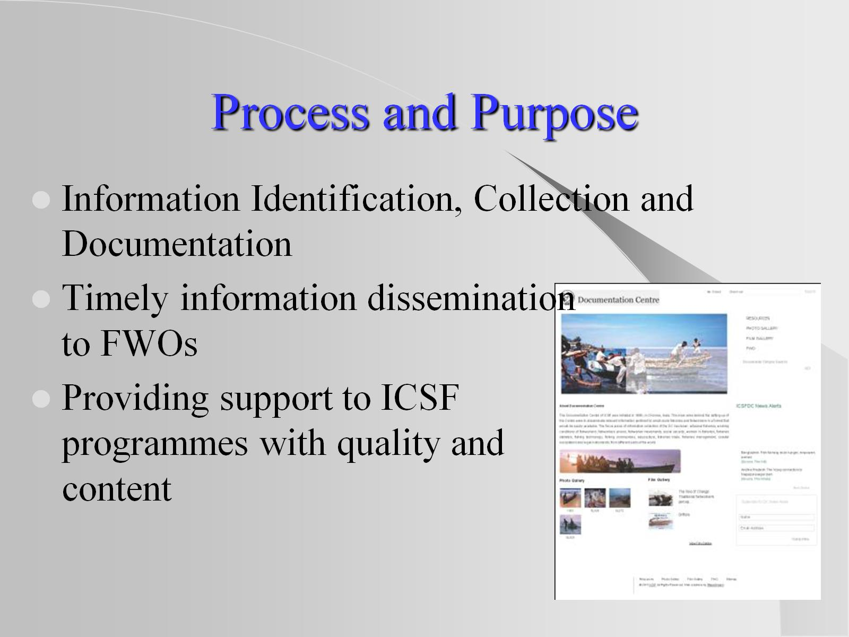
Process and Purpose

Slide 4
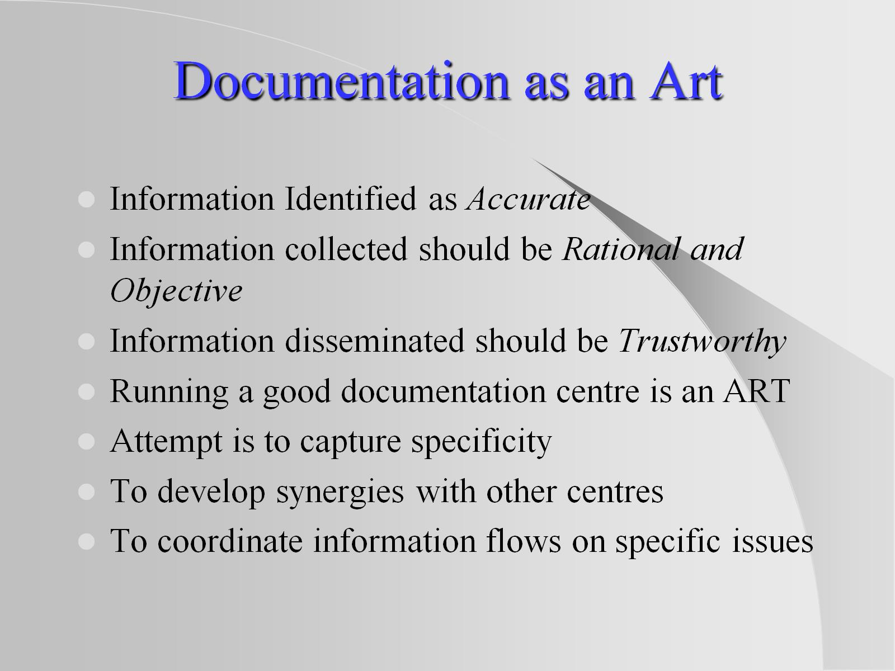
Documentation as an Art

Slide 5
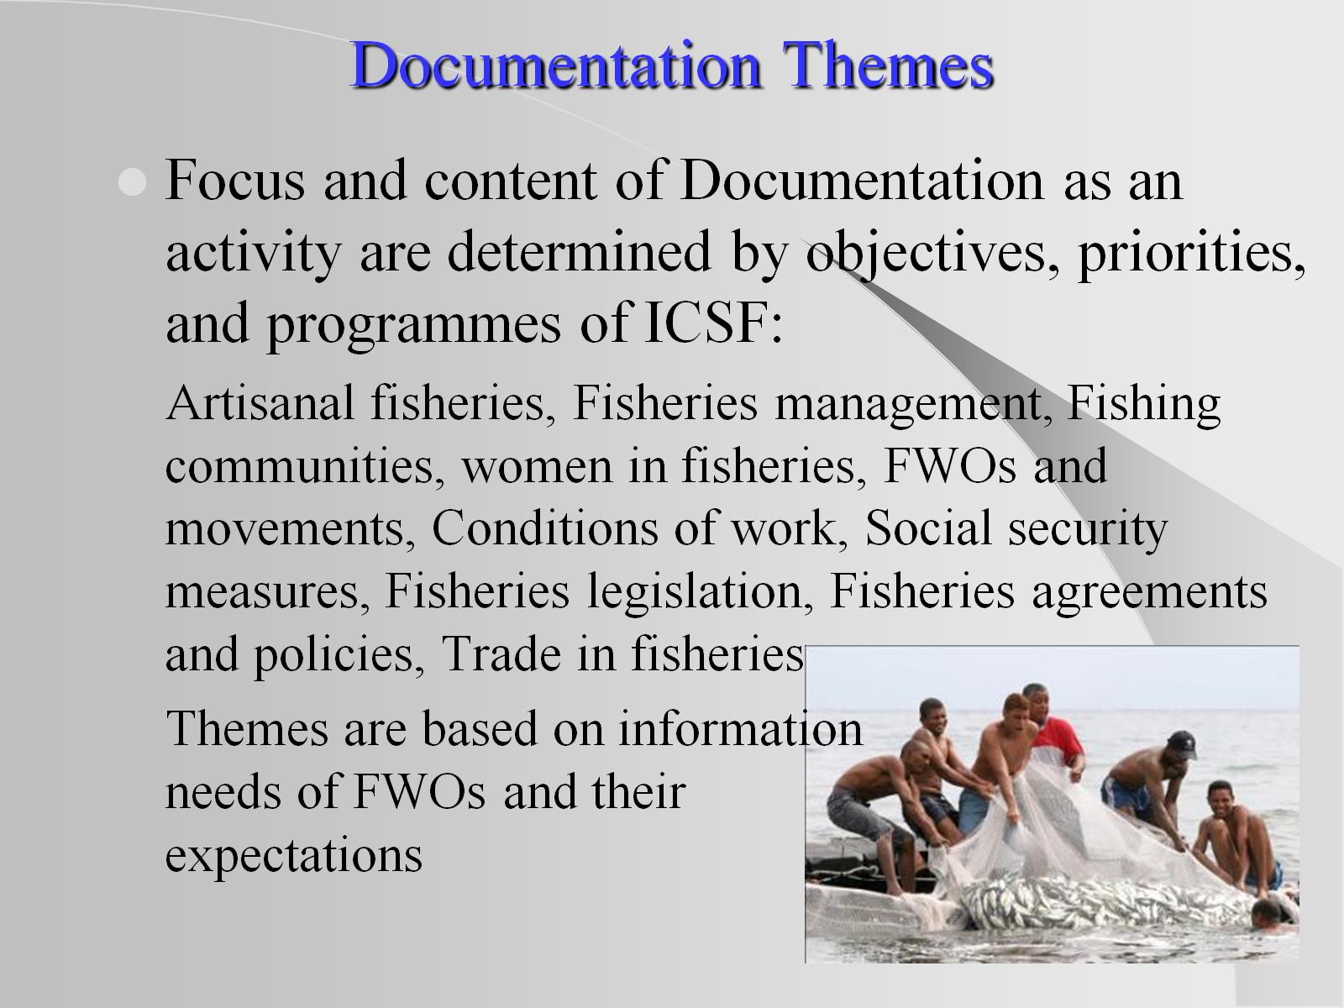
Documentation Themes

Slide 6
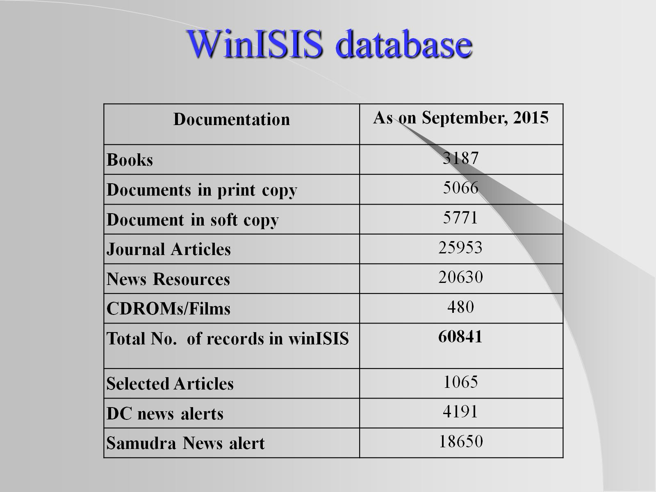
WinISIS database

Slide 7
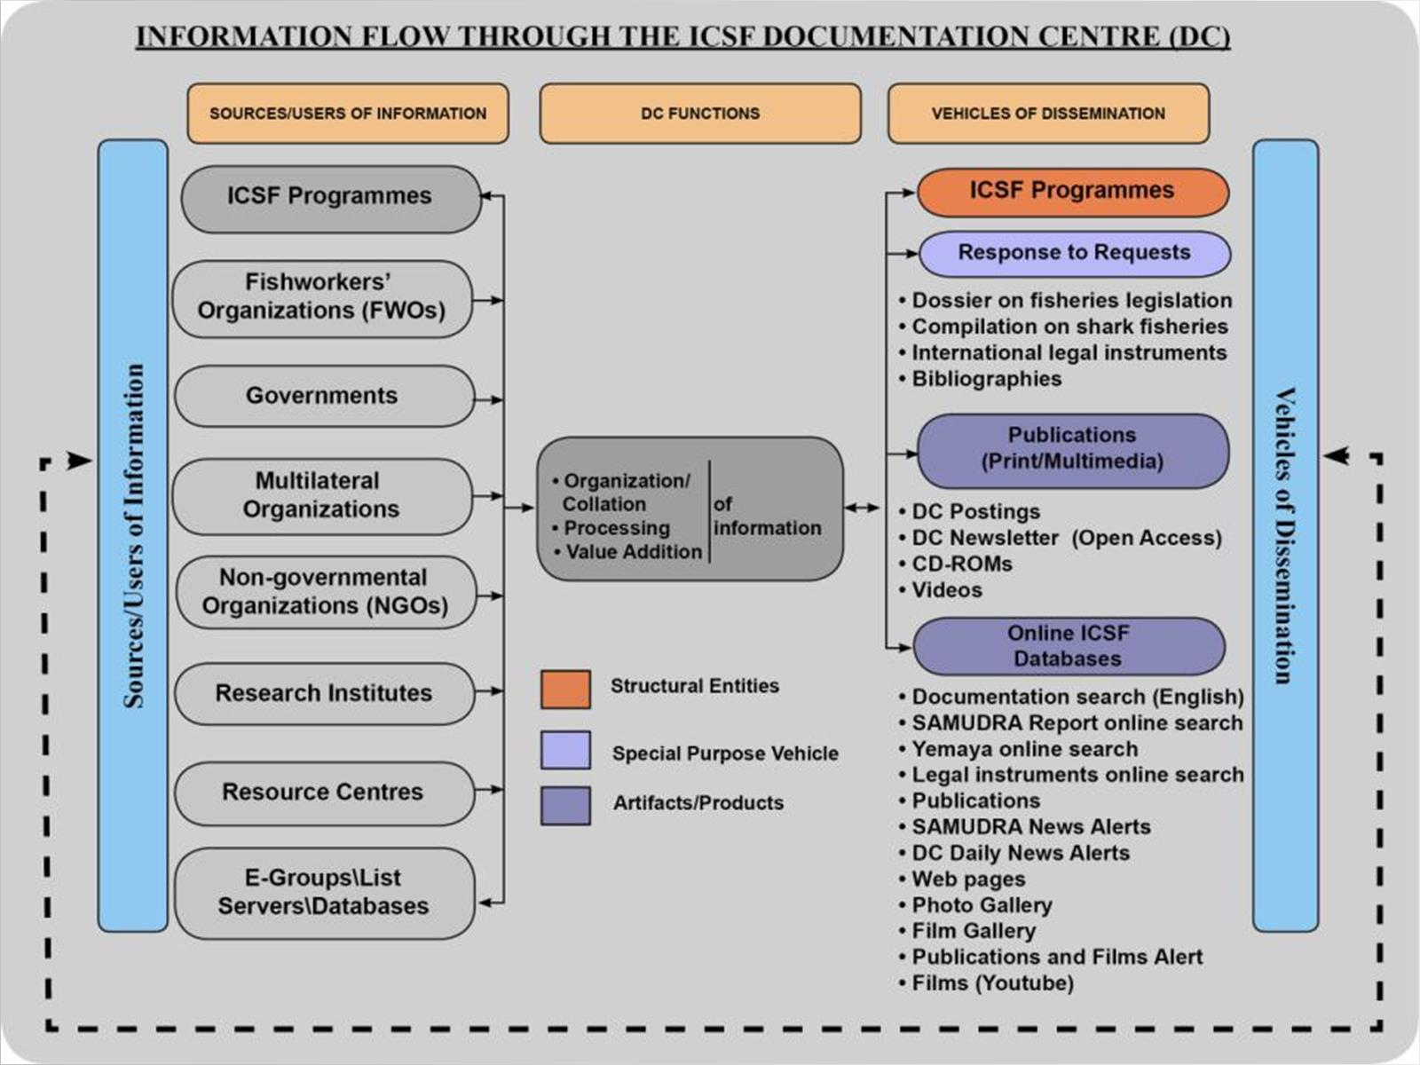

Slide 8
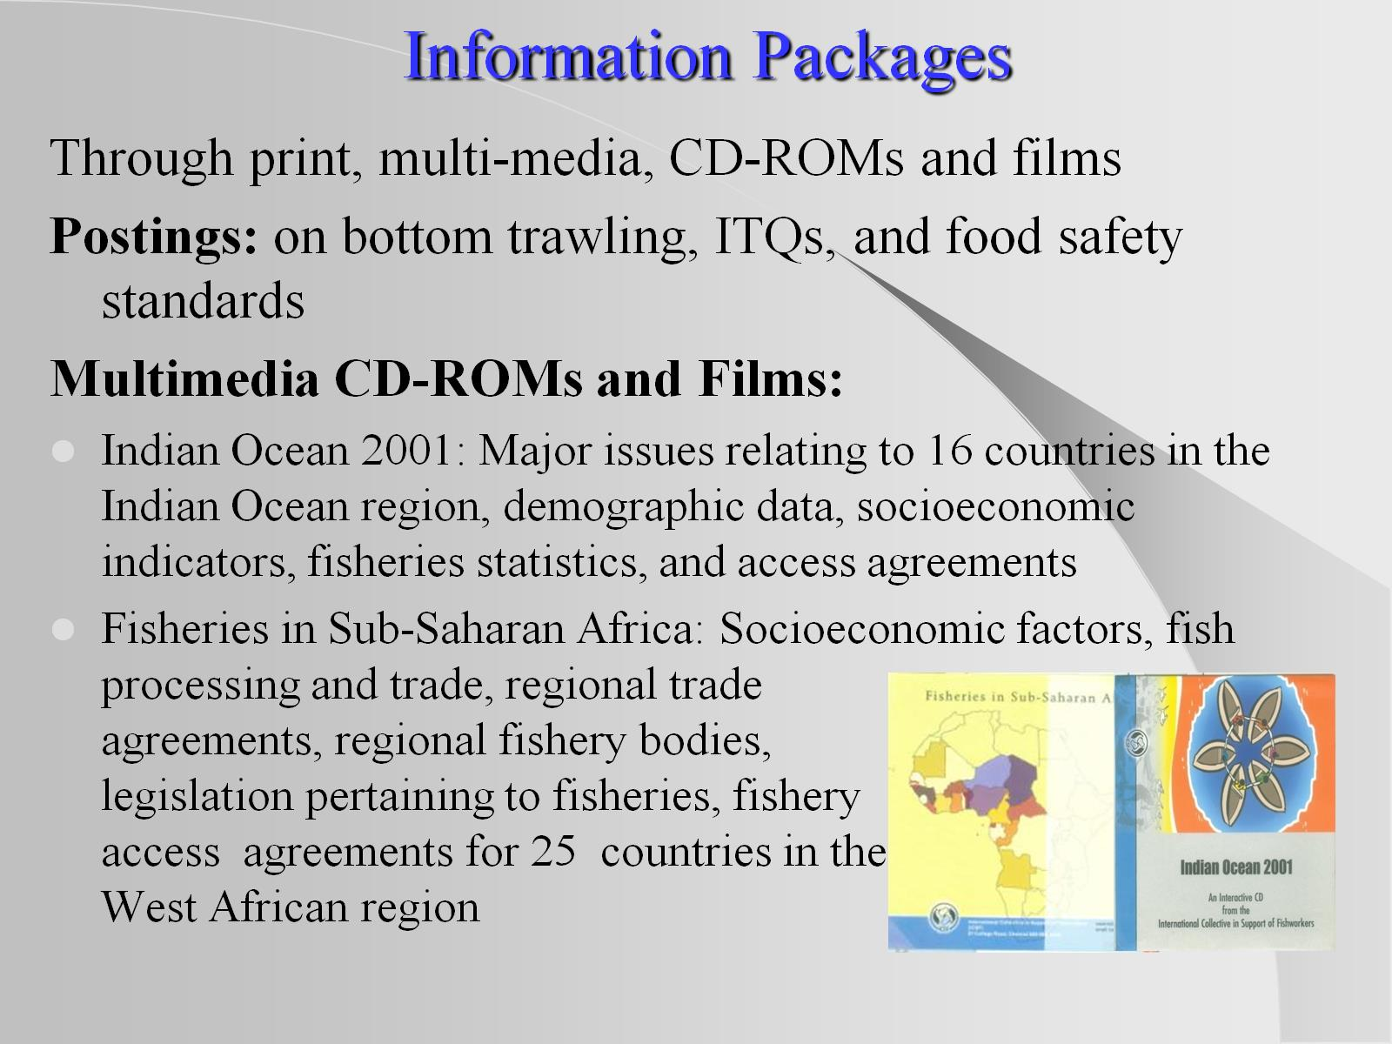
Information Packages

Slide 9
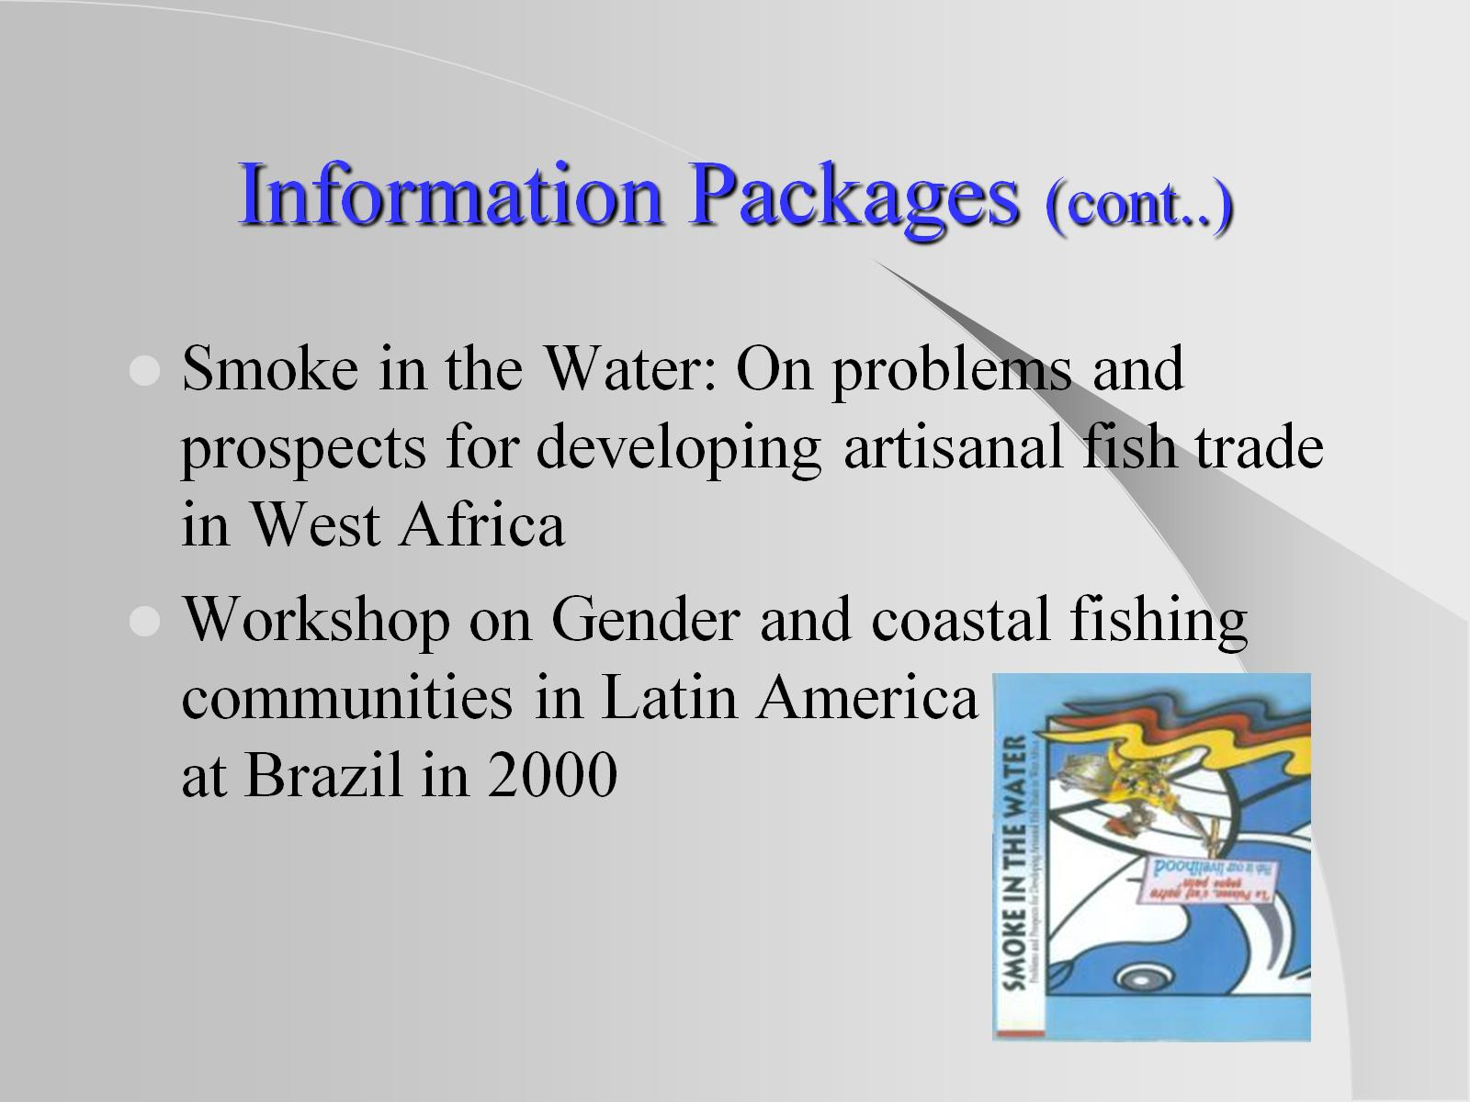
Information Packages (cont..)

Slide 10
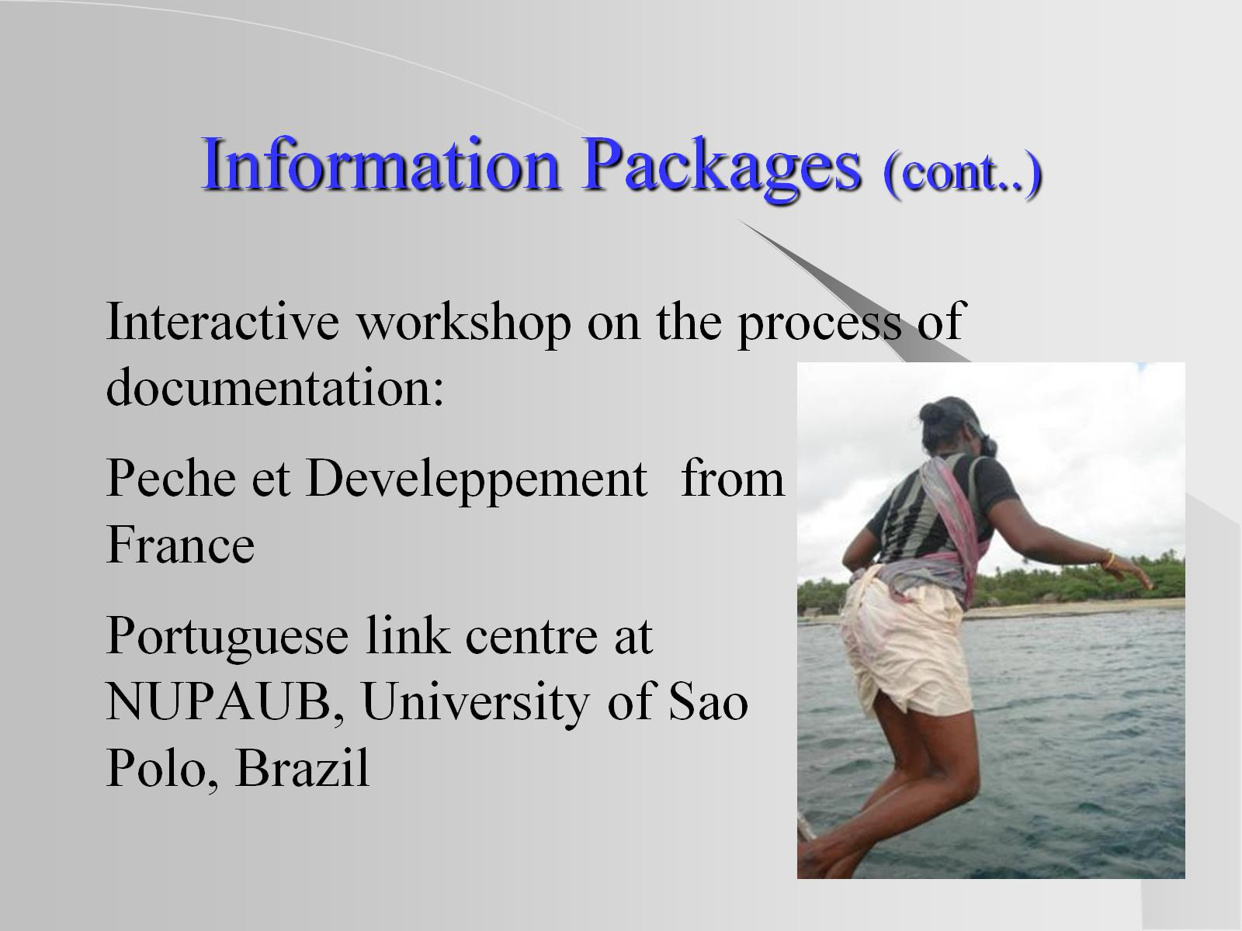
Information Packages (cont..)

Slide 11
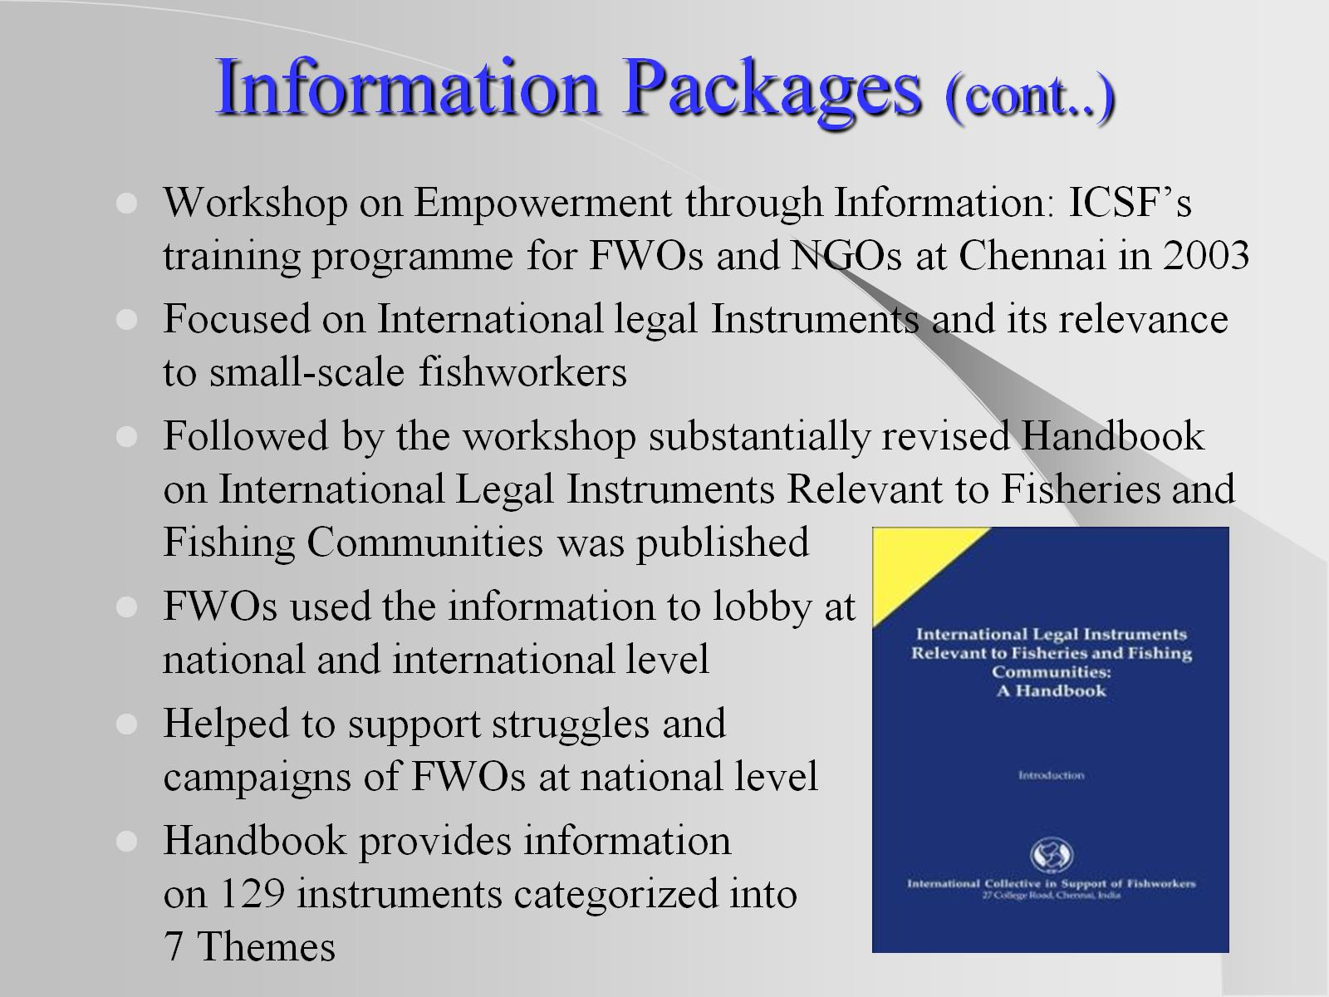
Information Packages (cont..)

Slide 12
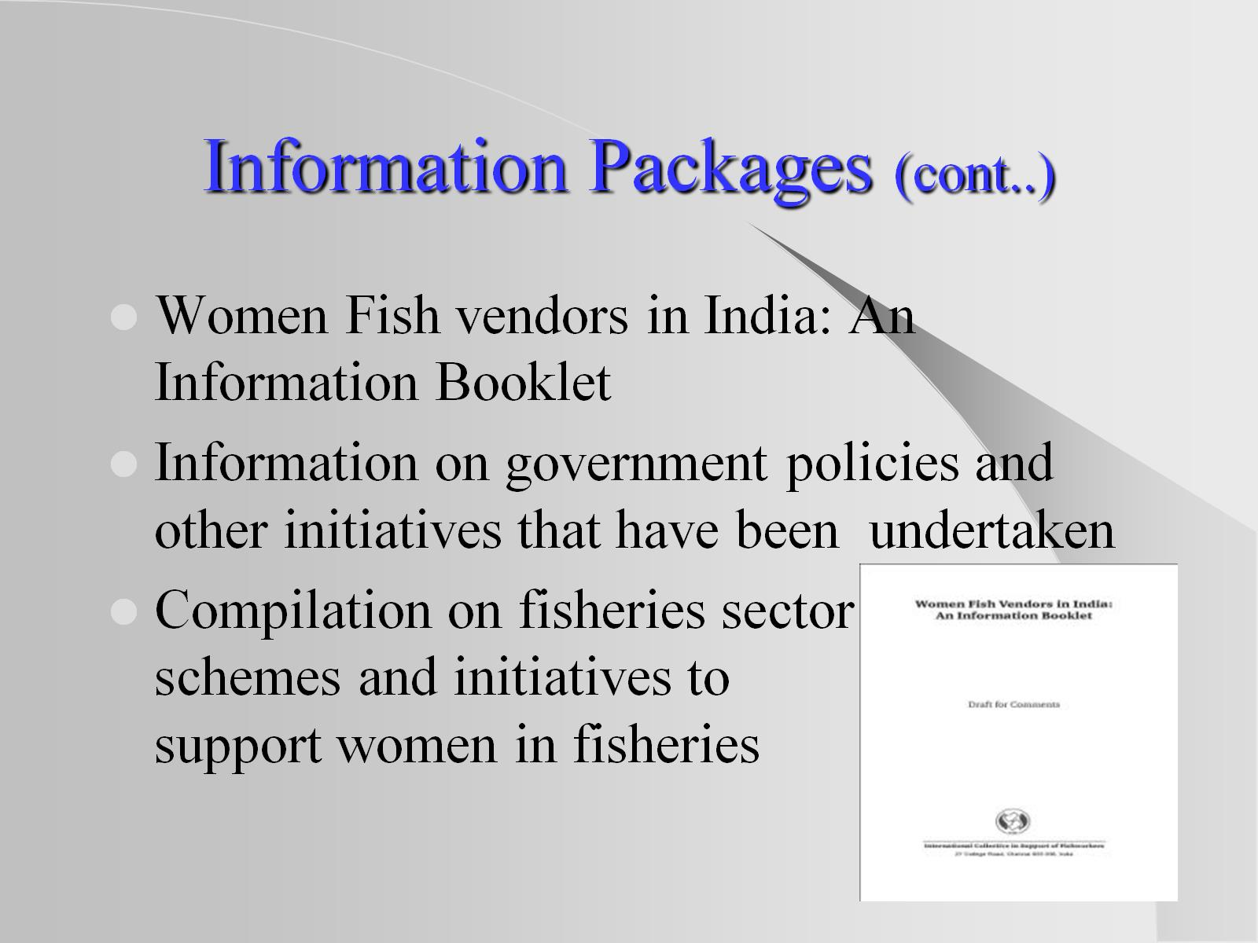
Information Packages (cont..)

Slide 13
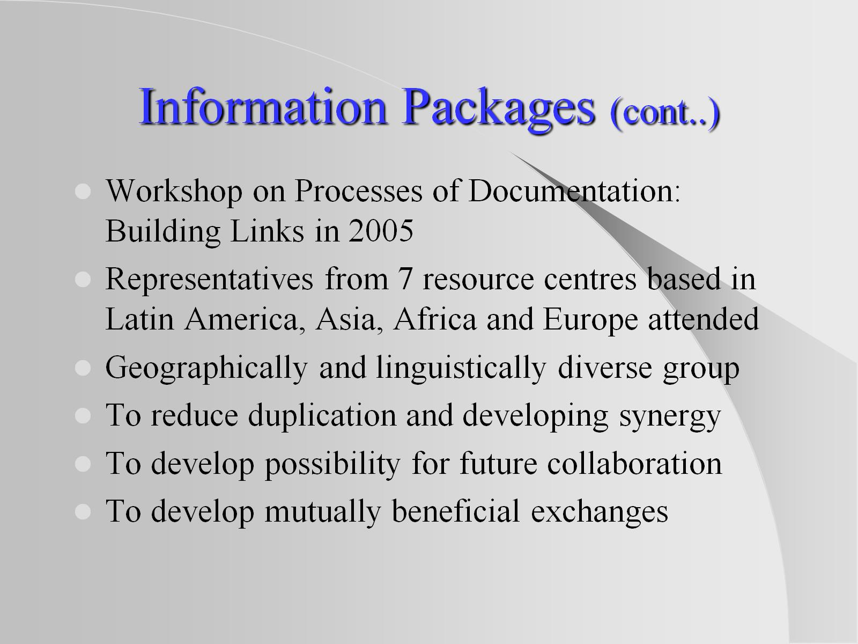
Information Packages (cont..)

Slide 14
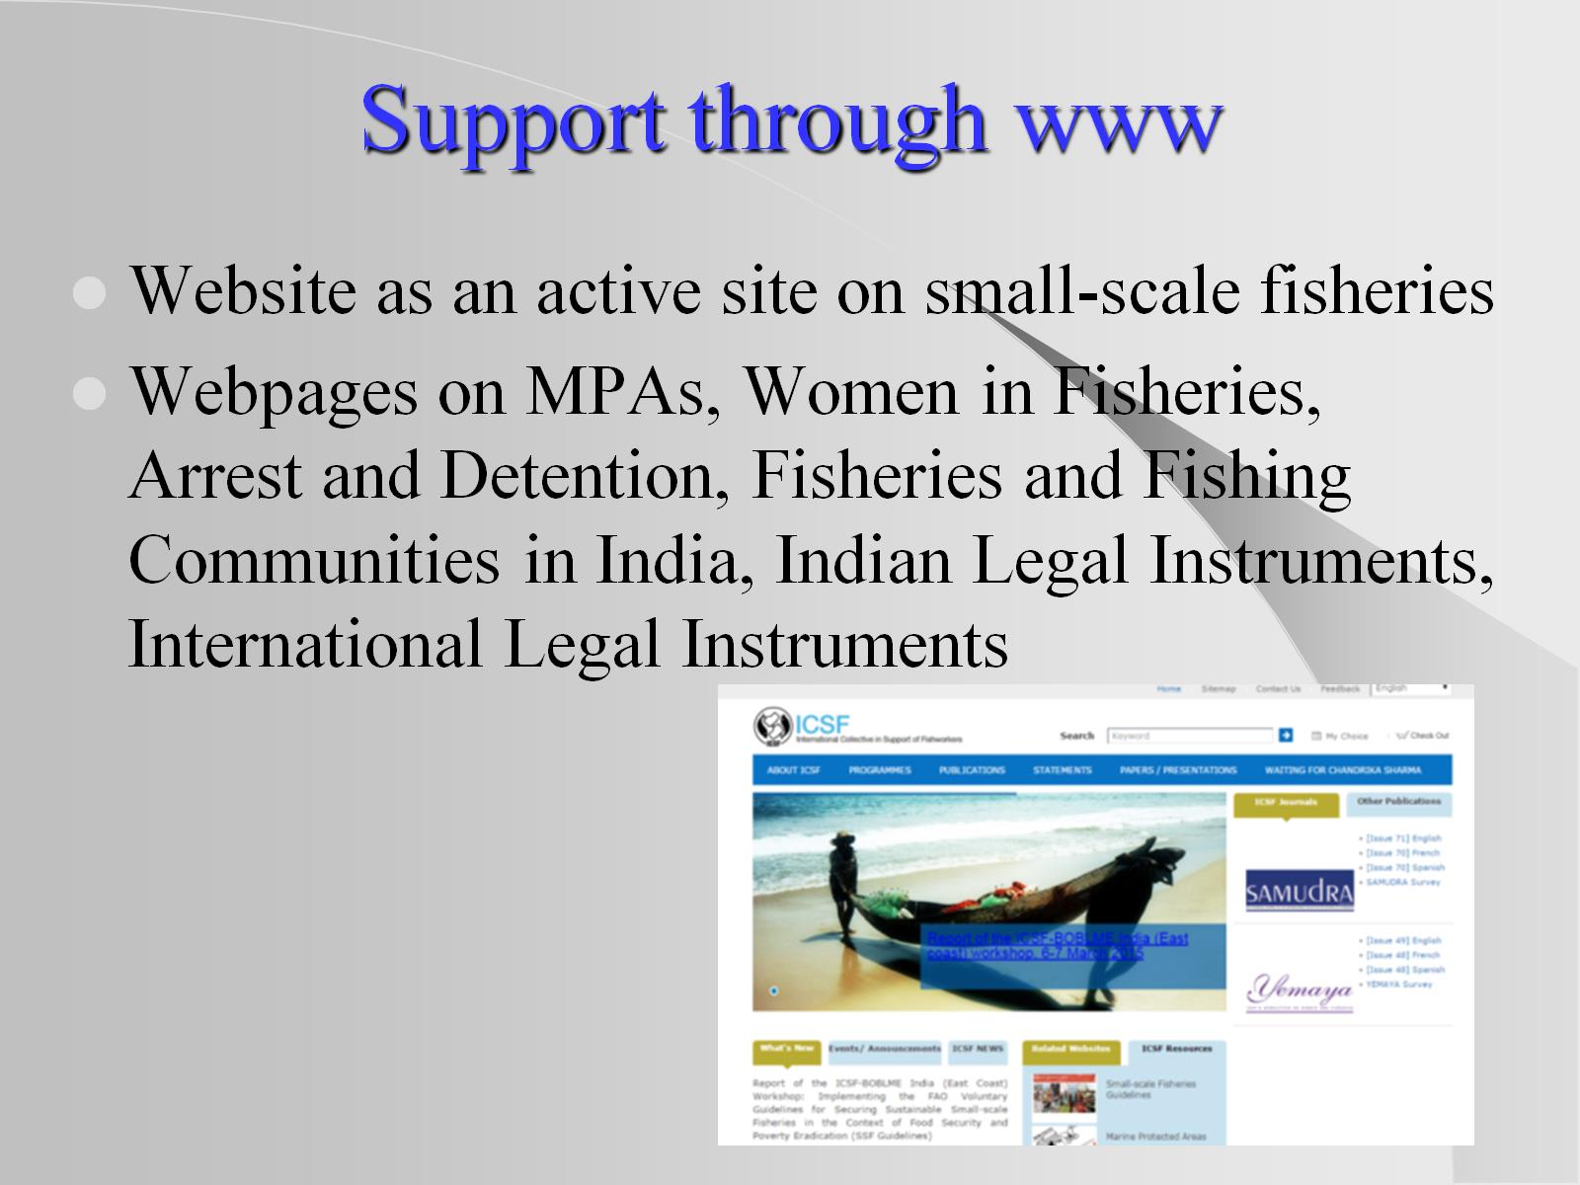
Support through www

Slide 15
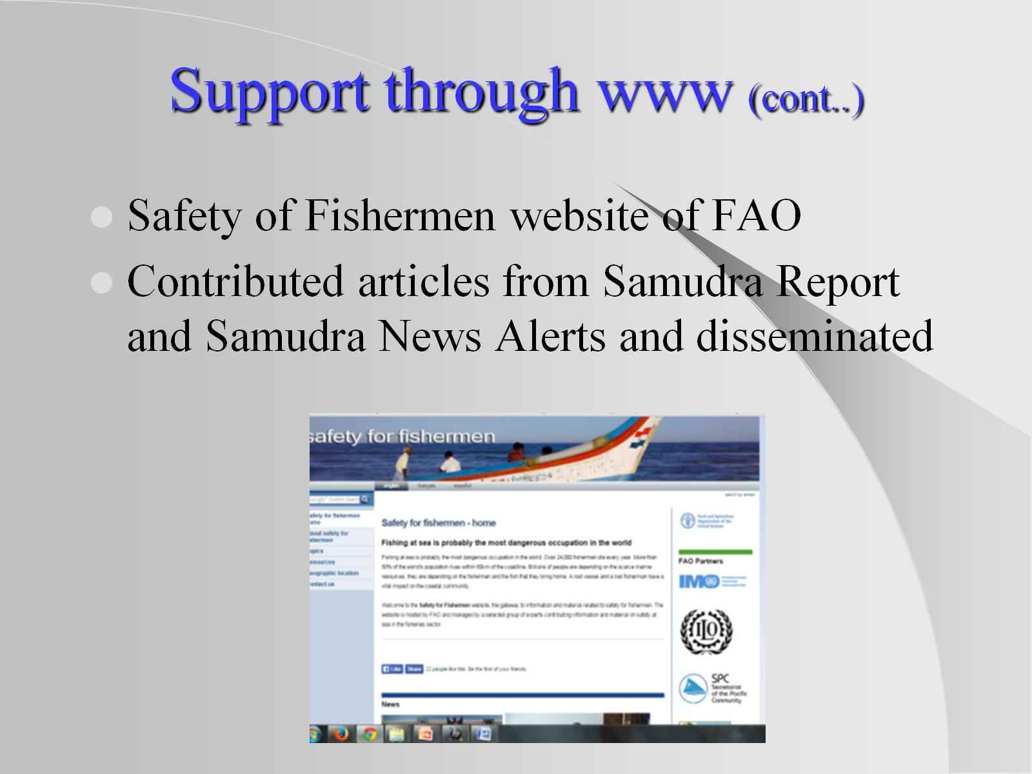
Support through www (cont..)

Slide 16
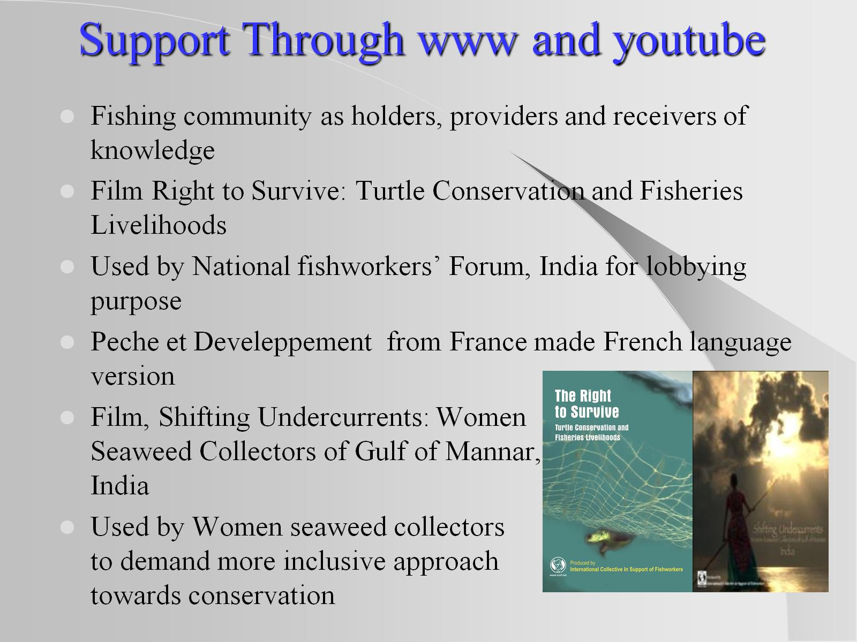
Support Through www and youtube

Slide 17
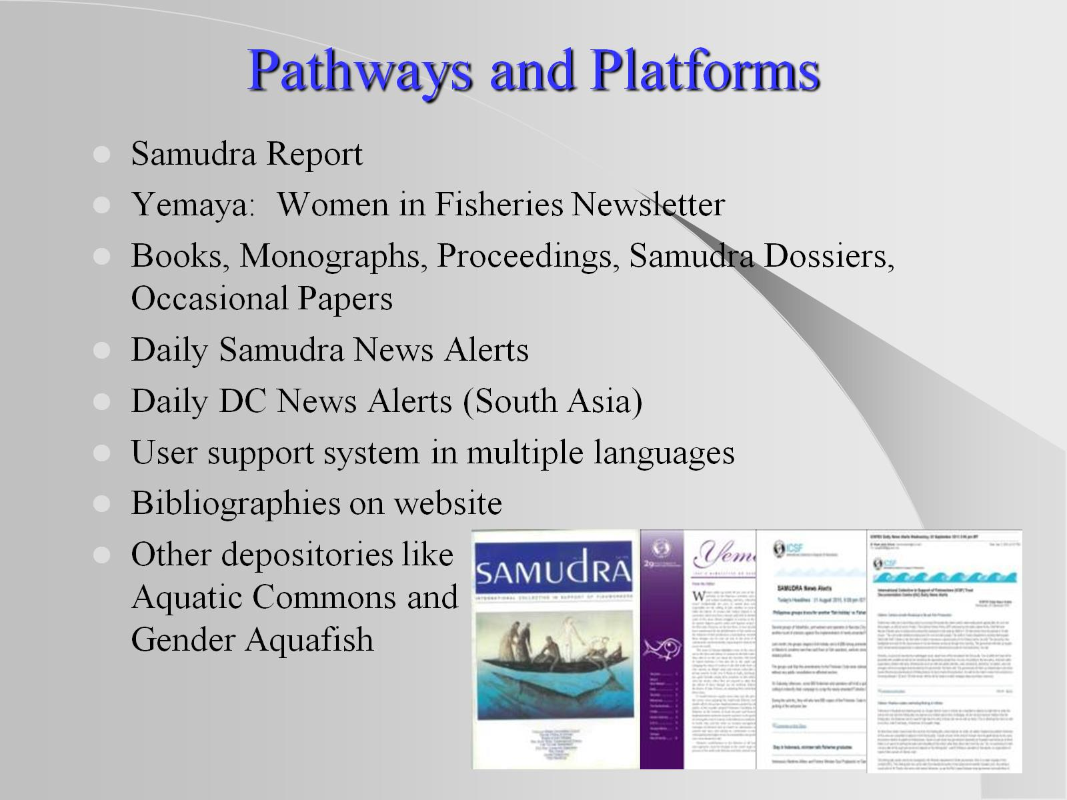
Pathways and Platforms

Slide 18
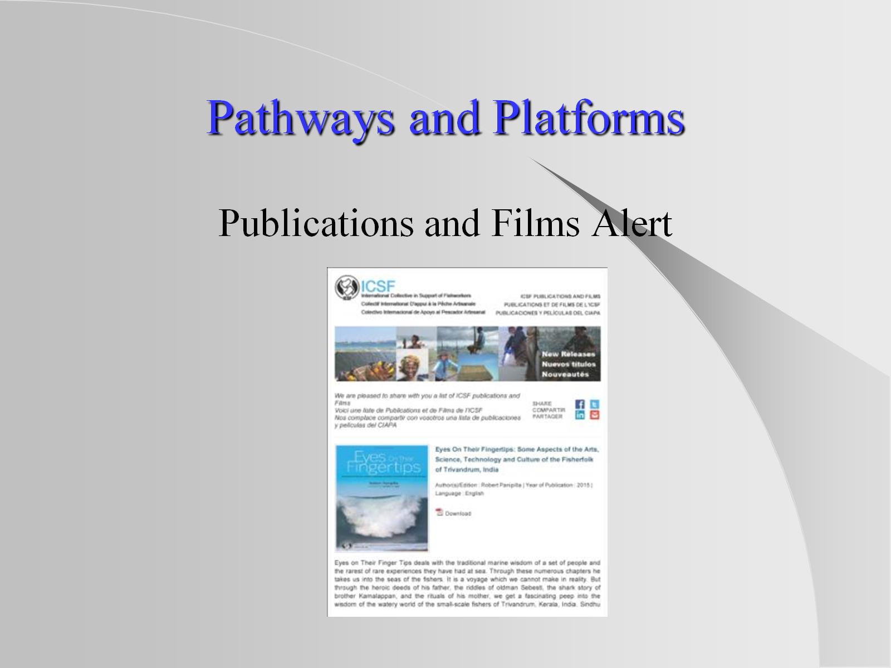
Pathways and Platforms

Slide 19
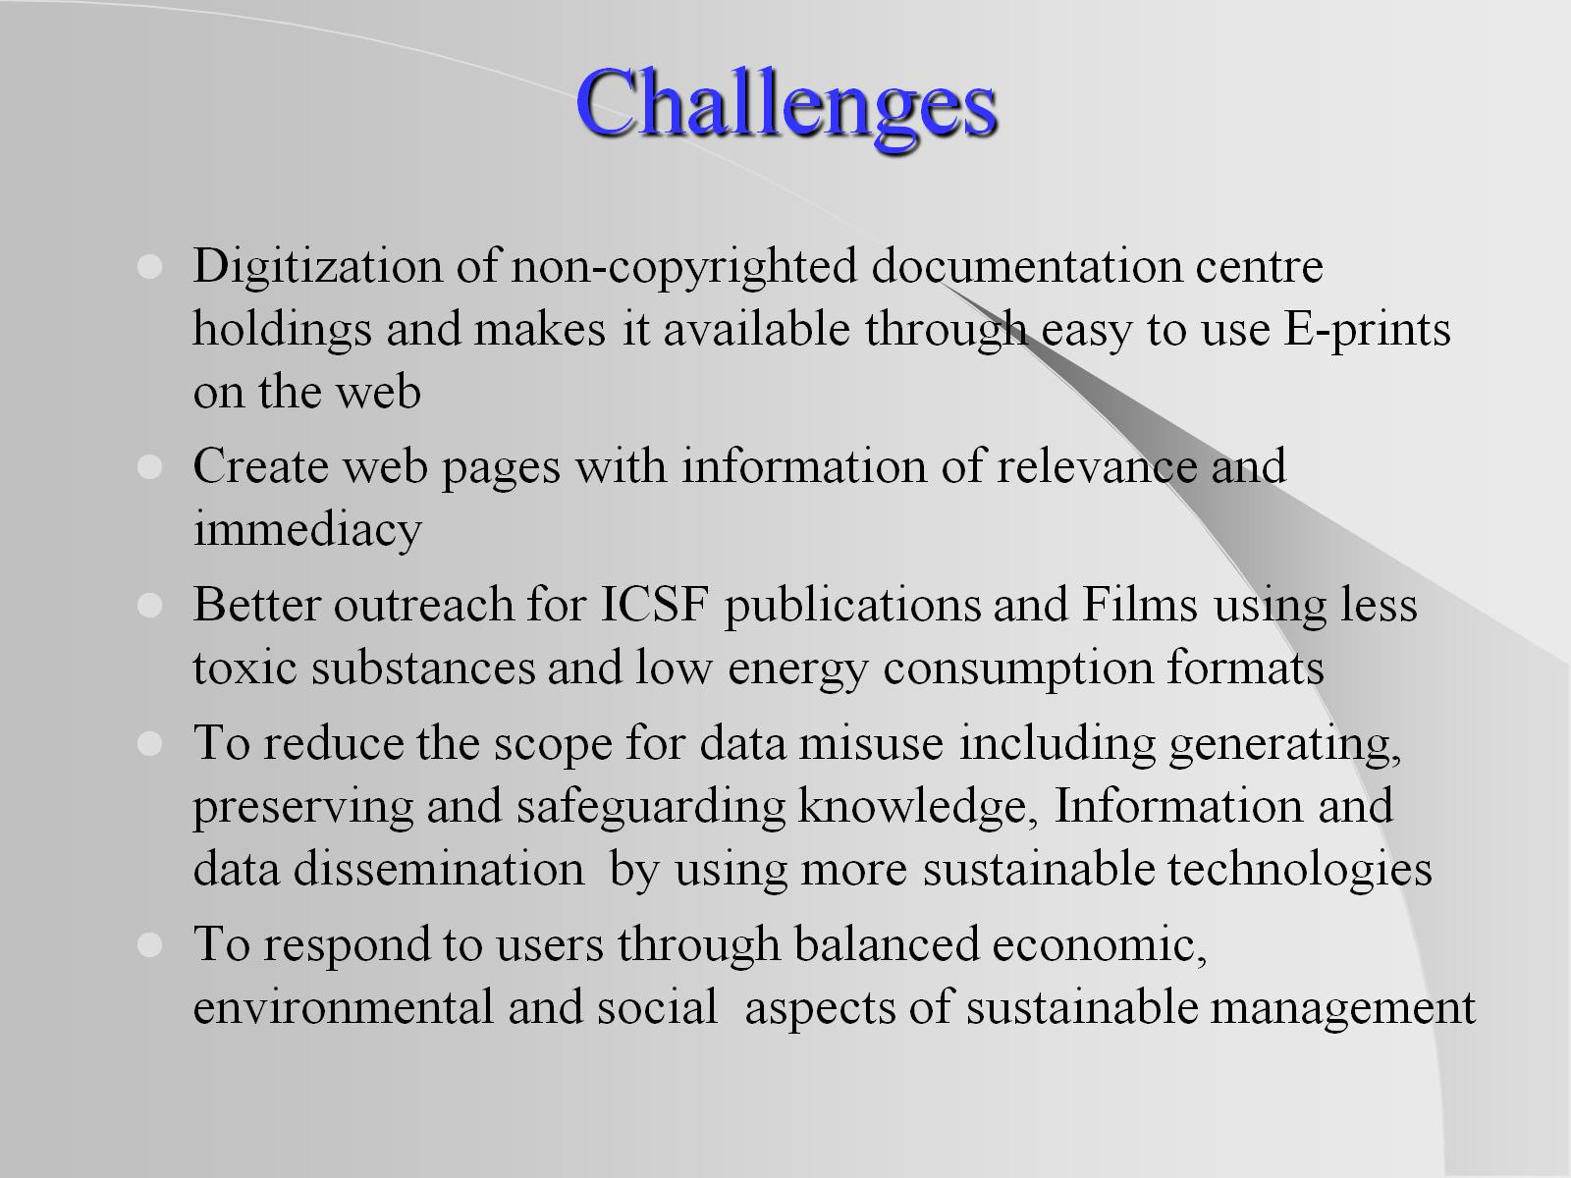
Challenges

Slide 20
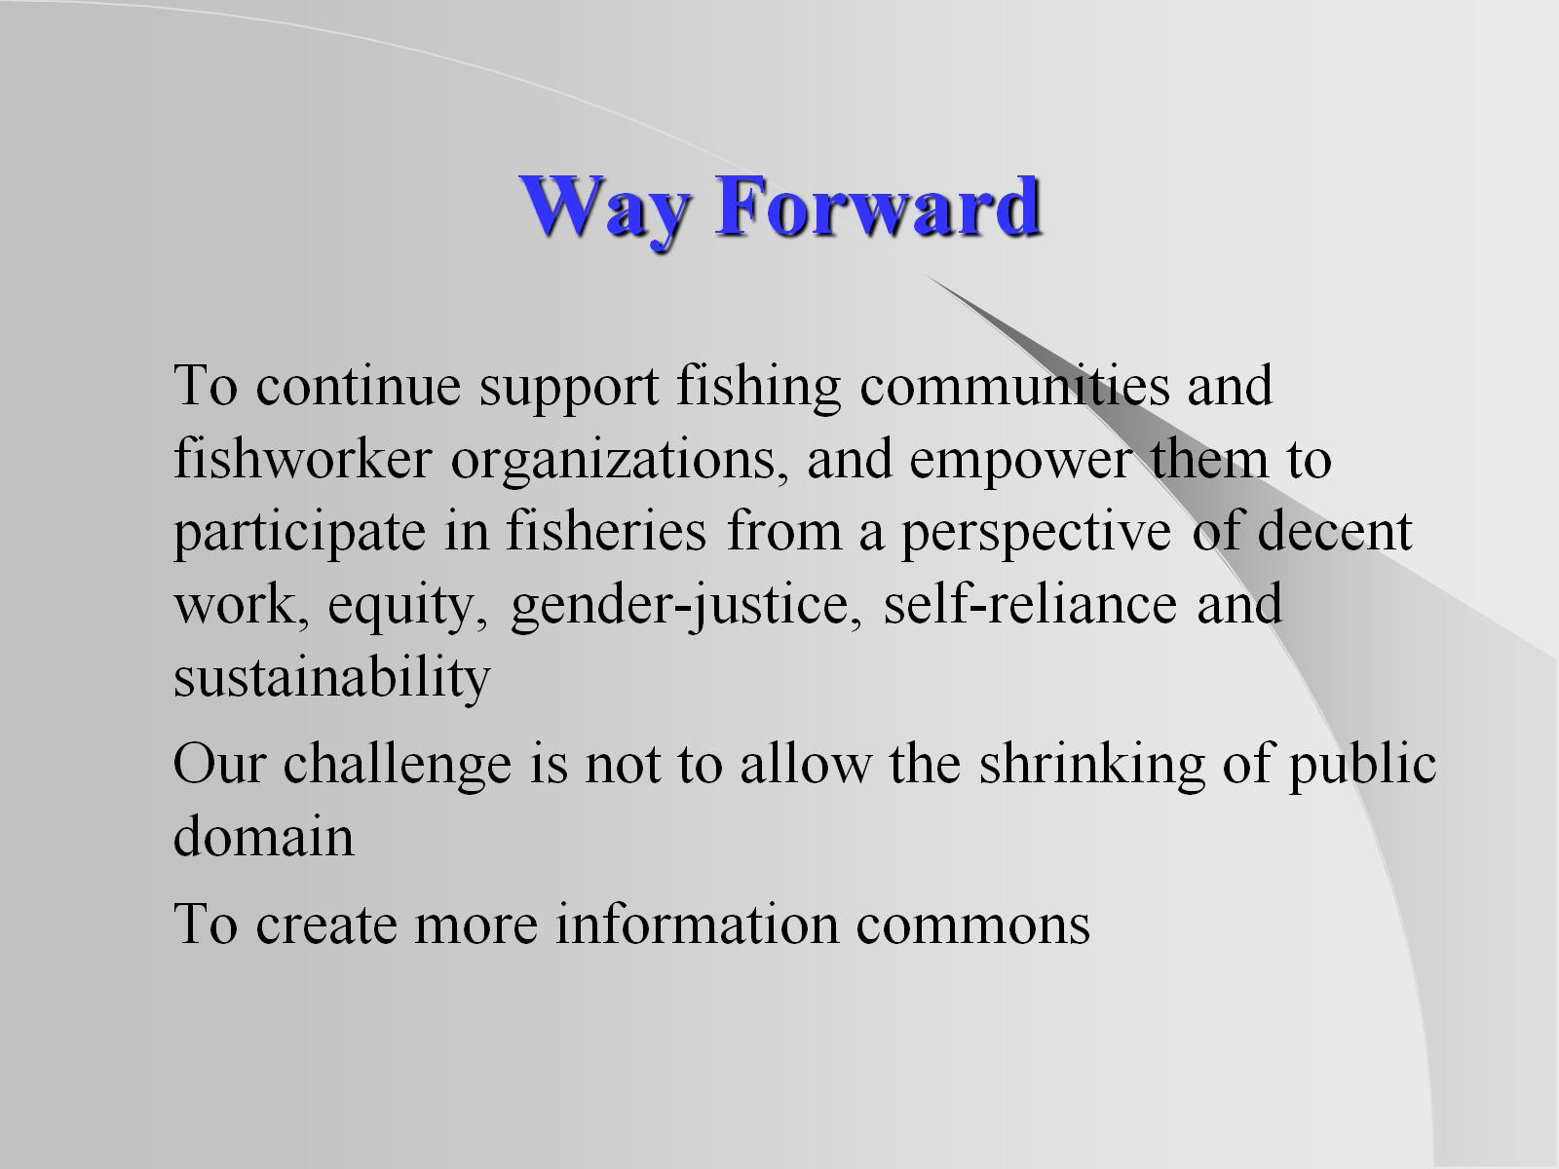
Way Forward

Slide 21
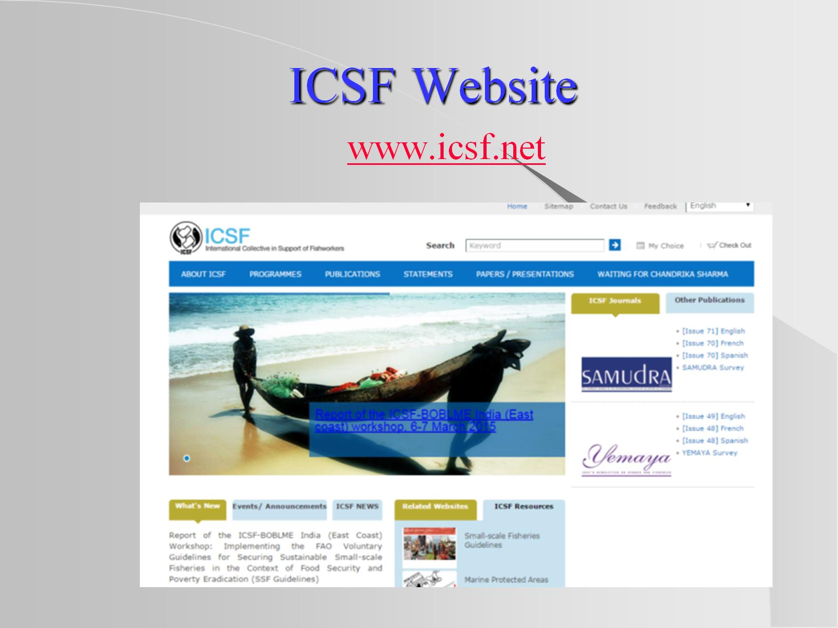
ICSF Website

Slide 22

Thank you

