Slide 1
Tamil Nadu Responsible Fishing: Challenges and Issues
International Collective in Support of Fishworkers (ICSF)
Venugopalan . N

Slide 2
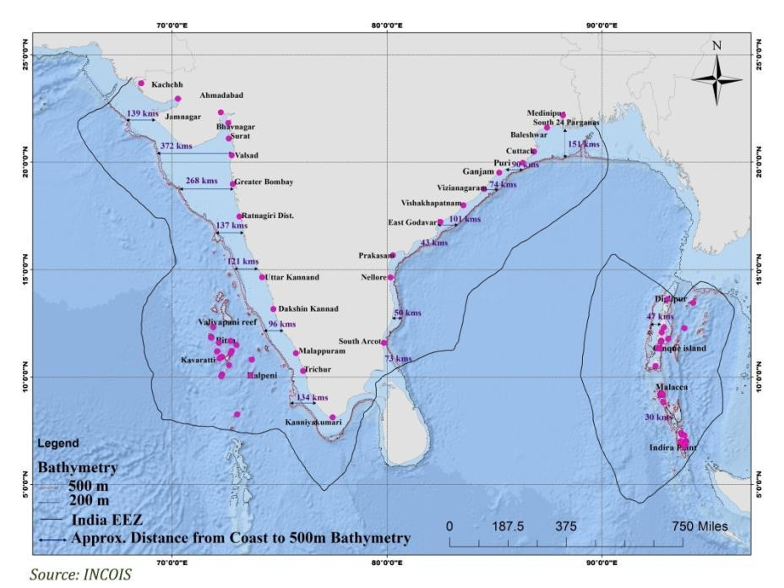
Indian EEZ

Slide 3
Tamil Nadu profile
 | India (without Islands) | Tamil Nadu
Coastal Length | 6,068 | 1,076 (18 per cent)
Fishing Villages | 3,288 | 573 (17.4 per cent)
Fisherfolk population | 3,999,214 | 802,912 (20 per cent)
Fish landing centres | 1,511 | 407 (27 per cent)
Active fishers | 9,90,083 | 2,14,064 (22 per cent)
Number of fishing craft | 194,490 | 46,070 (24 per cent)
Mechanized craft | 37 per cent (72,559) | 23 per c ent (10,692)
Motorized craft | 37 per cent (71,313) | 54 per cent (24,942)
Non –motorized craft | 36 per cent (50,618) | 23 per cent (10,436)
Source: CMFRI Census, 2010

Slide 4
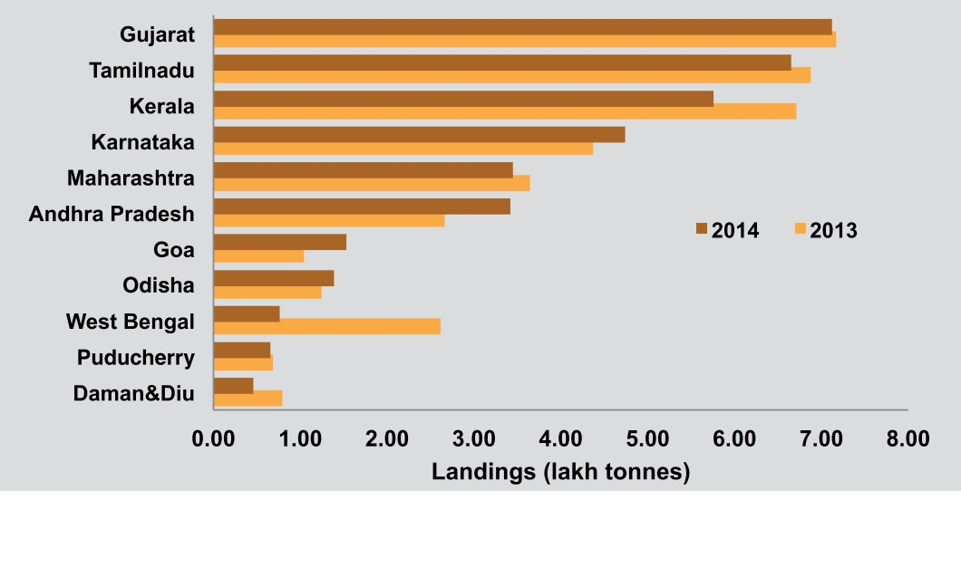
Fish Production
Total Marine fish production (2014): 3.59 million t
Tamil Nadu: 6.6 lakh t (second largest in India)
62 per cent of South-east India’ s fish production is from Tamil Nadu
Source: CMFRI Annual Report 2014-15

Slide 5
Tamil Nadu Marine Fish Production
Craft type | in %
Mechanized trawlers | 66.5
Mechanized ring seines | 6.6
Outboard gillnets | 14.3
Outboard ring seine | 2.7
Outboard hook and line | 2.2

Slide 6
Tamil Nadu Marine Fish Production
Pelagic finfishes 46%
Demersal finfishes 24%
Crustaceans 4%
Cephalapods 2%

Slide 7
How are we fishing?
Wide range of craft
Kattumaram
Fibre-reinforced Plastic boats
Vallams
Vathais (dug-out canoes)
Mechanized trawlers
Mechanized gillnetters
Ring seiners
Long-liners of Kanyakumari district (Thootoor boats)
Besides Tamil Nadu is also known for:
Divers for sea cucumbers and chanks
Women divers for seaweed harvesting
Women involved in crab harvesting

Slide 8
How are we fishing?
Gillnets
Trawls
Ring seines
Hook and line
Shore seines
Traps
Push nets
Boat seines
Longline, etc.

Slide 9
How are we fishing? Issues?
High diversity and keep evolving
Ineffective ban on ring seines and pair trawls
Enforce mesh size regulations for all gears
Enforce all gear related regulations by controlling the manufacture of these items
To make MFRA a more meaningful and a flexible tool
To provide delegation of authority to district level and panchayat level

Slide 10
Who is fishing?
Pattinavars in Coromandel Coast
Paravars of Gulf of Mannar Coast
Mukkuvars of Arabian Coast
Strong community institutions, including traditional panchayats, and other religious institutions
Boat owner association, trade unions, co-operatives and other forms of organizations such as women SHGs are also dominant in fisheries
Women play an important role in pre-harvest, harvest and post-harvest activities

Slide 11
Where are we fishing? When are we fishing?
Issues | Challenges
Fishing in new areas | Beyond zonation and beyond EEZ
Catch from other states and other countries | Arrest and detention, growth in production
New resources in coastal waters | To find appropriate market
Decrease in demersal species | To regulate bottom trawling
To maintain prey-predator relationship | Changes in targeting species
Lack of effective management to identify where fishing is taking place | Control of community

Slide 12
Where are we fishing? When are we fishing?
Issues | Challenges
No restrictions about ownership and where one can fish | To monitor the fleet size
Increase in horse power and increase in size | To develop a fleet management policy and develop standards for input control
Closed season | Limited utility
Promotion on deep sea fishing | Based on misplaced assessment
Increase in number of fishing days and single fishing trip of more than 15 days | Lack of sea safety training, sea worthiness, inadequate living conditions on board vessels, fatigue due to conditions at work

Slide 13
Different phases of Tamil Nadu Fisheries
1950s: Non-motorized fishing
1960s: Introduction of nylon nets
1970s: Introduction of trawlers on experimental basis, and late 1970s expansion of trawlers, leading to conflicts
1980s: Growth of mechanized sector
1990s: Growth of motorized sector
2000s: Decline in fish catch, overfishing; increase in fishing vessels
2014: Growth in fish production.
Fish Production in tons
Years

Slide 14
What are we fishing?

Slide 15
Resourcewise estimates of marine fish landings (in tonnes) in Tamil Nadu during 1985-2014
Resources | 1985 | 1990 | 1995 | 2000 | 2004 | 2013 | 2014
ELASMOBRANCHS
Sharks | 1654 | 937 | 7127 | 5731 | 9822 | 930 | 684
Skates | 174 | 49 | 512 | 181 | 768 | 167 | 370
Rays | 6779 | 6879 | 11507 | 10896 | 10834 | 9524 | 8732
Eels | 151 | 118 | 302 | 527 | 338 | 264 | 341
Catfishes | 2055 | 1521 | 3207 | 4942 | 3793 | 8135 | 5509
CLUPEIDS
Wolf herring | 2019 | 2413 | 1913 | 2278 | 2673 | 5487 | 4990
Oil sardine | 2896 | 31689 | 29611 | 52694 | 54948 | 182427 | 78570
Other sardines | 20945 | 19611 | 53475 | 38346 | 29400 | 72823 | 111254
Hilsa shad | 251 | 20 | 381 | 84 | 12 | 20 | 46
Other shads | 2349 | 1163 | 2353 | 3107 | 564 | 6637 | 7286
Anchovies
Coilia | 382 | 2990 | 1098 | 1315 | 394 | 76 | 2554
Setipinna | 37 | 600 | 31 | 291 | 73 | 58 | 480
Stolephorus | 8233 | 9000 | 11315 | 9671 | 8669 | 6662 | 9358
Thrissina | 0 | 0 | 0 | 22 | 0
Thryssa | 6738 | 4494 | 5794 | 7016 | 4113 | 9169 | 6787
Other clupeids | 5029 | 13085 | 9559 | 13469 | 6795 | 11865 | 14918
BOMBAYDUCK | 0 | 46 | 27 | 2 | 28 | 0
LIZARD FISHES | 1963 | 5188 | 8220 | 3325 | 4561 | 6676 | 5051
HALF BEAKS & FULL BEAKS | 711 | 1100 | 1214 | 5152 | 1714 | 2238 | 3616
FLYING FISHES | 605 | 786 | 3968 | 1918 | 2392 | 1759 | 3693

Slide 16
Resourcewise estimates of marine fish landings (in tonnes) in Tamil Nadu during 1985-2014
Resources | 1985 | 1990 | 1995 | 2000 | 2004 | 2013 | 2014
PERCHES
Rock cods | 1785 | 988 | 2747 | 3310 | 3337 | 2383 | 1973
Snappers | 936 | 581 | 1663 | 2355 | 4155 | 3223 | 4405
Pig-face breams | 1951 | 3545 | 8835 | 9939 | 10111 | 9197 | 11560
Threadfin breams | 2783 | 11290 | 12564 | 3250 | 4728 | 13668 | 10580
Other perches | 4645 | 5700 | 11780 | 9332 | 9876 | 20737 | 18291
GOATFISHES | 2171 | 9897 | 4846 | 6835 | 5885 | 10671 | 9321
THREADFINS | 397 | 869 | 601 | 572 | 486 | 2935 | 2002
CROAKERS | 7840 | 12347 | 15537 | 10605 | 7859 | 14885 | 12715
RIBBON FISHES | 7892 | 3077 | 2369 | 4507 | 3941 | 4936 | 5943
CARANGIDS
Horse Mackerel | 99 | 36 | 309 | 716 | 480 | 1009 | 2041
Scads | 238 | 7889 | 3160 | 1060 | 3107 | 14819 | 12821
Leather-jackets | 2797 | 690 | 963 | 1053 | 2963 | 2183 | 1720
Other carangids | 10193 | 14547 | 18715 | 16728 | 19765 | 19932 | 19364
SILVERBELLIES | 37407 | 37913 | 48927 | 33569 | 32789 | 78244 | 82049
BIG-JAWED JUMPER | 611 | 633 | 521 | 304 | 245 | 382 | 110
POMFRETS
Black pomfret | 185 | 395 | 1576 | 1368 | 817 | 572 | 662
Silver pomfret | 151 | 924 | 1824 | 1374 | 1698 | 3266 | 2577
Chinese pomfret | 2 | 4 | 15 | 2 | 106 | 43 | 30
MACKERELS
Indian mackerel | 6080 | 6956 | 23261 | 10799 | 20058 | 14621 | 19346
Other mackerels | 0 | 22 | 3 | 0 | 0 | 0 | 17

Slide 17
Resourcewise estimates of marine fish landings (in tonnes) in Tamil Nadu during 1985-2014
Resources | 1985 | 1990 | 1995 | 2000 | 2004 | 2013 | 2014
SEER FISHES
S. commersoni | 2524 | 2933 | 4961 | 12835 | 6671 | 4429 | 5691
S. guttatus | 763 | 202 | 757 | 168 | 113 | 727 | 346
S. lineolatus | 22 | 2 | 24 | 51 | 1 | 0 | 12
Acanthocybium spp. | 0 | 0 | 0 | 2 | 19 | 12 | 90
TUNNIES
E. affinis | 783 | 2308 | 2259 | 4110 | 3787 | 9649 | 5901
Auxis. Spp | 47 | 331 | 707 | 902 | 500 | 1740 | 1588
K. pelamis | 13 | 54 | 22 | 1817 | 464 | 2270 | 2064
T. tonggol | 0 | 0 | 762 | 109 | 667 | 0 | 5
Other tunnies | 493 | 829 | 153 | 1497 | 1408 | 5668 | 4415
BILL FISHES | 261 | 79 | 156 | 254 | 1068 | 1285 | 750
BARRACUDAS | 1309 | 4694 | 5306 | 8035 | 4546 | 7323 | 5892
MULLETS | 429 | 304 | 808 | 965 | 525 | 7394 | 3010
UNICORN COD | 0 | 0 | 0 | 7 | 0 | 0
FLAT FISHES
Halibut | 296 | 1104 | 618 | 230 | 228 | 345 | 363
Flounders | 21 | 58 | 27 | 39 | 2 | 5 | 2
Soles | 1219 | 2334 | 2566 | 2206 | 1574 | 1137 | 1905

Slide 18
Resourcewise estimates of marine fish landings (in tonnes) in Tamil Nadu during 1985-2014
Resources | 1985 | 1990 | 1995 | 2000 | 2004 | 2013 | 2014
CRUSTACEANS
Penaeid prawns | 11304 | 19110 | 28038 | 22004 | 14912 | 25675 | 27048
Non-penaeid prawns | 165 | 68 | 677 | 2002 | 2871 | 2551 | 600
Lobsters | 442 | 365 | 294 | 142 | 226 | 299 | 208
Crabs | 6575 | 6827 | 11568 | 13682 | 13332 | 14507 | 15746
Stomatopods | 287 | 145 | 729 | 327 | 1054 | 368 | 95
MOLLUSCUS
Bivalves | 1147 | 2695 | 28 | 62 | 141 | 5280 | 3826
Gastropods | 40 | 144 | 513 | 22 | 810 | 764 | 1354
Cephalopods | 4441 | 7436 | 14929 | 9569 | 15464
Squids |  |  |  |  |  | 9255 | 5204
Cuttlefish |  |  |  |  |  | 10051 | 10432
Octopus |  |  |  |  |  | 1259 | 1417
Seacow |  |  |  |  |  | 0 | 0
Whale |  |  |  |  |  | 0 | 0
Seaweeds |  |  |  |  |  | 0 | 0
Miscellaneous | 16836 | 31261 | 34192 | 33650 | 48073 | 32976 | 85147
TOTAL | 200551 | 303275 | 421924 | 393332 | 392753 | 687592 | 664877

Slide 19
What are we fishing? Issues?
Changes in species composition
Mismatching fisheries statistics
Gap between scientific research and fisheries management
Five fold increase in catch from 1, 10, 000 tonnes in 1956 to a Peak 6, 60, 000 tonnes in 2014
Doubled the active fishermen population from 1,28,585 in 1986 to 2,14,064 in 2010

Slide 20
What are we fishing? Issues?
Contribution of sardine to total landings is 29%
Behind increase in catch lies a complex picture
Lack of information at the level of stock of individual species
Lack of information about Oil sardine growth
Many of the species seem to be spread much beyond the administrative boundaries of TN
Almost all species are caught by a wide range of gear
Is it sustainable?
Is it responsible fishing?

Slide 21
History of responsible fishing
Introduced first through the three-day—four-day fishing rule in Palk bay in late 1970s
Tamil Nadu Marine Fishing Regulation Act and Rules – enacted in 1983
focus on regulations, restrictions, and prohibition of fishing by fishing vessels in the sea
Created a three mile zone for traditional fishing
Ban on purse seine and pair trawling
Introduction of seasonal fishing ban for 45 days, to be expanded into 60 days in future
Licence and registration of fishing vessels
Ban on night fishing
However, most of the regulations are not strictly implemented, leading to further conflicts between mechanized and motorized/non-motorized sector

Slide 22
Issues, Challenges and Solutions
Lack of political will in implementation of existing rules and regulations
Existing community structures/institutions and their regulations not legally recognized such as the Padu system or gear restrictions imposed by traditional panchayats
Improper implementation of license and registration of fishing vessels
Overcapacity and investment in fishing fleet
Increase in number of fishing fleet, and further expansion in terms of increase in engine power, hold capacity
Change in species diversity in the last few years
Increase in production of Oil sardine and reduction in mackerel
Change in species composition, while there is also size reduction in most species landed

Slide 23
Issues, Challenges and Solutions
Inequitable access to fisheries resources (mechanized sector with low labour force having access to major fisheries resources)
Continued pair trawling and purse seining in different areas
Introduction of deep sea long-liners
Need to look at the resource capacity, international regulations (such as IOTC), proper registration and licence procedures, issues of safety at sea
Lack of proper registration of existing vessels with all details
Increase in transboundary fishing
Non-participatory decision-making process
Community governance structures not involved in any form of decision-making process
Look at post-harvest and trade implications of fisheries as well
Need to minimize on loss, and provide access to women for first sale
Number of species are listed in schedule I of the Wildlife (Protection) Act, 1972 such as sea cucumbers which have affected the divers

Slide 24
Policy related international instruments
1995 FAO Code of Conduct for Responsible Fisheries
1982 United Nations Convention on the Law of the Sea
1995 United Nations Fish Stocks Agreement
2014 Voluntary Guidelines for Securing Sustainable Small-scale Fisheries in the Context of Food Security and Poverty Eradication
2012 The Voluntary Guidelines on the Responsible Governance of Tenure of Land, Fisheries and Forests in the Context of National Food Security

Slide 25
Policy related international instruments
States and all those engaged in fisheries management should, through an appropriate policy, legal and institutional framework, adopt measures for the long term conservation and sustainable use of fisheries resources. Conservation and management measures, whether at local, national, sub regional or regional levels, should be based on the best scientific evidence available and be designed to ensure the long-term sustainability of fishery resources at levels which promote the objective of their optimum utilization and maintain their availability for present and future generations; short-term considerations should not compromise these objectives.
Source: CCRF, Article 7

Slide 26
Policy related international instruments
Fisheries management should promote the maintenance of the quality, diversity and availability of fishery resources in sufficient quantities for present and future generations in the context of food security, poverty alleviation and sustainable development. Management measures should not only ensure the conservation of target species but also of species belonging to the same ecosystem or associated with or dependent upon the target species.
Source: CCRF, Article 6.2

Slide 27
Policy related international instruments
States should recognize that responsible fisheries requires the availability of a sound .scientific basis to assist fisheries managers and other interested parties in making decisions. Therefore, States should ensure that appropriate research is conducted into all aspects of fisheries including biology, ecology, technology, environmental science, economics, social science, aquaculture and nutritional science. States should ensure the availability of research facilities and provide appropriate training, staffing and institution building to conduct the research, taking into account the special needs of developing countries.
Source: CCRF, Article 12.1

Slide 28
Policy related international instruments
States, in accordance with their legislation, should ensure that small-scale fishers, fish workers and their communities have secure, equitable, and socially and culturally appropriate tenure rights to fishery resources (marine and inland) and small-scale fishing areas and adjacent land, with a special attention paid to women with respect to tenure rights.
Source: VGSSF 2015

Slide 29
Policy related international instruments
States and all those engaged in fisheries management should adopt measures for the long-term conservation and sustainable use of fisheries resources and to secure the ecological foundation for food production. They should promote and implement appropriate management systems, consistent with their existing obligations under national and international law and voluntary commitments, including the Code, that give due recognition to the requirements and opportunities of small scale fisheries.
Source: VGSSF 2015

Slide 30
Conclusion
Time to look at the fleet strength, limited entry and redeployment if necessary
To develop detailed estimate of fish resources harvested
To disseminate management advisories from time to time
Fisheries management system as a whole is weak
Integrate local community based management measures
To develop marine fishing policy for short term and long term with the help of scientific institutions and FWOs
FM is increasingly impacted by coastal development in other sectors
To develop coordination with other departments to asses the impacts
Without incentives and drivers like subsidized inputs and high fish prices

Slide 31
Conclusion
To develop incentives for fisheries conservation and management measures undertaken
Better participation of stakeholders in fisheries management meetings
Better funding for such meetings
Current stress is more on welfare and less on management
Better preparedness to meet natural disasters
Creating and improving facilities for cleaning and processing fish under hygienic conditions at landing centres and harbours, and developing clean fish markets with availability of water and sanitation facilities, learning from the example of existing markets,
To develop along term policy with Objectives, Methods of implementation, the role of rights, impact assessment and policy coherence with developments on the coast
To develop an enabling Act with a preamble which allows Executive to make timely changes

Slide 32
Thank You

