Slide 1
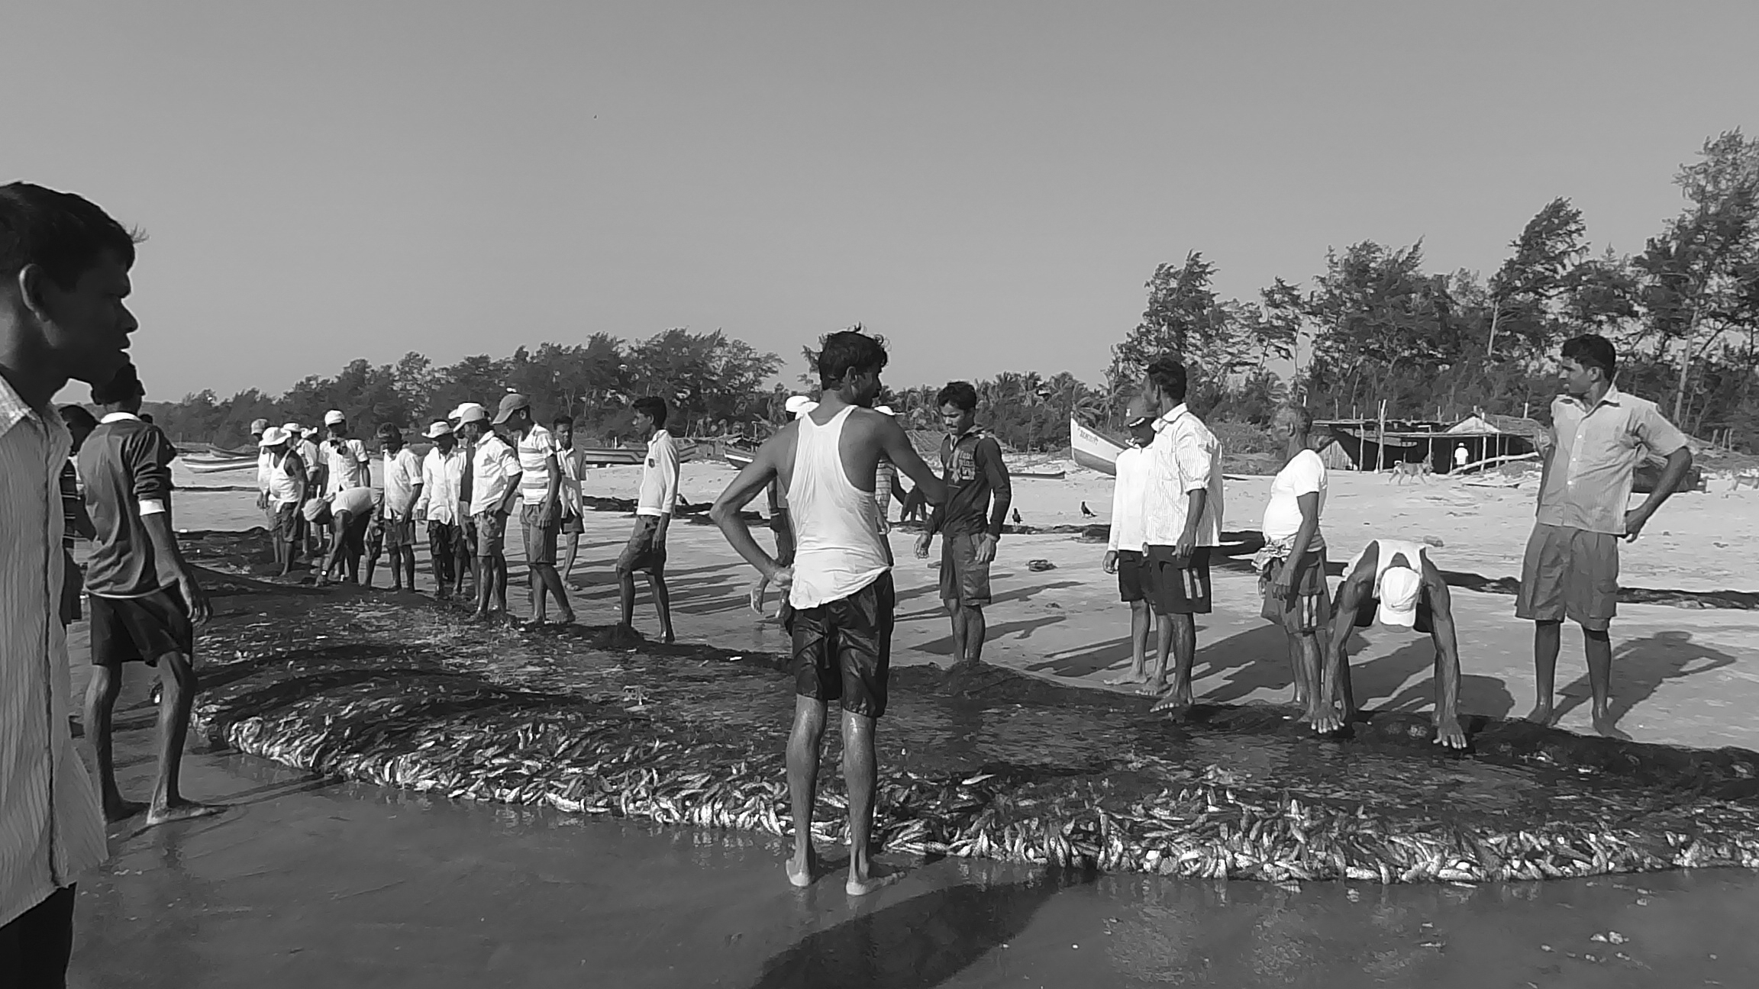
Oceans and Sustainable Development: Adopting a Human Rights-based Approach in Small-scale Fisheries
Sebastian Mathew
International Collective in Support of Fishworkers (ICSF)
ICP 16, United Nations, New York
07 April 2015
Shuddhawati Peke/India

Slide 2
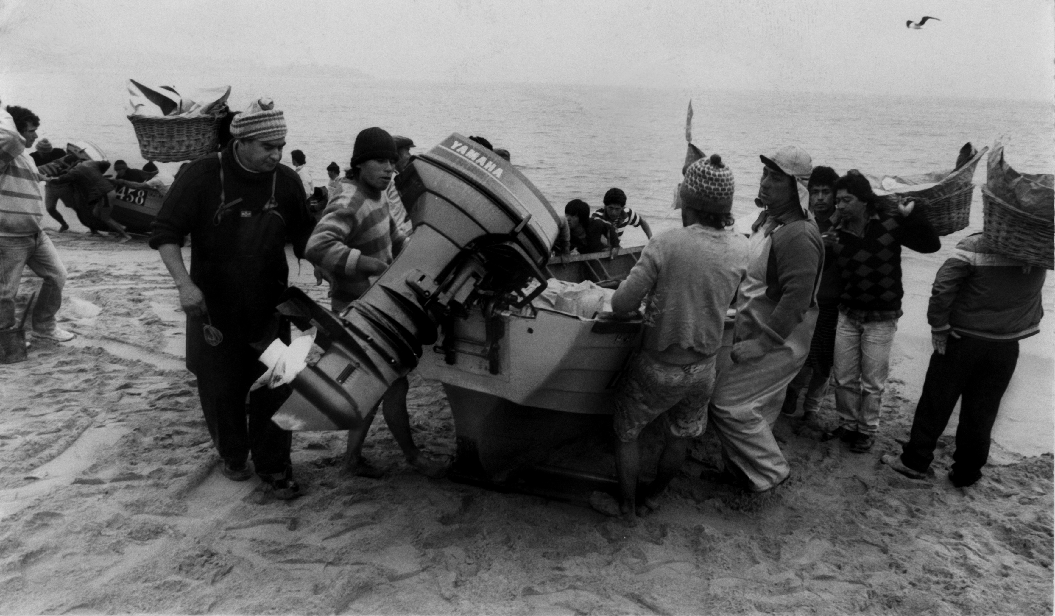
Rio+20
In order to achieve sustainable development in all its dimensions, in a comprehensive manner, it is important to integrate economic, social and environmental aspects and to recognize their interlinkages
Since 1992 there have been areas of insufficient progress and setbacks in the integration of the three dimensions of sustainable development (This is particularly so in the case of fisheries due to neglect of the social pillar-with too much emphasis on the environmental and economic pillars)
Hugo Moreira/Chile

Slide 3
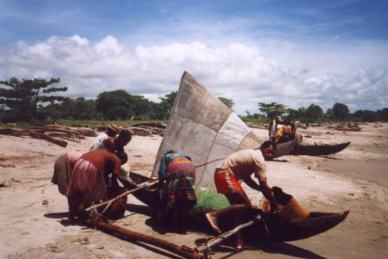
Approaches to Sustainable Development
Different approaches to achieve sustainable devt. of fisheries in its three dimensions (ecosystem approaches, market-based approaches, etc)
Human rights-based approach is one such approach, particularly giving emphasis to the social dimension of sustainable fisheries
SSF Guidelines, negotiated and developed by FAO, adopts a human
rights-based approach
Brian O'Riordan/Madagascar

Slide 4
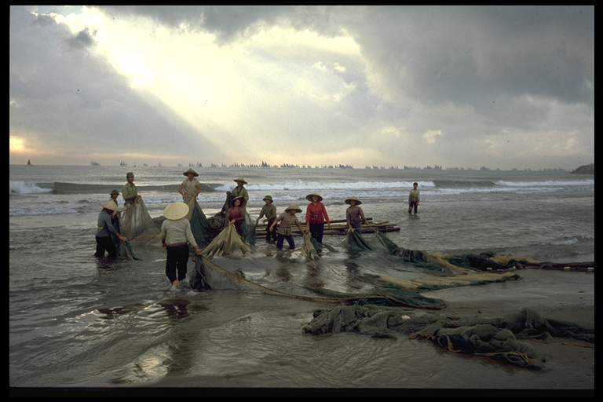
SSF Guidelines, 2014
Developed to complement the FAO CCRF:
  Bring social development, employment and decent work as a new focus to empower small-scale fishing communities, particularly the vulnerable and marginalized groups, to enjoy their human rights
  Draw attention to gender equality and equity, especially to address discrimination against women in the full range of activities along the value chain
  Raise awareness about disaster risks and climate change, especially to understand their implications for food security, nutrition, housing and livelihoods
Olivier Barbaroux/Vietnam

Slide 5
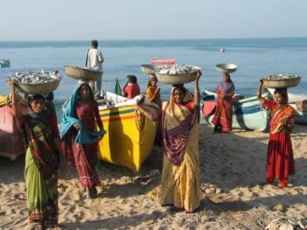
Small-scale Fishing Communities
Coastal communities most dependent on oceans and seas for a livelihood
Small-scale fishing communities, both men and women, contribute significantly to employment, poverty eradication, nutrition and food security along the value chain but remain marginalized; their contributions are not adequately recognized
Enjoying economic, social and
environmental benefits of
sustainable development is a
basic right of small-scale
fishing communities
Neena Koshy/India

Slide 6
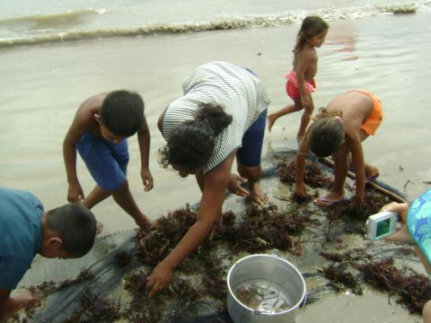
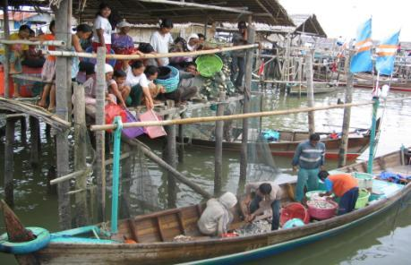
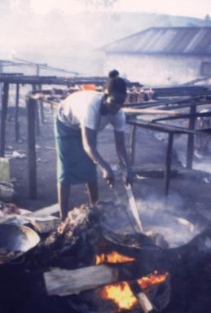
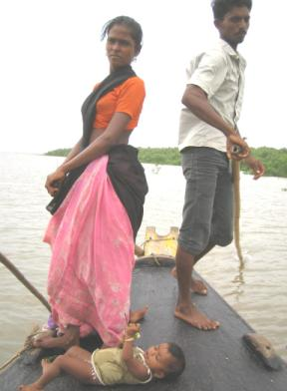
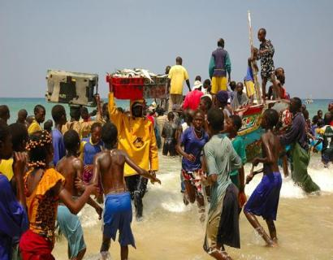
Noor Aida /Indonesia
Naina Pierri/Brazil
APRAPAM/Senegal
Kenya/ICSF
Prasad/ICM/India

Slide 7
SSF Guidelines and a Human Rights-based Approach
Human rights of all individuals dependent on small-scale fisheries should be recognized in accordance with international human rights standards
Non-state actors should respect human rights of fishing communities
Existing forms of organizations, traditional and local knowledge and sustainable practices of small-scale fishing communities should be respected and incorporated into decision-making processes
All kinds of discrimination in policies and practice should be eliminated
A social safety net should be provided to fishers and fishworkers, including migrants, children, women in fishing communities

Slide 8
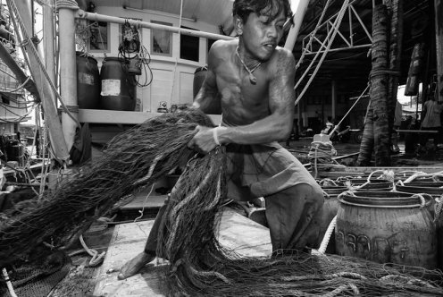
Human Rights Standards
Universal and inalienable
Interdependent, indivisible and interrelated
Non-discrimination and equality
Obligations of States to respect, protect, and fulfil human rights
John Hulme/ILO/Thailand

Slide 9
Benefits of a Human Rights-based Approach in Fisheries 1
Brings greater recognition to the human rights and fundamental freedoms of members of fishing communities, workers, indigenous peoples, and women (individual and collective rights)
Renders greater visibility to small-scale fishing communities, both men and women, their contribution to global food security and nutrition
Empowers and encourages them to participate in decision-making processes on their own free will, and to assume responsibilities for sustainable use of fishery resources

Slide 10
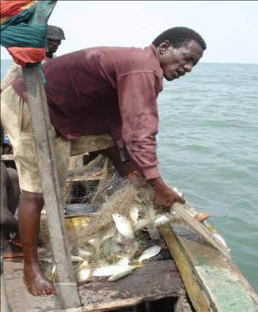
Benefits of a Human Rights-based Approach in Fisheries 2
Community adherence to adopting responsible fisheries standards (precautionary approach, an ecosystem approach to fisheries, risk management, etc) towards
environmental, economic,
and social sustainability in
relation to fisheries and
biodiversity
Romain Le Bleis/Sierra Leone

Slide 11
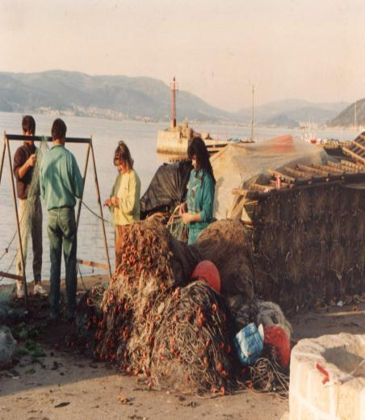
Benefits of a Human Rights-based Approach in Fisheries 3
Congruence between duty-bearing State, fishing communities, non-State parties and other stakeholders to meet their obligations could contribute to better integration of the three dimensions of sustainable development inter alia in the context of oceans and seas, particularly fisheries
Cornelie Quist/Spain

Slide 12
Realizing a Human Rights-based Approach in Fisheries
Governance of tenure: Small-scale fishing communities to have secure tenure rights to the resources that form the basis for their social and cultural wellbeing
Governance reforms: Create/strengthen mechanisms, processes and institutions through which fishing communities and other stakeholders can “articulate their interests, exercise their legal rights, meet their obligations and mediate their differences” (UNDP)—these elements need to be present in a balanced manner at various levels

Slide 13
What is unique about the SSF Guidelines?
The first negotiated international instrument exclusively for small-scale fisheries
Adoption of an inclusive approach, particularly to benefit the vulnerable and marginalized groups, towards poverty eradication and food security
Ground-up development process of the Guidelines:
  Active involvement of CSOs/NGOs, led by WFF, WFFP, ICSF and IPC, in discussing the Zero Draft during 2011-12 and in the negotiations in Rome during 2013-14
  Combined stakeholder participation in developing these Guidelines is estimated to be 4000 across four regions and over 50 countries

Slide 14
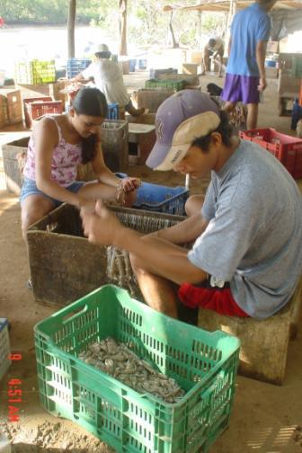
Implementing the SSF Guidelines
Several developing countries and regional fisheries bodies are in the process of implementing or otherwise applying the Guidelines (e.g. Brazil, Costa Rica, Myanmar, India, Indonesia, Mauritania, Senegal, Thailand, OSPESCA)
CSOs/NGOs have already held several implementation workshops
ICSF-BOBLME Workshops held in India, Myanmar and Thailand early this year to contextualize the SSF Guidelines for implementation at national and subnational levels
CoopeSoliDar R.L./Costa Rica

Slide 15
In conclusion
Based on the SSF Guidelines a human rights approach in all maritime activities should be developed
Other approaches to sustainable development of oceans and seas should be made coherent with a human rights approach
Adopting such an approach can address setbacks in the integration of the three dimensions of sustainable development

Slide 16
Human Rights of Fishing Communities
“Adopting a human rights approach for improving the life and livelihoods of fishing communities – and indeed all marginalized groups – is not really a matter of choice but an obligation”
--Chandrika Sharma, Executive Secretary, International Collective in Support of Fishworkers (ICSF), at the Global Conference on Small-scale Fisheries,
Bangkok, 2008

Slide 17
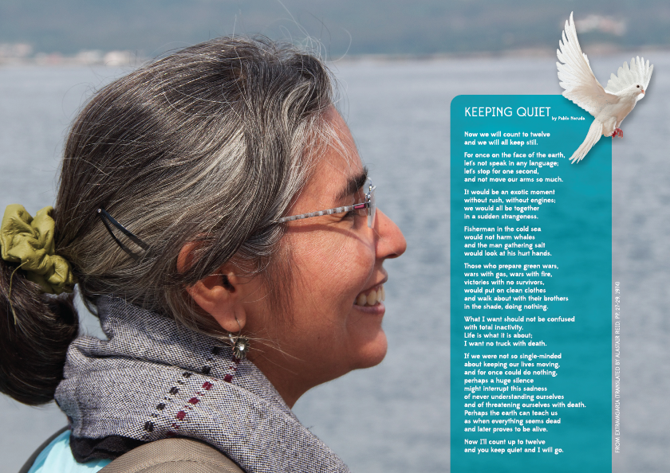
ICSF

Slide 18
Thank you

