Slide 1
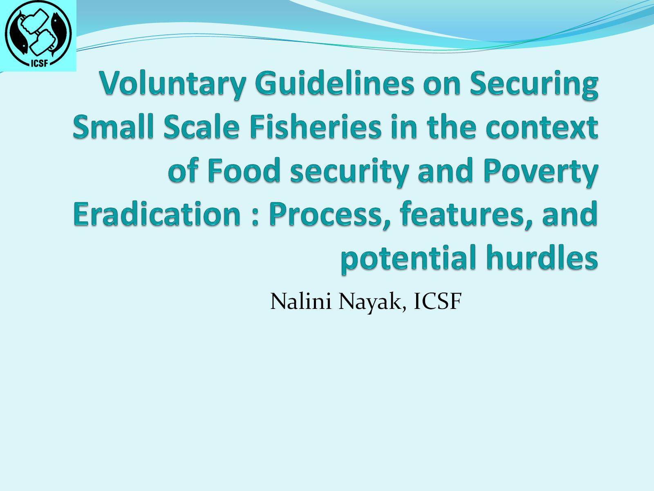
Voluntary Guidelines on Securing Small Scale Fisheries in the context of Food security and Poverty Eradication : Process, features, and potential hurdles

Slide 2
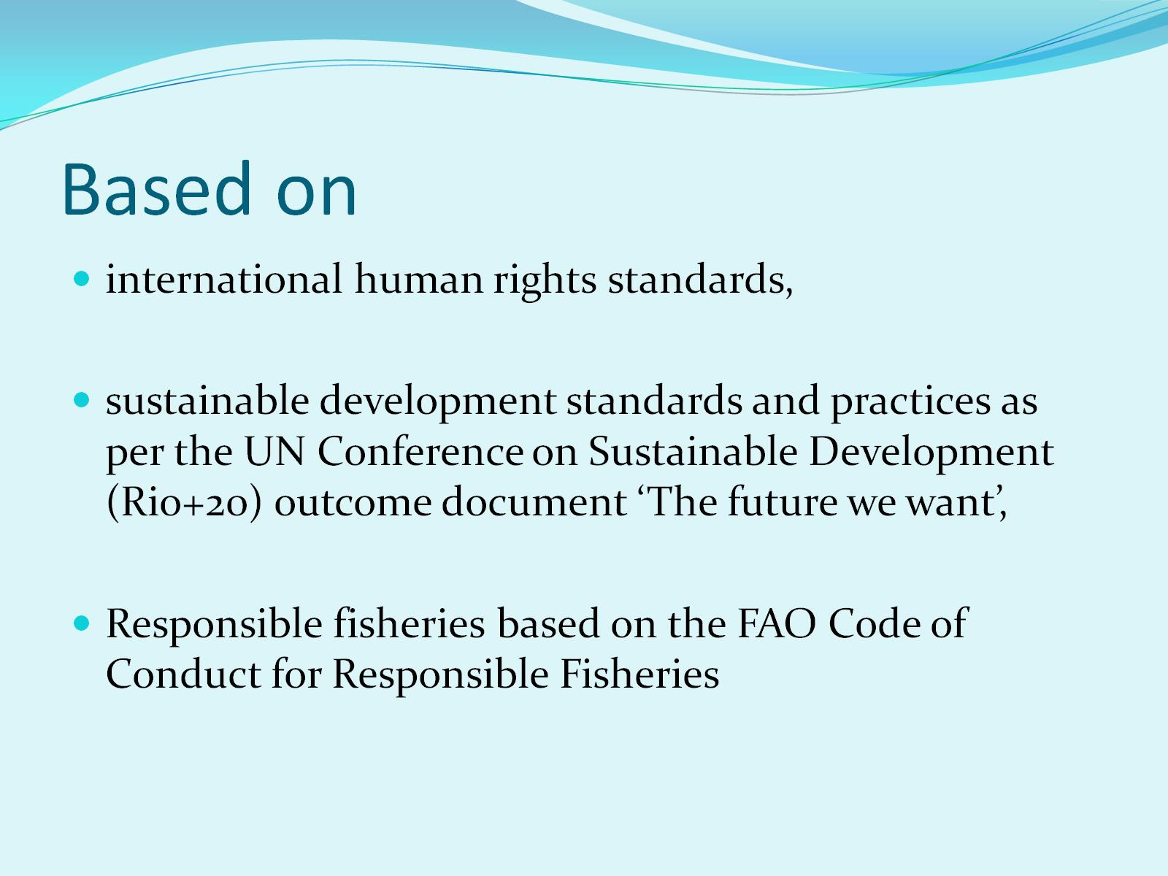
Based on

Slide 3
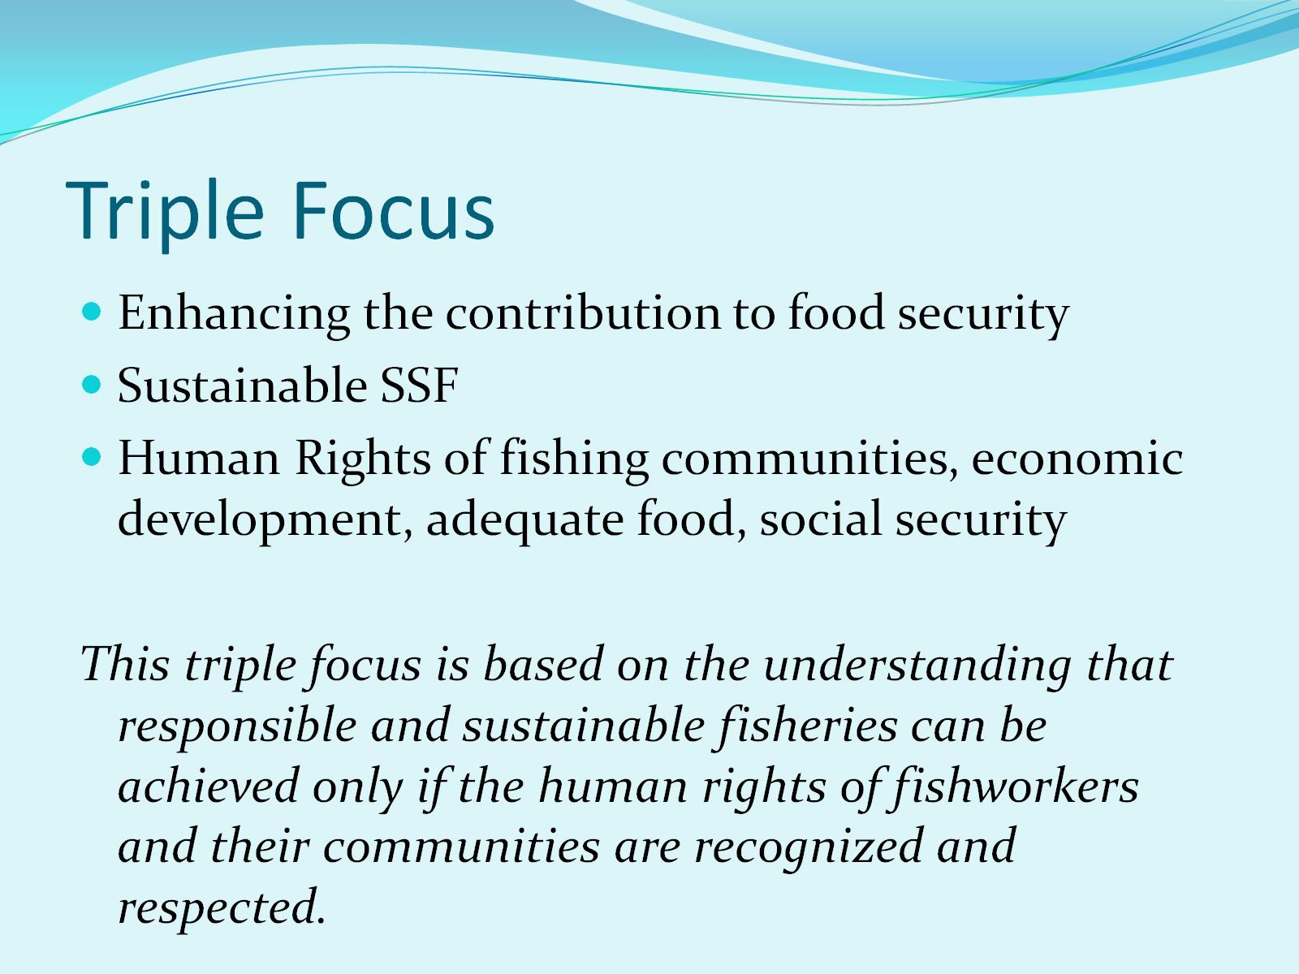
Triple Focus

Slide 4
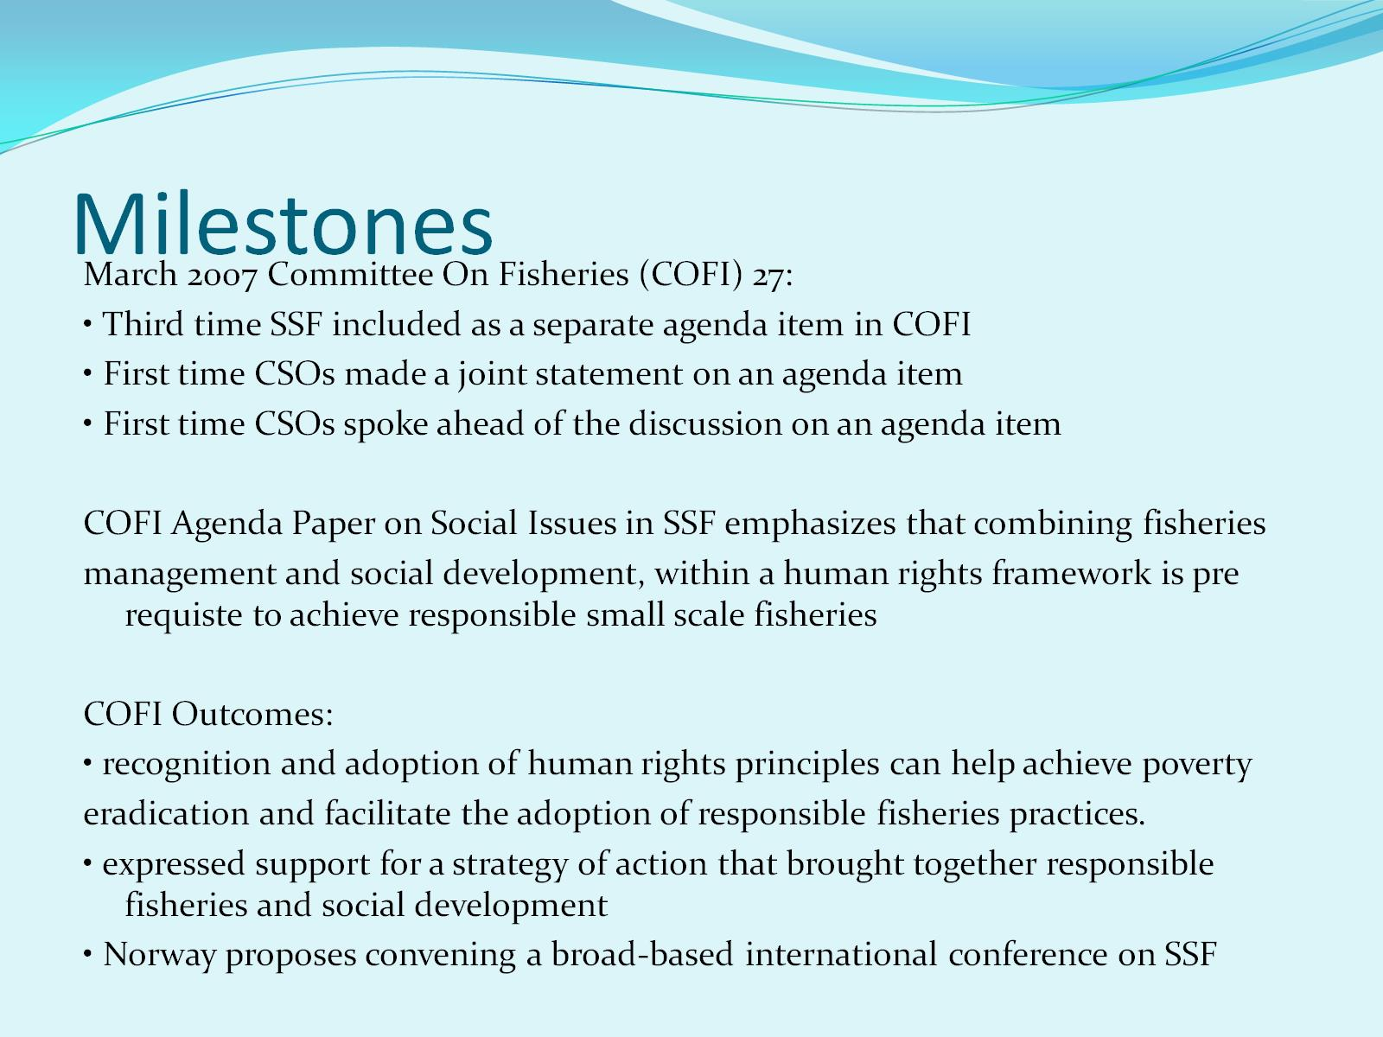
Milestones

Slide 5
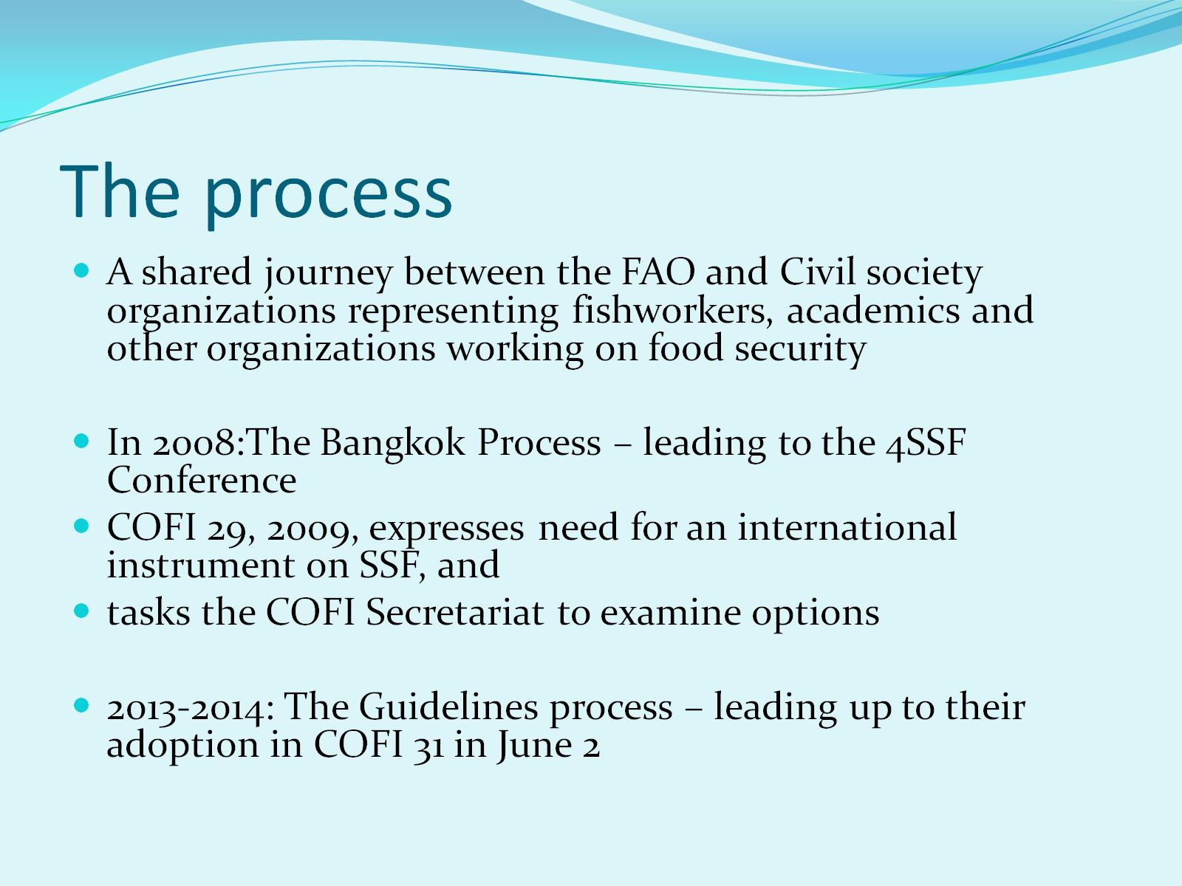
The process

Slide 6
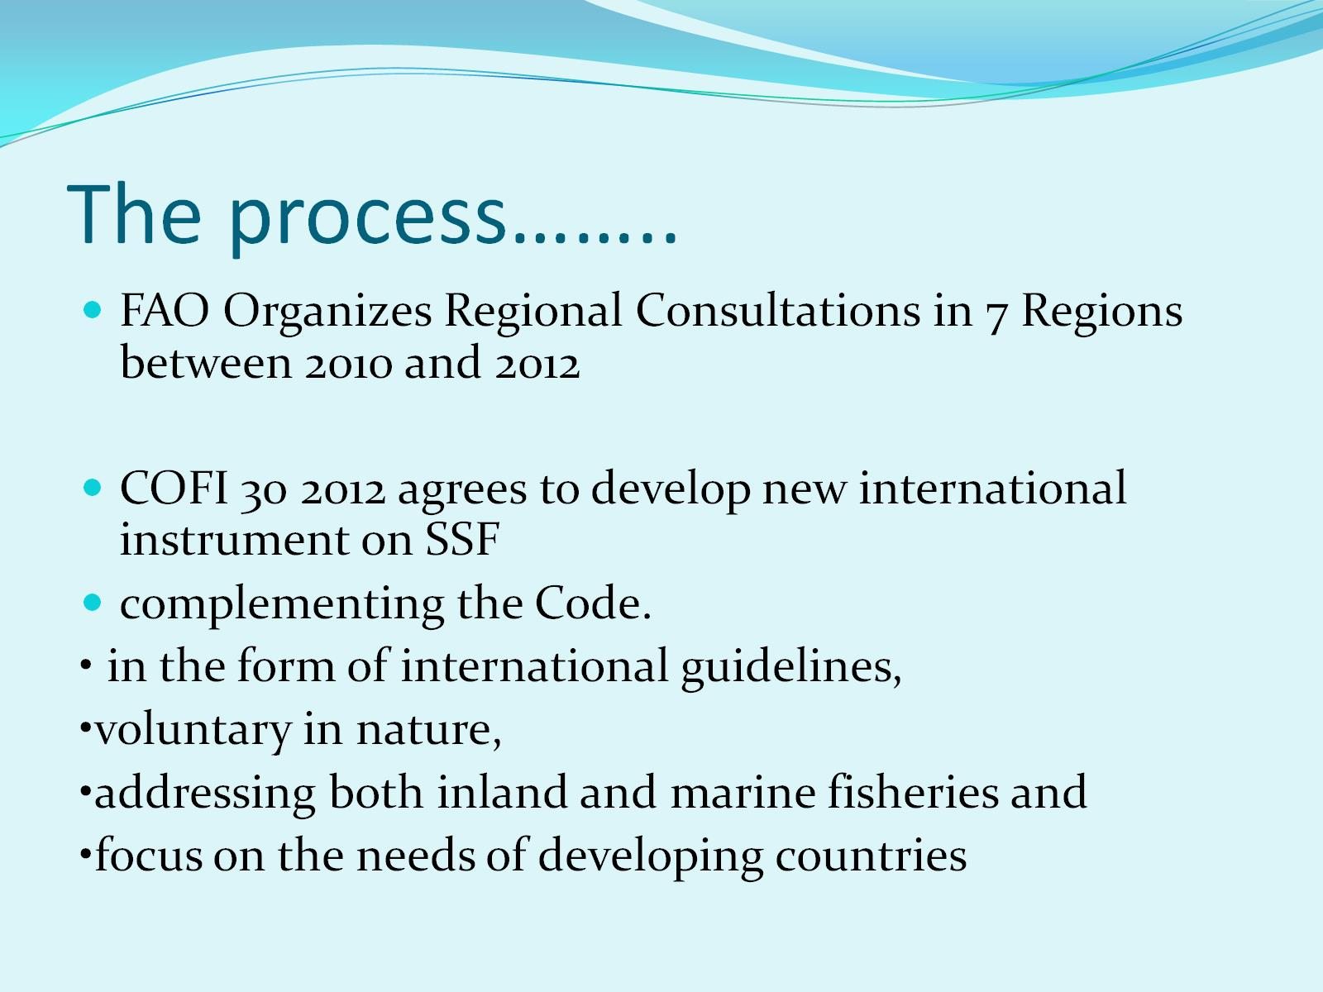
The process……..

Slide 7
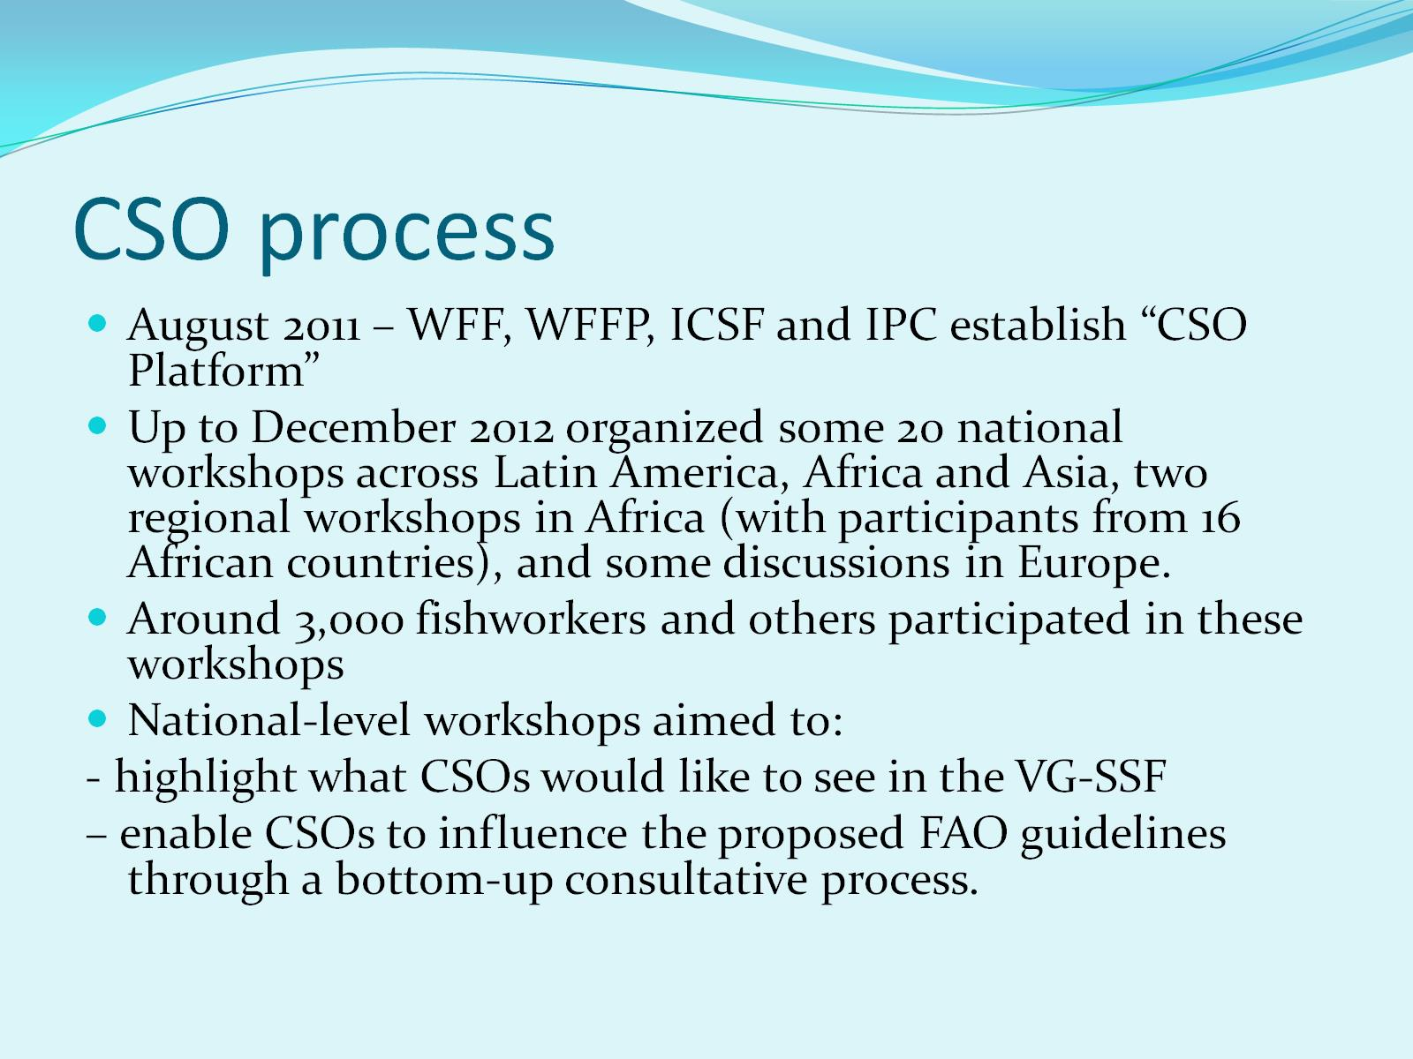
CSO process

Slide 8
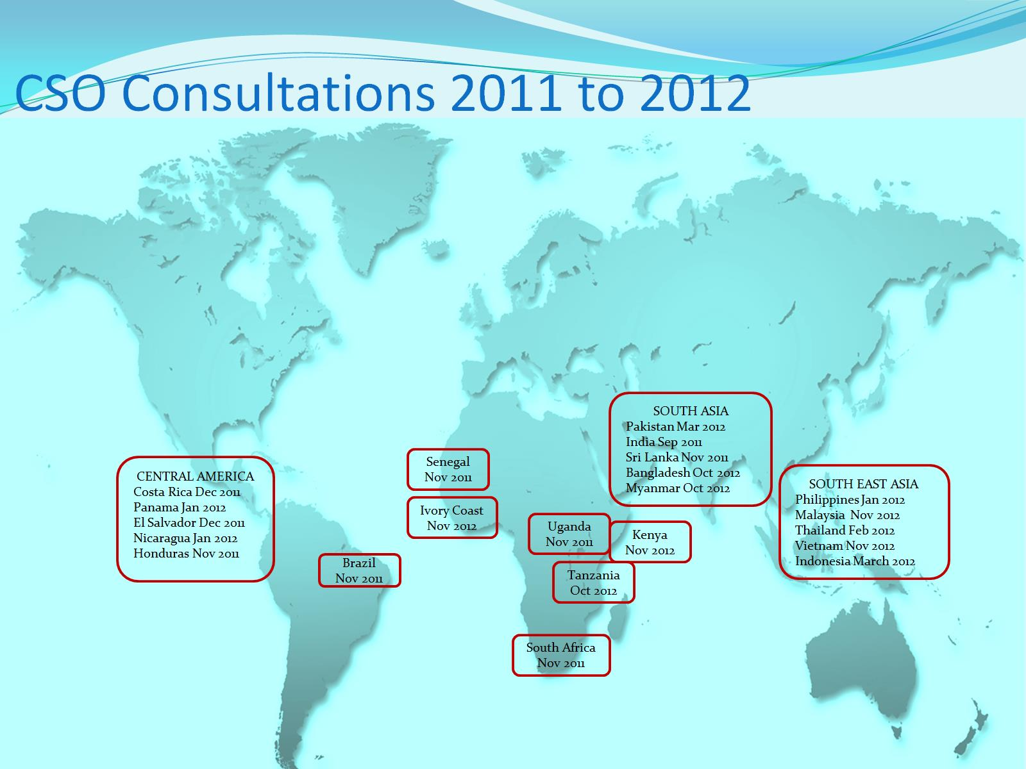
CSO Consultations 2011 to 2012

Slide 9
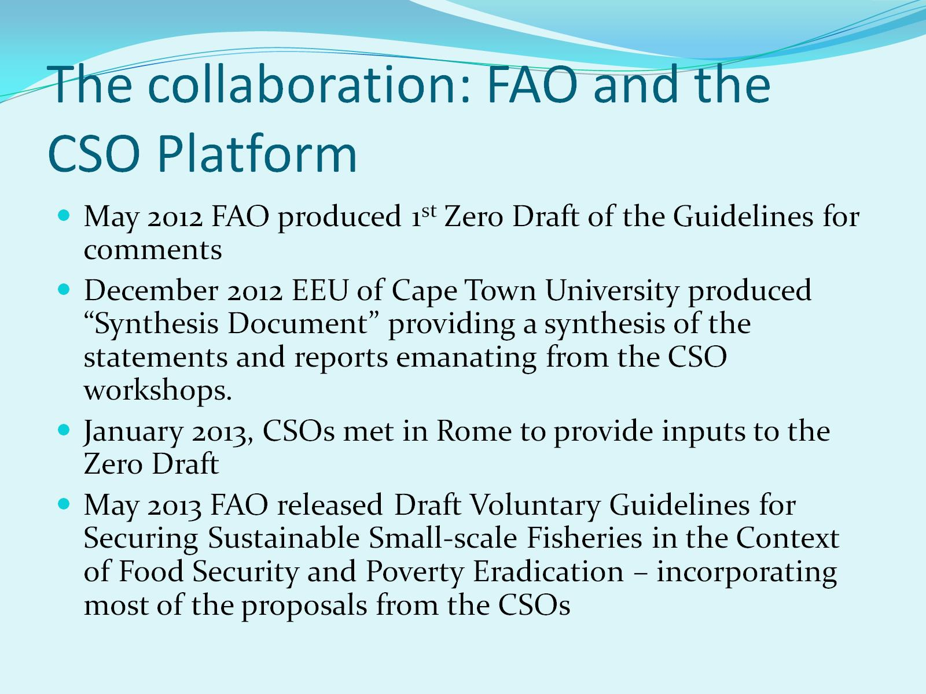
The collaboration: FAO and the CSO Platform

Slide 10
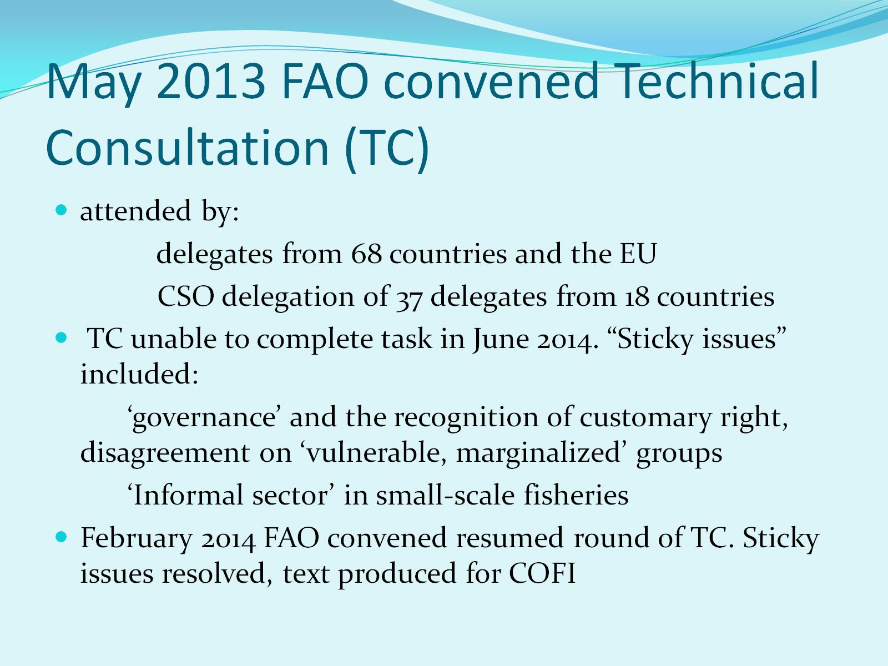
May 2013 FAO convened Technical Consultation (TC)

Slide 11
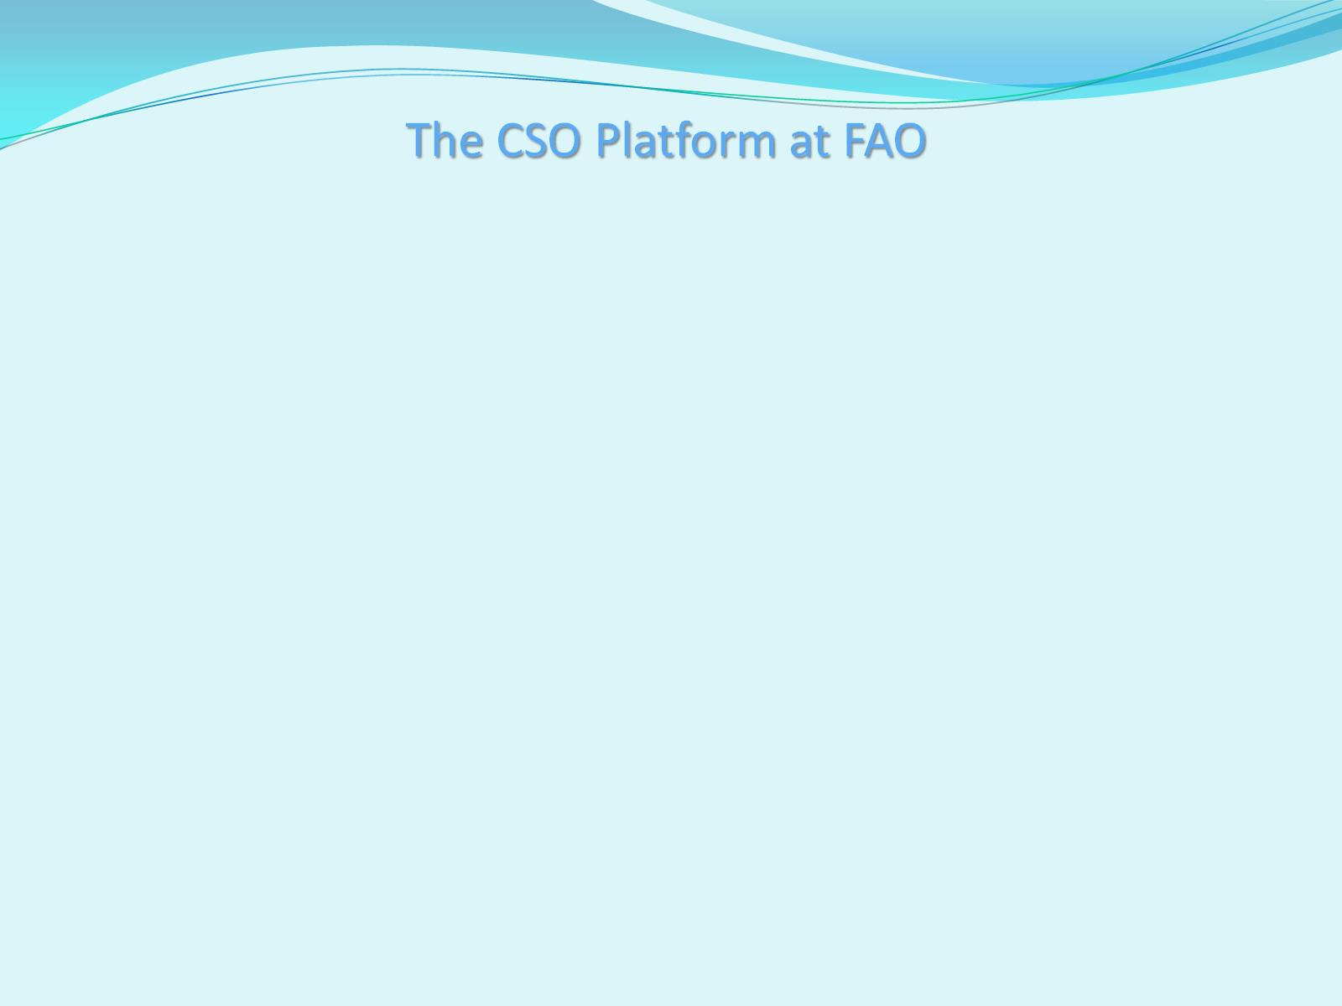

Slide 12
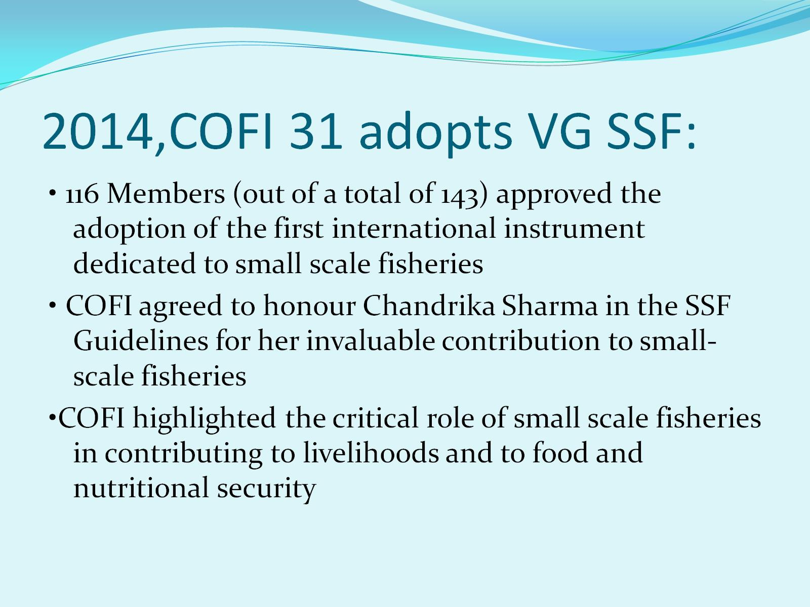
2014,COFI 31 adopts VG SSF:

Slide 13


Slide 14
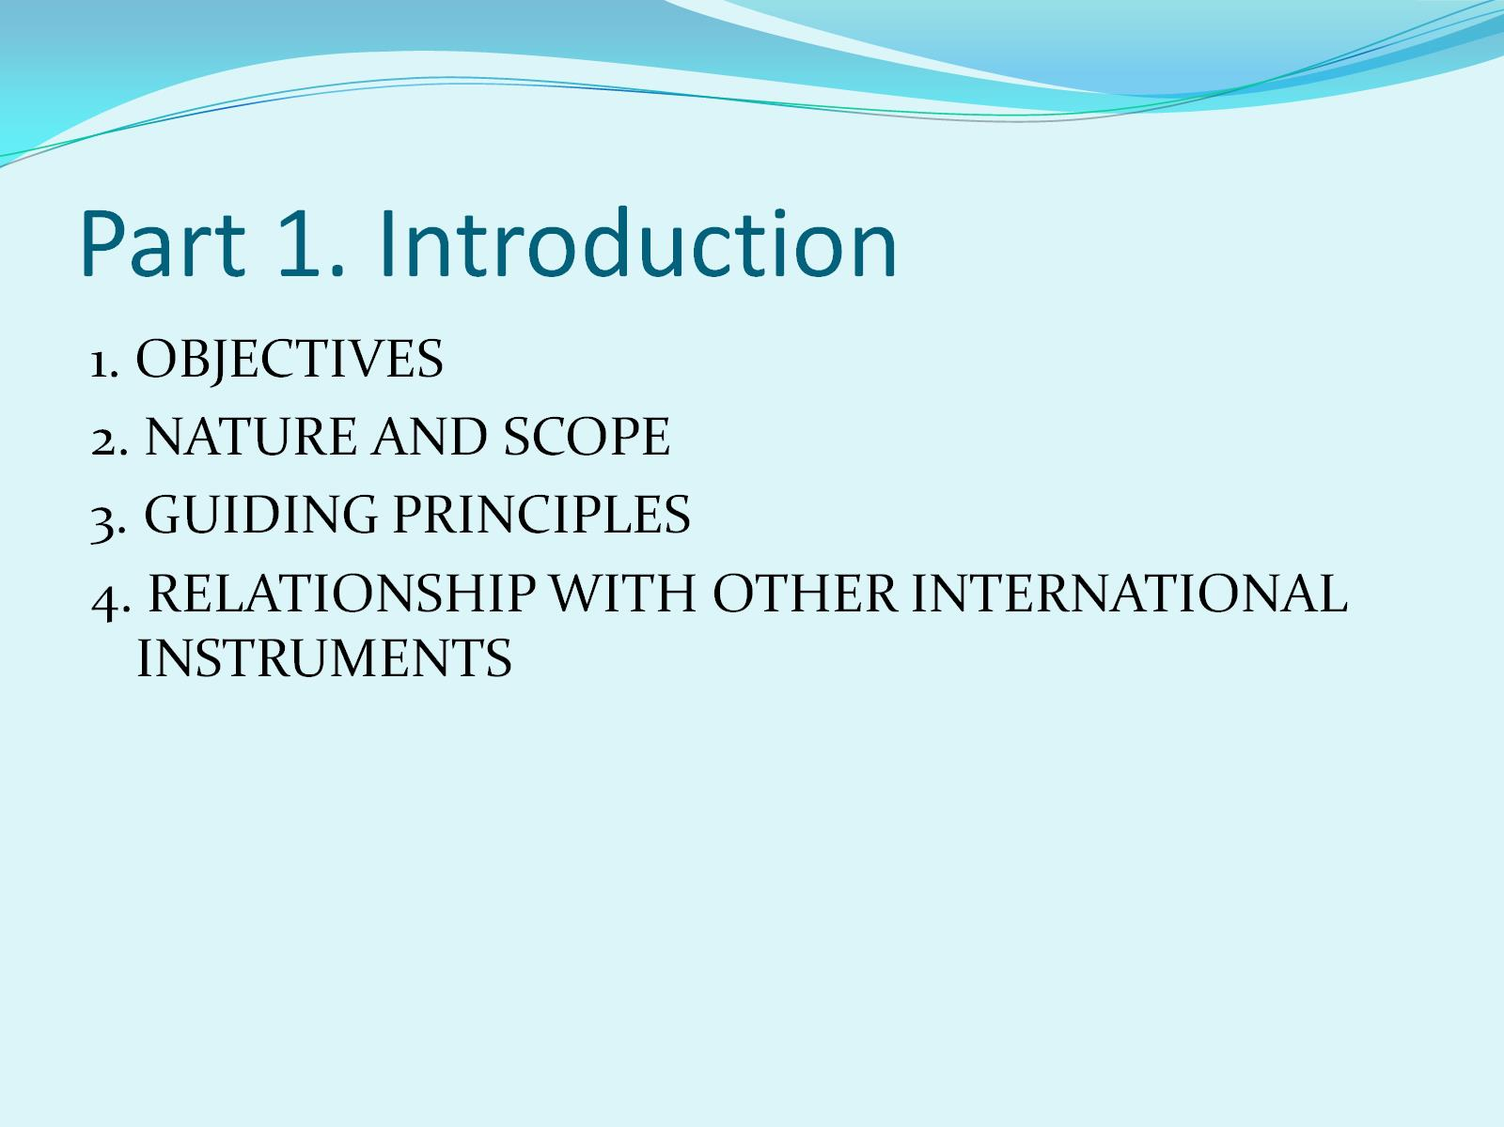
Part 1. Introduction

Slide 15
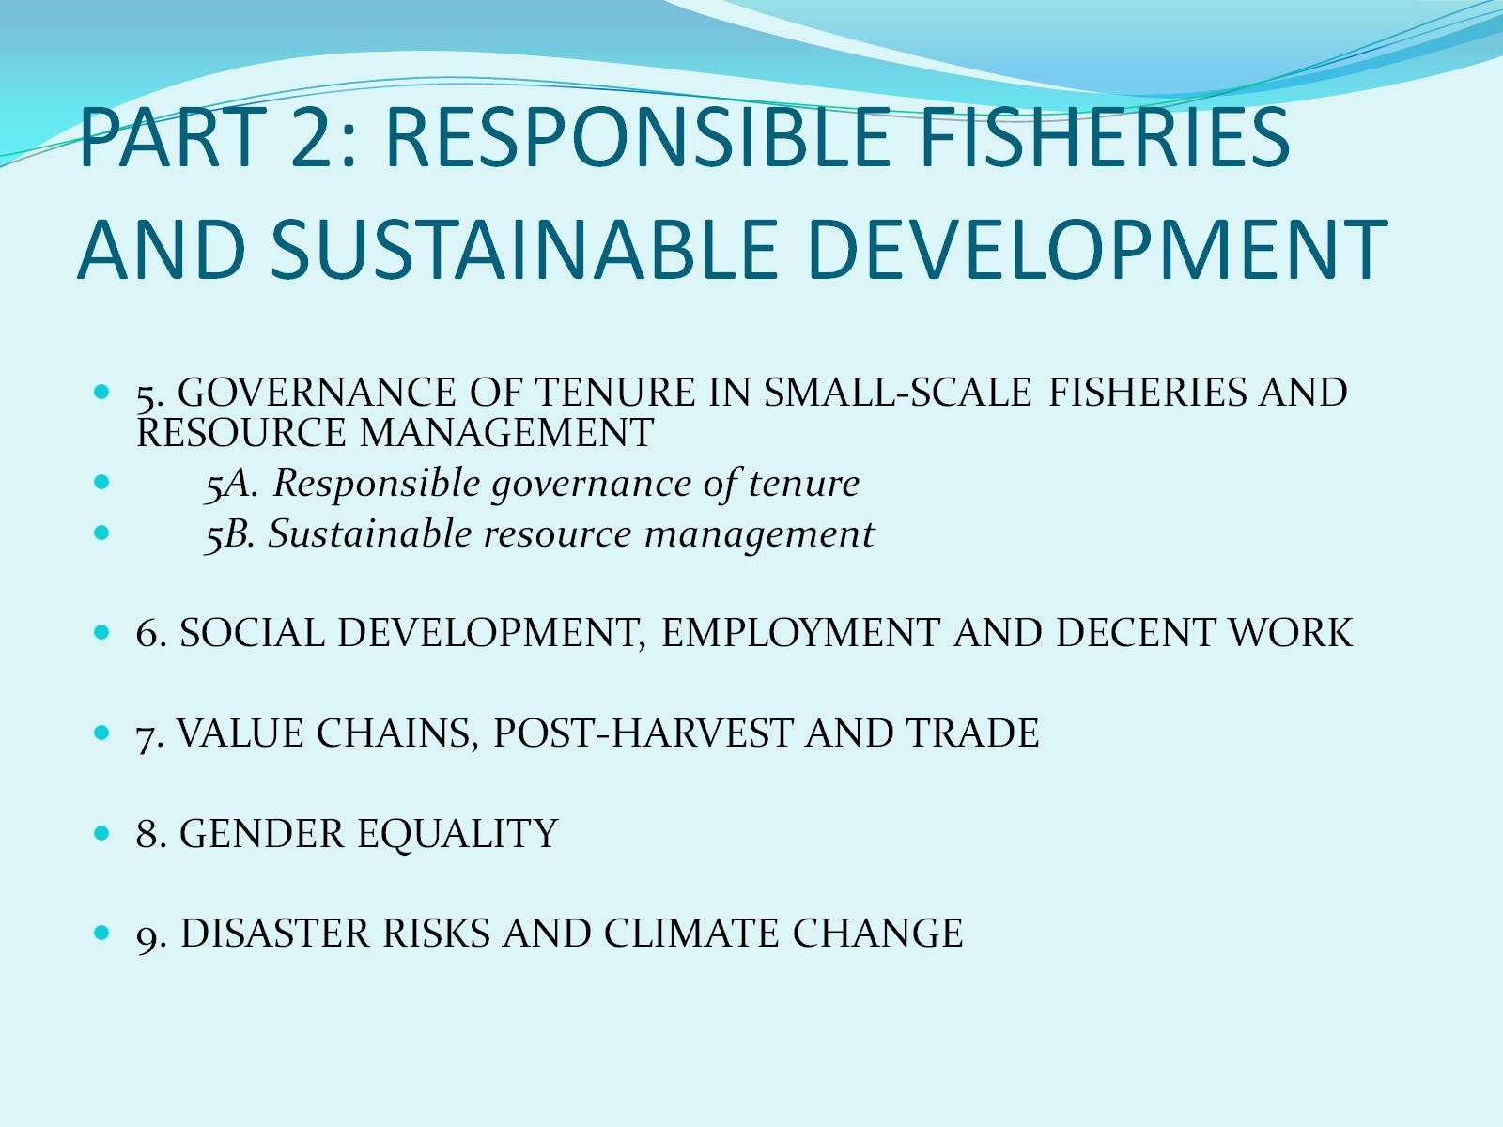
PART 2: RESPONSIBLE FISHERIES AND SUSTAINABLE DEVELOPMENT

Slide 16
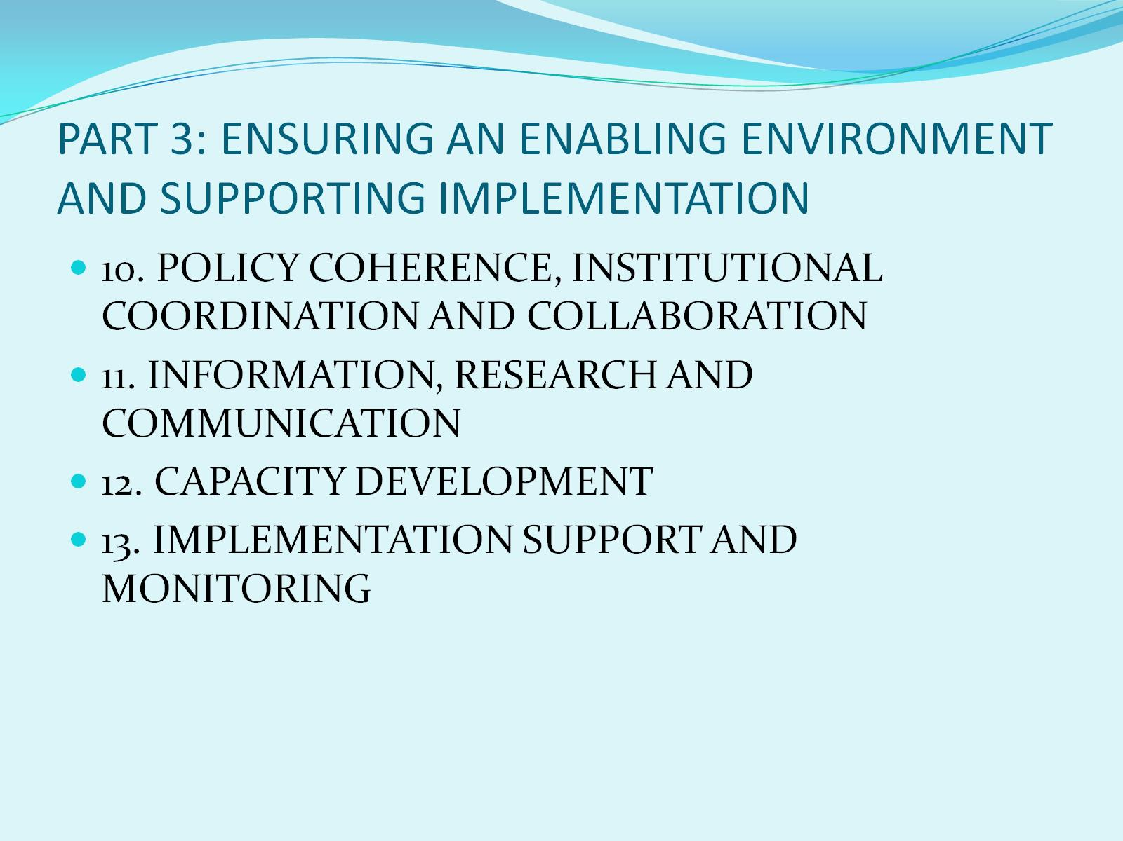
PART 3: ENSURING AN ENABLING ENVIRONMENT AND SUPPORTING IMPLEMENTATION

Slide 17
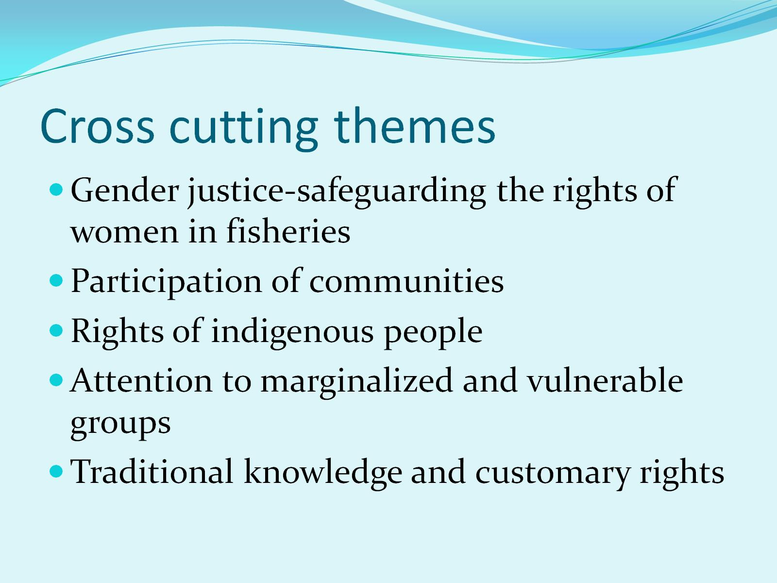
Cross cutting themes

Slide 18
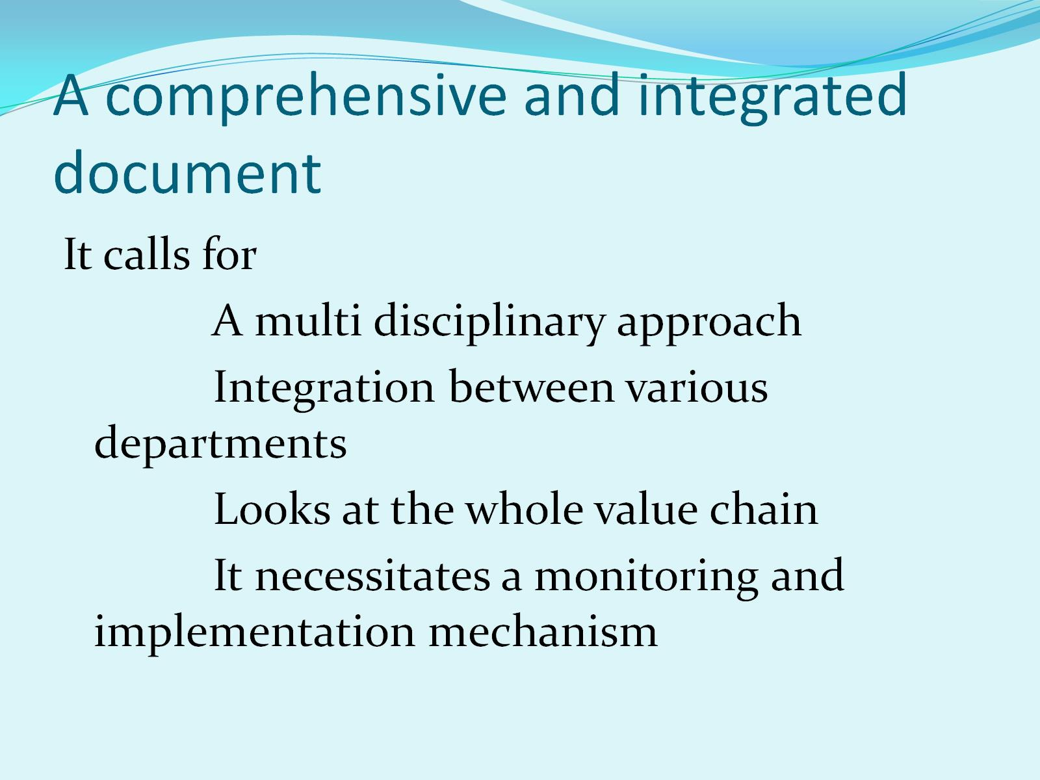
A comprehensive and integrated document

Slide 19
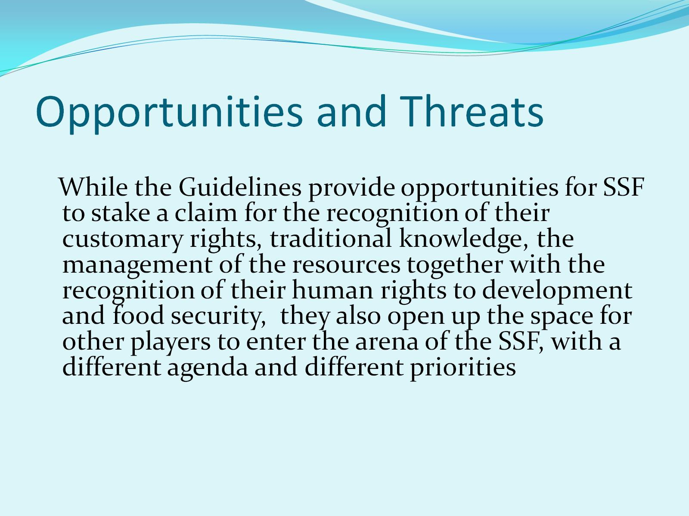
Opportunities and Threats

Slide 20
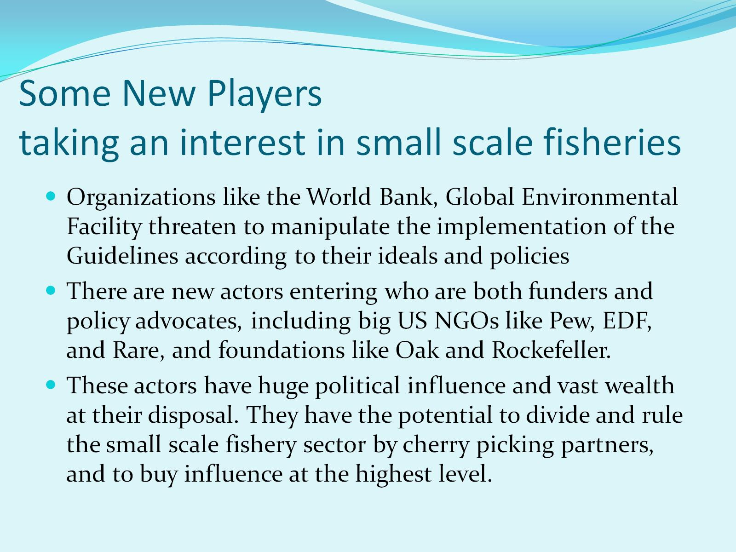
Some New Players taking an interest in small scale fisheries

Slide 21
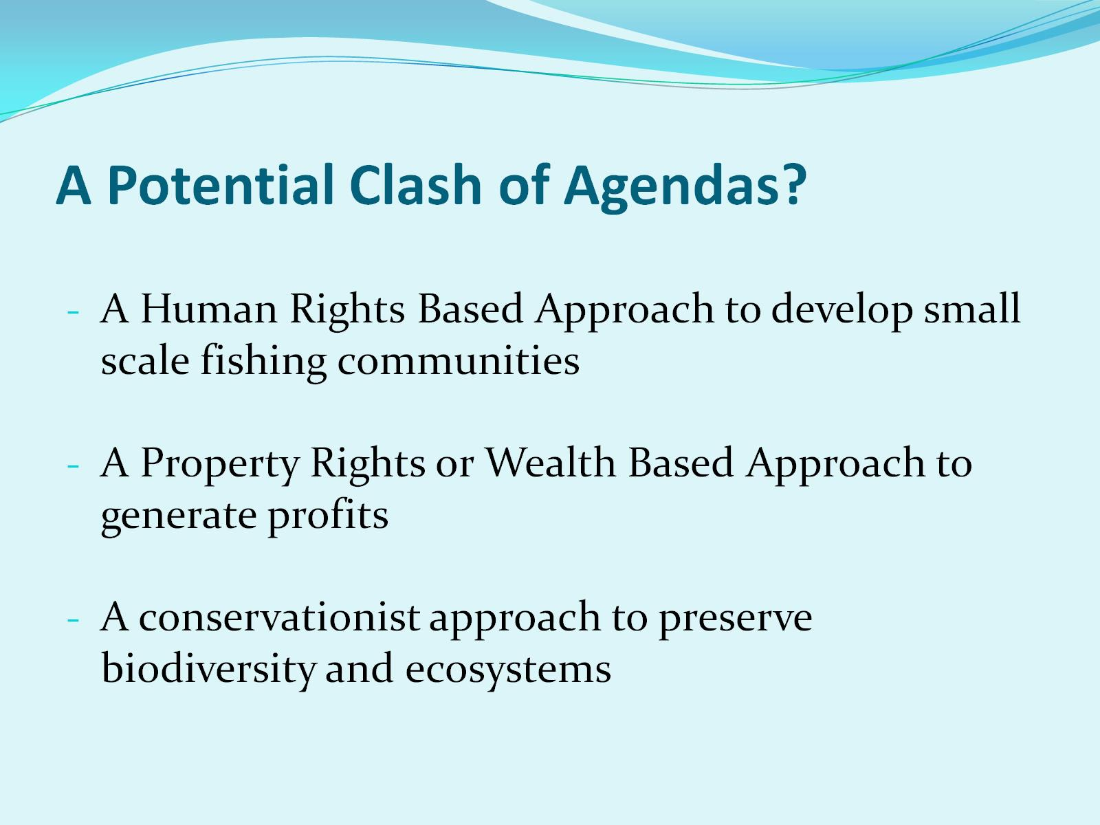
A Potential Clash of Agendas?

Slide 22
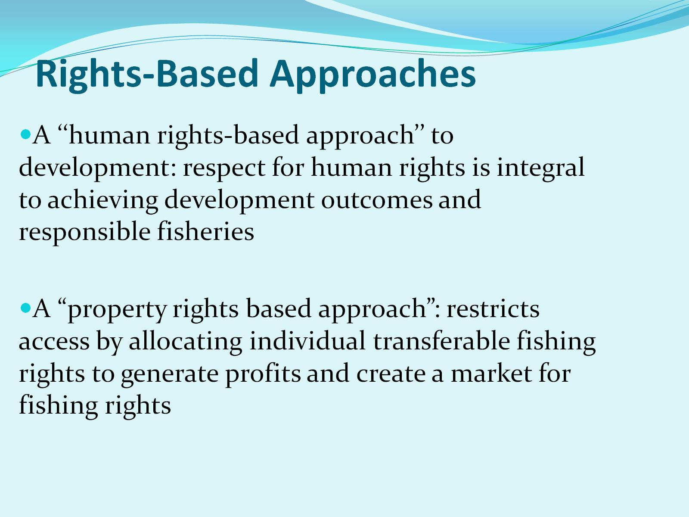
Rights-Based Approaches

Slide 23
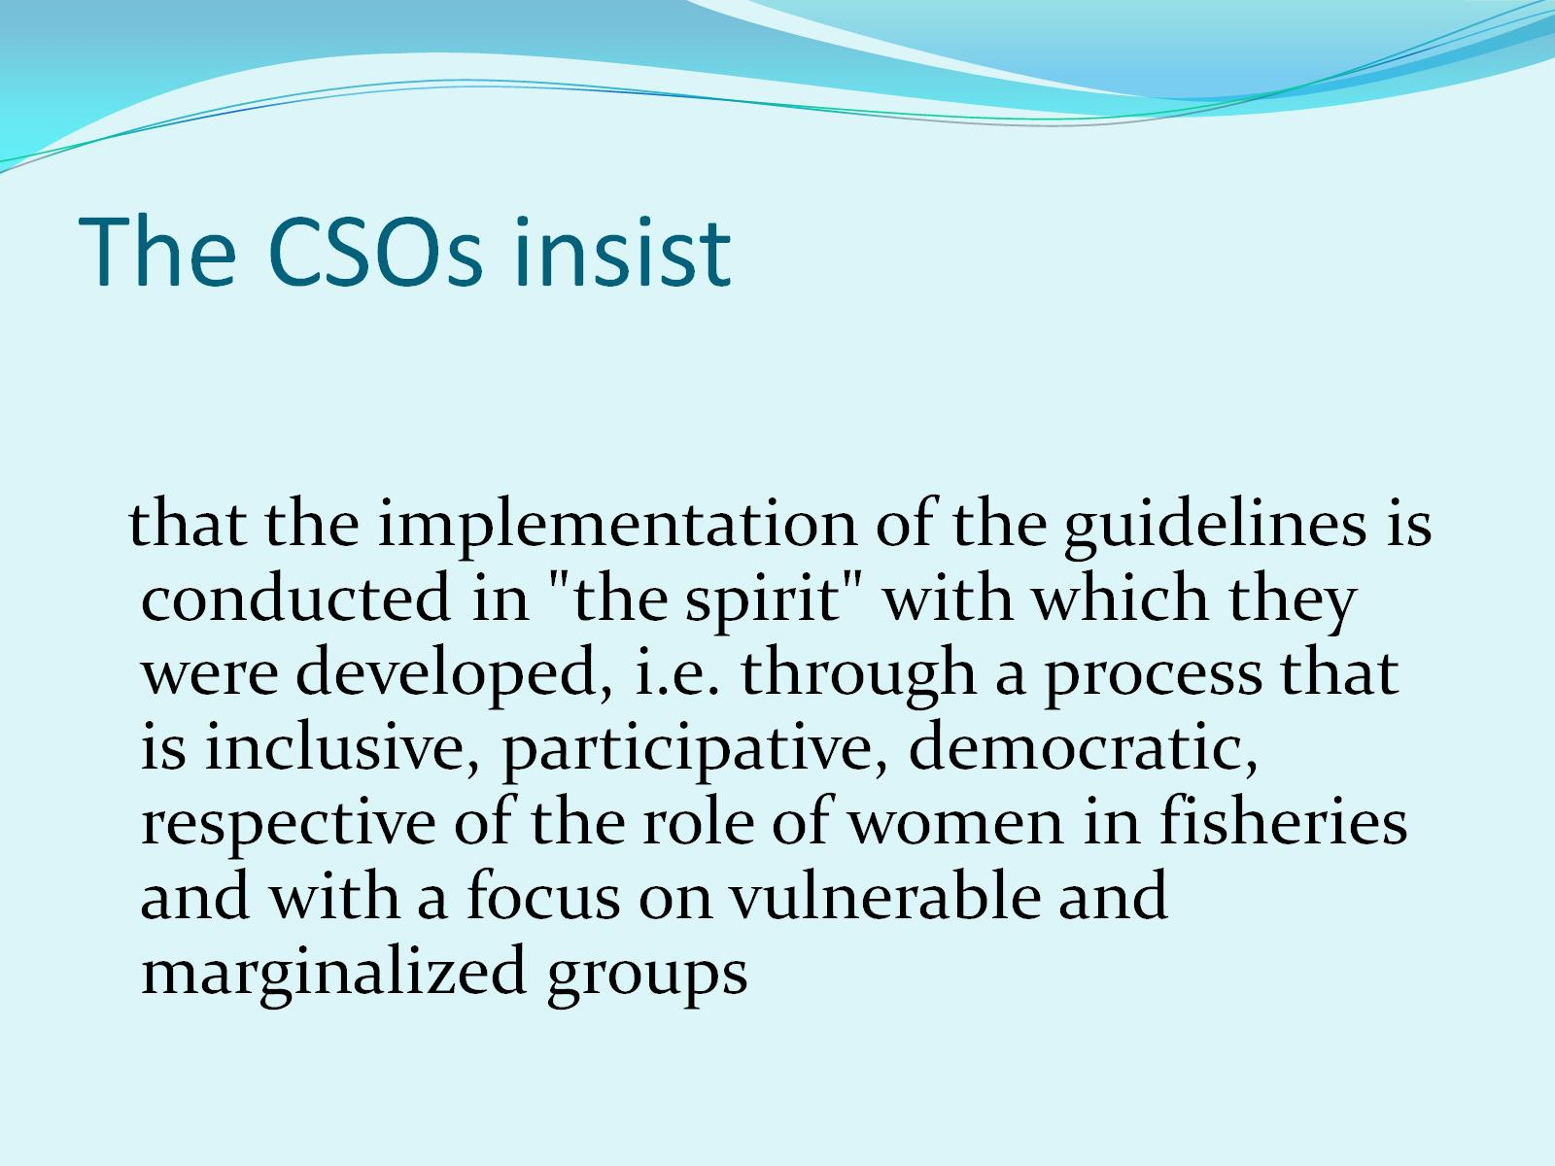
The CSOs insist

Slide 24
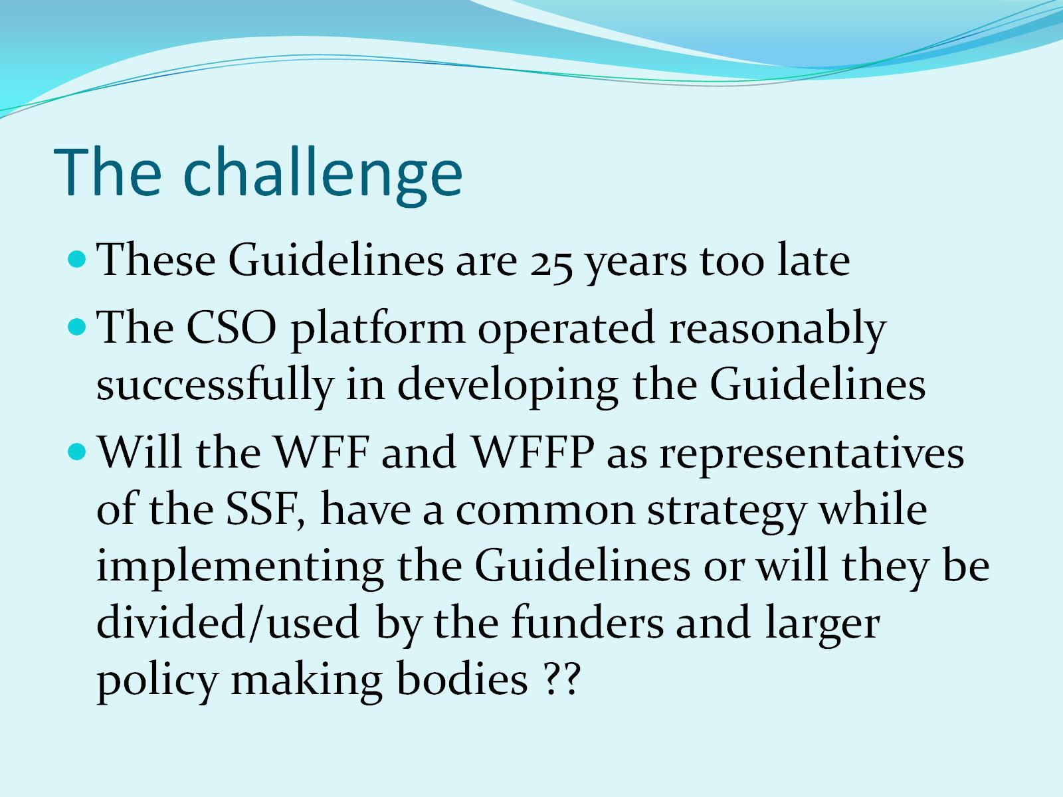
The challenge

Slide 25
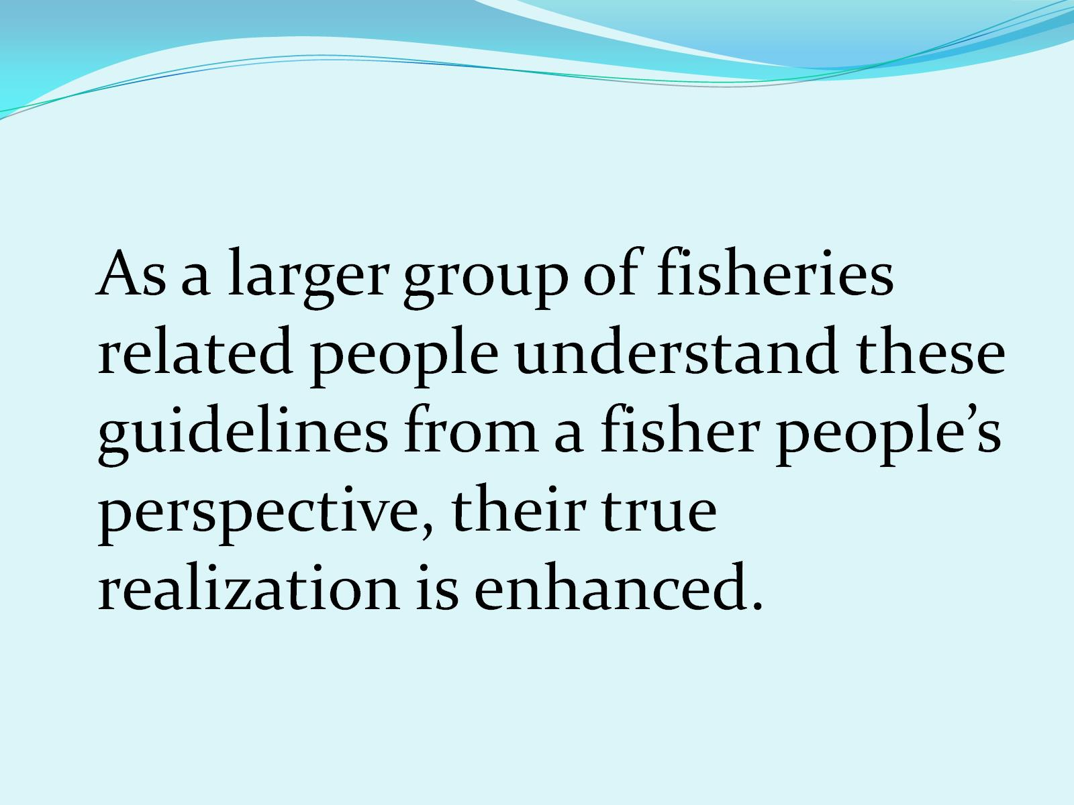

Slide 26

Thank You

