Slide 1

Challenges of Women in fisheries – THE CASE OF fish vendors of Mumbai

Slide 2
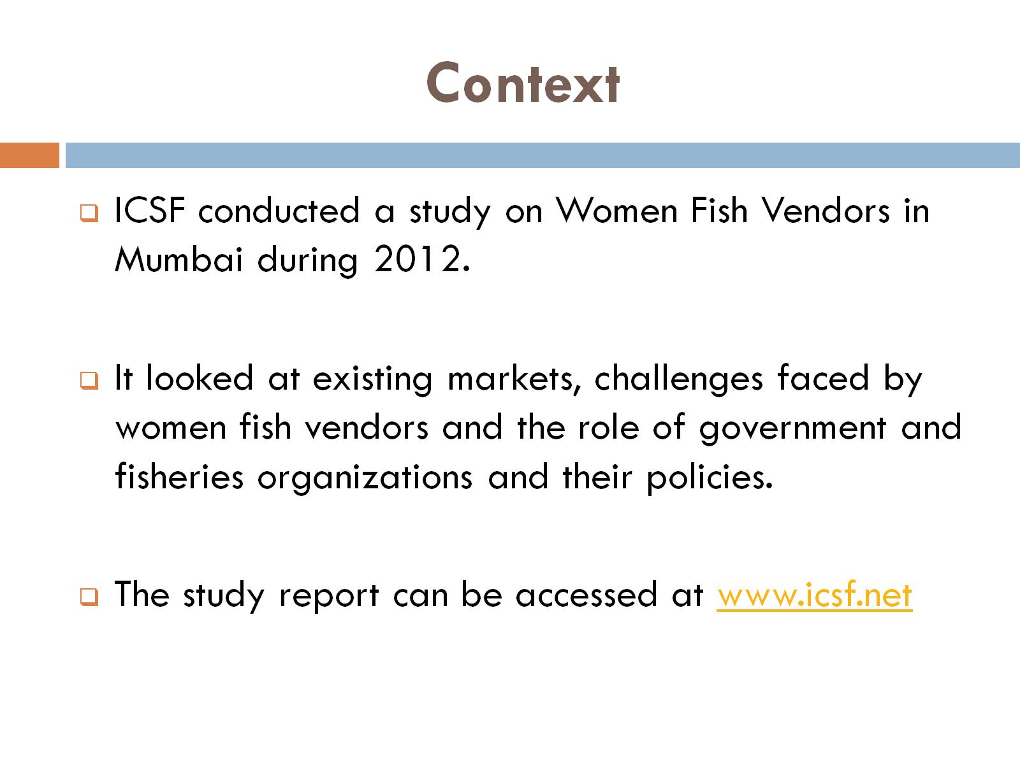
Context

Slide 3
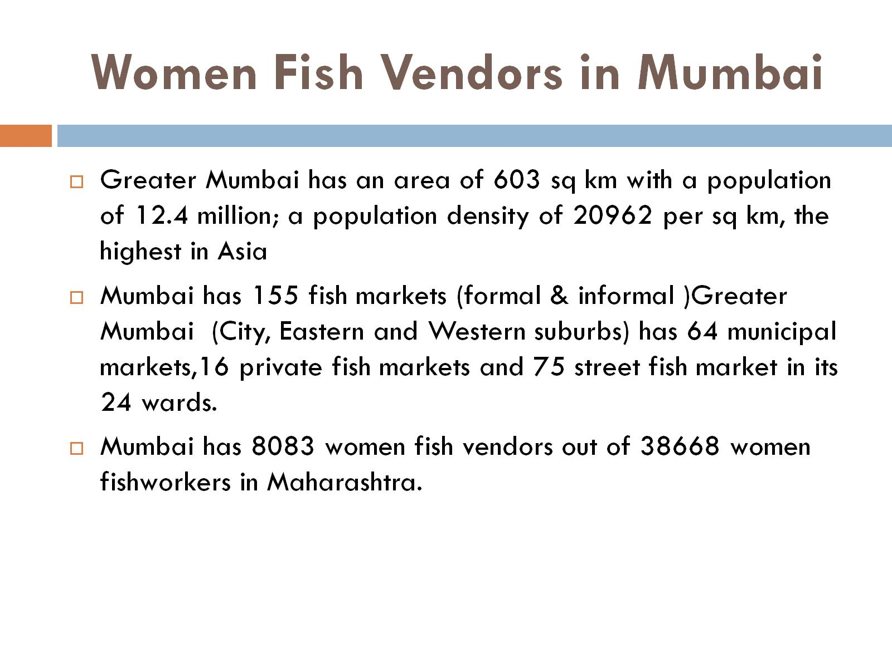
Women Fish Vendors in Mumbai

Slide 4
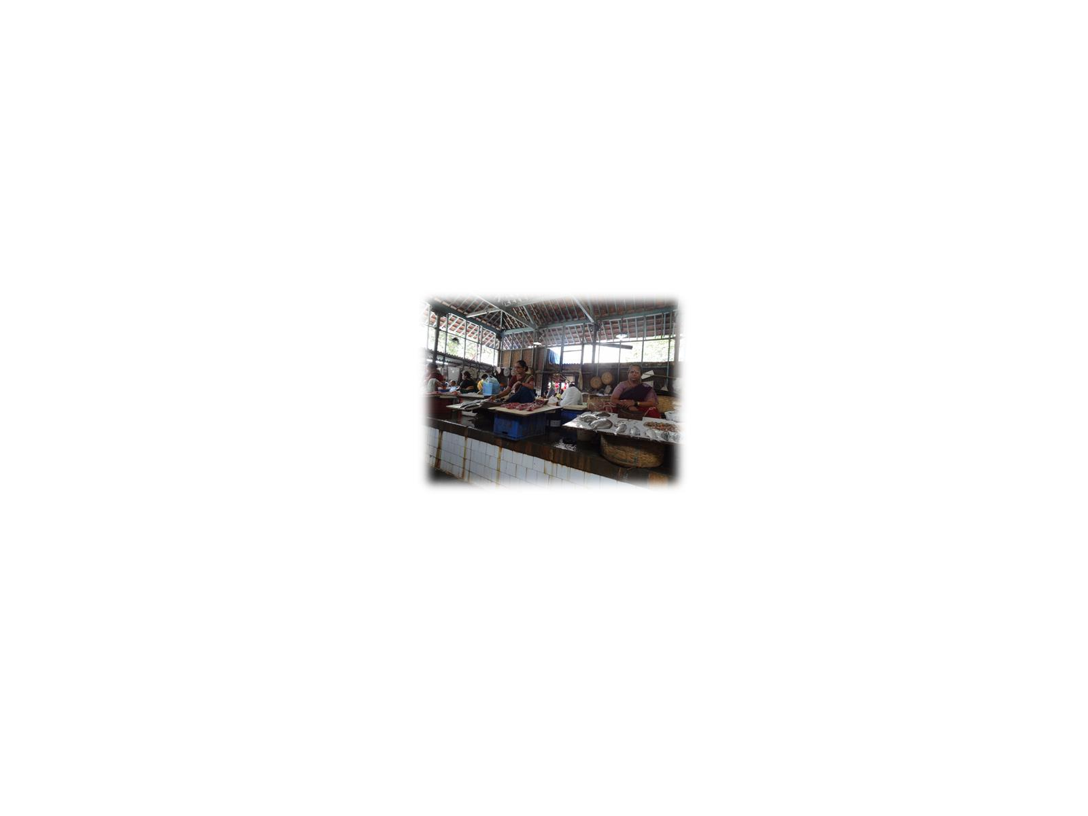

Slide 5
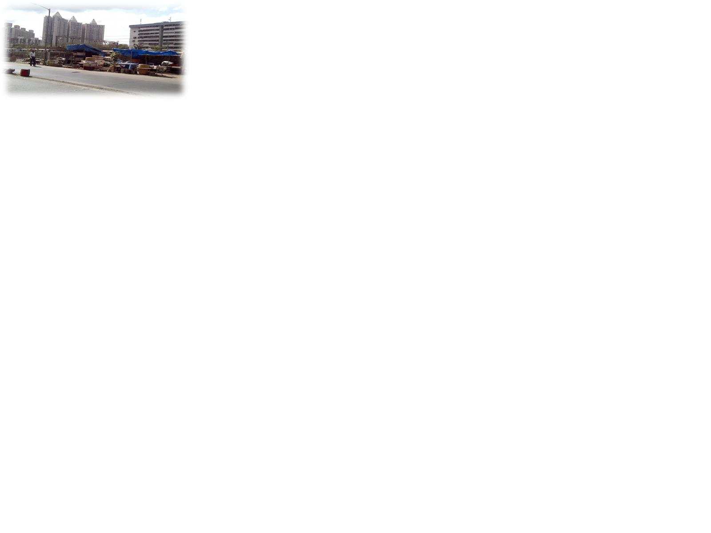

Slide 6
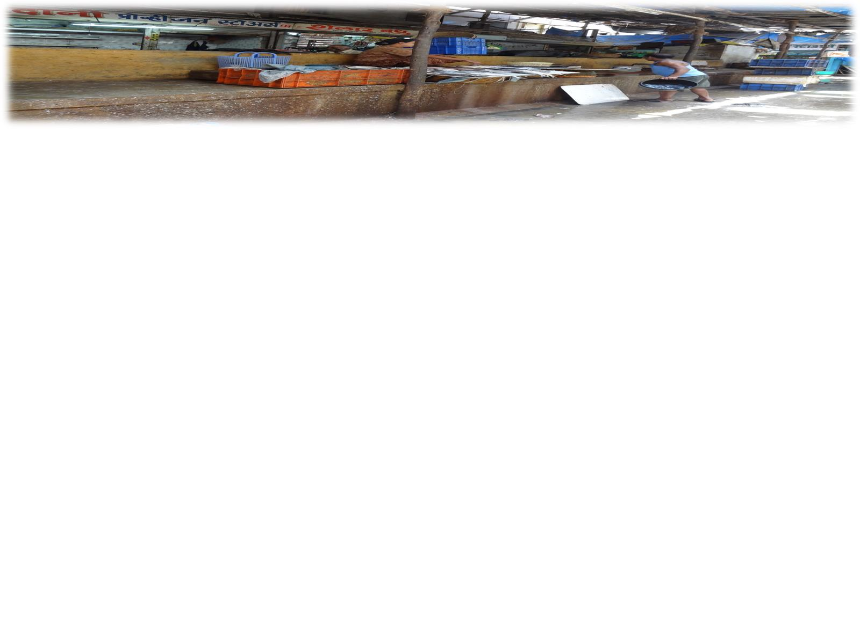

Slide 7
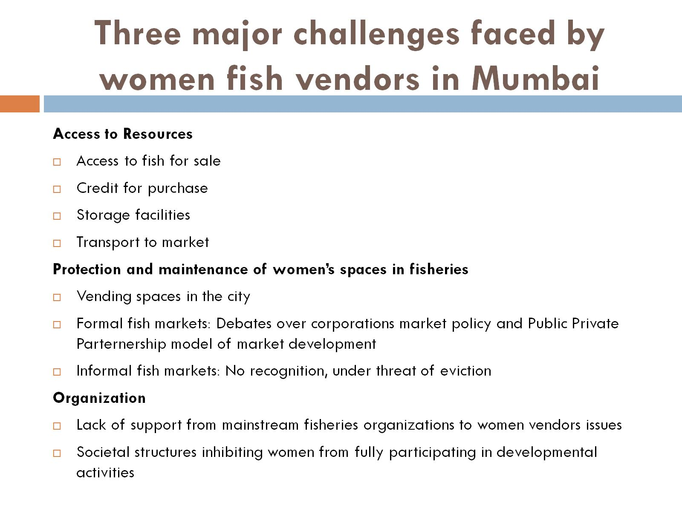
Three major challenges faced by women fish vendors in Mumbai

Slide 8
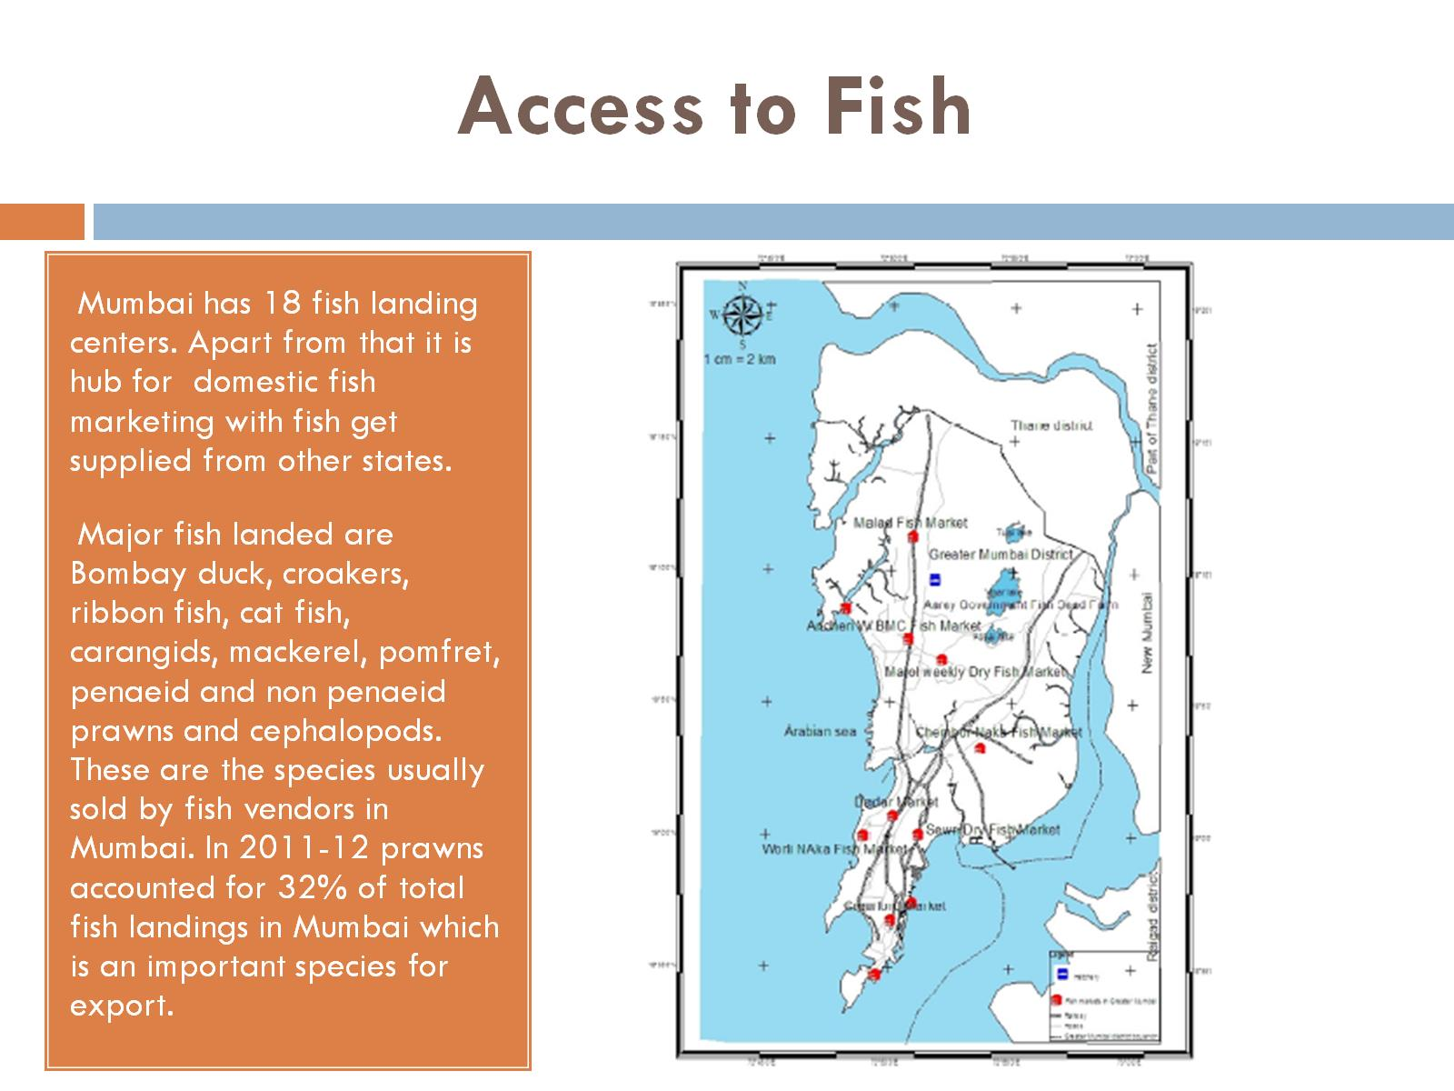
Access to Fish

Slide 9
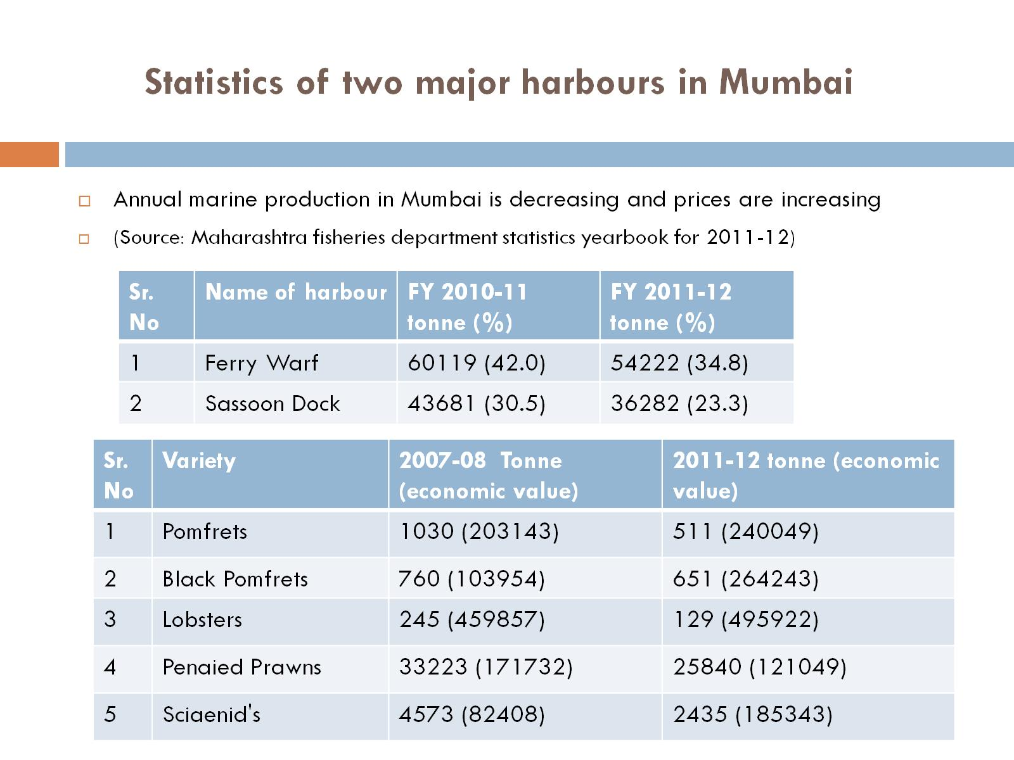
Statistics of two major harbours in Mumbai

Slide 10
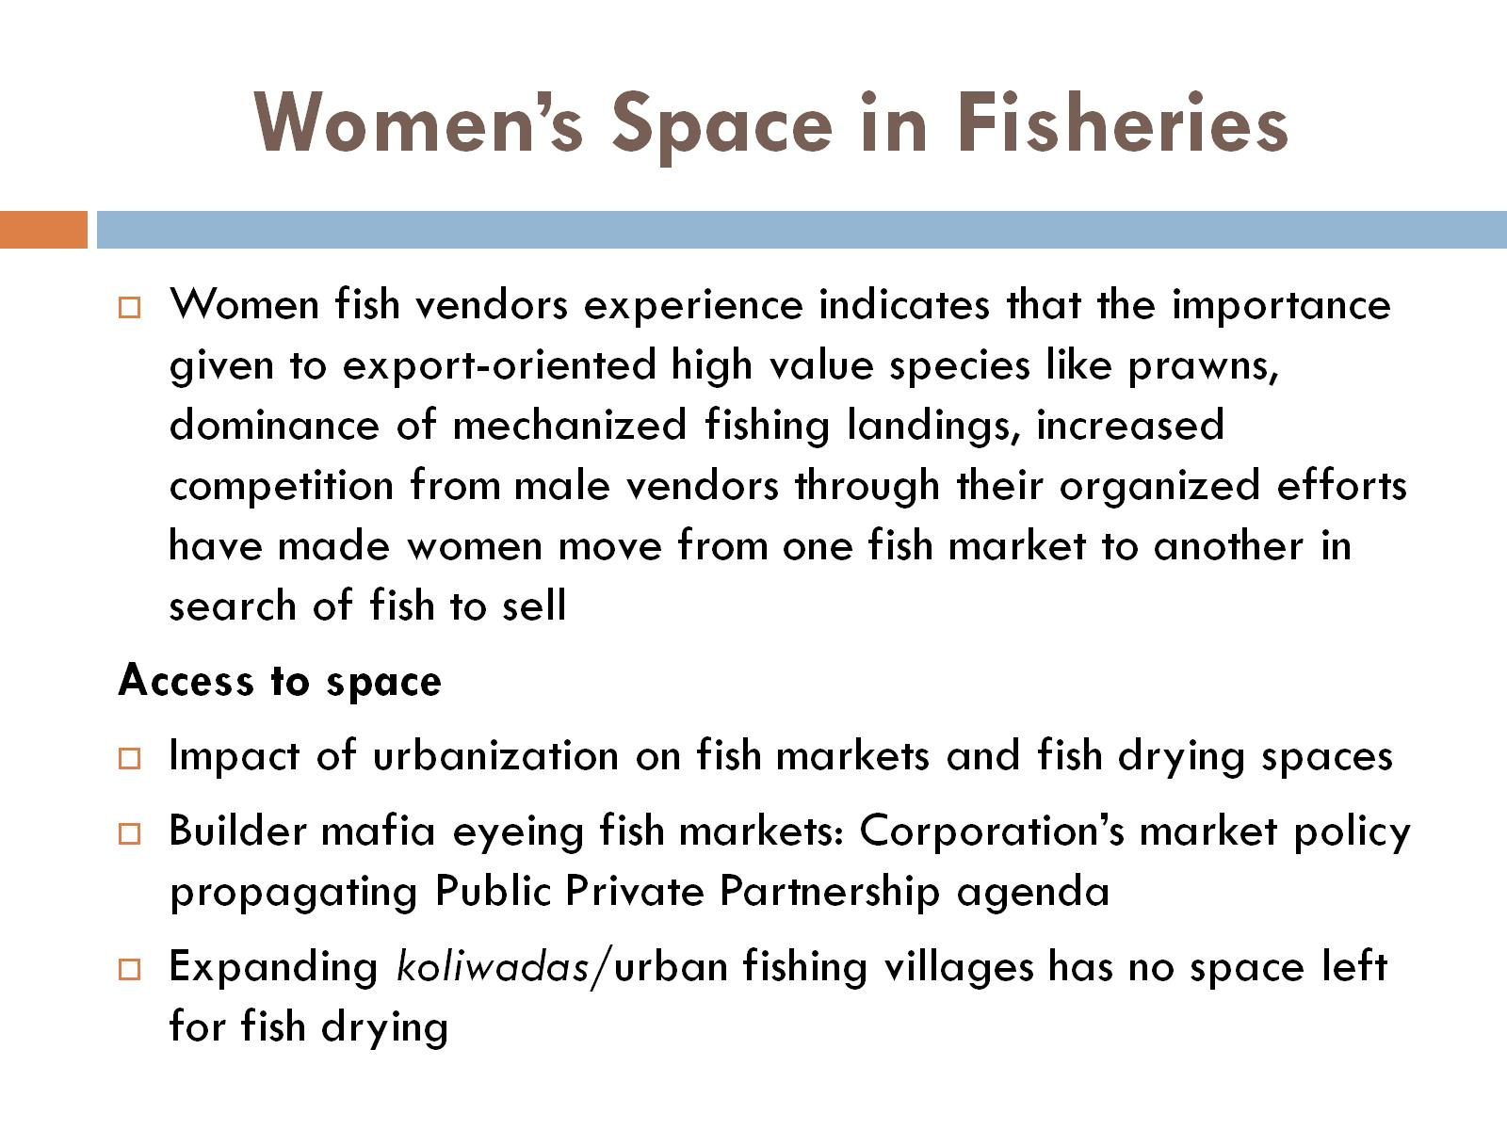
Women’s Space in Fisheries

Slide 11
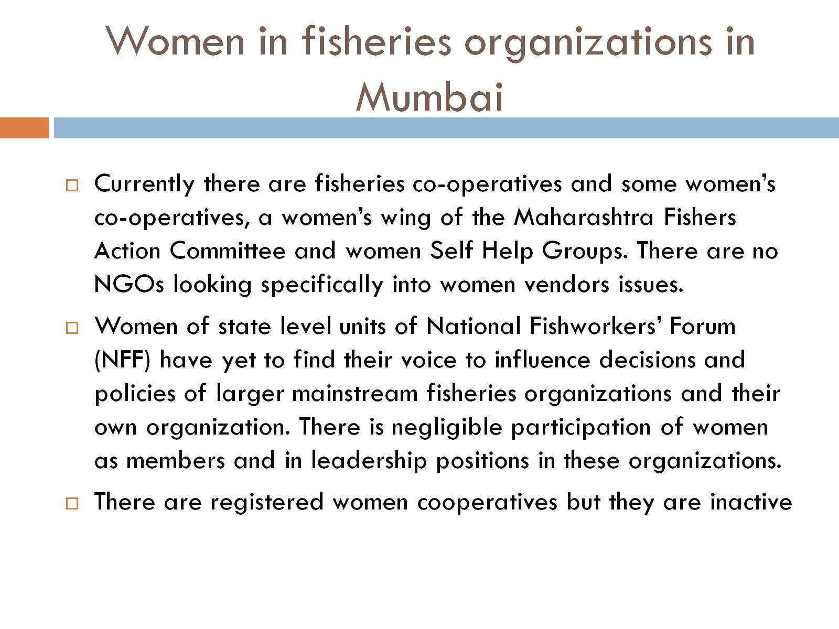
Women in fisheries organizations in Mumbai

Slide 12
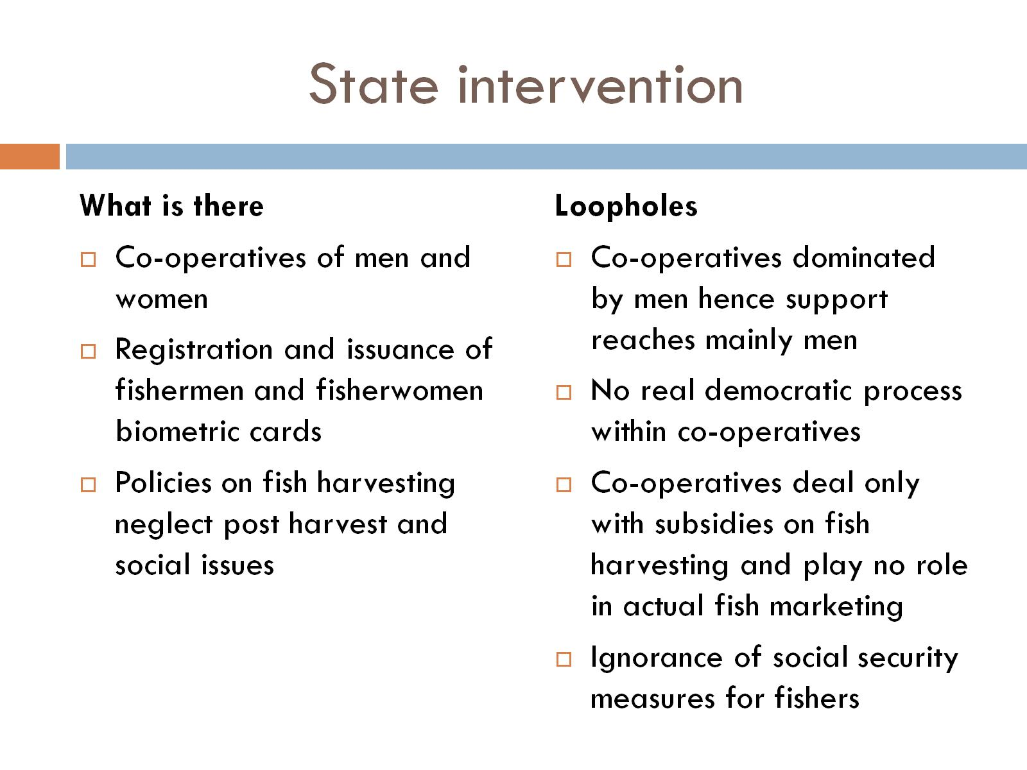
State intervention

Slide 13
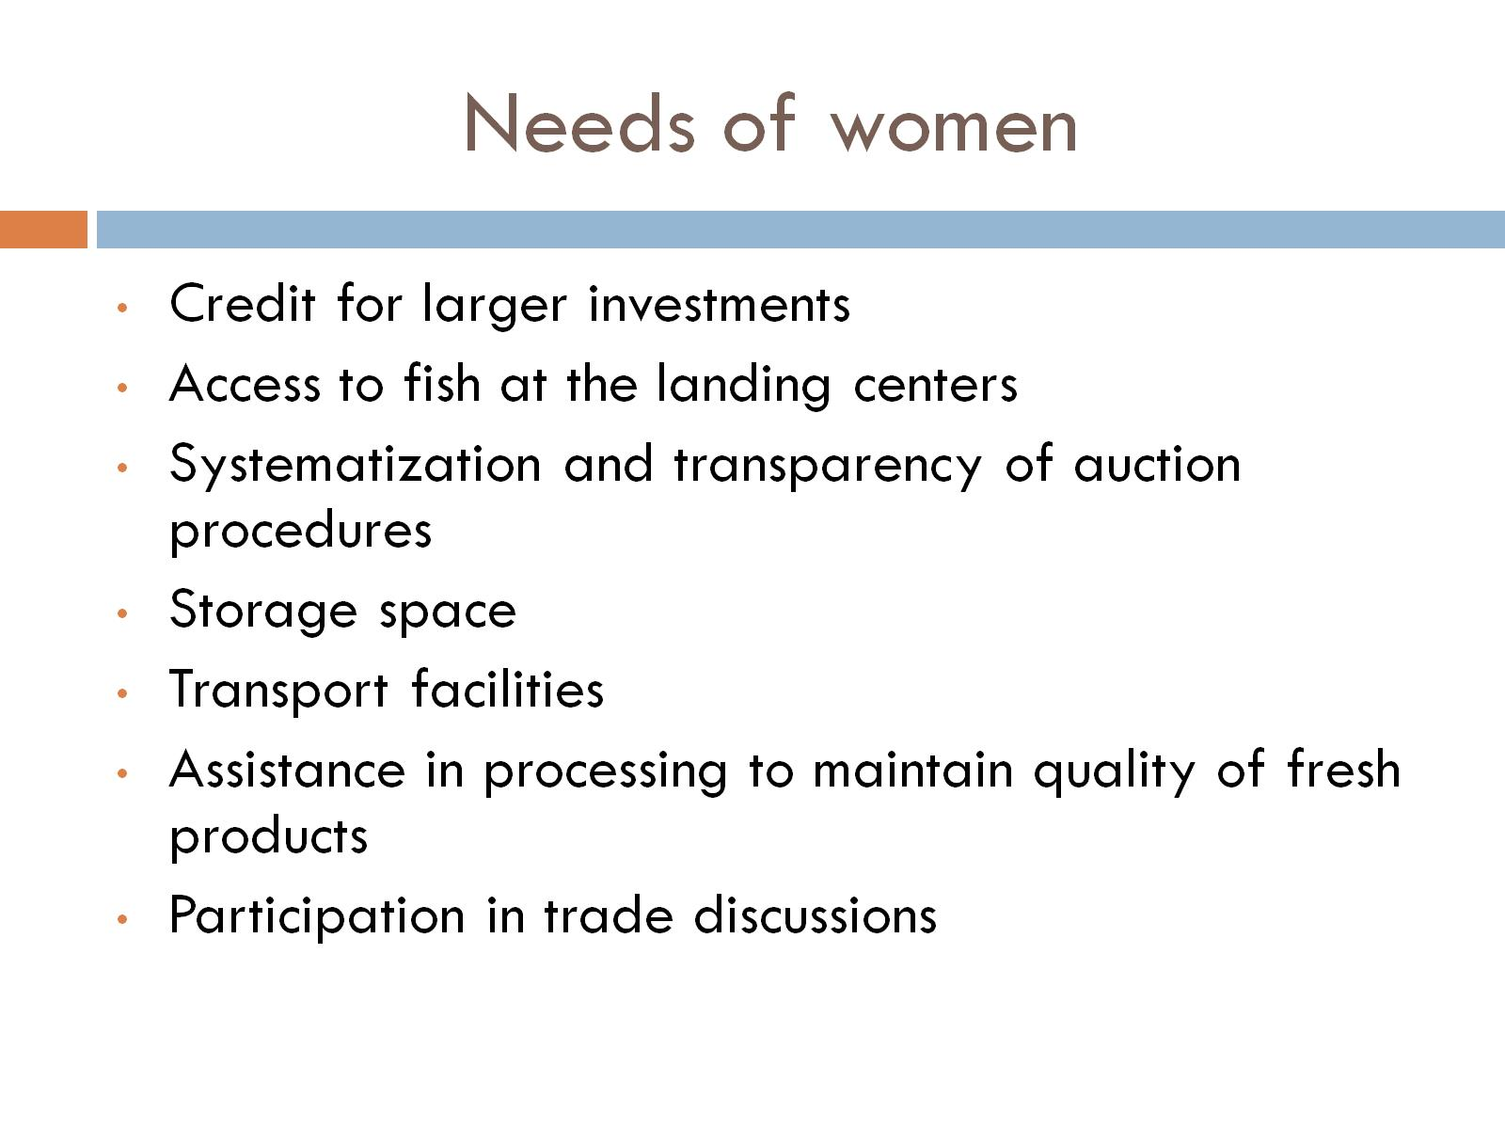
Needs of women

Slide 14
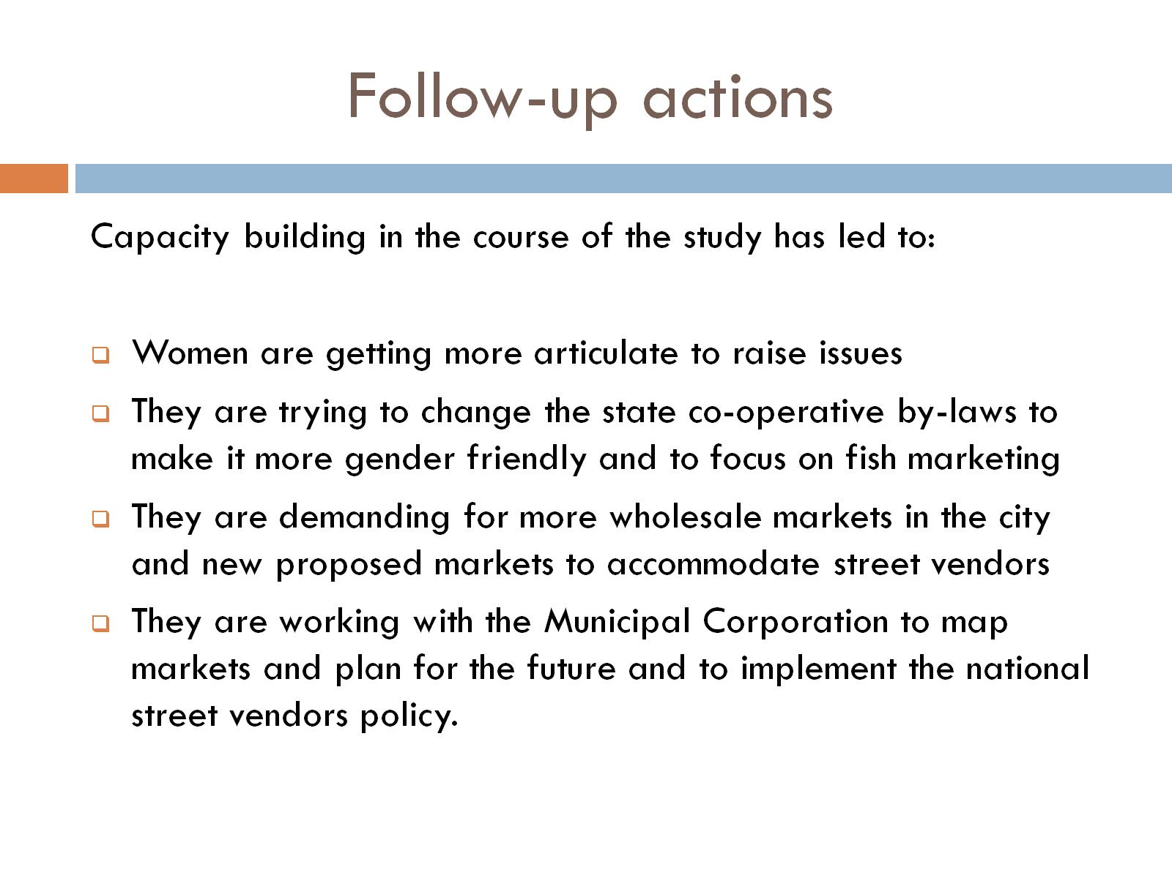
Follow-up actions

Slide 15

THANK YOU

