Slide 1
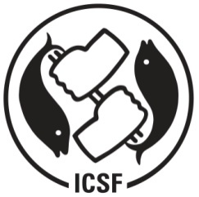
ECOSYSTEM APPROACHES TO FISHERIES AND LOCAL IMPLEMENTATION
[IN THE CONTEXT OF THE SUSTAINABLE OCEANS INITIATIVE OF THE CONVENTION ON BIODIVERSITY]
JOHN KURIEN
INTERNATIONAL COLLECTIVE IN SUPPORT OF FISHWORKERS (ICSF)

Slide 2
Contextualizing EAF in the
SOI of the CBD
Under Strategic Goal B
Reduce the direct pressures on biodiversity and promote sustainable use
Under Aichi Target 6
By 2020 all fish and invertebrate stocks and aquatic plants are managed and harvested sustainably, legally and applying ecosystem based approaches so that:
  overfishing to be avoided
  recovery plans and measures in place for all depleted/damaged species/resources
  fisheries to have no significant adverse impacts on threatened species and vulnerable ecosystems and
  impacts of fisheries on stocks, species and ecosystems are within safe ecological limits.

Slide 3
ICSF Approach to Re-instituting
EAF at Local Level
Supporting SSF communities who are the repositories of EAF to meet and exchange views, experiences and strategies
Supporting efforts for reviving TEK which is an important pillar of the worldviews and identity of SSF communities
Supporting capacity building initiatives to build co-management approaches and arrangements to strengthen SSF communities

Slide 4
Recent Initiatives
Efforts taken in India, Bangladesh, Thailand, Indonesia, Myanmar to bring together SSF communities to discuss the aspects pertaining to marine and coastal resource management (conservation, rejuvenation, regulation and allocation) in a manner which will ensure greater participation of SSF in determining their future.

Slide 5
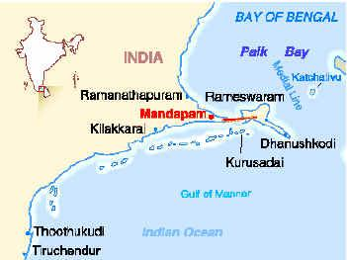
INDIA ( Gulf of Mannar)

Slide 6
INDIA ( Gulf of Mannar)
Designated as a national marine park and biosphere reserve with a ban on all extrative activities covering an area of 560 sq.kms
Area has 178 fishing villages with 41,000 small-scale fishing families with over 37,000 fishworkers – including 5000 women seaweed collectors ( including divers) and 3000 men sea cucumber skin divers.

Slide 7
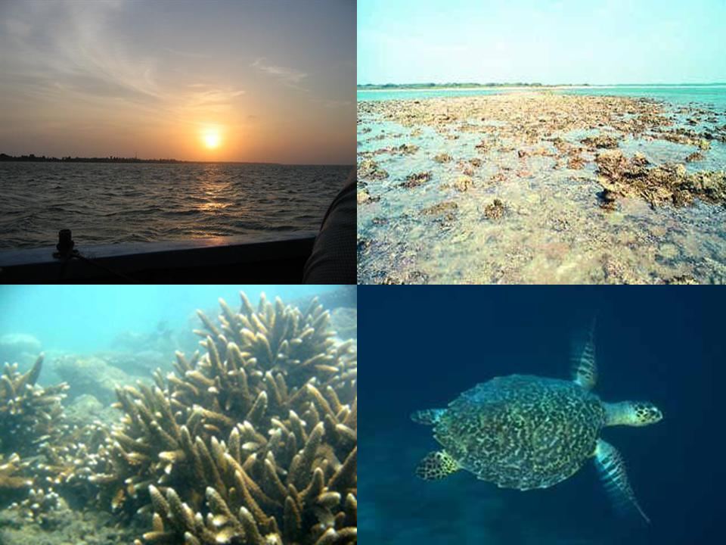
Resources

Slide 8
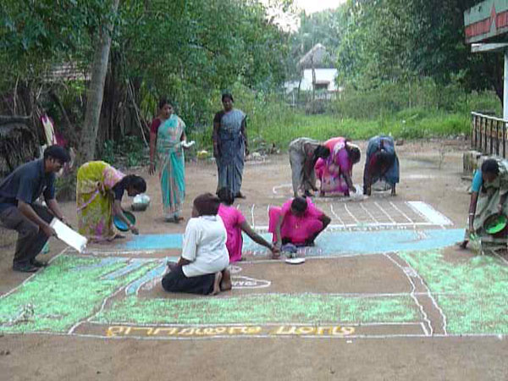
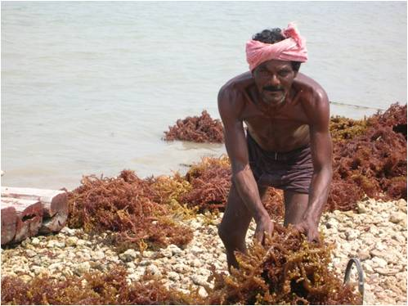
People

Slide 9
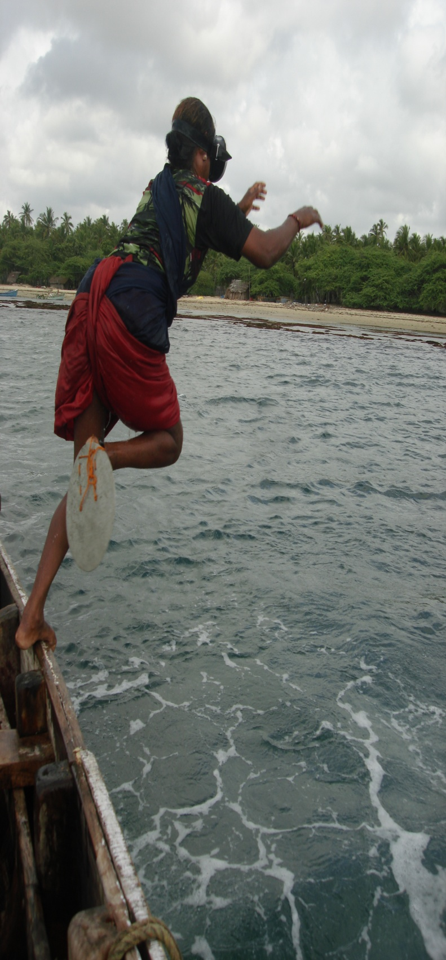
Community decides to restrict seaweed collection to certain periods of the month (12 days) and have a three month closure for collection
Ban on collection of all except three species of sea cucumber and collection restricted to three months.

Slide 10
Community suggests ways and means to ban the use of trawling.
Community-based monitoring and surveillance to stop illegal and destructive fishing
Collaboration with Departments of Fisheries, Forests; scientists and NGOs to work out resource conservation strategies

Slide 11
Community initiated ‘kootams’ (gatherings) to discuss how to ensure best use of resources to ensure their sustainability. How this can be done with collaboration of state and civil society representatives.
“We have not amassed any great wealth for our children; we can at least take care of these marine resources and give that as our legacy to our children” said a participant.

Slide 12
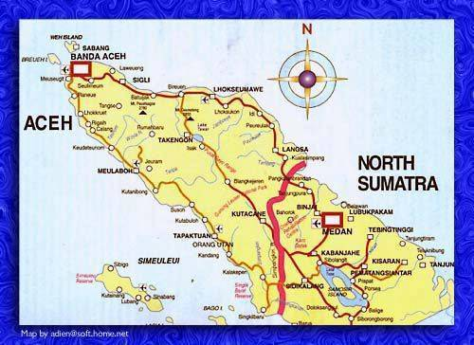
INDONESIA (West Aceh)

Slide 13
West Aceh was devastated by the 2004 tsunami. Over 200,000 people in the coastal communities were devoured by the sea. Many leaders of the customary fishers organisation died. With this also disappeared a great fund of traditional knowledge.
Many coastal resources such as coral reefs, small islands, mangroves, coastal land were totally destroyed and require rejuvenation.

Slide 14
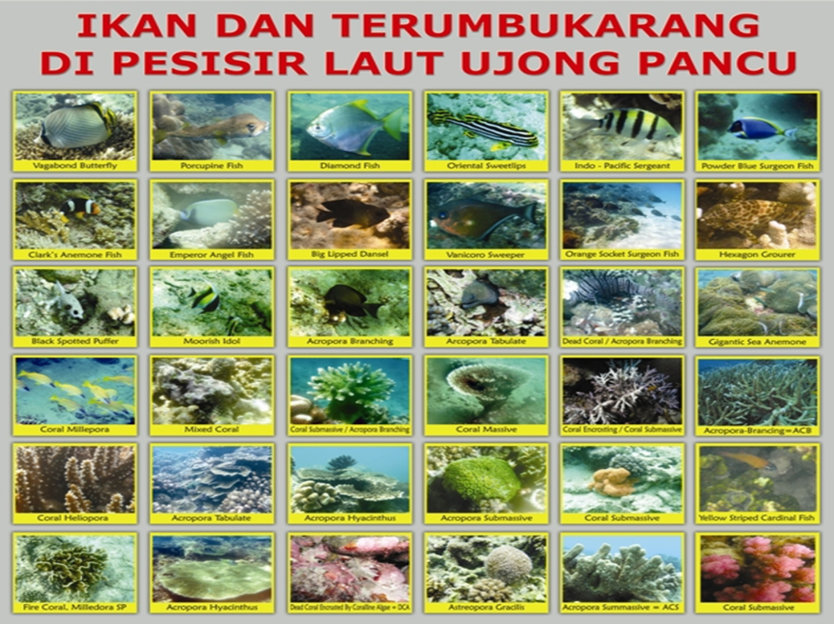
Resources

Slide 15
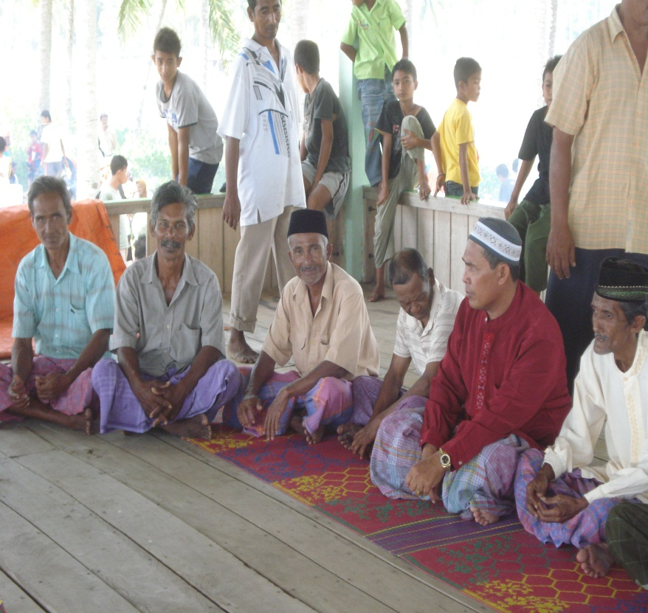
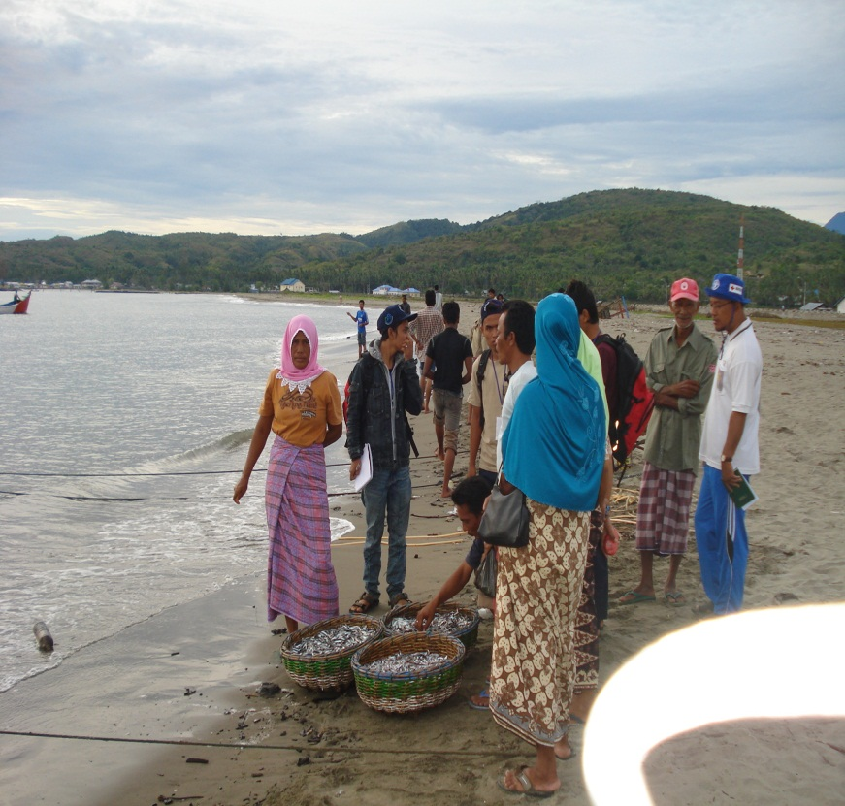
People

Slide 16
Representatives from five co-management initiatives facilitated by an UN/FAO program gather for a ‘lokakarya’ (workshop) to discuss ways for SSF to creatively engage in the task of resource rejuvenation and conservation.
Lokakarya attended by SSF, women from coastal community; fisher youth leaders; district government fishery officials; leaders of customary fisher organisation; university researchers; conservation NGO representatives

Slide 17
They discuss success and failures of efforts of the five co-management centres between 2010 and 2013 and exchange views on different strategies for management.
Examine the socio-political forces which support illegal and destructive fishing methods and plan to take efforts to restrain them.
How to mobilise support from state ( departments of fisheries, tourism, police etc) and civil society to coordinate the multiple uses and services to which the marine and coastal resources are subjected. Build the human resource capacity for this.

Slide 18
How a 400 year old customary fisher organisation can transform its structure and style of functioning and how younger persons from the coastal communities can take responsibility for this.
The visit-and-exchange strategy to spread the idea of co-management for protection of marine resources ( fish, turtles, corals, mangroves, coastal forests).

Slide 19
ICSF POSITION ON
LOCAL IMPLEMENTATION OF EAF
EAF at local level is NOT NEW. It was always practiced by small-scale fishing (SSF) communities. A review of traditional ecological knowledge (TEK) will testify for this.
TEK lost due to neglect resulting from imposition of compartmentalized modern fishery science brought from temperate ecosystems
Revival of EAF for local level implementation wholly incumbent on sustained participation of those who labour at sea – e.g. male SSF, female divers and gatherers
Co-management – i.e. the collaboration between fishers, state and civil society – is key to ensure sustainable and socially just EAF

Slide 20
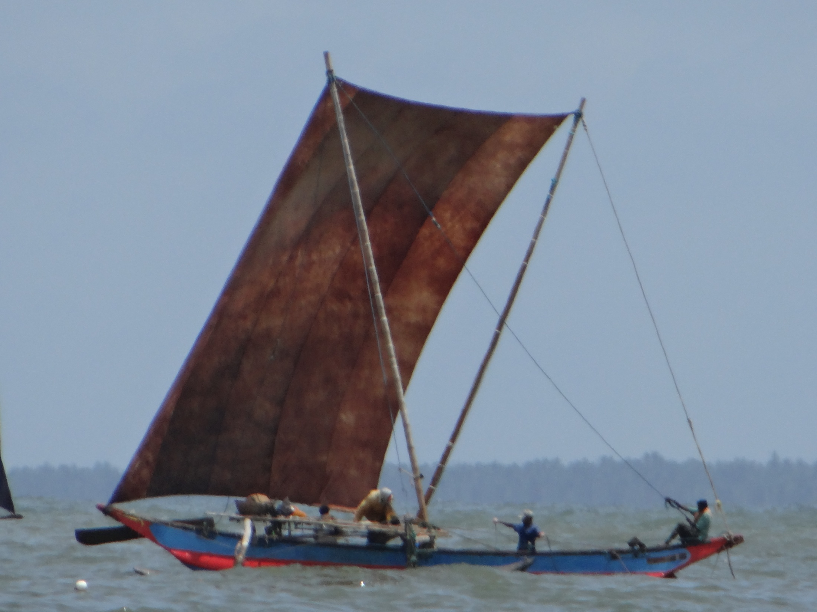
Thank you

